Slide 1


S4 & S5
Course Choice
Information Evening
Mr Ryalls:
        Introduction
Mr Reid:
        Updates, Pathways & Process
Mrs Moretta:
        Support

Slide 2
House-keeping
Please note that this meeting will be recorded
Please enter any questions into the chat bar

Slide 3
Mr Ryalls:
Introduction

Slide 4
School Vision:-
One Peebles –
our community where we
grow, belong and achieve

Slide 5
School values:-
Work hard
Do you have high expectations of yourself especially when faced with challenges?
Show kindness
Contribute
Do you bring a helpful and positive approach to everything you do?

Slide 6
Mr Reid:
  Updates, Pathways & Process

Slide 7
Updates
SBC Changes
S4 changes - Nat 5s at 4 periods
Highers stay at 5 periods
Advanced Highers at 4 periods initially (September decision on course numbers)
S6 – Friday offer
Digital & Travel offer – where clashes arise, we may attempt to resolve with school partnership
PHS Changes
Changes to the Course Choice Process & Information Evening
Work Experience Option

Slide 8

S5 & S6 Curriculum
S4s choose either:
A minimum 6 courses
or
5 L6 courses plus School Study
S5 choose either:
A minimum of 5 courses at any level (which can include School Service)
or
3 L7 courses, LRC School study plus one other course at any level or School Service
In addition, all new S6 pupils will complete a Leadership qualification in one column
 | 1 | 2 | 3 | 4 | 5 | 6
S5 | Full Course | Full Course | Full Course | Full Course | Full Course | Full Course
 | L6 Course | L6 Course | L6 Course | L6 Course | L6 Course | Sch Study
 | 1 | 2 | 3 | 4 | 5 | 6
S6 | Full Course | Full Course | Full Course | Full Course | Full Course/ School Service | Leadership
 | L7 Course | L7 Course | L7 Course | LRC Study | Full Course/ School Service

Slide 9
Course Choices:
Thinking About Pathways

Slide 10
Pathways
Ownership of Pathways – University course recognition
Percentage pass rates of Cs and Ds into Higher and Advanced Higher – listen to your course choice recommendations & Prelim Results
Percentage pass rates of crashes can be low
Repeating courses – statistically does not improve results
What levels mean

Slide 11
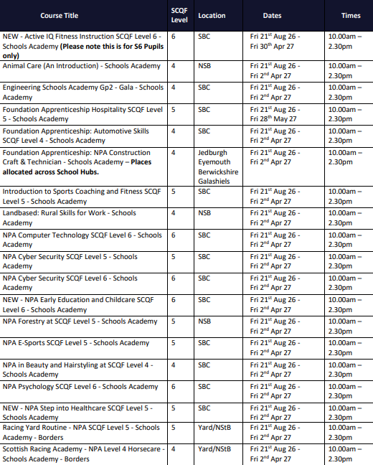

Borders College & Partners
Online and SBC school partnership
In the case that you do not see a course that you wish to study, please inform your pastoral teacher and the school will do what it can to support your request

Slide 12
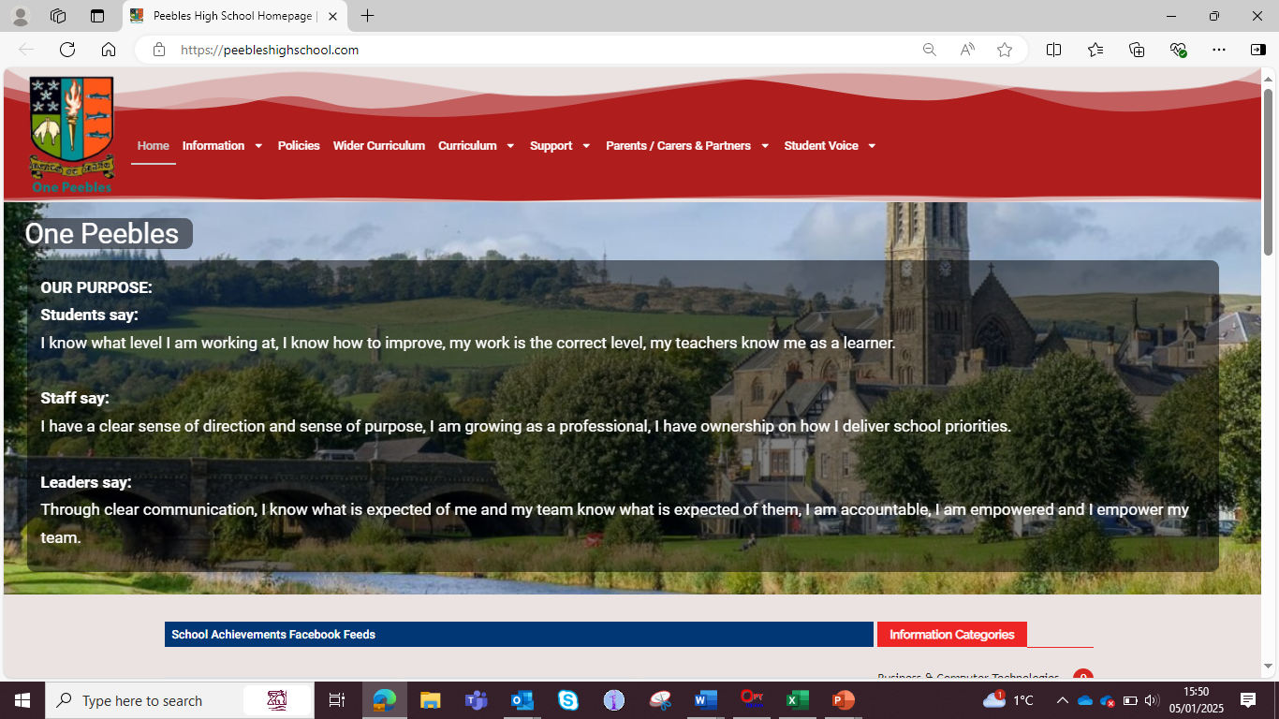

Slide 13
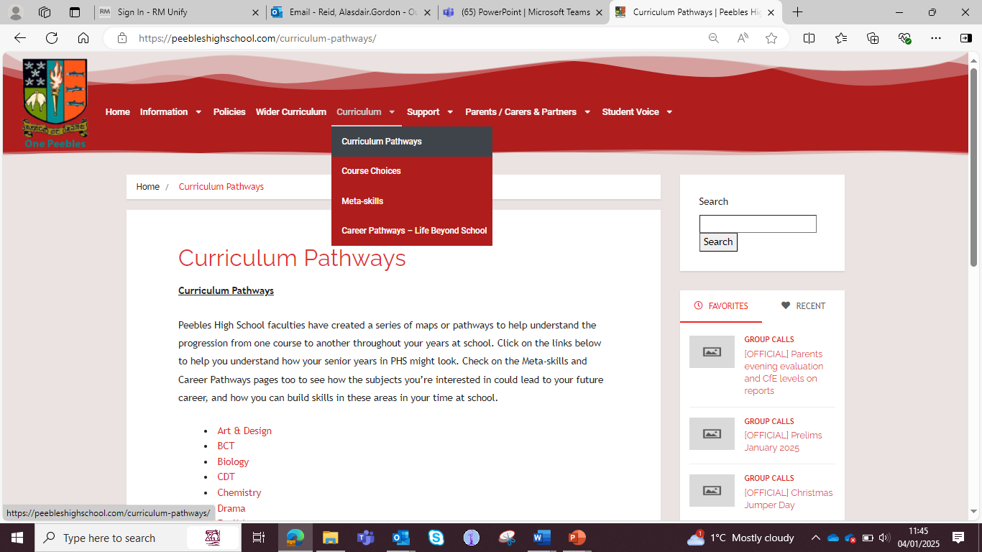

Slide 14
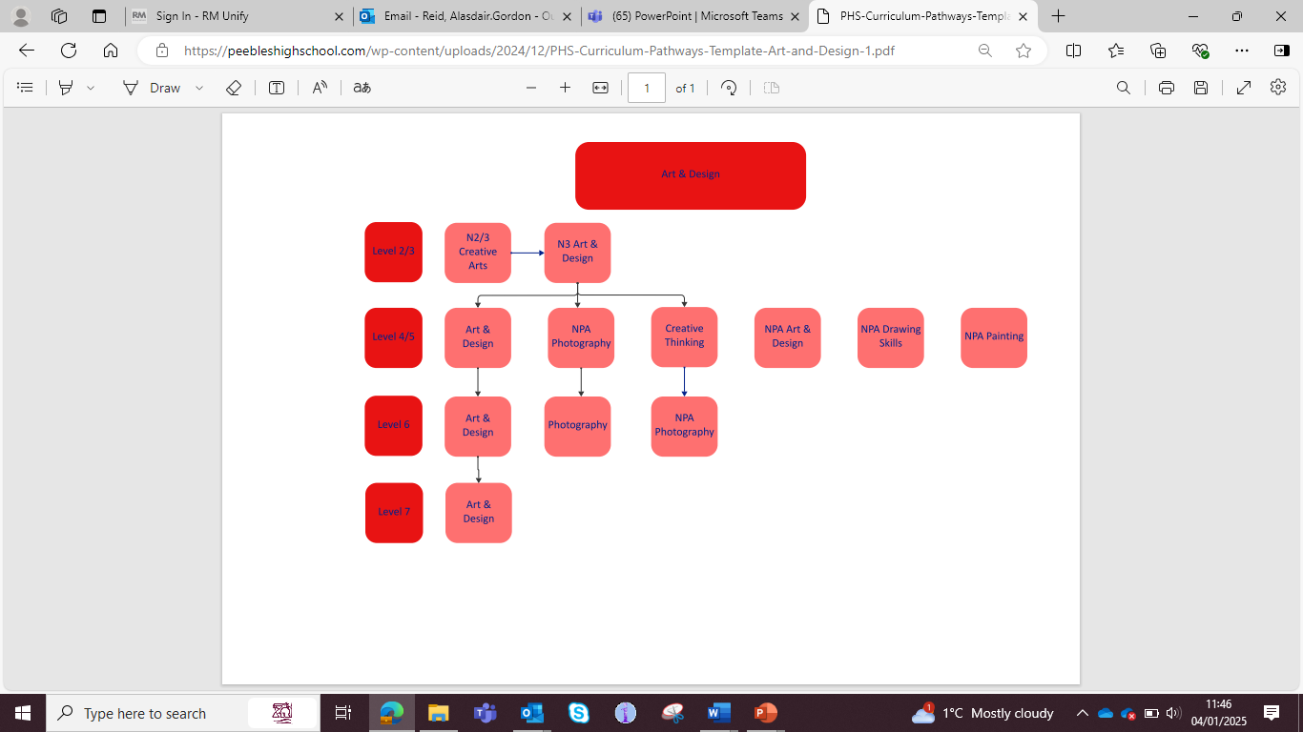

Slide 15
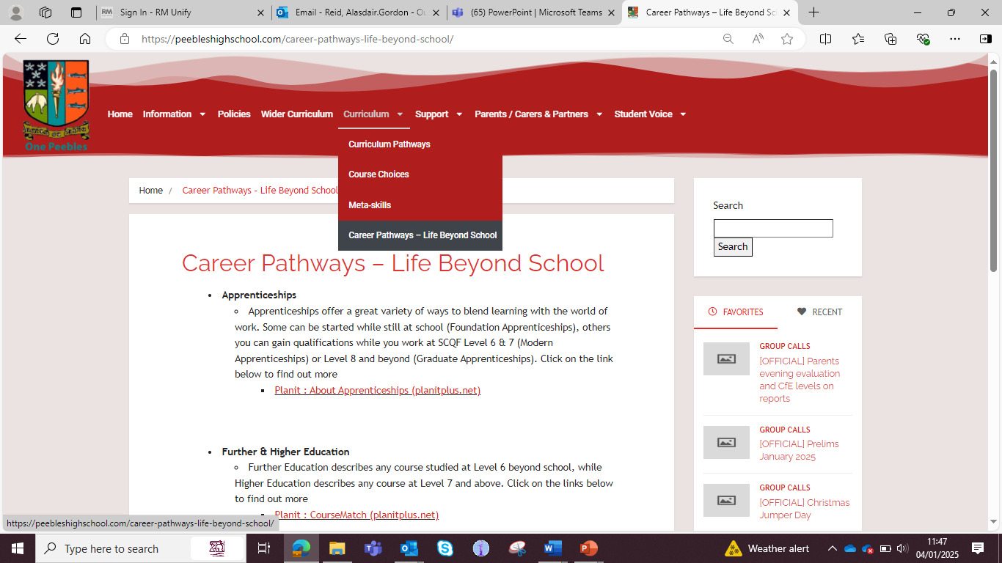

Slide 16
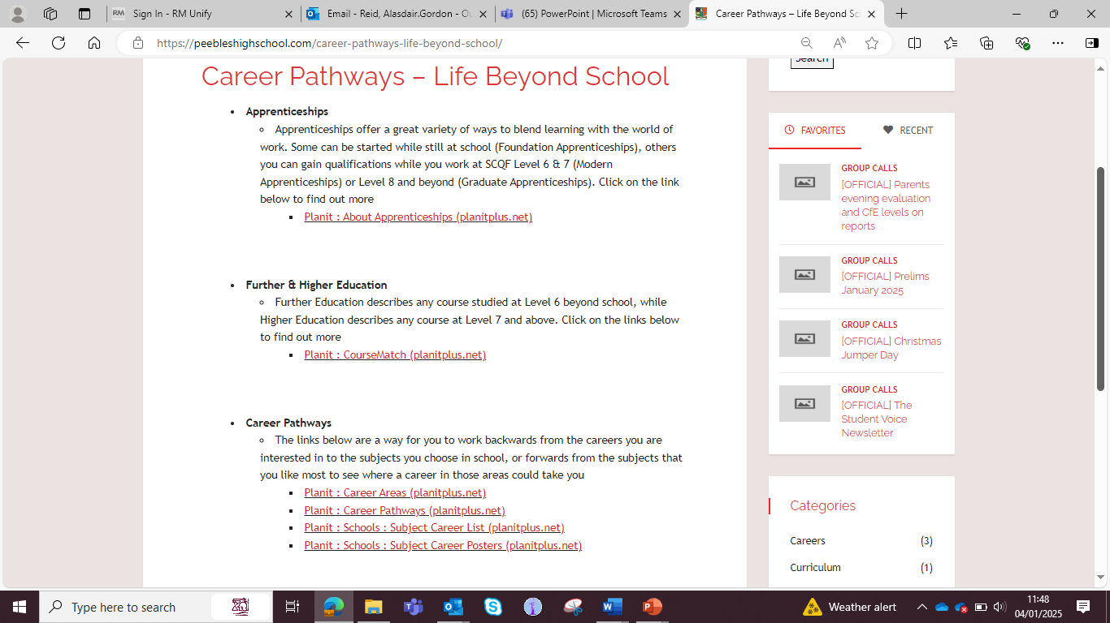

Slide 17

Apprenticeships – Useful Links
https://www.planitplus.net/Apprenticeships/
https://apprenticeships.scot/
https://www.apprenticeships.scot/become-an-apprentice/graduate-apprenticeships/
https://apprenticeships.scot/become-an-apprentice/modern-apprenticeships/

Slide 18
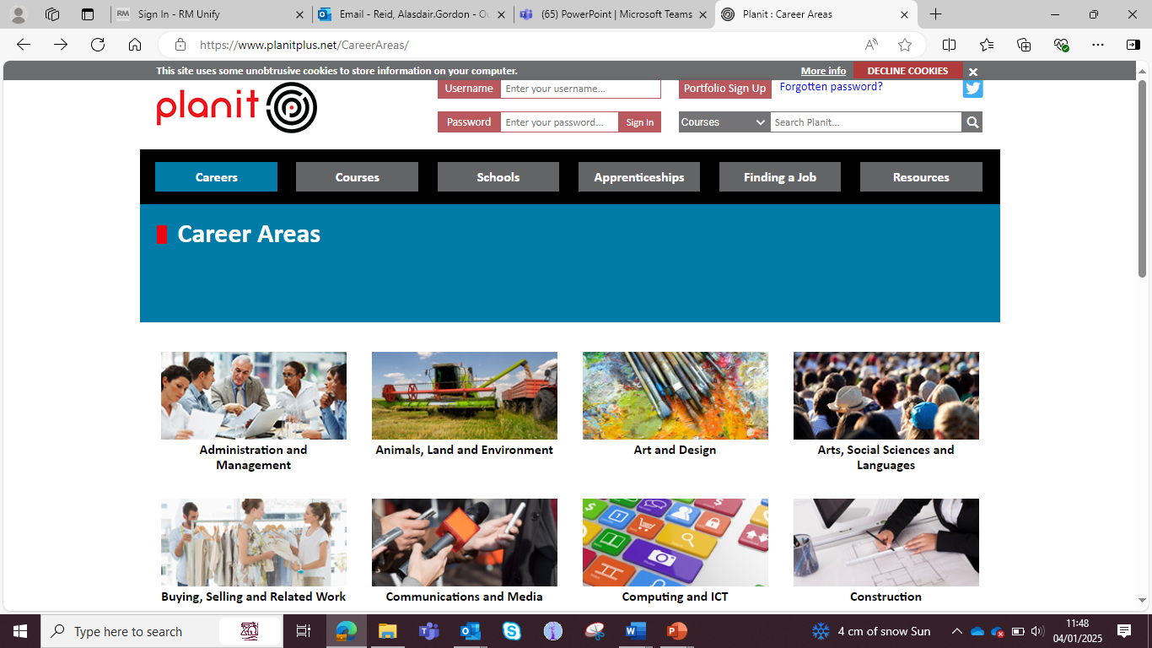

Slide 19
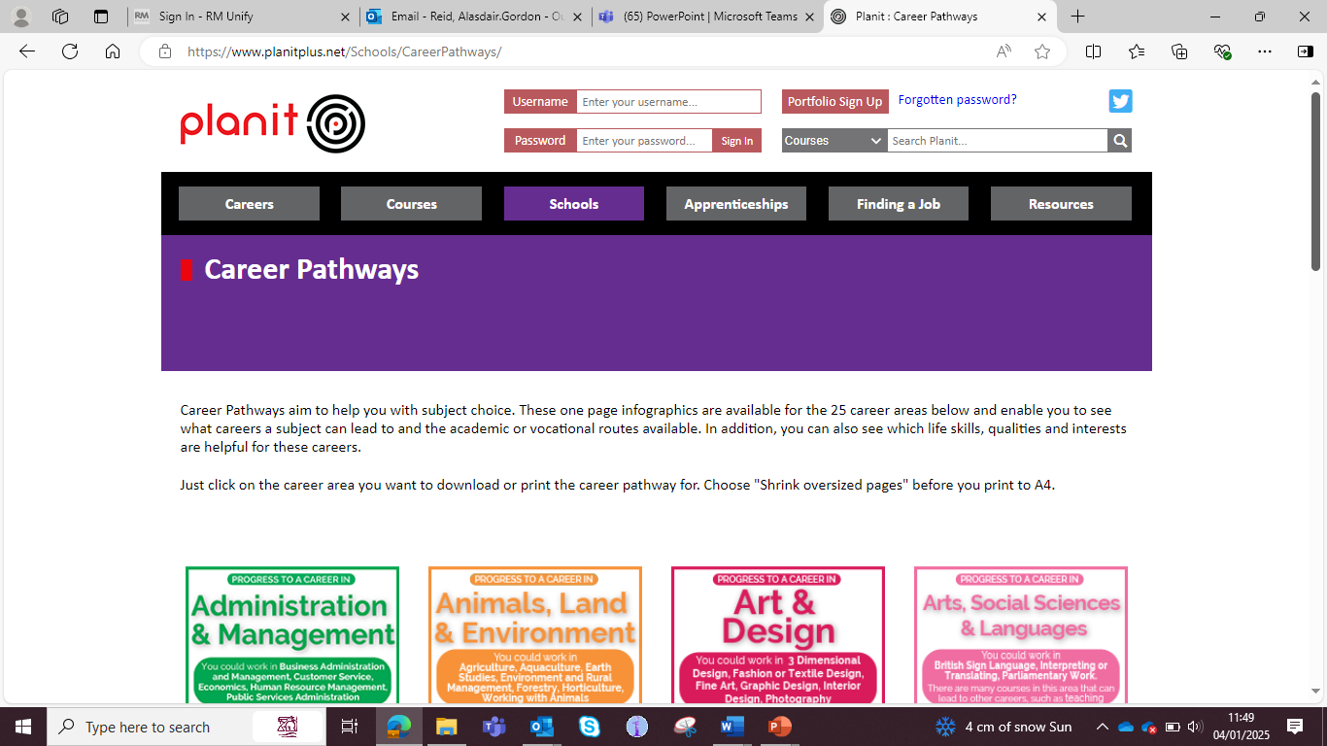

Slide 20


Slide 21


Slide 22
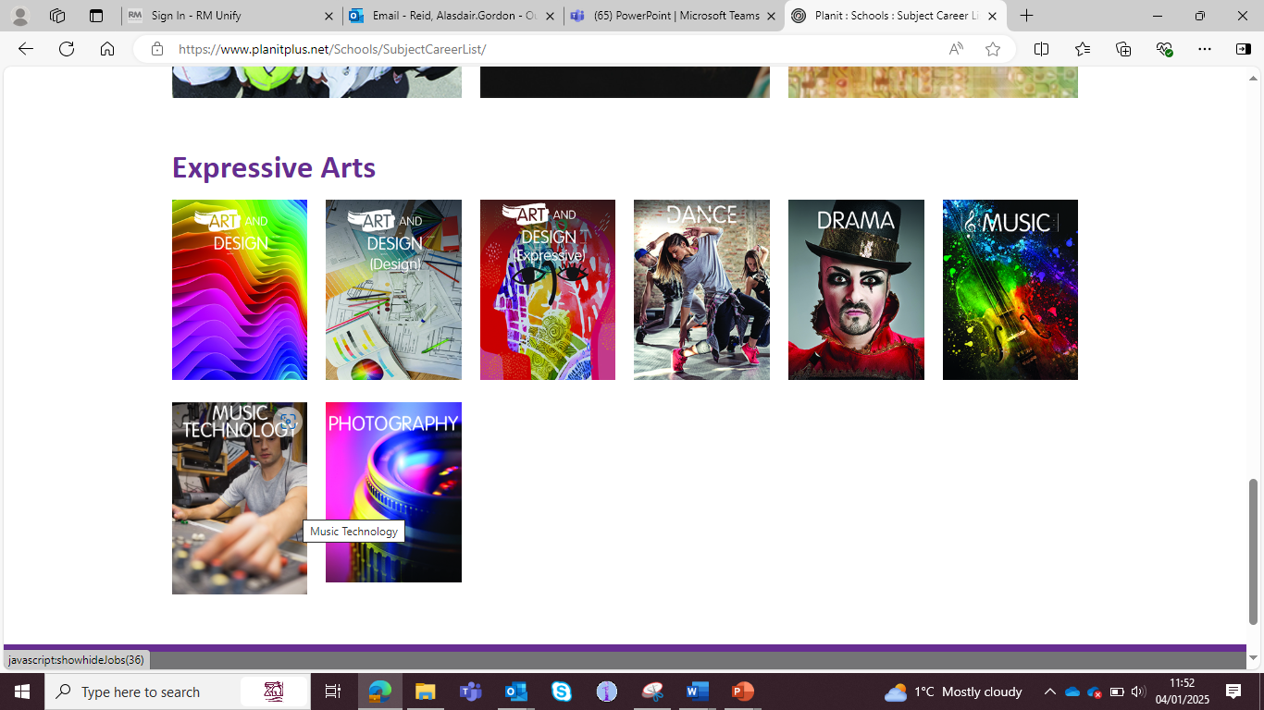

Slide 23
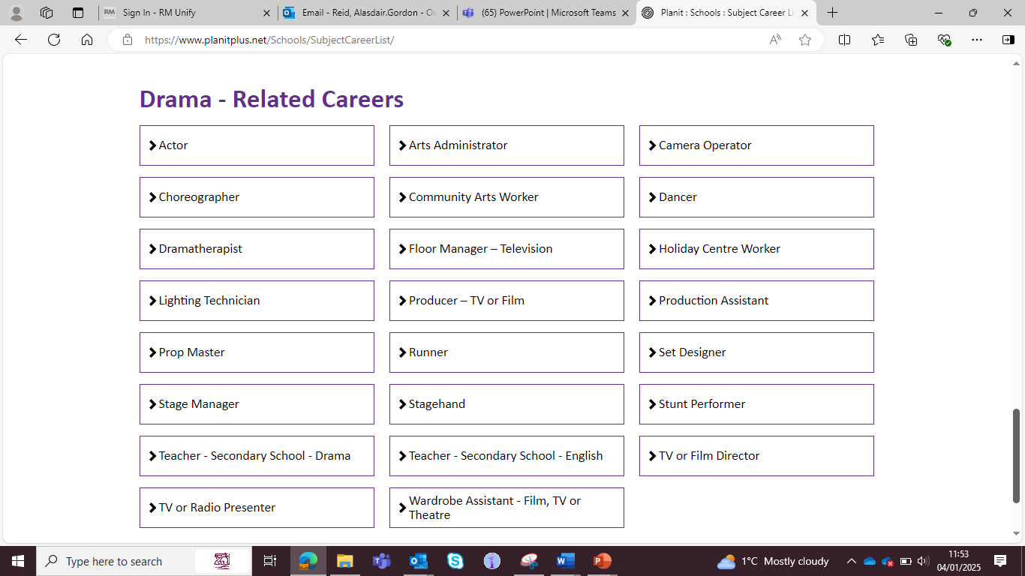

Slide 24
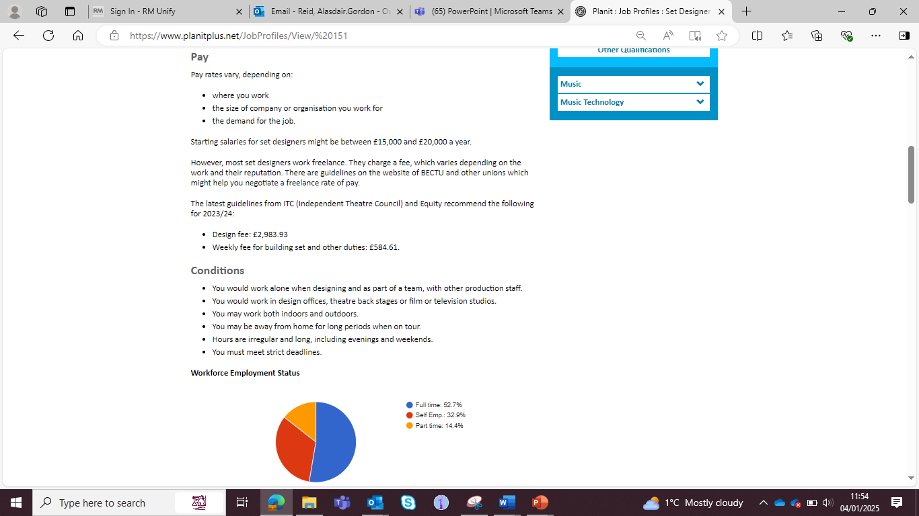


Slide 25
The Process
Course Choice Website
Core and Elective Courses
Course Choice Sheet

Slide 26
Course Choice Website

Slide 27
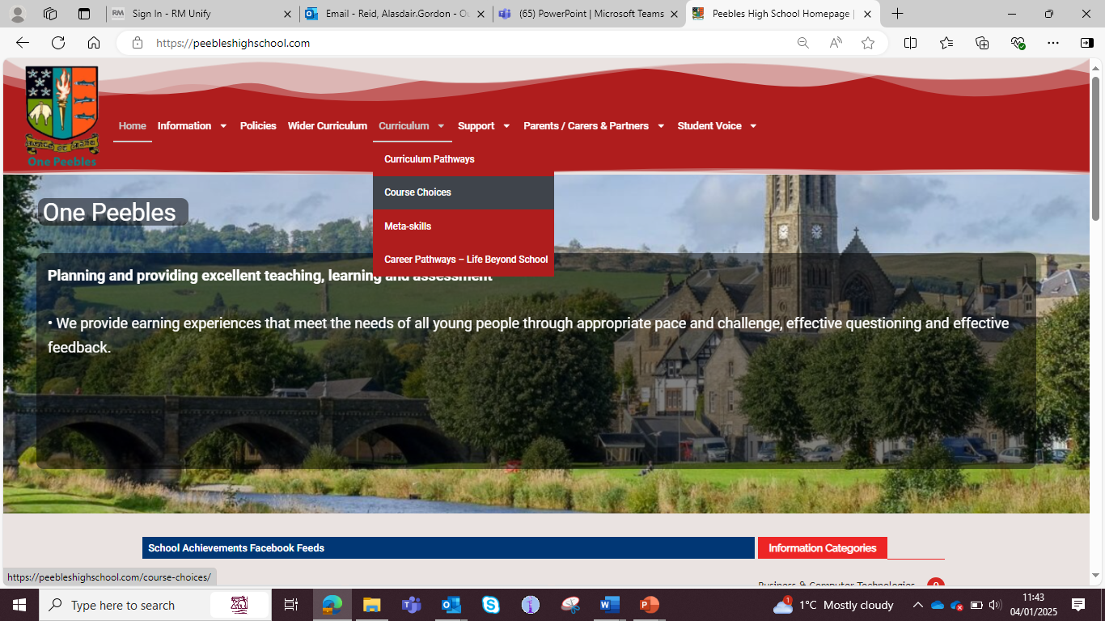

Slide 28
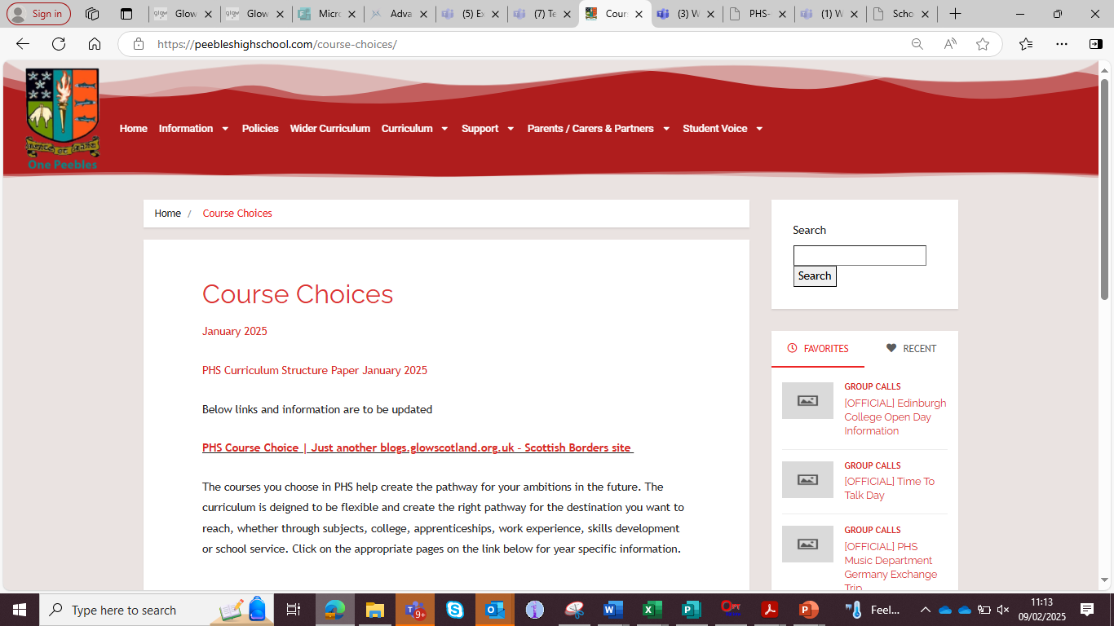

Slide 29


Slide 30
Core and Elective Courses

Slide 31
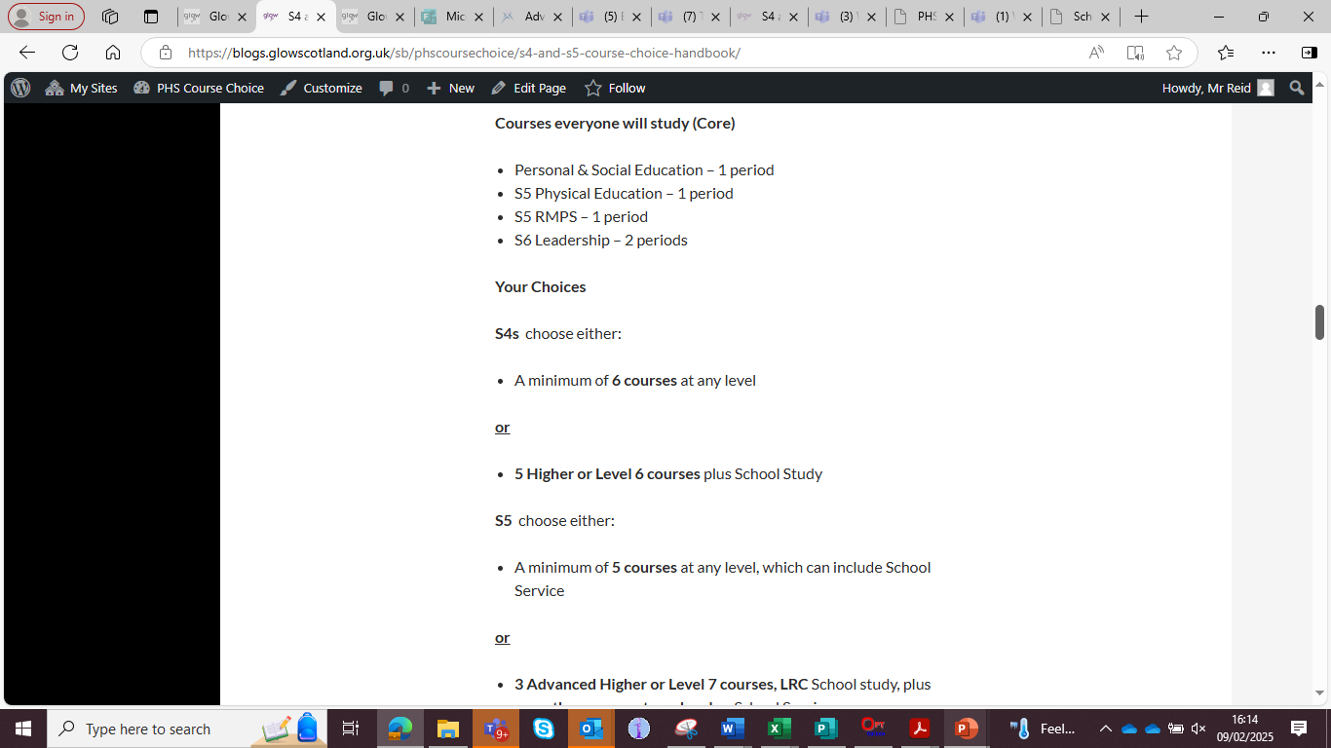

Slide 32
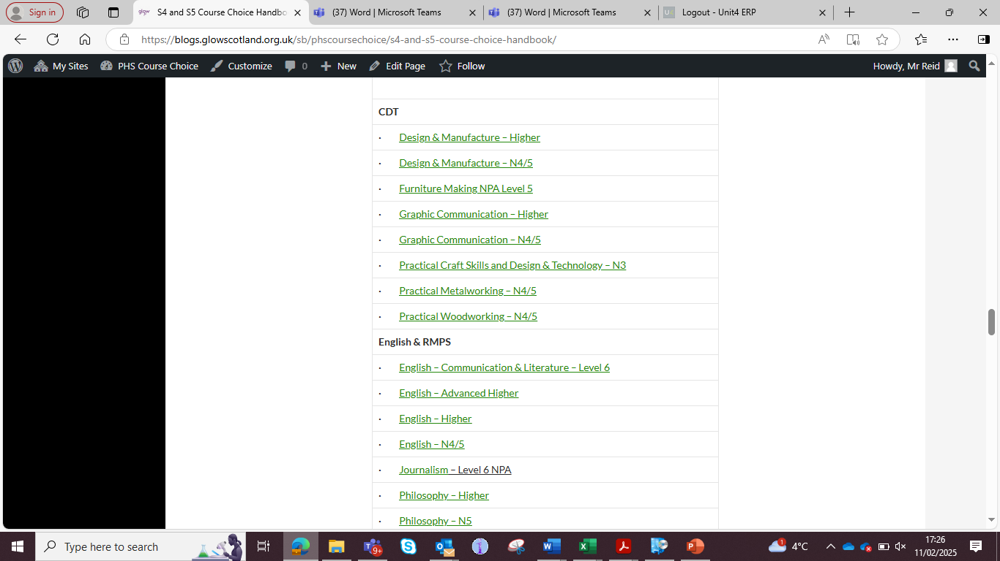

Slide 33


Slide 34
Course Choice Sheet

Slide 35
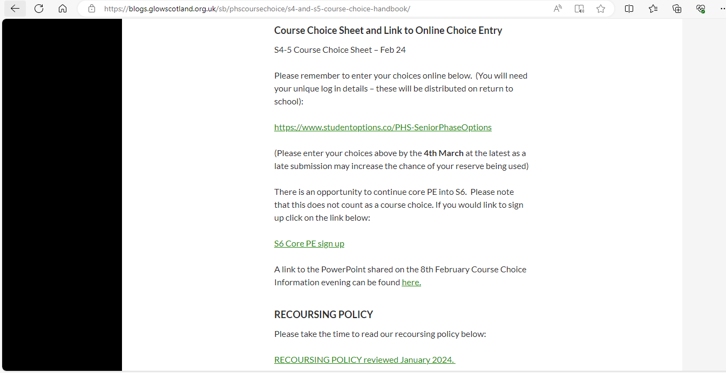

Slide 36
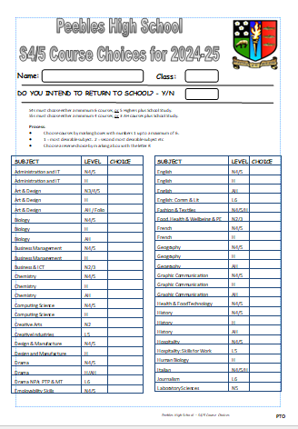

Slide 37
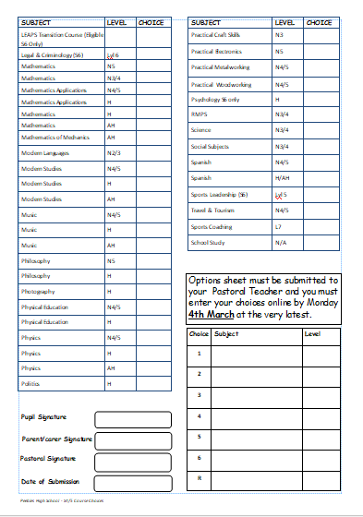

Slide 38
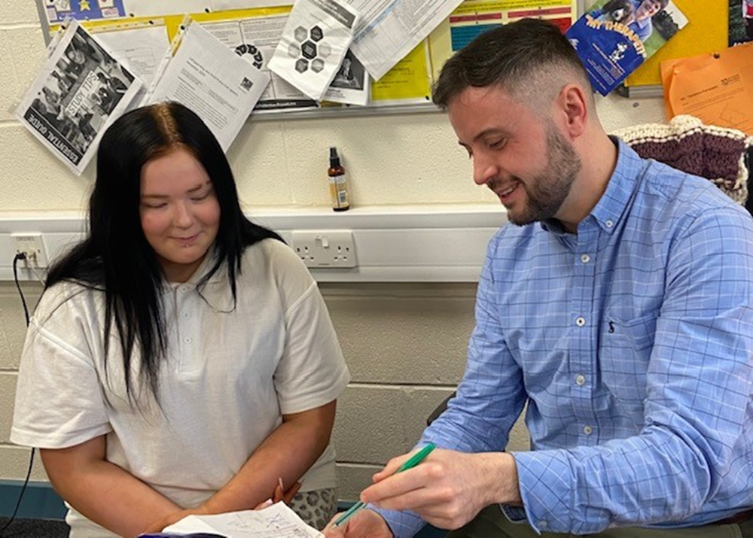
How will my child be supported?

Slide 39
PSE programme – Choices/Careers
MWoW and Planit Plus
Course descriptors
Progression levels
Career routes/paths
Personal research
Q&A sessions
Interview with Pastoral Teacher
Reassurance and emotional support
1:1 interview with Mr Conway, Skills Development Scotland (targeted support or self referral)
Groupwork led by Mr Conway in PSE

Slide 40
Point of contact for parents/carers
4C1 – Mrs Robertson
4C2 – Mrs Milligen
4C3 – Mrs Robertson
4D1 – Mr Shirra-Gibb
4D2 – Mr Scott
4D3 – Mr Scott
4M1 – Mrs Marsden-Roy
4M2 – Mrs Boyd
4M3 – Mrs Marsden- Roy
5C1 – Mrs Milligen
5C2 – Mrs Robertson
5C3 – Mrs Milligen
5D1 – Mr Scott
5D2 – Mr Scott
5D3 – Mr Shirra-Gibb
5M1 – Mrs Marsden-Roy
5M2 – Mrs Marsden-Roy
5M3 – Mrs Boyd

Slide 41
What can parents/carers do?
Access the online supports
Read through course descriptors with your child
Encourage your child to do some personal research
Use the course choice preparation form as a prompt for discussion with your child
Listen to your child
www.myworldofwork.co.uk
www.skillsdevelopmentscotland.co.uk
https://www.planitplus.net

Slide 42
Timeline
5th December – S4/5/6 Reports
January: Pastoral S4 interviews begin
Fri 30th January: S4/5 course choice handbook for 2025-26 will go live on the website
Fri 30th January: course choice preparation form to support course choice conversations at home will be on the website
10th February: S4/5 Course Choice Information Evening @ 6:30
Start of Feb - S4/5 Prelim Results
February: Pastoral S5 interviews begin
From February: targeted 1:1 interviews with Skills Development Scotland (Mr Conway)
Friday 6th March: S4/5 Options Completion Deadline

