Slide 1


S2
Course Choice
Information Evening
Mr Ryalls: Introduction & Rationale
Mr Reid: Course Choice Process
Mrs Moretta: Support

Slide 2
House-keeping
Please enter any questions into the chat bar

Slide 3
Introduction & Rationale
– Mr Ryalls

Slide 4
School Vision:-
One Peebles –
our community where we
grow, belong and achieve

Slide 5
School values:-
Work hard
Do you have high expectations of yourself especially when faced with challenges?
Show kindness
Contribute
Do you bring a helpful and positive approach to everything you do?

Slide 6
S3 – Curriculum Overview
S3 in 2025-26 will study 7 subjects, as well as Core subjects like English and Maths
Then in S4, this year group will get to choose to study 5 subjects, as well as Core
This means everyone will study 7 subjects in S4 including English and Maths
Core Curriculum:
4 periods of English
4 periods of Maths
2 periods of PE
1 period of RMPS
1 period of PSE

Slide 7
S3 – Curriculum Overview
Options:
Choice 1 | Choice 2 | Choice 3 | Choice 4 | Choice 5 | Choice 6 | Choice 7
Sciences | Social Subjects | Expressive Arts | Choose one of: BCT CDT HWB Mod Langs | Choose one of: BCT CDT HWB Mod Langs | Free | Free

Slide 8
Rationale
– Why do we do this?
Data shows us we need to broaden our curriculum offer
Studying 7 subjects in S4 will mean 4 periods per National subject per week (now it is 5 periods of 6 subjects per week)
Changes to S3 will mean minimum 3 periods per Optional subject per week, instead of 2 as it is now
This bring PHS in line with a broad national curriculum rationale

Slide 9
What are the benefits?
Specialisation of 7 subjects will allow for more periods per week and depth of learning of subjects in S3
This will allow better preparation for S4 while still offering a Broad General Education in S3
Studying more subjects in S4 means more subjects you are able to study when you return for S5

Slide 10
The Process
Course choice website
Core and elective courses
Course choice sheet (changes this year)

Slide 11
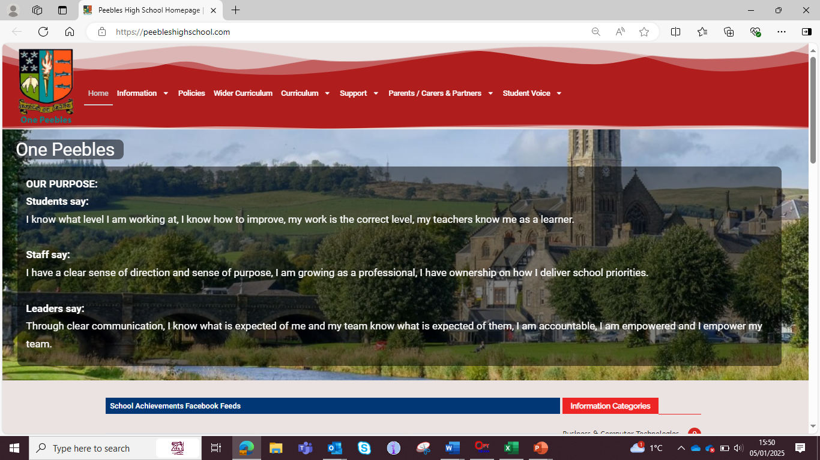

Slide 12
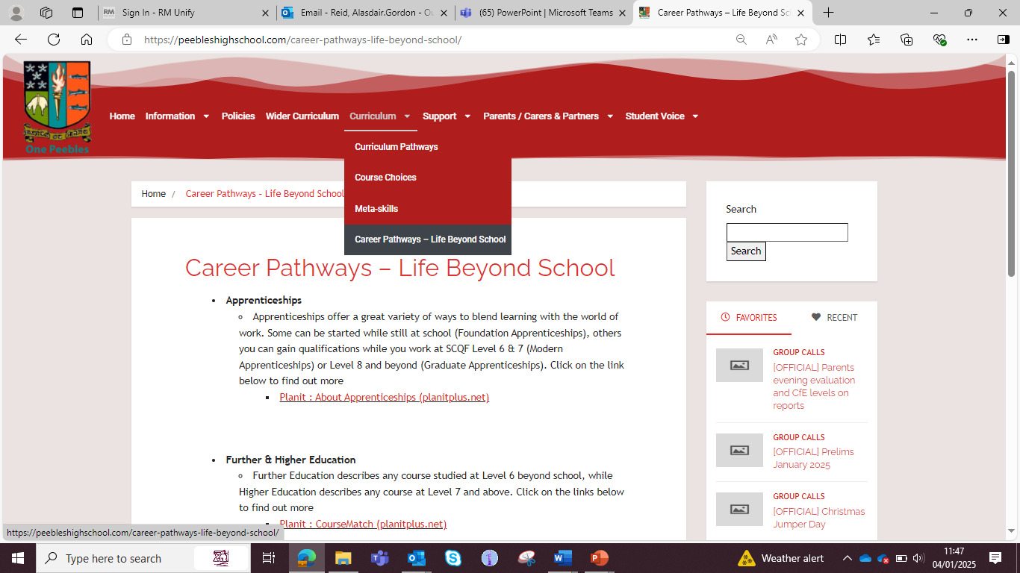

Slide 13
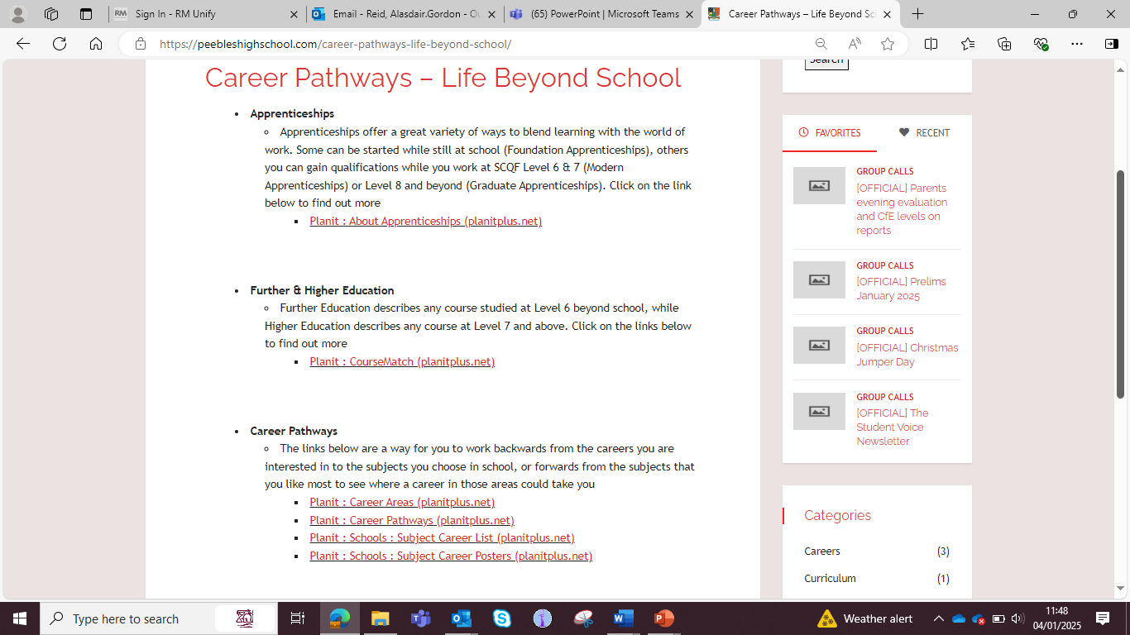

Slide 14
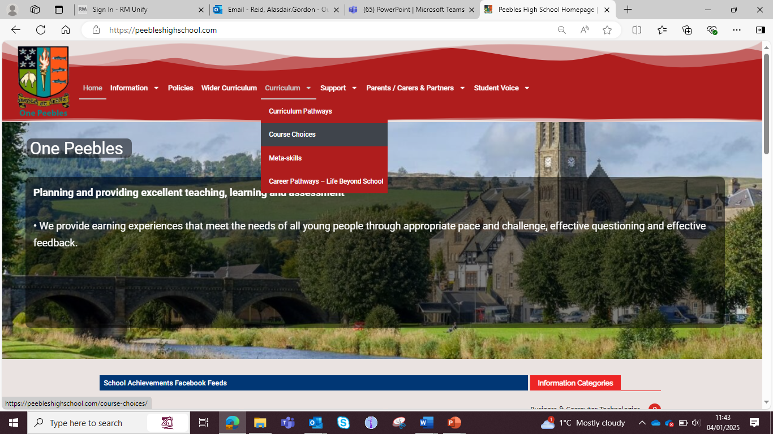

Slide 15


Slide 16
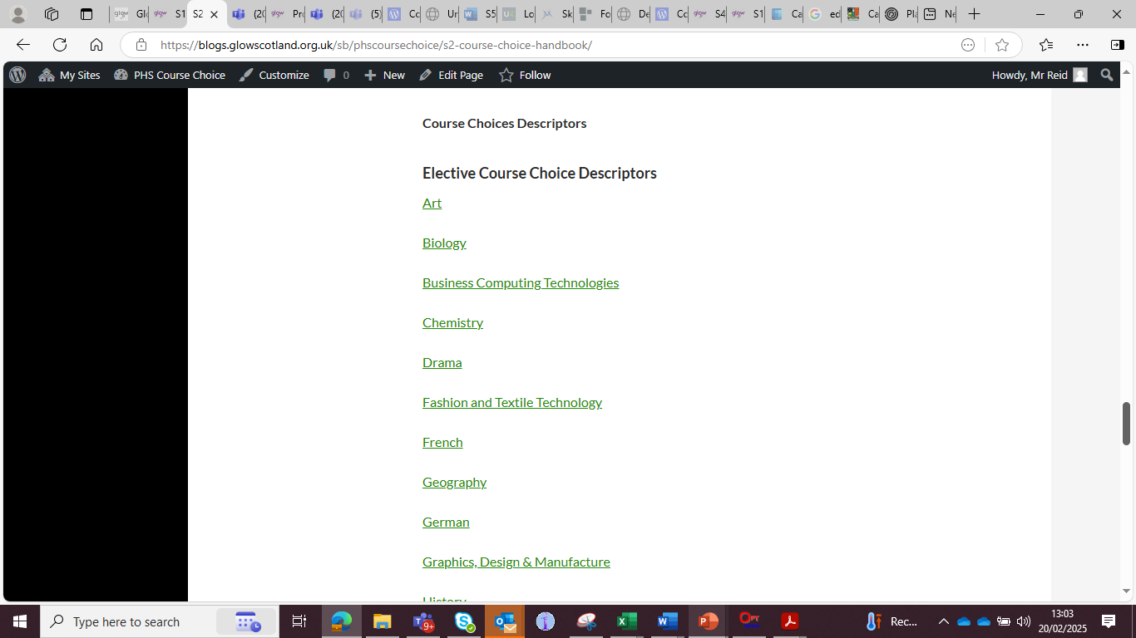

Slide 17
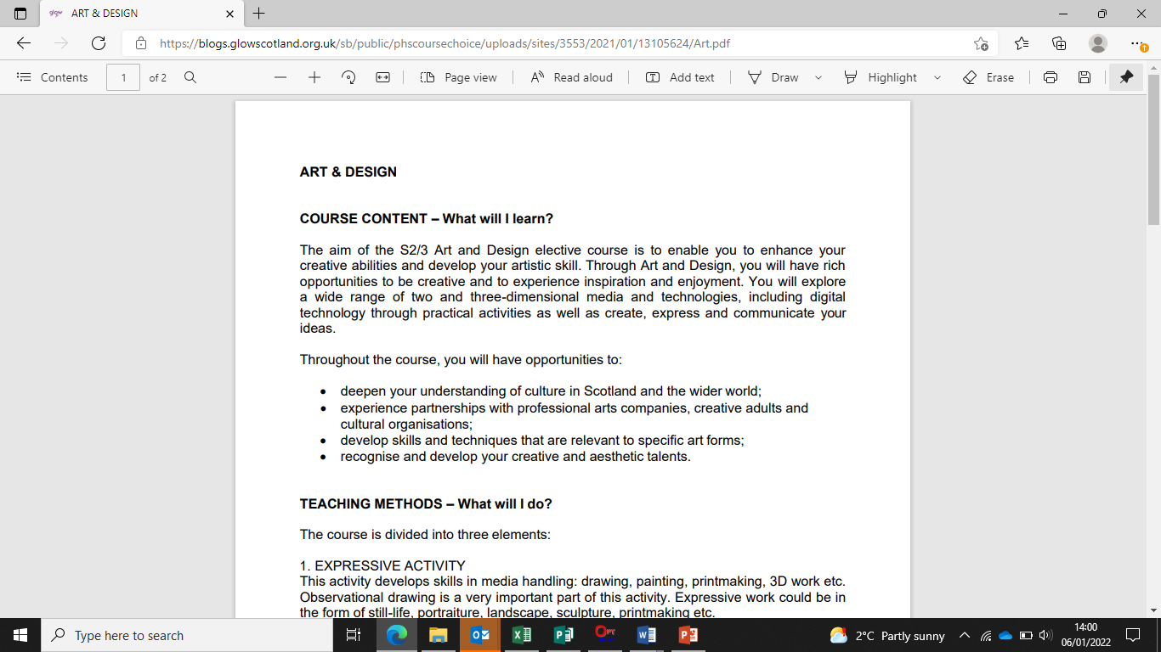

Slide 18
Course choice sheet

Slide 19
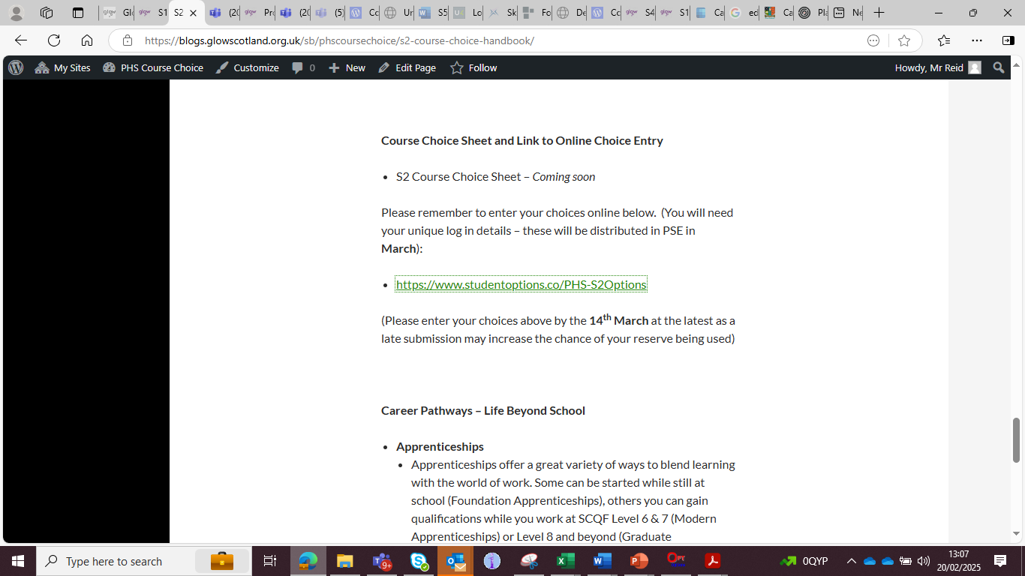

Slide 20


Slide 21
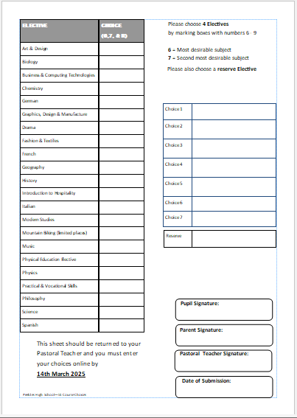

Slide 22
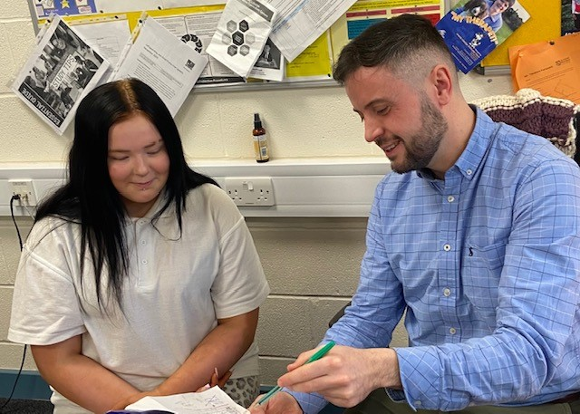
How will my child be supported?
Mrs Moretta

Slide 23
How will my child be supported?
PSE programme – Careers
MWoW and Planit Plus
Course descriptors
Progression levels
Career routes/paths
Personal research
Q&A sessions
Reassurance and emotional support
Individual support available from Pastoral Teacher

Slide 24
Points of contact for parents
2C1 – Mrs Milligen
2C2 – Mrs Robertson
2C3 – Mrs Robertson
2D1 – Mr Scott
2D2 – Mr Shirra-Gibb
2D3 – Mr Shirra-Gibb
2M1 – Mrs Boyd
2M2 – Mrs Boyd
2M3 – Mrs Marsden-Roy/Mrs Ferguson

Slide 25
What can you do?
Access the online supports
Read through course descriptors with your child
Encourage your child to do some personal research
Use the course choice preparation form as a prompt for discussion with your child
Listen to your child
www.myworldofwork.co.uk
www.skillsdevelopmentscotland.co.uk
https://www.planitplus.net

Slide 26
Timeline
19th December: S2 course choice handbook for 2025-26 will go live on the website
January: course choice preparation form to support course choice conversations at home will be on the website
January: S2 Pastoral interviews begin
10th February: S2 Course Choice Information Evening at 6:30pm
6th March – S2 Reports
Friday 13th March – S2 Course Choice Completion deadline

