Slide 1


S2
Course Choice
Information Evening
Mr Ryalls: Introduction & Rationale
Mr Reid: Course Choice Process
Mrs Moretta: Support

Slide 2
House-keeping
Please note that this meeting will be recorded
Please enter any questions into the chat bar

Slide 3
Introduction & Rationale
– Mr Ryalls

Slide 4
Rationale
– What’s changing?
PHS learners currently choose to study 9 subjects which they study for 2 periods per week in S2 & S3
In March 2025, S2s will be asked to make new course choices for the first time
S3 in 2025-26 will study 7 subjects, as well as Core subjects like English and Maths
Then in S4, this year group will get to choose to study 5 subjects, as well as Core
This means everyone will study 7 subjects in S4 including English and Maths

Slide 5
Rationale
– Why are we doing this?
Data shows us we need to broaden our curriculum offer
Studying 7 subjects in S4 will mean 4 periods per National subject per week (now it is 5 periods of 6 subjects per week)
Changes to S3 will mean minimum 3 periods per Optional subject per week, instead of 2 as it is now
This bring PHS in line with a broad national curriculum rationale

Slide 6
What will the benefits be?
Specialisation of 7 subjects will allow for more periods per week and depth of learning of subjects in S3
This will allow better preparation for S4 while still offering a Broad General Education in S3
Studying more subjects in S4 means more subjects you are able to study when you return for S5

Slide 7
Rationale
– What will the new S3
curriculum be like?
Core:
4 periods of English
4 periods of Maths
2 periods of PE
1 period of RMPS
1 period of PSE

Slide 8
Rationale
– What will the new S3
curriculum be like?
Options:
Choice 1 | Choice 2 | Choice 3 | Choice 4 | Choice 5 | Choice 6 | Choice 7
Sciences | Social Subjects | Expressive Arts | Choose one of: BCT CDT HWB Mod Langs | Choose one of: BCT CDT HWB Mod Langs | Free | Free

Slide 9
Questions so far?

Slide 10
The Process
Course choice website
Core and elective courses
Course choice sheet
How to input choices

Slide 11
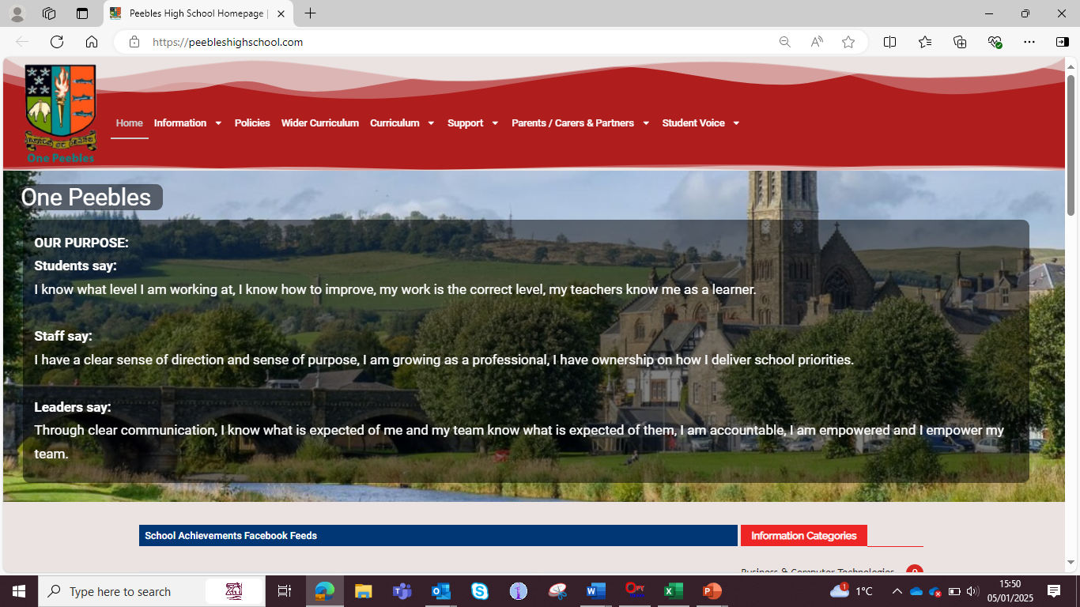

Slide 12
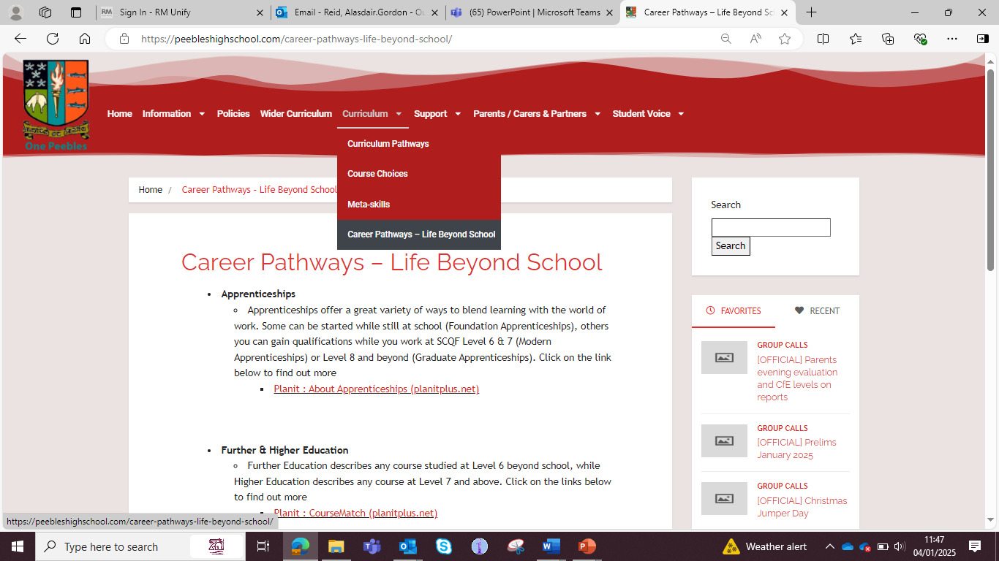

Slide 13
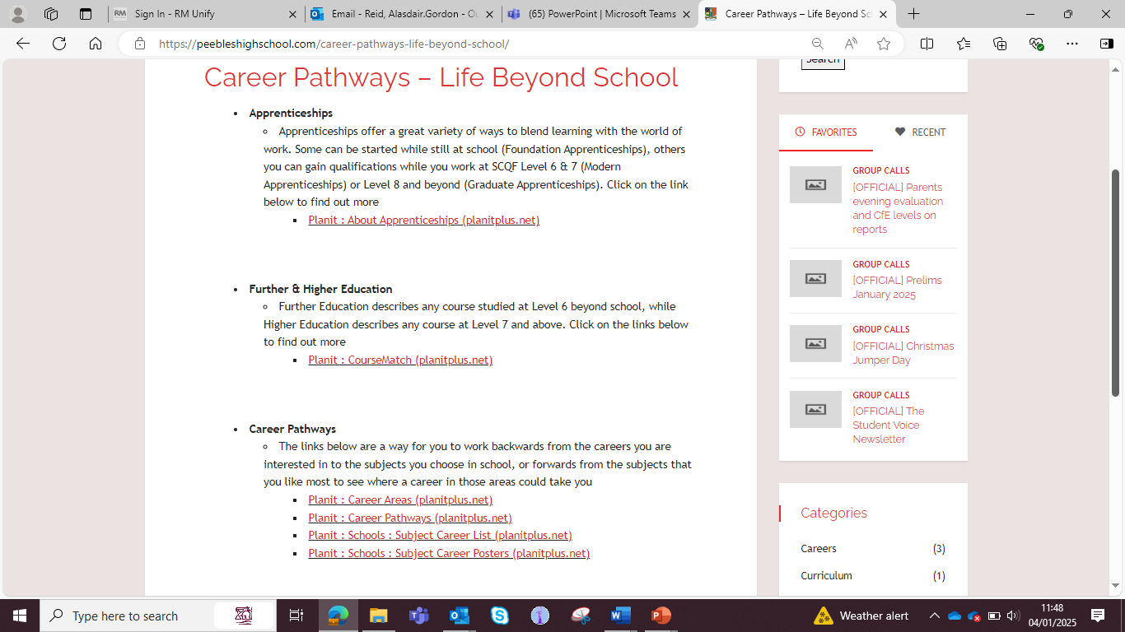

Slide 14
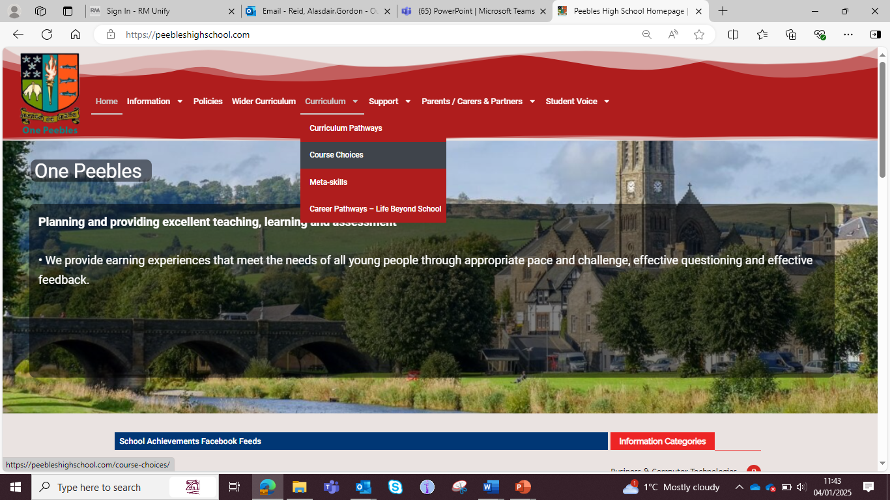

Slide 15
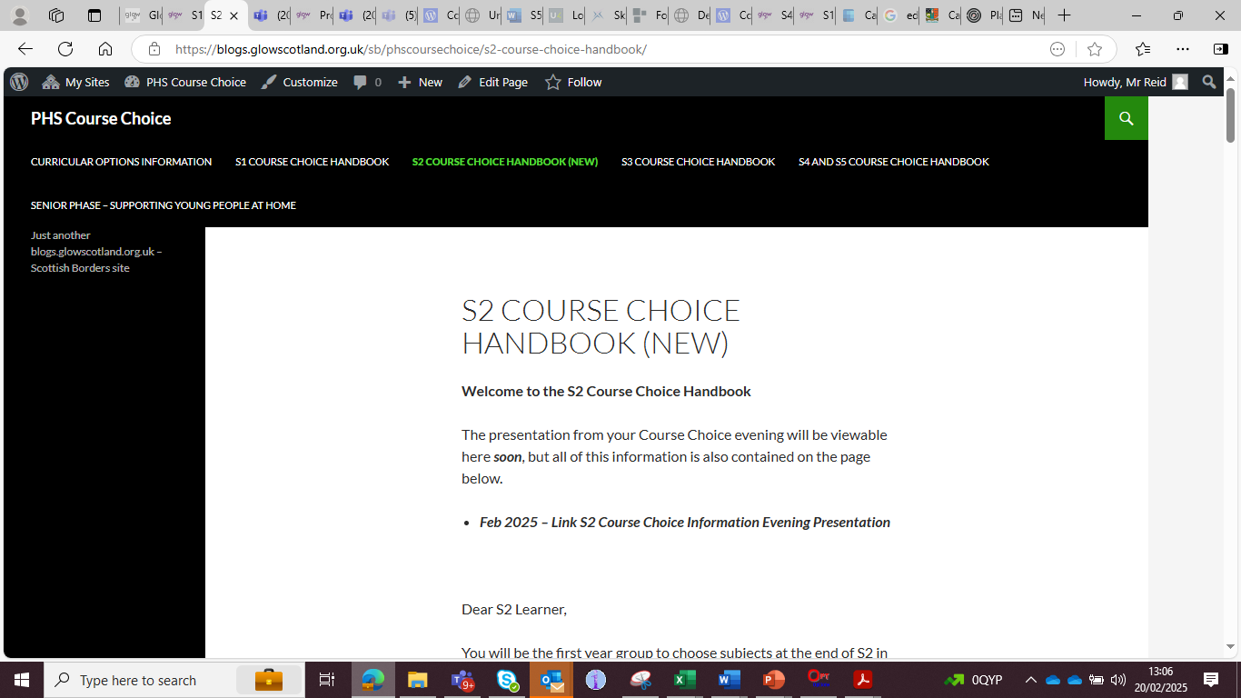

Slide 16
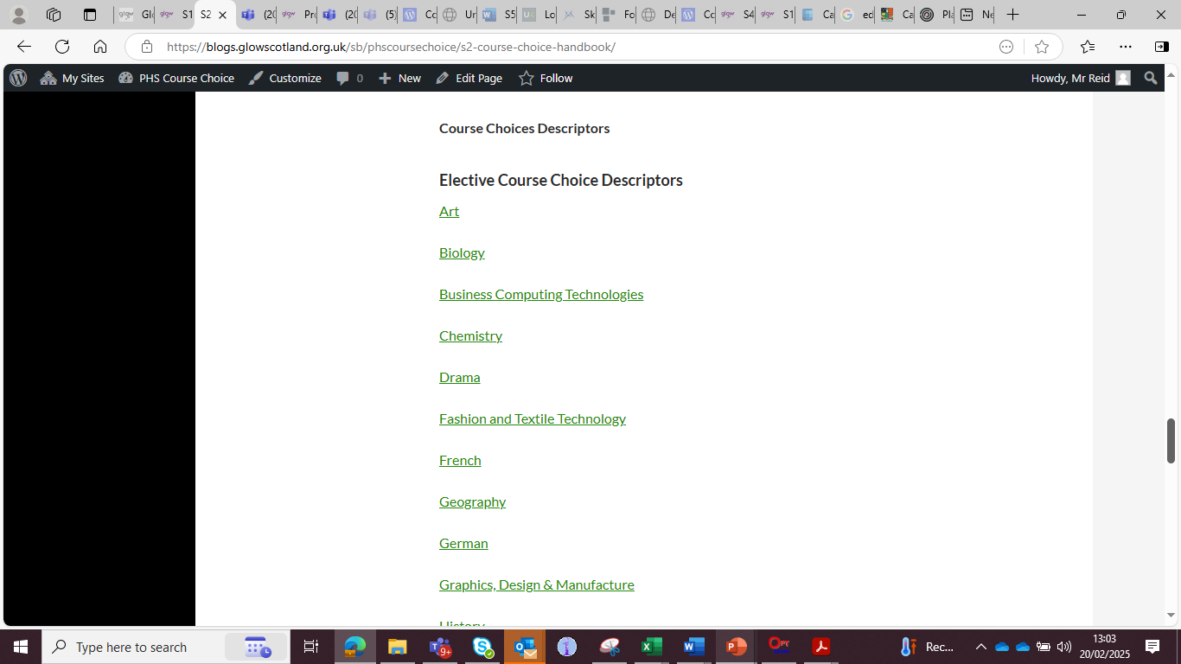

Slide 17
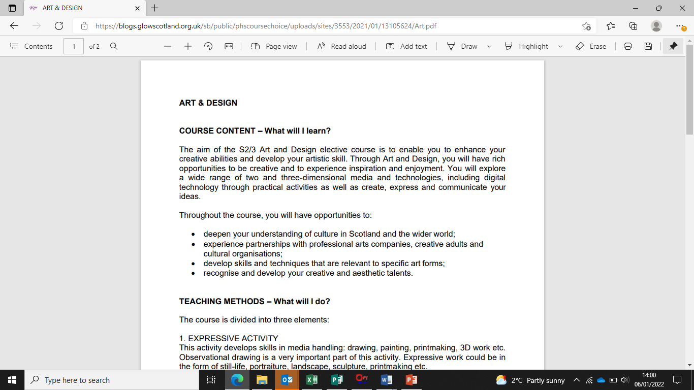

Slide 18
Course choice sheet

Slide 19
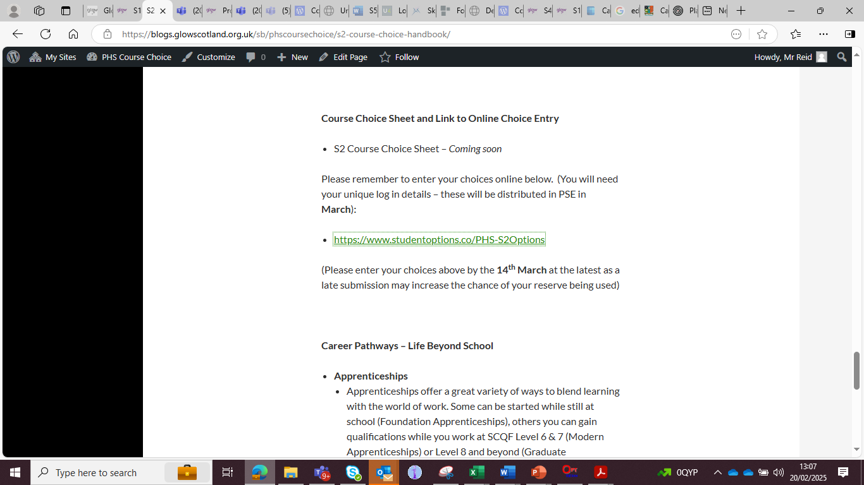

Slide 20


Slide 21
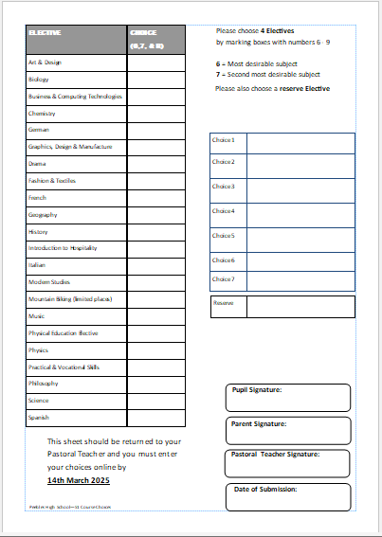

Slide 22
How to input choices

Slide 24
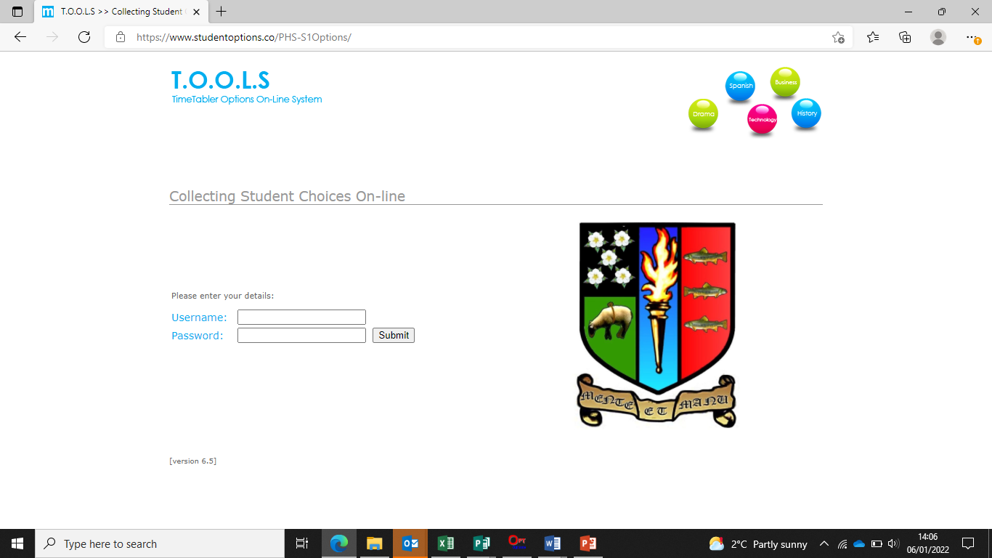

Slide 25
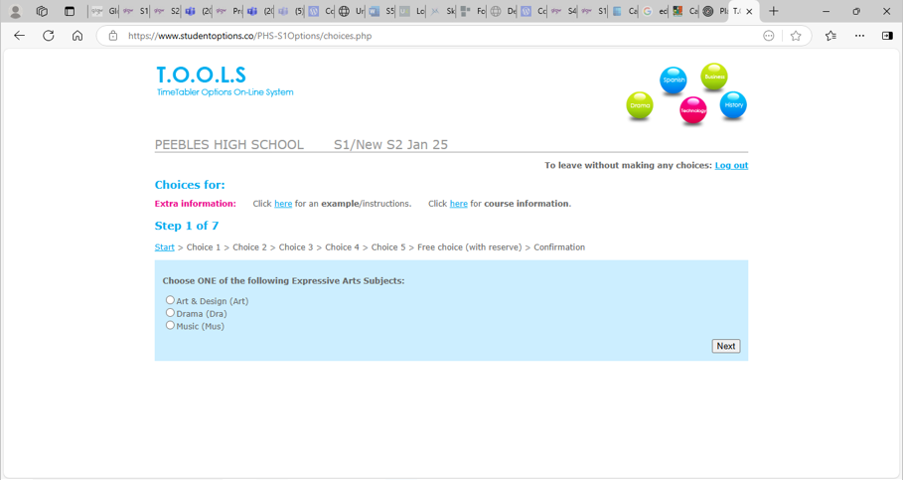

Slide 26
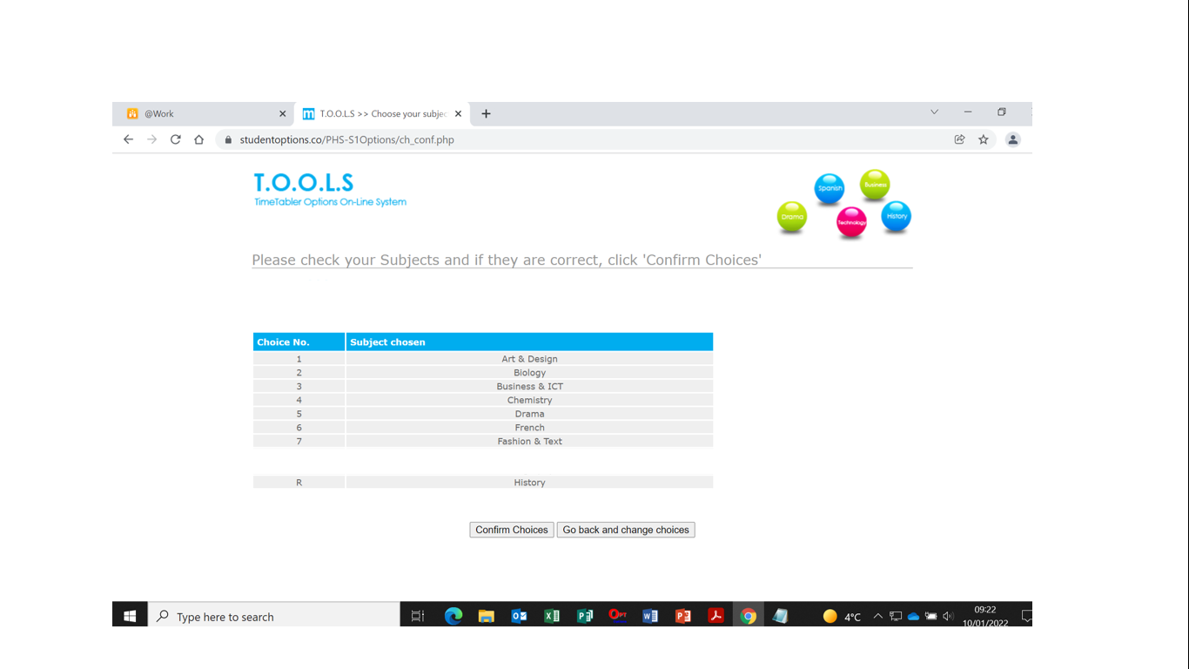

Slide 27
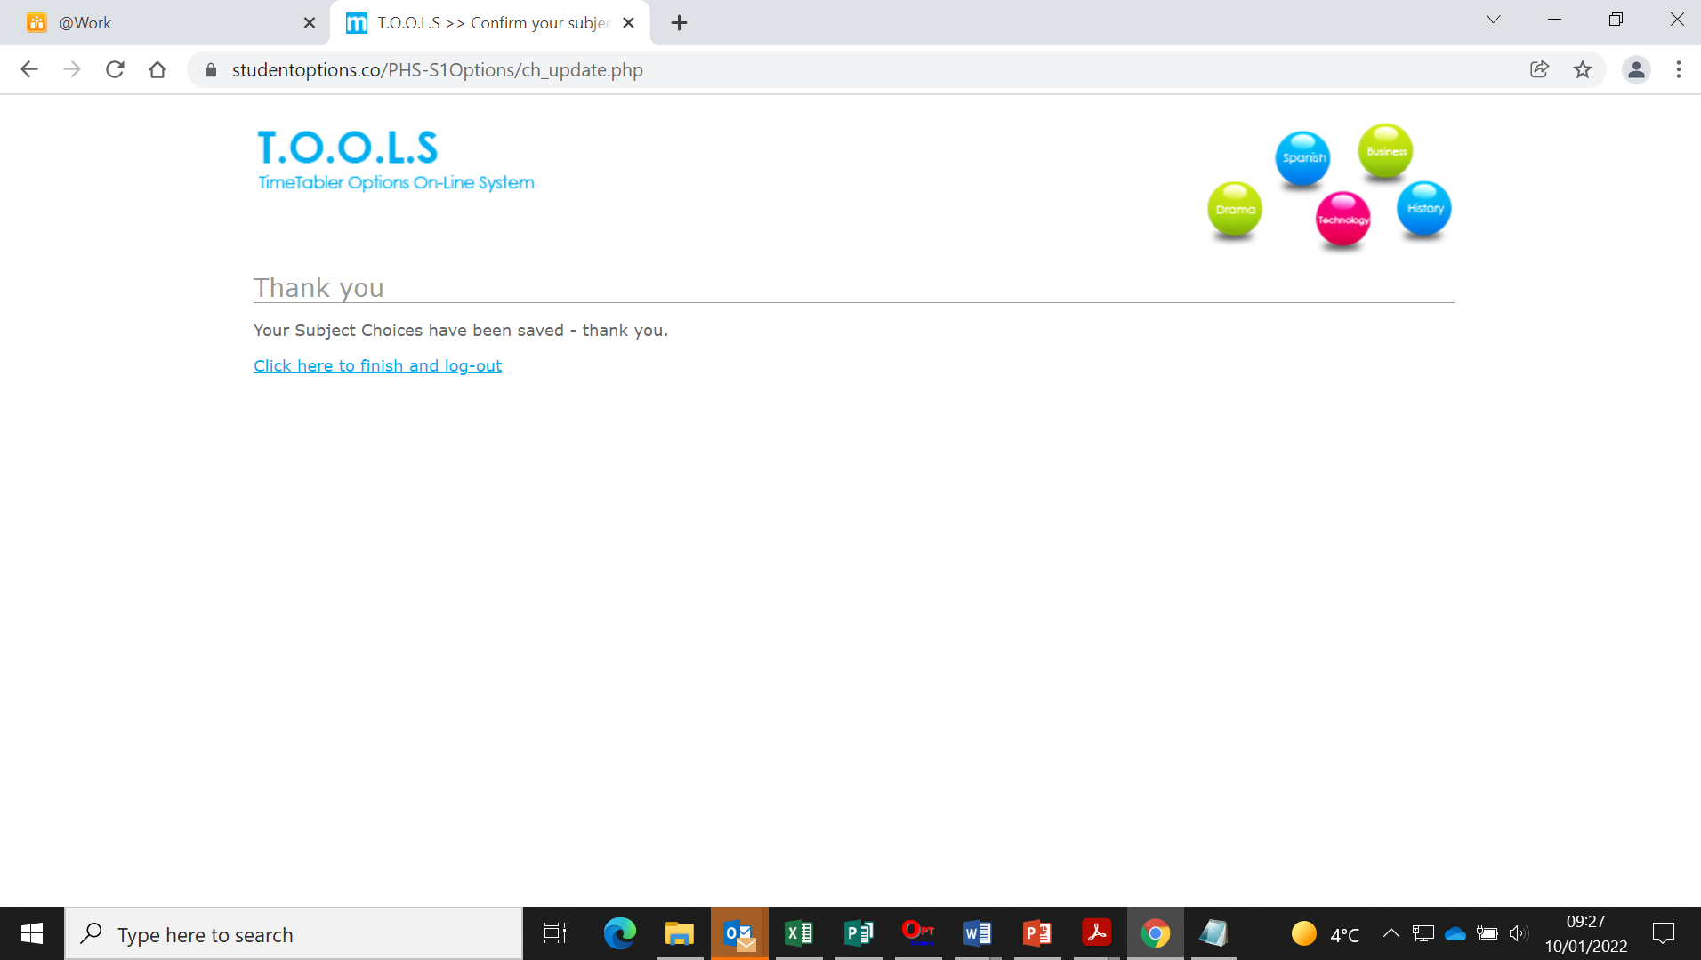

Slide 28
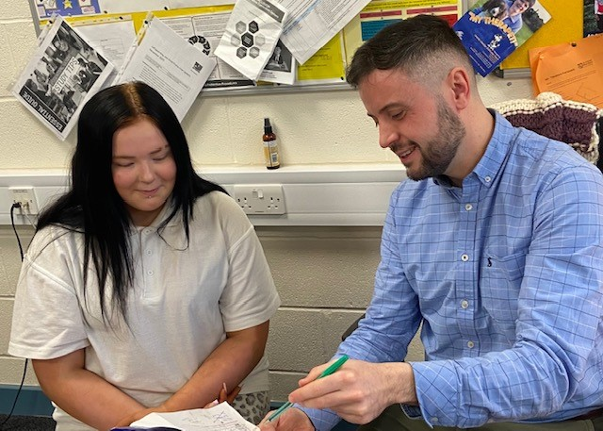
How will my child be supported?
Mrs Moretta

Slide 29
How will my child be supported?
PSE programme – Careers
MWoW and Planit Plus
Course descriptors
Progression levels
Career routes/paths
Personal research
Q&A sessions
Practise entering choices in Tools
Reassurance and emotional support
Individual support available from Pastoral Teacher

Slide 30
Points of contact for parents
2C1 – Mrs Milligen
2C2 – Mrs Milligen
2C3 – Mrs Robertson
2D1 – Mr Shirra-Gibb
2D2 – Mr Shirra-Gibb
2D3 – Mr Scott
2M1 – Mrs Boyd
2M2 – Mrs Boyd
2M3 – Mrs Marsden-Roy

Slide 31
What can you do?
Access the online supports
Read through course descriptors with your child
Encourage your child to do some personal research
Use the course choice preparation form as a prompt for discussion with your child
Listen to your child
www.myworldofwork.co.uk
www.skillsdevelopmentscotland.co.uk
https://www.planitplus.net

Slide 32
Timeline
w/b 3 Feb – Mock Choices information shared
We have held preliminary “Mock Choice” window, where learners gave an indication of their intentions for subjects they would like to take into S3
Thursday 13 Feb – Mock Choices deadline
w/b 24 Feb - S2 Course Choice Support begins with Pastoral
Learners will receive input in PSE lessons to help them decide their choices, with individual also available
Tuesday 25 Feb - S2 Handbook Webpage Launch
This will be a webpage dedicated to providing additional information about the new S2 curriculum structure, the courses you will be able to study, and the course choice process
Tuesday 25 Feb 6pm - Online information evening for parents/carers and pupils
As was held in S1, this will be an optional information evening held online which will explain the changes and the course choice process
Friday 7 March/Monday 10 March - Progress and Achievement reports uploaded to Showbie
This is a new rescheduled report that will be sent to parents and carers which will help with the final decision-making process
Friday 14 March - Course Choice deadline
The date by which course choices should be entered online

