Slide 1


S1
Course Choice
Information Evening
Mr Ryalls: Introduction
Mr Reid: Course Choice Process
Mrs Moretta: Support

Slide 2
Introduction – Mr Ryalls

Slide 3
The Process
Course choice website
Core and elective courses
Course choice sheet
How to input choices

Slide 4
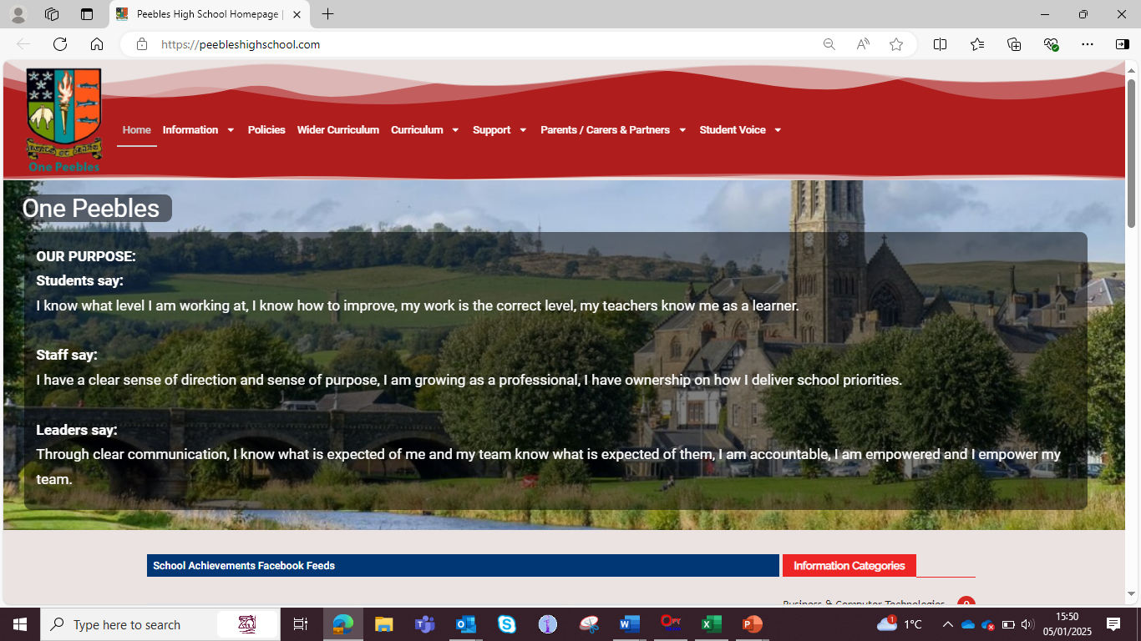

Slide 5
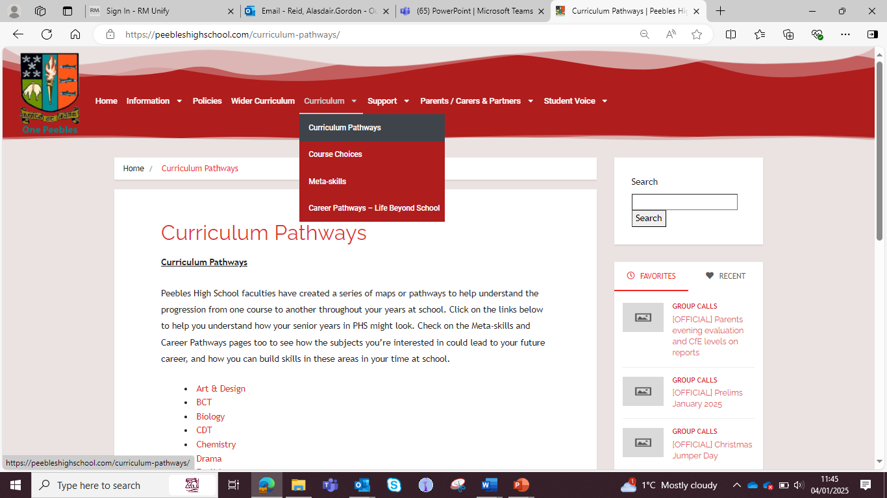

Slide 6
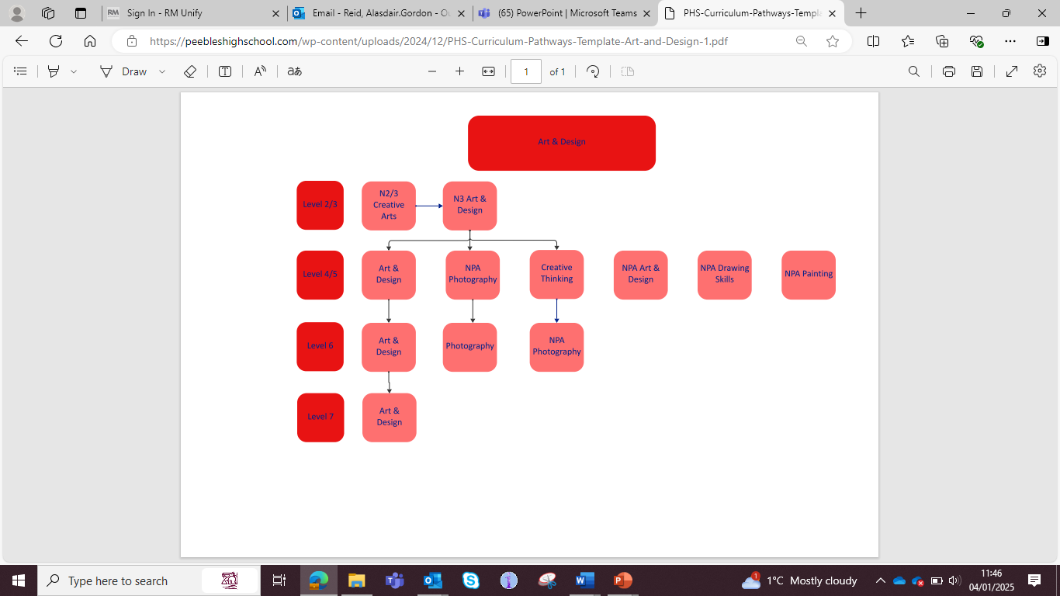

Slide 7
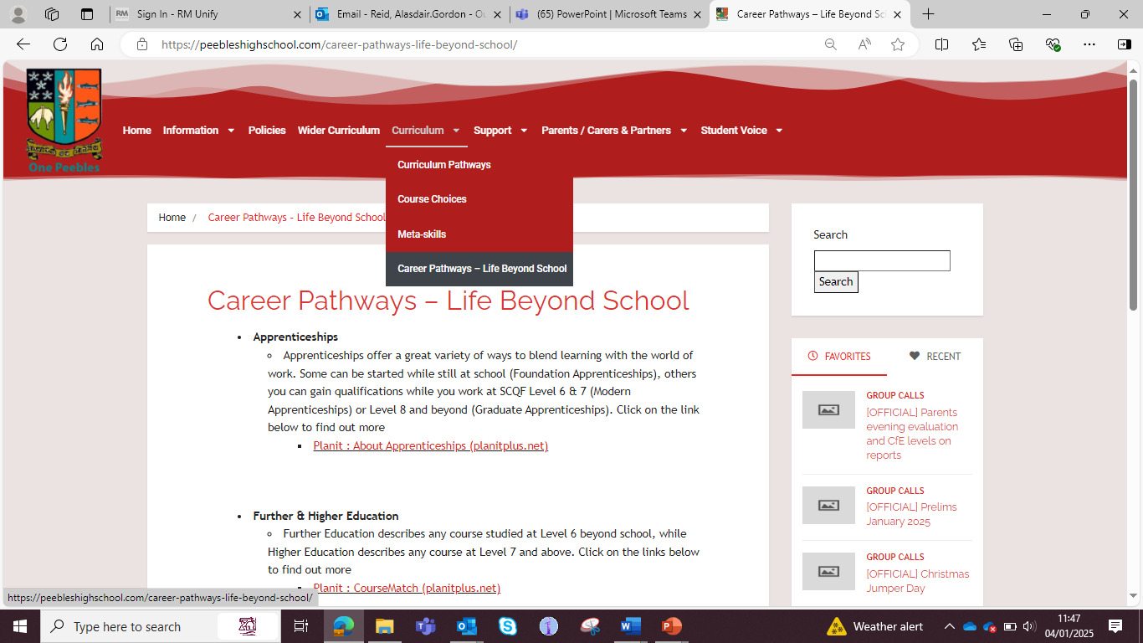

Slide 8
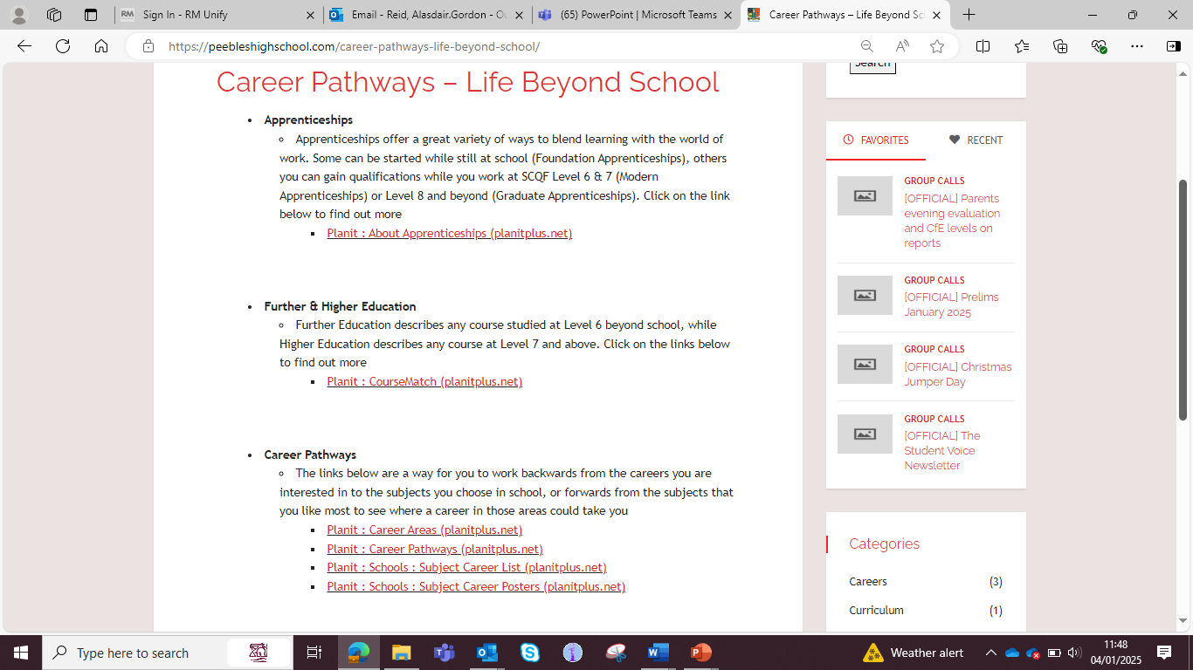

Slide 9
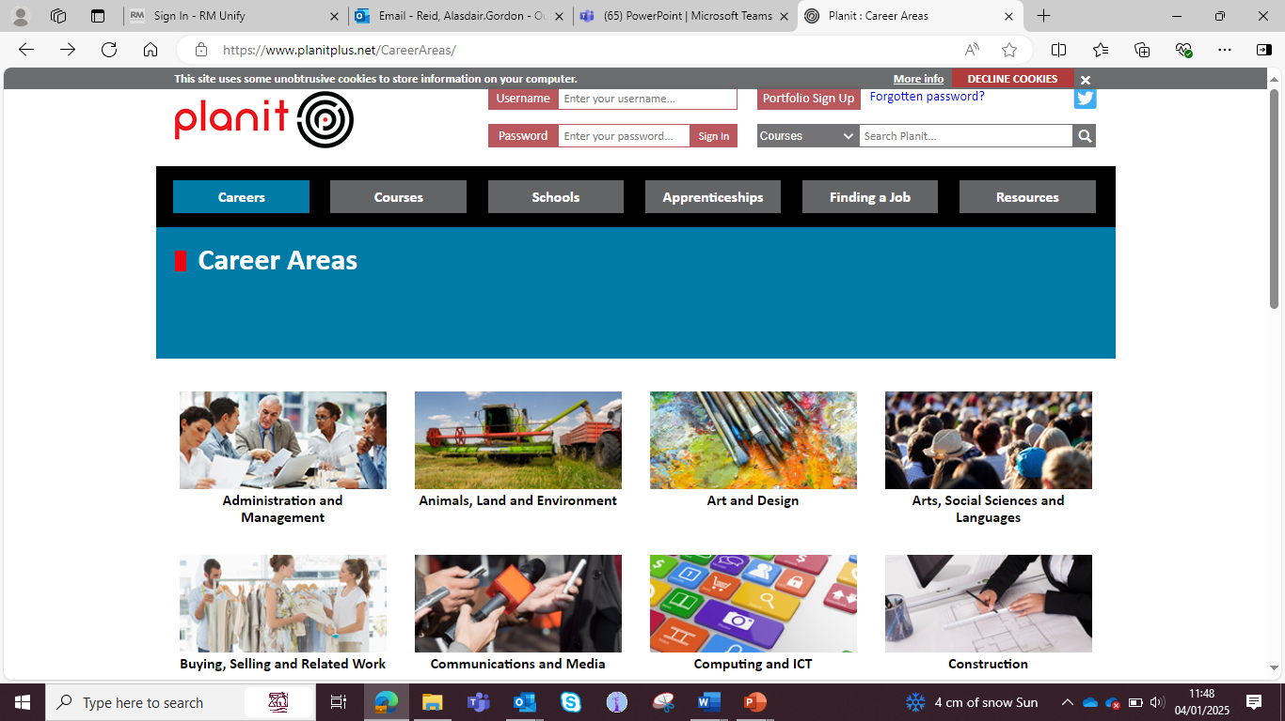

Slide 10
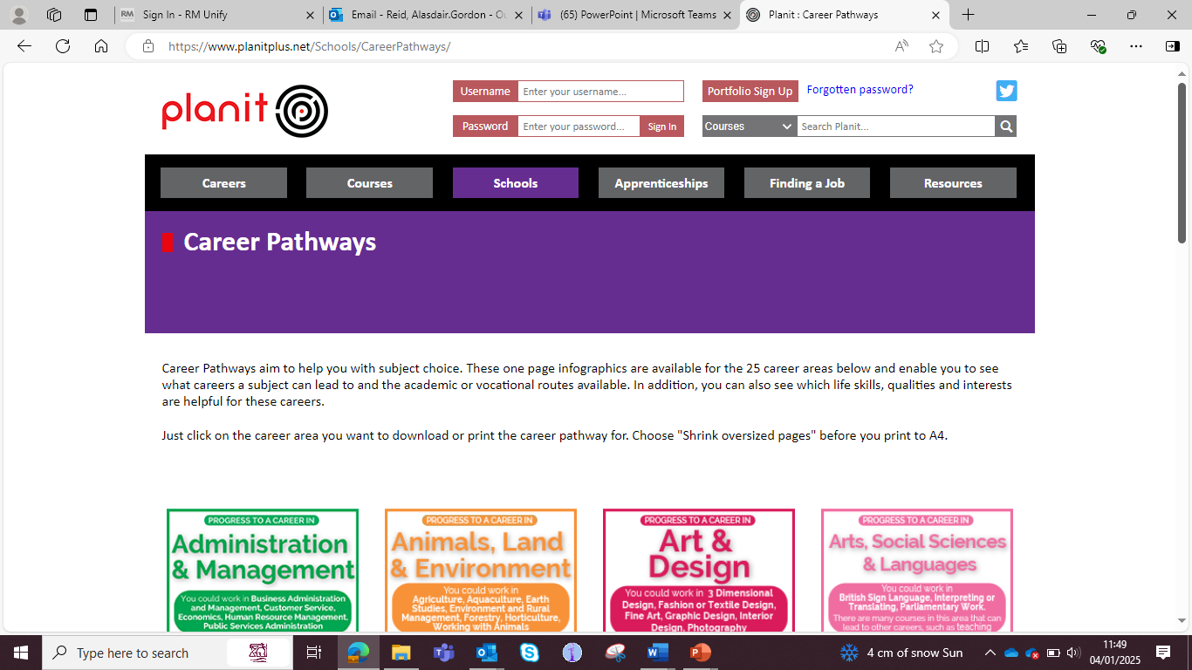

Slide 11


Slide 12


Slide 13
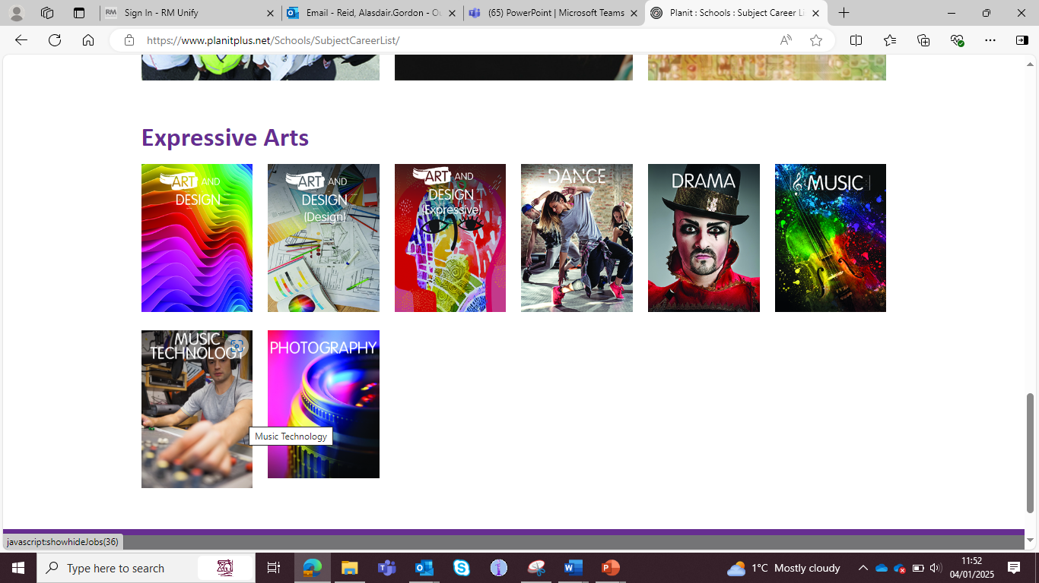

Slide 14
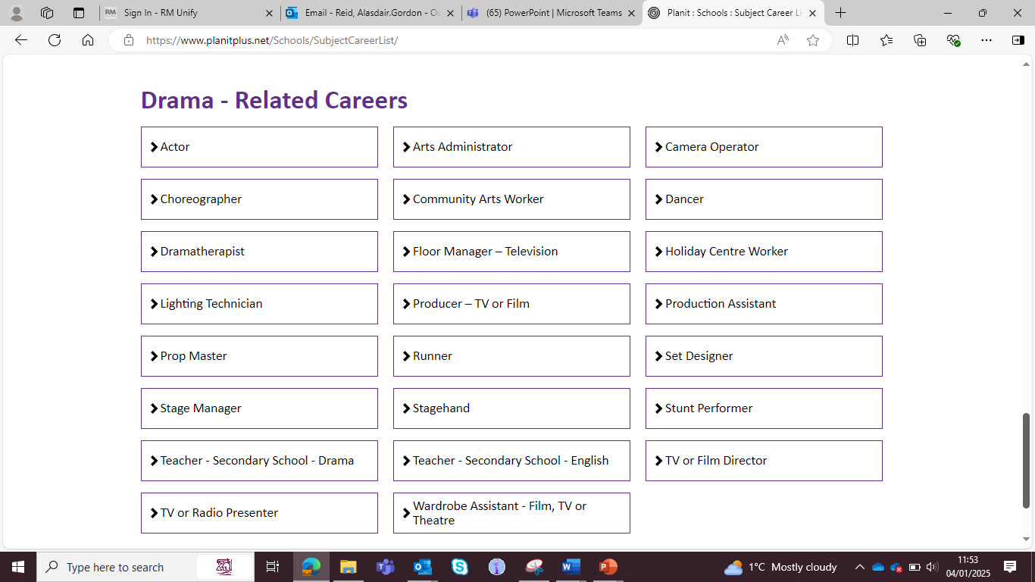

Slide 15
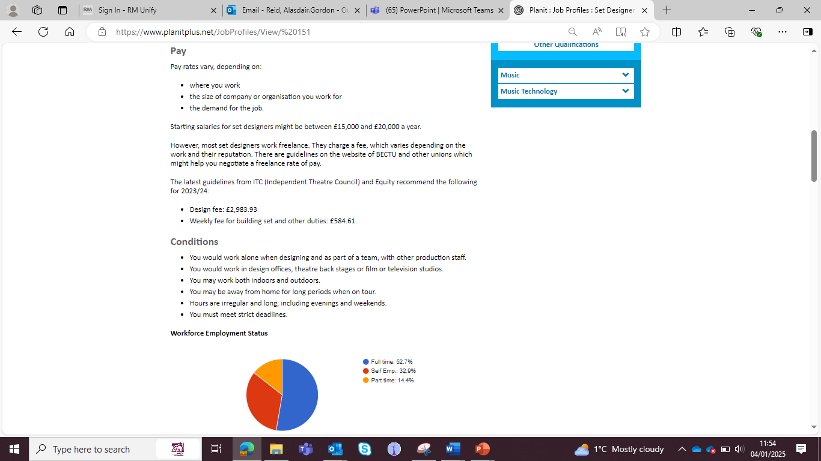


Slide 16
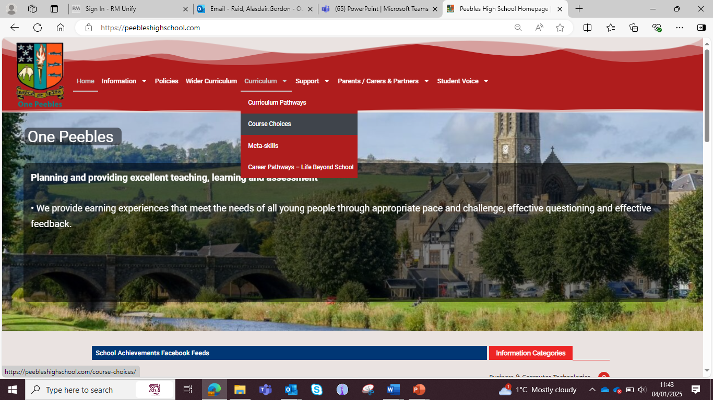

Slide 17


Slide 18
Core and elective courses

Slide 19
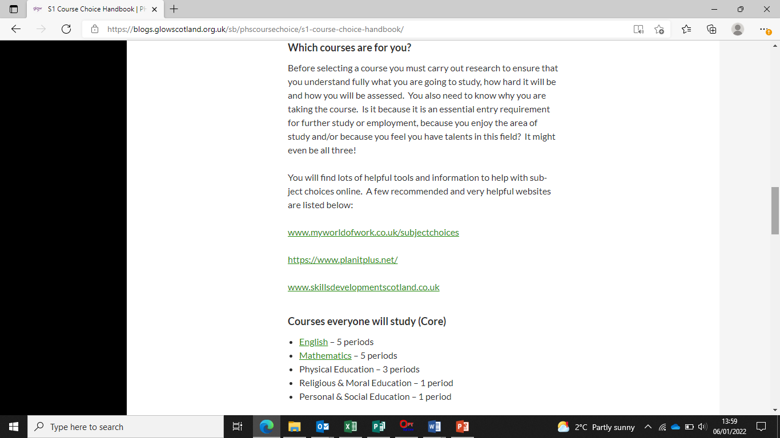

Slide 20
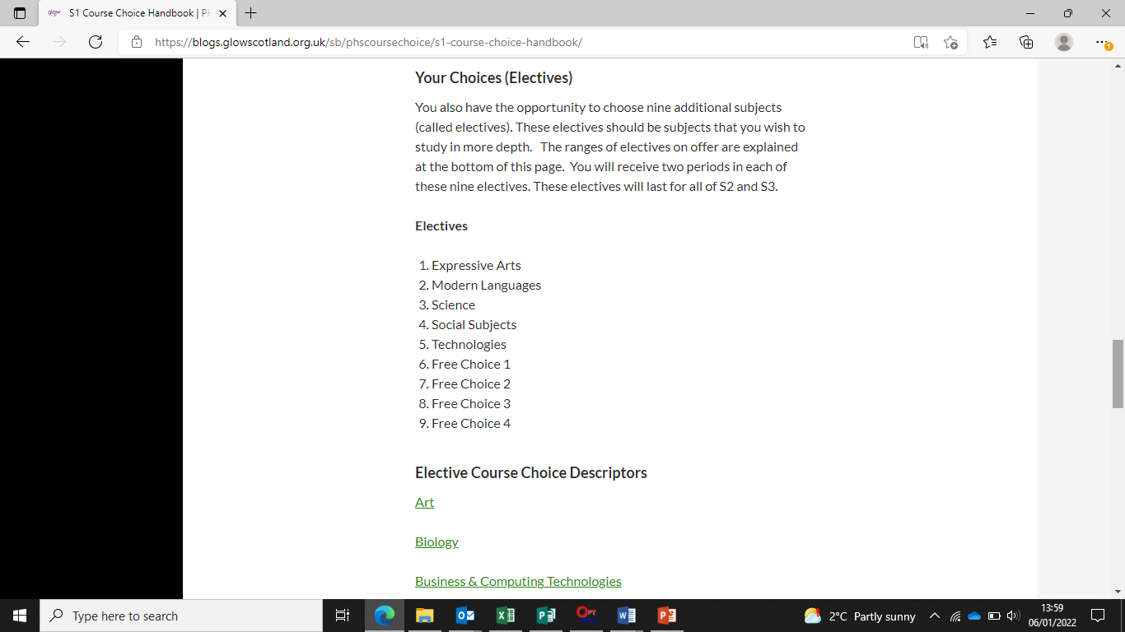

Slide 21
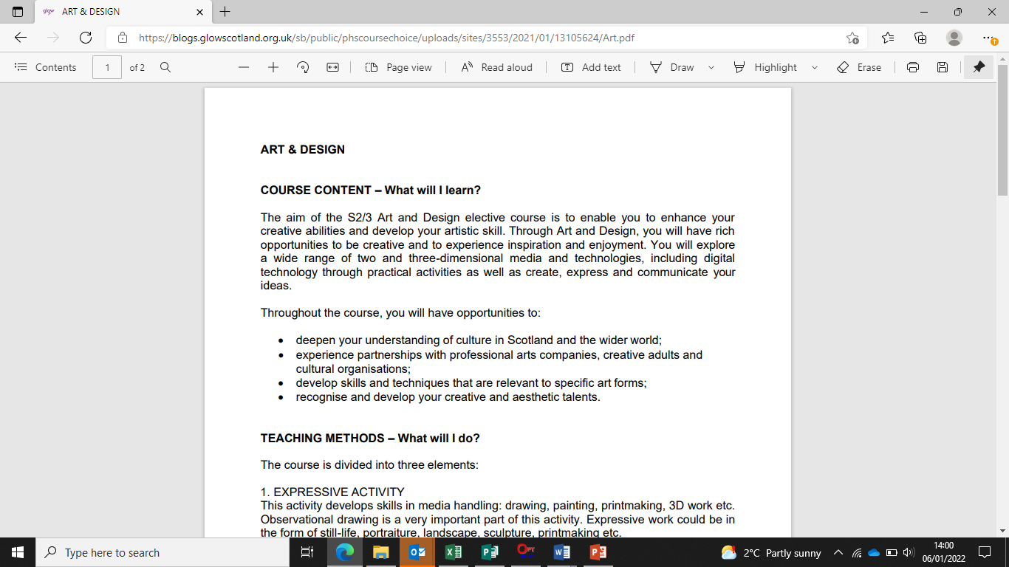

Slide 22
Course choice sheet

Slide 23
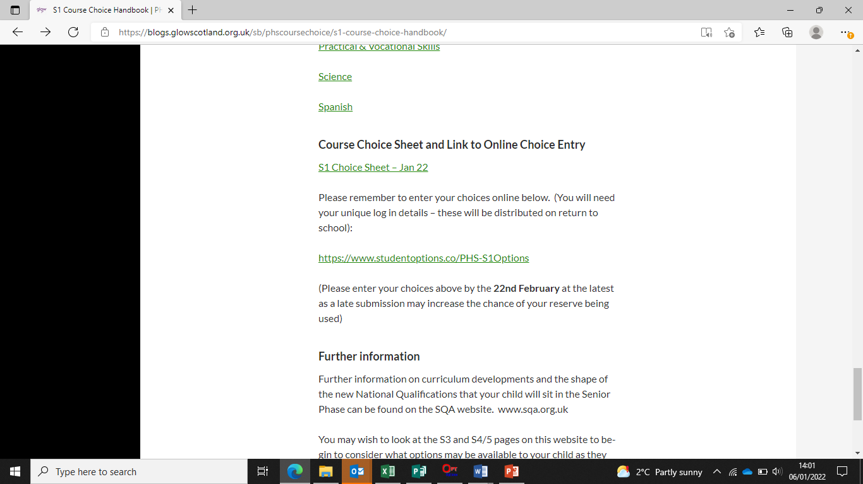

Slide 24
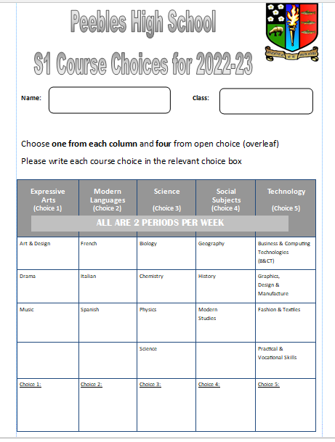

Slide 25
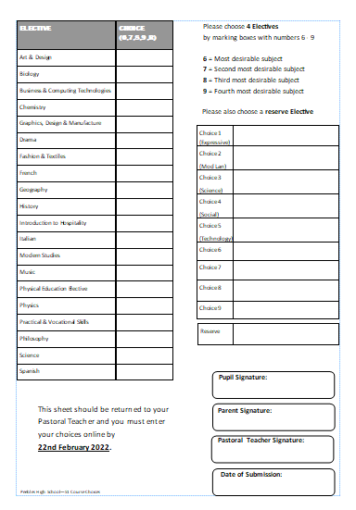

Slide 26
How to input choices

Slide 28
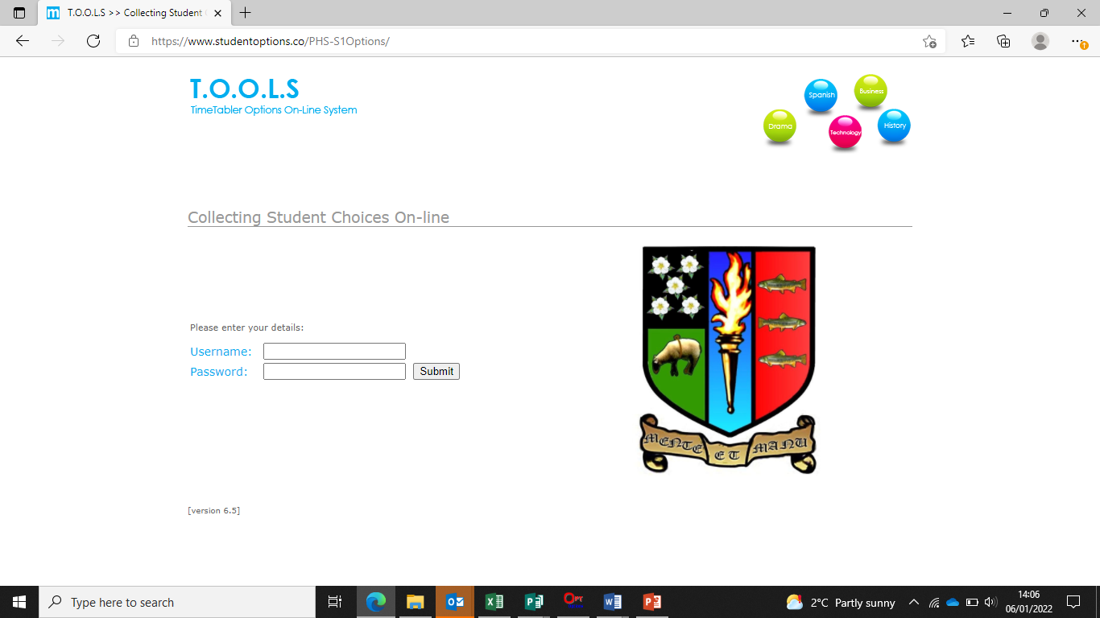

Slide 29
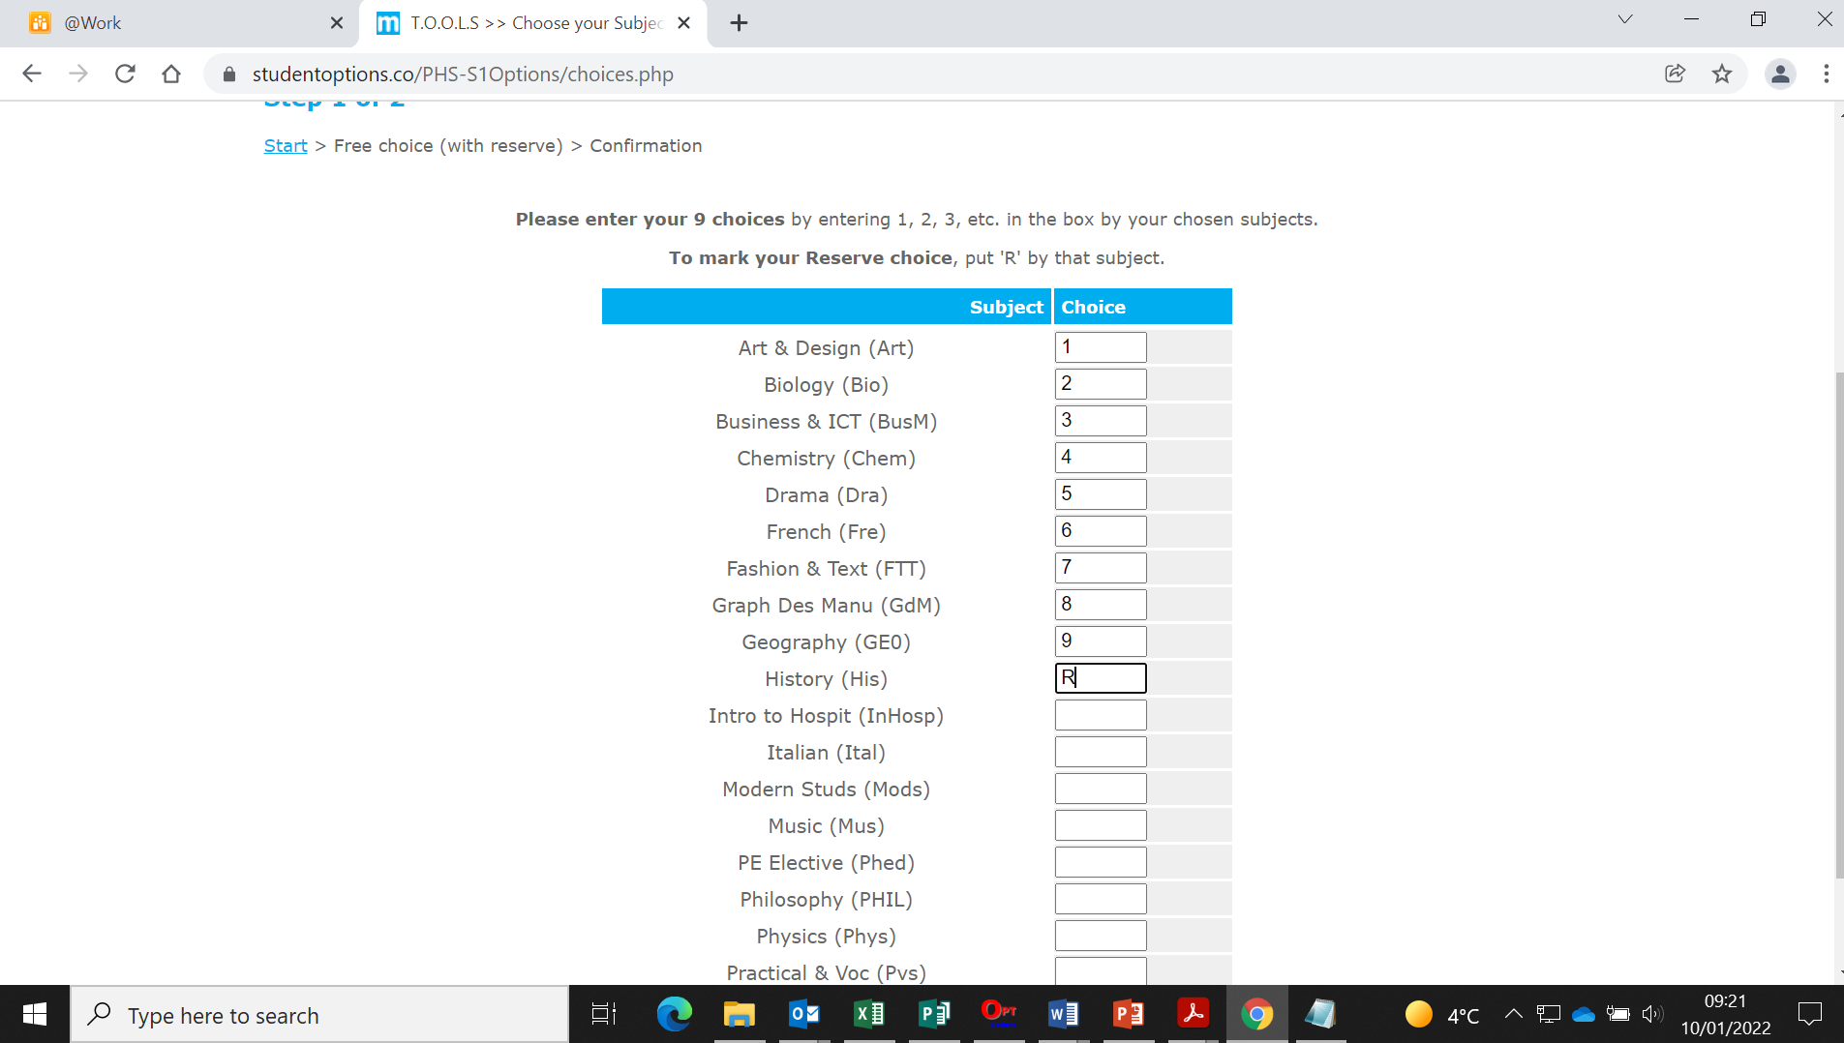

Slide 30
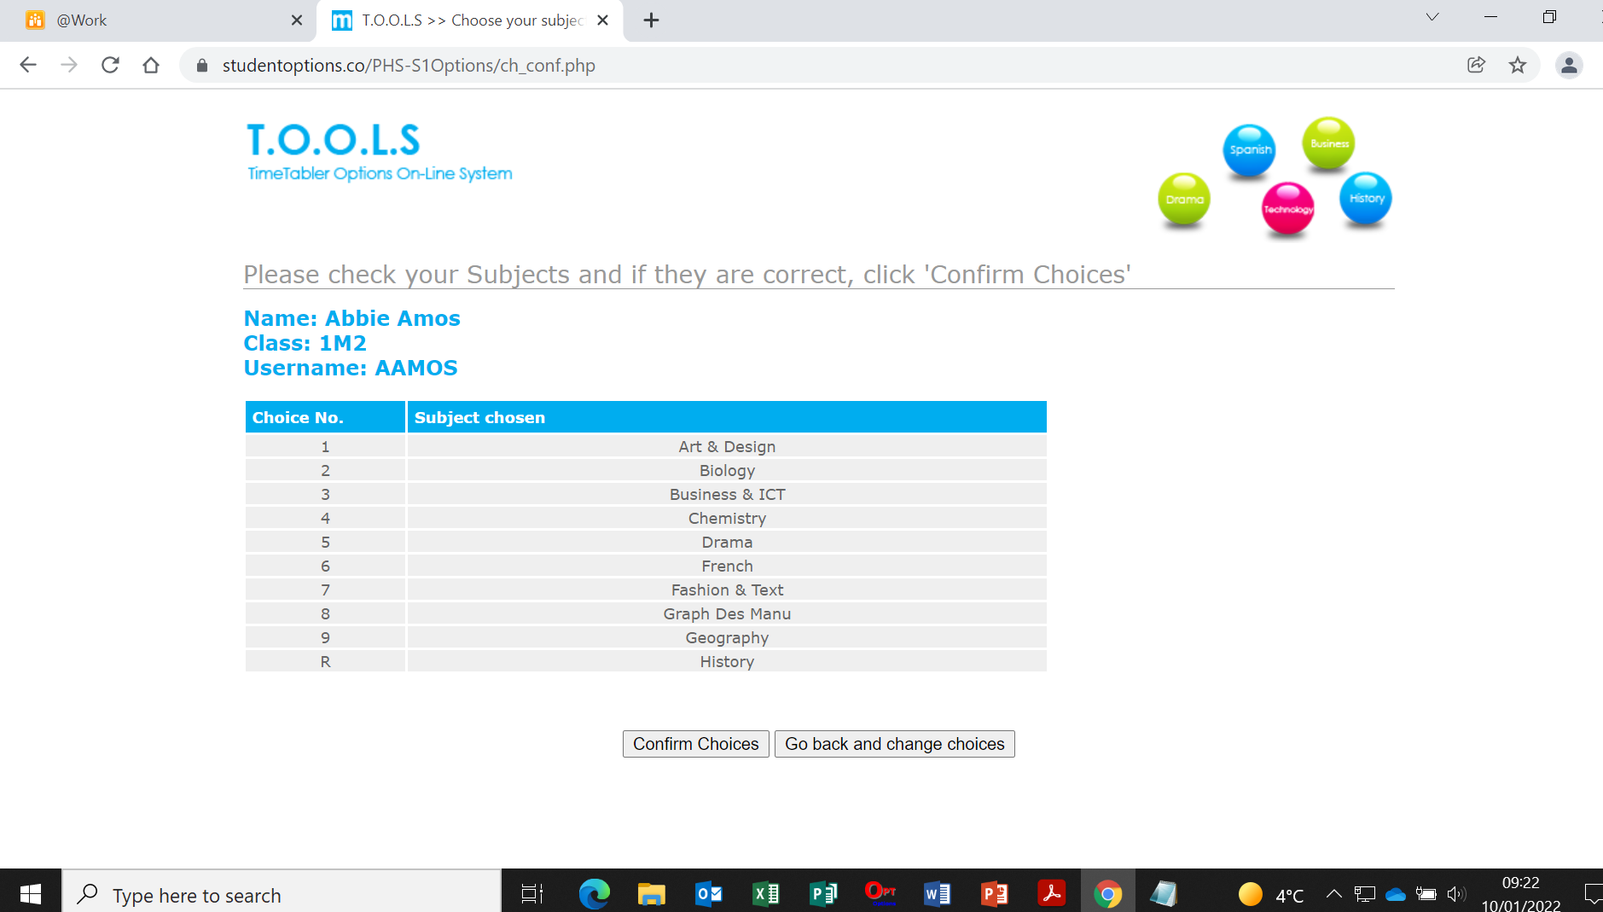

Slide 31


Slide 32
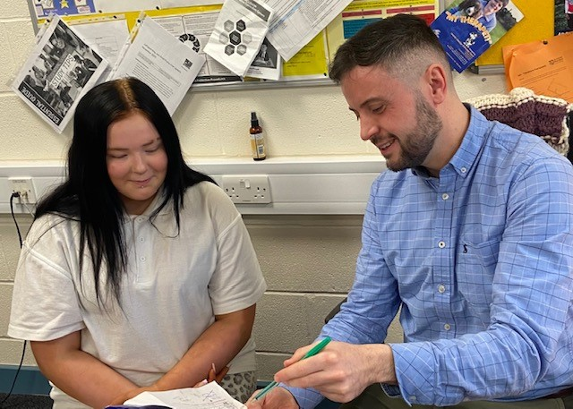
How will my child be supported? – Mrs Moretta

Slide 33
How will my child be supported?
PSE programme – Choices/Careers
MWoW and Planit Plus
Course descriptors
Progression levels
Career routes/paths
Personal research
Q&A sessions
Practise entering choices in Tools
Reassurance and emotional support
Interview with Pastoral Teacher
1:1 interview with Mr Conway, Skills Development Scotland

Slide 34
Points of contact for parents
1C1 – Mrs Milligen
1C2 – Mrs Robertson
1C3 – Mrs Robertson
1D1 – Mr Shirra-Gibb
1D2 – Mr Shirra-Gibb
1D3 – Mr Scott
1M1 – Mrs Boyd
1M2 – Mrs Boyd
1M3 – Mrs Ferguson/Mrs Marsden-Roy

Slide 35
What can you do?
Access the online supports
Read through course descriptors with your child
Encourage your child to do some personal research
Use the course choice preparation form as a prompt for discussion with your child
Listen to your child
www.myworldofwork.co.uk
www.skillsdevelopmentscotland.co.uk
https://www.planitplus.net

Slide 36
Timeline
20th December 24: S1 course choice handbook for 2025-26 will go live on the website
14th January 25: course choice preparation form to support course choice conversations at home will be on the website
14th January 25: S1 Course Choice Information Evening
17th January: S1 reports will be issued
20th January: S1 Pastoral interviews begin
14th February: S1 Options completion deadline. Please note that this is online and should be done with parents at home

