Slide 1
s4 and s5 Course choice evening
8th February 2024

Slide 2
Senior course Choice Evening
Format:
Introduction - KR
Updates & Process - AR
Support- DM

Slide 3
Introduction: HMIE
“Senior leaders should review timetables in existence for senior phase learners”
“Senior leaders should review their curriculum offer to young people. Staff, supported by senior leaders, should continue to explore approaches to ensure aspirational coursing for all young people in the senior phase to maximise their time and potential”

Slide 4
introduction
Making informed choices
Using the whole curriculum & partners (Borders College)
The senior phase S5-S6

Slide 5
Updates
Changes to the 2024-25 session
Process
Course choice website
Course choice sheet
How to input choices.

Slide 6
Updates: Changes to the 2024-25 Session
S5 & S6 Choices
New courses
Recoursing Policy

Slide 7
S5 & S6 Choices
 | 1 | 2 | 3 | 4 | 5 | 6
S5 | Full Course | Full Course | Full Course | Full Course | Full Course | Full Course
 | L6 Course | L6 Course | L6 Course | L6 Course | L6 Course | Sch Study
 | 1 | 2 | 3 | 4 | 5 | 6
S6 | Full Course | Full Course | Full Course | Full Course | Full Course | Leadership
 | L7 Course | L7 Course | L7 Course | LRC Study | Full Course
S4s choose either:
A minimum 6 courses
or
5 l6 courses plus School Study
S5 choose either:
A minimum of 5 courses at any level
or
3 l7 courses, LRC School study plus one other course at any level
Pupils who wish to participate in school service rather than one of their subjects can make an application to do so.
In addition, all new S6 pupils will complete a Leadership qualification in one column

Slide 8
New Course examples
Furniture-making – Level 5
Journalism (now open to S5s) – Level 6
Sports Coaching – Level 7

Slide 9
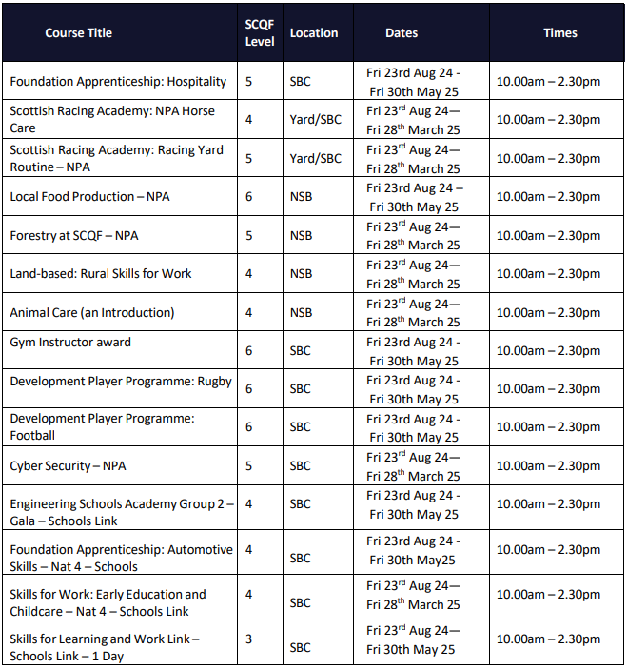
Borders College & partners
In the case that you do not see a course that you wish to study, please inform your pastoral teacher and the school will do what it can to support your request

Slide 10
Recoursing policy
PHS does not support the dropping of subjects. Students will be supported to complete each course that they begin. This is the agreement entered into upon returning for S5 & S6 at PHS.
Please choose Reserve subjects carefully – these are considered a valid choice and young people may be expected to sit this subject.

Slide 11
process
Peebles High School – Wisdom, Compassion, Justice, Integrity (glowscotland.org.uk)

Slide 12
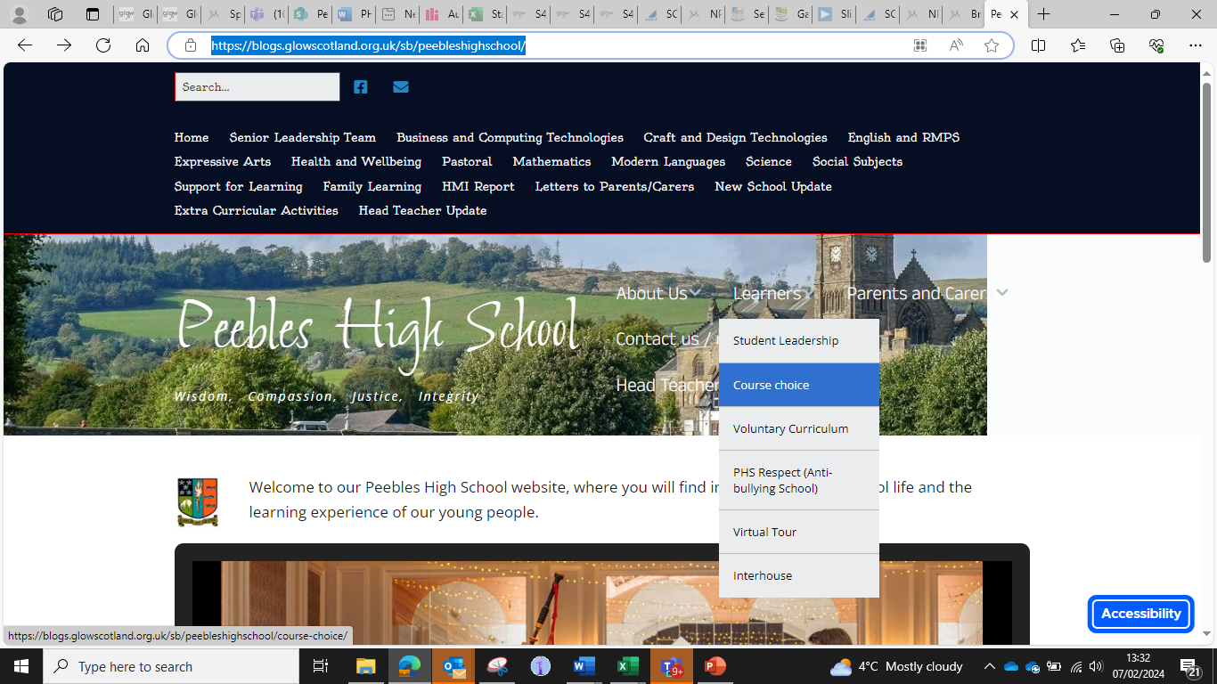

Slide 14
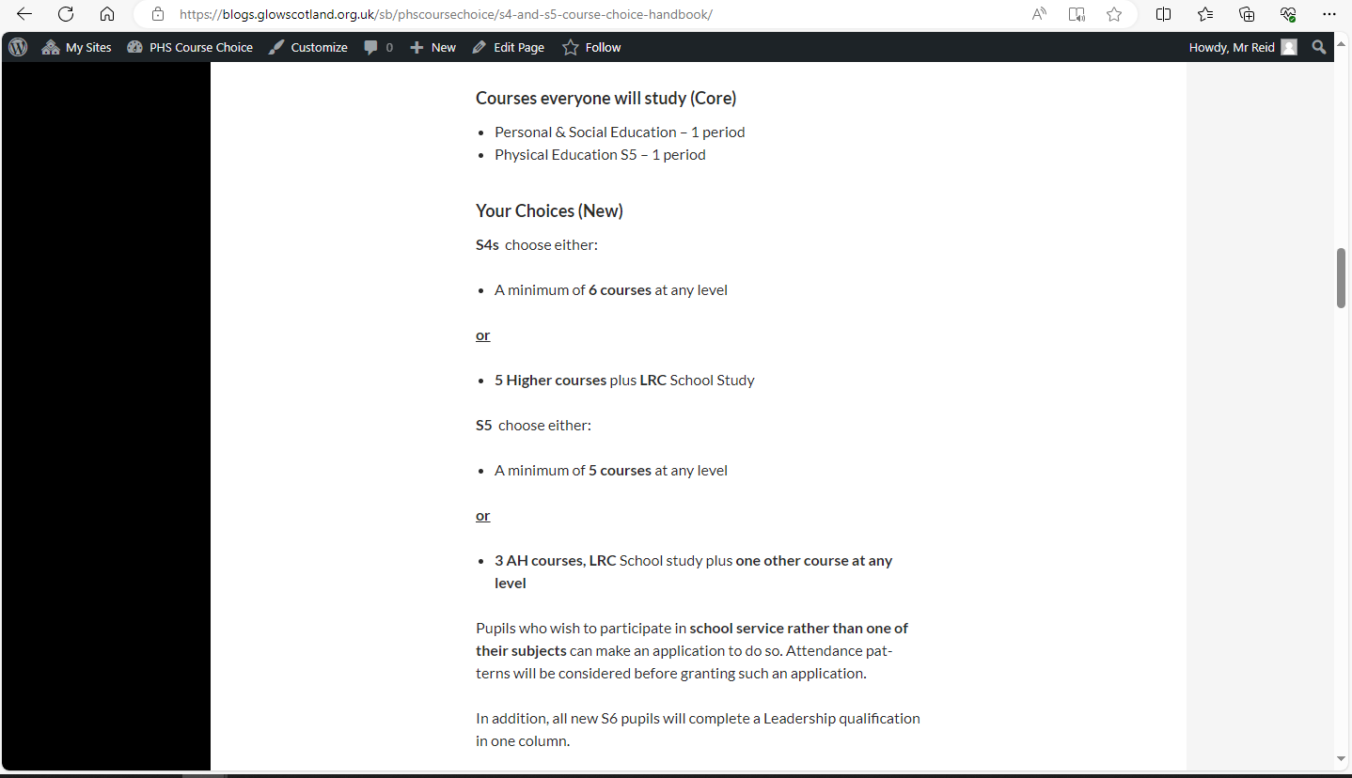

Slide 17
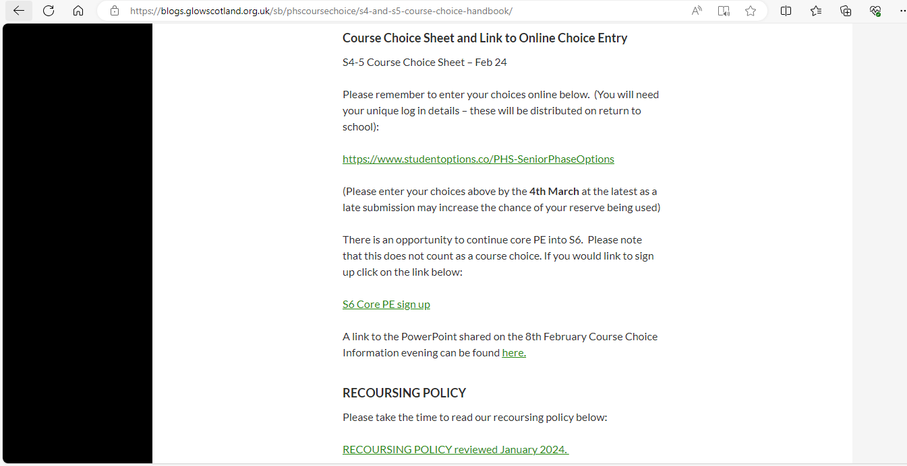

Slide 18
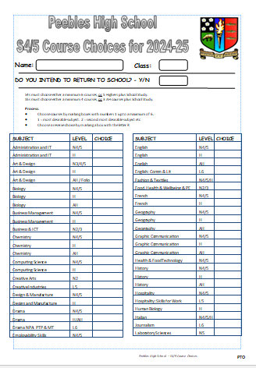

Slide 19
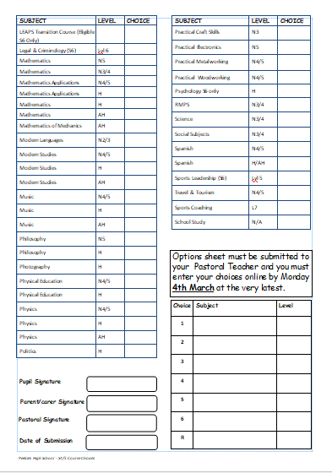
8th

Slide 20
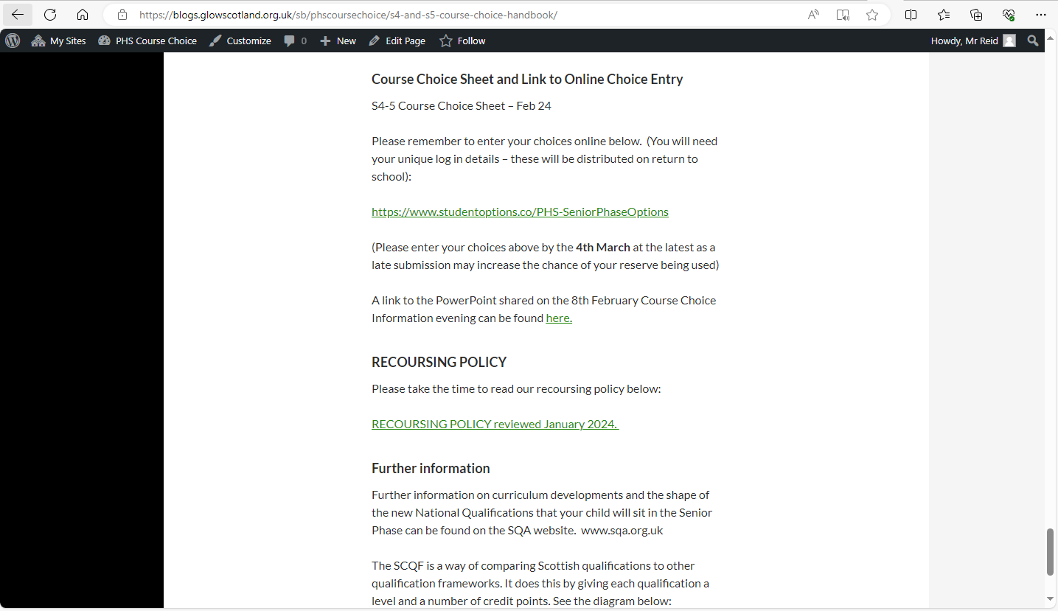

Slide 26
How will my child be supported?

Slide 27
How will my child be supported?
PSE programme – Choices/Careers
MWoW and Planit Plus
Course descriptors
Progression levels
Career routes/paths
Personal research
Q&A sessions
Practise entering choices in Tools
Reassurance and emotional support
Interview with Pastoral Teacher
1:1 interview with Mr Conway, Skills Development Scotland (targeted young people)

Slide 28
Points of contact for parents/carers
4C1 - Mrs Robertson
4C2 - Mrs milligen
4C3 – Mrs Milligen
4D1 – Miss riddell
4D2 – Mr Shirra-Gibb
4D3 – Mr shirra-gibb
4M1 – Mrs Ferguson
4M2 - Mrs ferguson
4M3 – Mrs Boyd
5C1 – Mrs Robertson
5C2 – Mrs robertson
5C3 – Mrs milligen
5D1 – Miss riddell
5D2 – Mr Shirra-Gibb
5D3 – Miss riddell
5M1 – Mrs ferguson
5M2 – Mrs boyd
5M3 – Mrs Boyd

Slide 29
What can parents do?
Access the online supports
Read through course descriptors with your child
Encourage your child to do some personal research
Use the course choice preparation form as a prompt for discussion with your child
Listen to your child
www.myworldofwork.co.uk
www.skillsdevelopmentscotland.co.uk
https://www.planitplus.net

Slide 30
Timeline
8th February: S4/5 course choice handbook for 2022-23 will go live on the website
8th February: course choice preparation form to support course choice conversations at home will be on the website
26th February: Pastoral S4/5 interviews begin
26th February: S4/5 reports issued
From 6th February: targeted 1:1 interviews with Skills Development Scotland (Mr Conway)
8th march: S4/5 Options completion deadline. Please note that this is online and should be done with parents at home (as per Mr Reid’s presentation)

