Slide 1
15th January 2024
S3 Course Choice Information
Mr Wilson: introduction
Mr Reid: the process
Mrs Moretta: support

Slide 2
Making the right decisions:

Slide 3
Course choice evening s3
11th January 2024

Slide 4
The Process
Course choice website
Core and elective courses
Course choice sheet
How to input choices

Slide 7
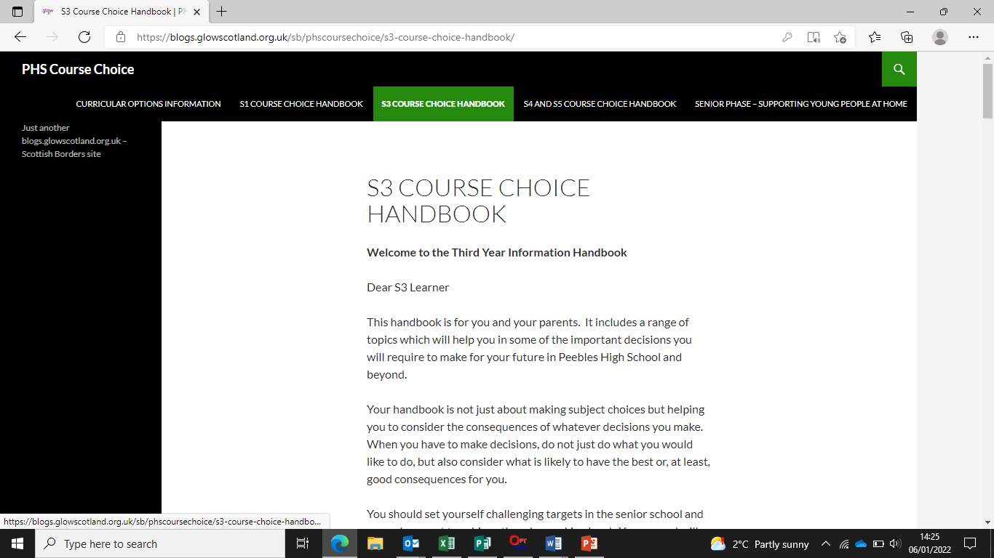

Slide 8
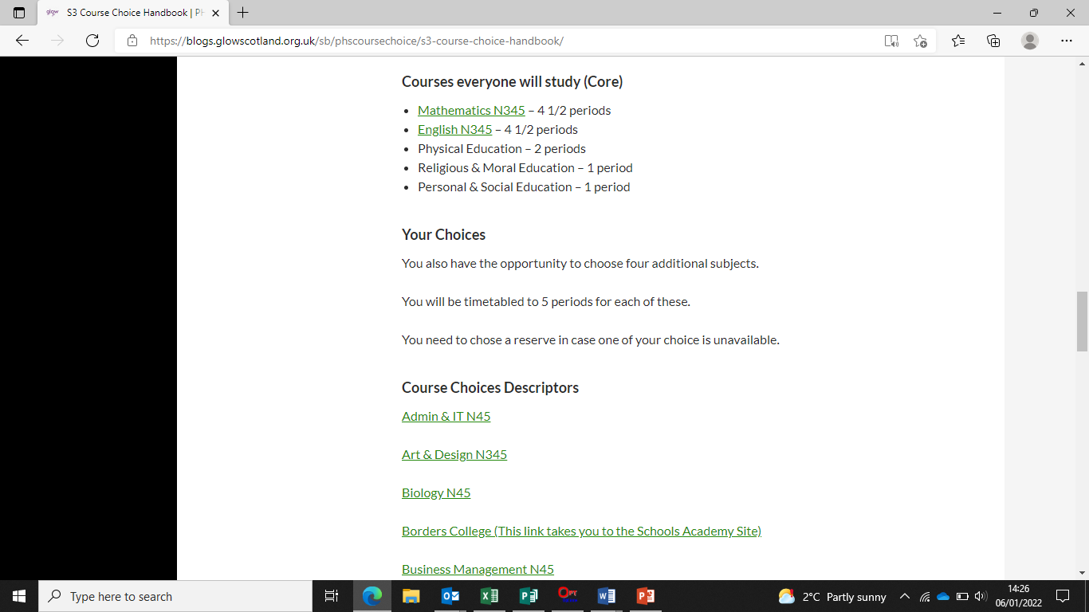

Slide 9
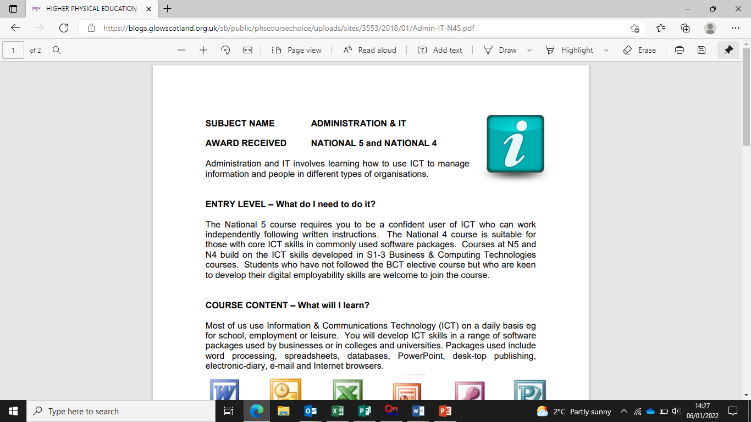

Slide 13
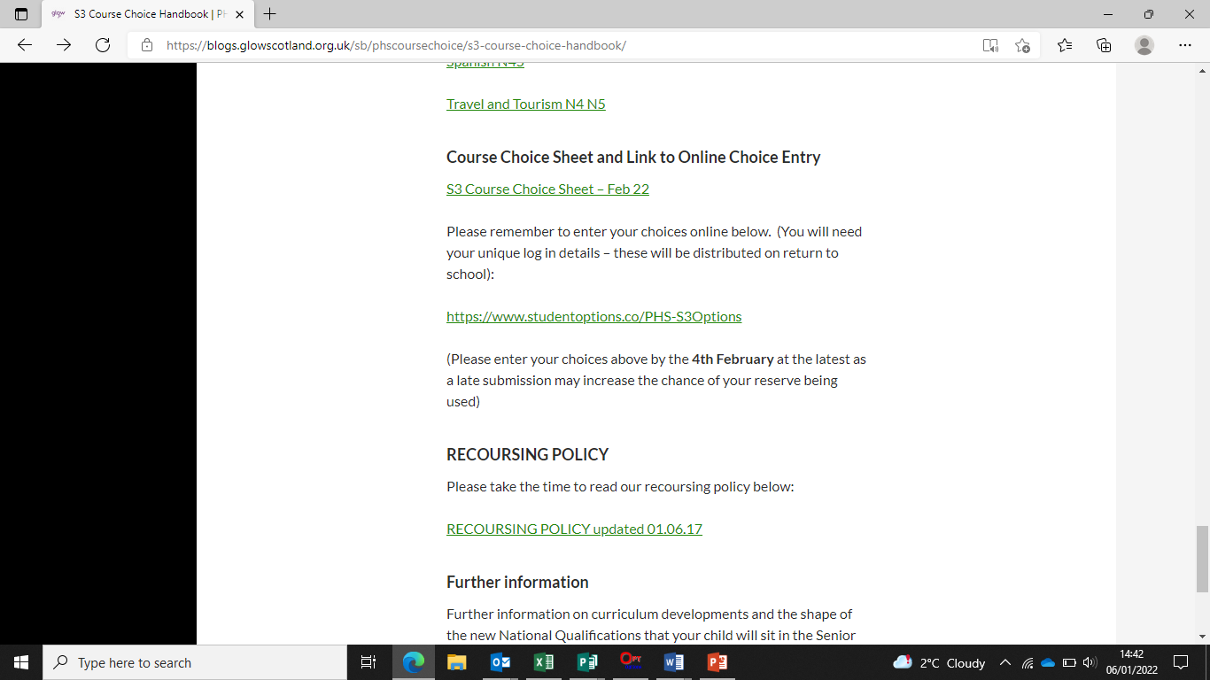

Slide 14
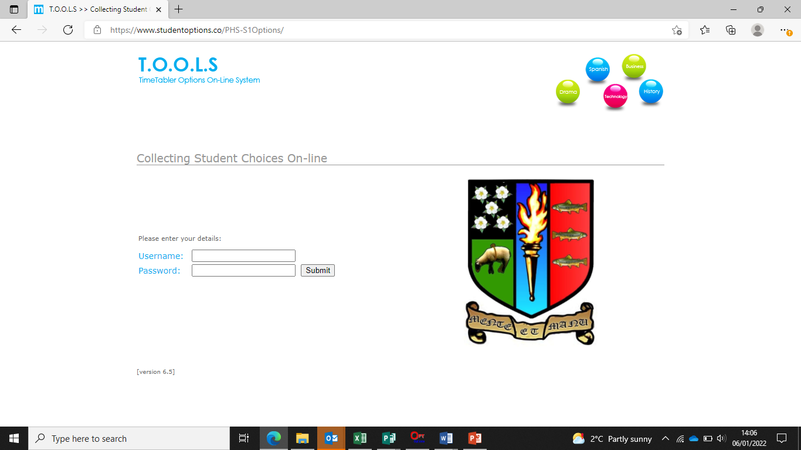

Slide 18
How will my child be supported?

Slide 19
How will my child be supported?
PSE programme – Choices/Careers
MWoW and Planit Plus
Course descriptors
Progression levels
Career routes/paths
Personal research
Q&A sessions
Practise entering choices in Tools
Reassurance and emotional support
Interview with Pastoral Teacher
1:1 interview with Mr Conway, Skills Development Scotland
SDS groupwork in PSE

Slide 20
Points of contact for parents
3C1 - Mrs Milligen
3C2 - Mrs Robertson
3C3 – Mrs Milligen
3D1 – Miss Riddell
3D2 – Mr Miss Riddell
3D3 – Mr Shirra-Gibb
3M1 – Mrs Ferguson
3M2 - Mrs Ferguson
3M3 – Mrs Boyd

Slide 21
What can parents do?
Access the online supports
Read through course descriptors with your child
Encourage your child to do some personal research
Use the course choice preparation form as a prompt for discussion with your child
Listen to your child
www.myworldofwork.co.uk
www.skillsdevelopmentscotland.co.uk
https://www.planitplus.net

Slide 22
Timeline
From December: all young people in S3 offered a 1:1 interview with Skills Development Scotland which will continue until deadline (Mr Conway)
20th December: S3 reports issued
15th January: S3 course choice handbook for 2024-25 will go live on the website
15th January: course choice preparation form to support course choice conversations at home will be on the website
15th January: S3 Pastoral interviews begin
2nd February: S3 Options completion deadline. Please note that this is online and should be done with parents at home (as per Mr Reid’s presentation)

Slide 23
PHS S3 Work Placement
Veronica Boyd
PT Pastoral
DYW Link/S3 Work Placement Co-ordinator

Slide 24
2024 Options
Choose any one week in May
Choose from list of approved providers (48 local to PHS catchment)
Do NOT contact approved company directly at this point
Find your own – contact directly
2023 – 137 students went on placement at 72 different providers

Slide 25
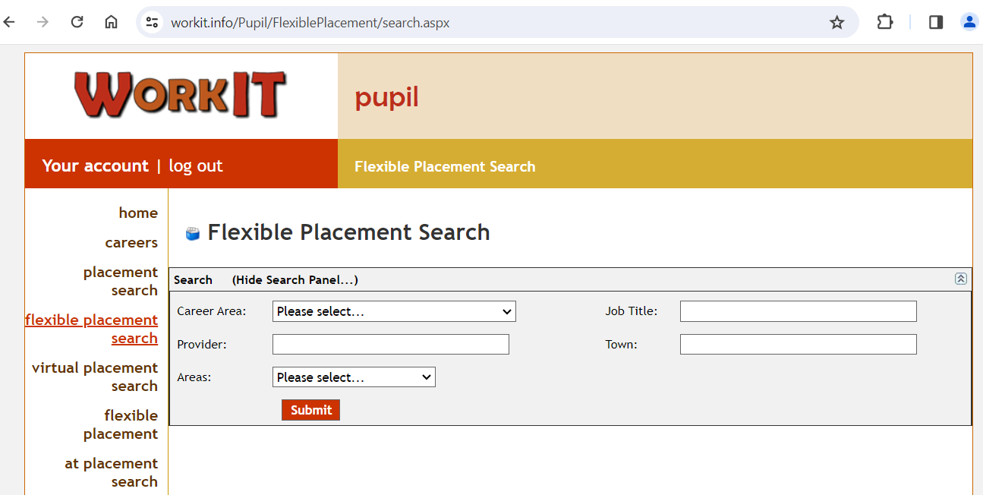
Approved Provider Route
Pupils Access Workit using https://www.workit.info/Careers/default.aspx
Navigate through Find an Opportunity/On Site Placement/Flexible Placement
Select Peebles Area
View and Select opportunities
Complete preferred week and then SUBMIT

Slide 26
Independent Provider
Must have £10 million in Employer Liability (not Public Liability)
Student needs to make direct contact with company
Use family/friend networks
Can take up to 6-8 weeks to be approved (depending on industry sector/H & S)
Provider needs to complete Googleform (Link on Welcome email)
https://tinyurl.com/bordersplacement

Slide 27
Support Resources
WorkIt website
My World of Work Tools
DYW Workplace Learning Advice (paper)
PHS Work Placement Checklist (paper)
SQA Work Placement Logbook (electronic on Showbie)
All resources will be made available in Files section of S3 Team

Slide 28
Deadlines/Key Dates*
Task | Due Date
Check Workit email/login details | Now
Placement request submitted (for both routes) | 20 February 2024
Approved Provider Placements Allocated and confirmed | w/b 4 March 2024
Independent Provider Placements confirmed | As processed by Gateway
Student introductory contact (in writing) | Within 2 weeks of notification of placement
Parental Permission Slip | ASAP but no less than 2 weeks before placement starts
Completed SQA (including employerWorkbook on Showbie for Pastoral Teacher to approve) | 14 June
* Due to number of students involved we are unable to accept submissions received after the deadline

Slide 29
Key Considerations
Independent travel required
Consider “like” opportunities if unable to get exact type of placement
Use networks
Make timely contact with key information
School trips? Check first.
Have you completed the Preferred Pathways survey? (important if places oversubscribed)
Meet the deadlines to ensure you can go out on placement

Slide 30
Any Questions?
Email me on vboyd@scotborders.gov.uk

