Slide 1
15th January 2024
S1 Course Choice Information Evening
Mr Wilson: introduction
Mr Reid: the process
Mrs Moretta: support

Slide 2
Making the right decisions:

Slide 3
Course choice evening s1
15th January 2024

Slide 4
The Process
Course choice website
Core and elective courses
Course choice sheet
How to input choices

Slide 5
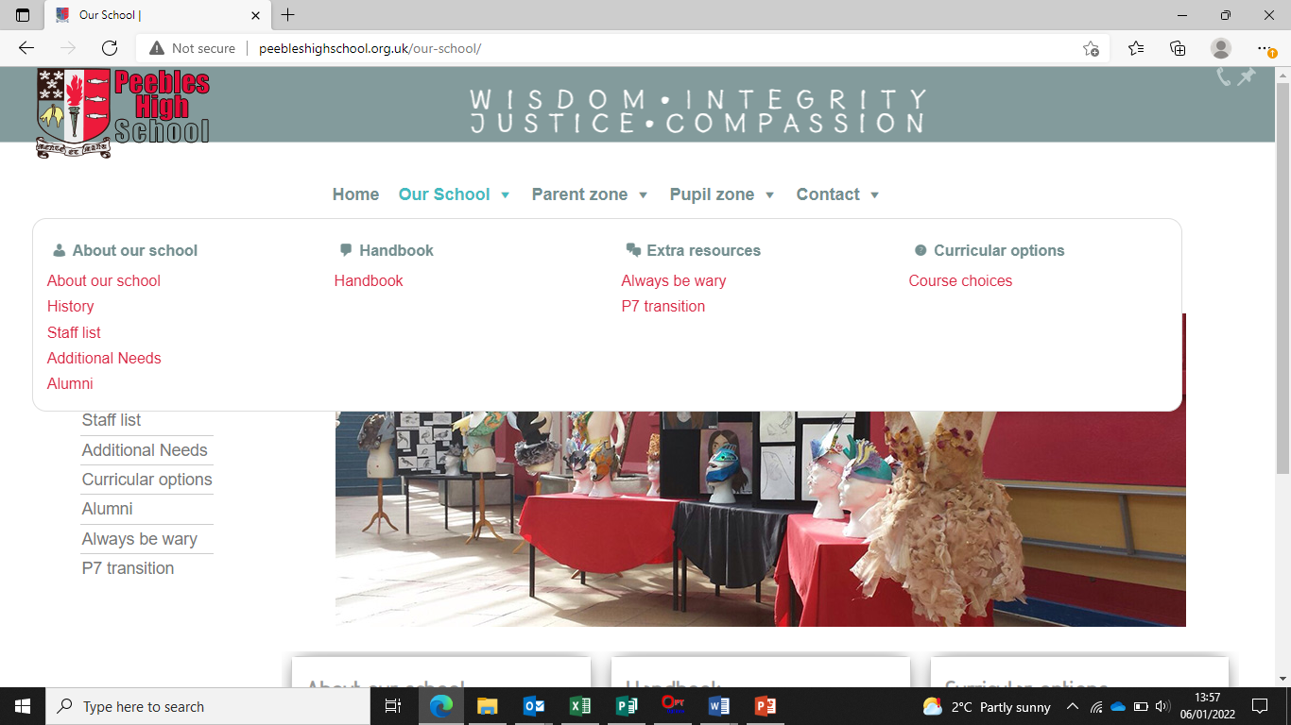

Slide 8
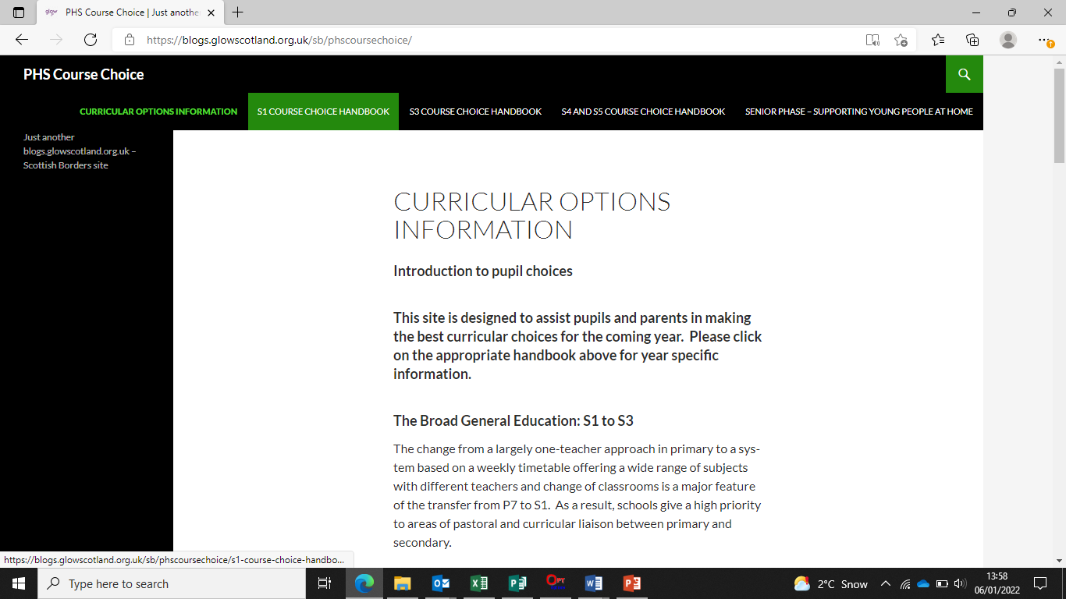

Slide 9
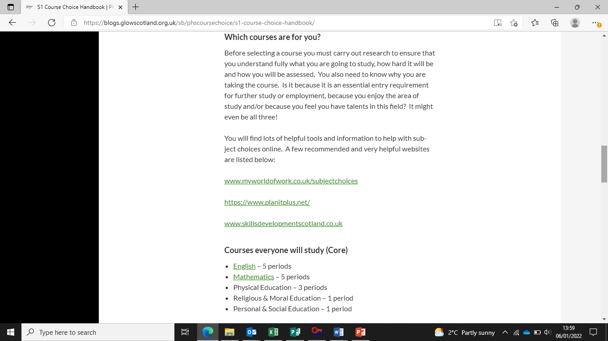

Slide 10
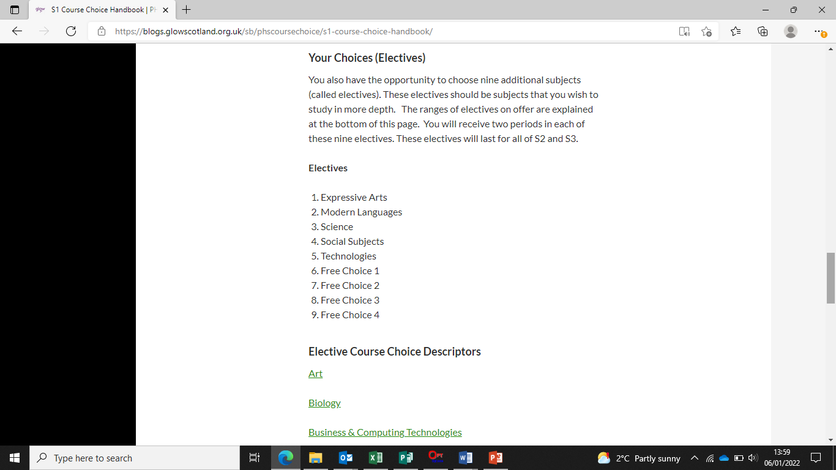

Slide 11
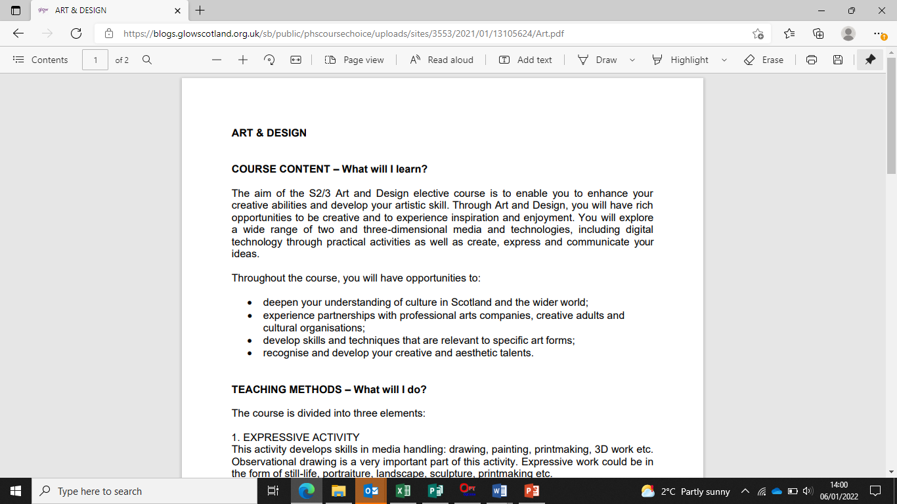

Slide 12
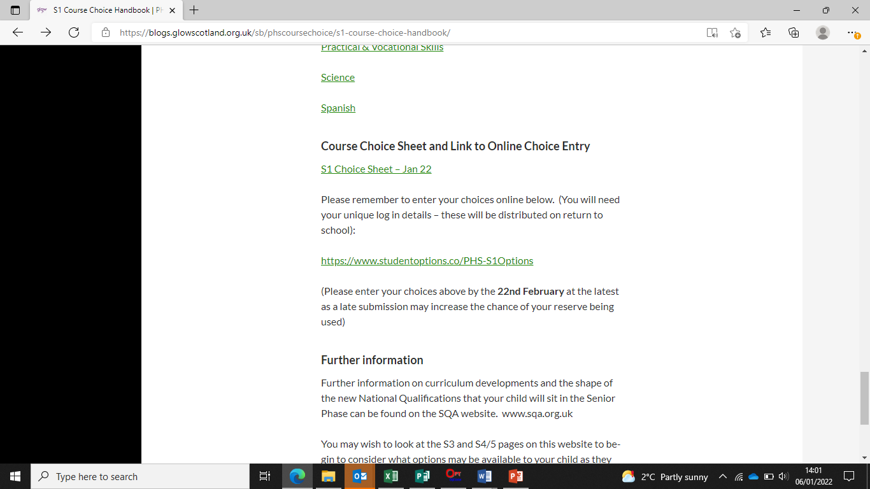

Slide 16
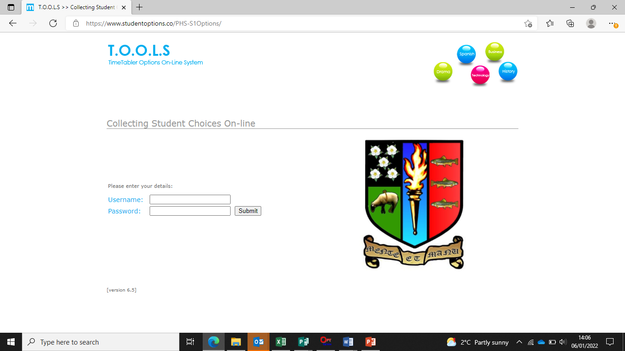

Slide 20
January 2022
S1 Course Choice Information

Slide 21
How will my child be supported?

Slide 22
How will my child be supported?
PSE programme – Choices/Careers
MWoW and Planit Plus
Course descriptors
Progression levels
Career routes/paths
Personal research
Q&A sessions
Practise entering choices in Tools
Reassurance and emotional support
Interview with Pastoral Teacher
1:1 interview with Mr Conway, Skills Development Scotland
SDS groupwork in PSE

Slide 23
Points of contact for parents
1C1 – Mrs Milligen
1C2 - Mrs Milligen
1C3 – Mrs Robertson
1D1 - Mr Shirra-Gibb
1D2 – Mr Shirra-Gibb
1D3 – Miss Riddell
1M1 – Mrs Boyd
1M2 - Mrs Boyd
1M3 – Mrs Ferguson

Slide 24
What can parents do?
Access the online supports
Read through course descriptors with your child
Encourage your child to do some personal research
Use the course choice preparation form as a prompt for discussion with your child
Listen to your child
www.myworldofwork.co.uk
www.skillsdevelopmentscotland.co.uk
https://www.planitplus.net

Slide 25
Timeline
15th January: S1 course choice handbook for 2024-25 will go live on the website
15th January: course choice preparation form to support course choice conversations at home will be on the website
22nd January: S1 Pastoral interviews begin
29th January: S1 reports will be issued
20th February: S1 Options completion deadline. Please note that this is online and should be done with parents at home (as per Mr Reid’s presentation)

