Slide 1
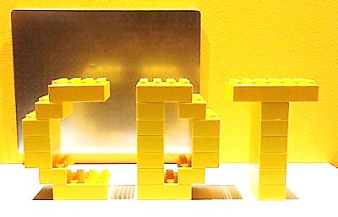
Practical Woodworking/Metalworking
National 4/5

Slide 2
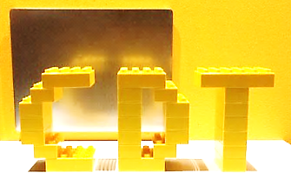
Course Outline
Learning each course is split into 3 sections or units.
Practical Woodworking
Machining & finishing
Carcase construction
Flat frame construction
Practical Metalworking
Bench Skills
Machine processes
Fabrication & thermal joining
In both Units, you will gain knowledge and understanding of design and manufacturing technologies and how these impact on our environment and society.

Slide 3
Course Assessment
Final Assessment is normally split into 2 sections.
However modifications from last session remain in place where the question paper element has been removed for session 2021-22
Practical Assignment
70 marks
Internally marked and externally moderated
Manufacturing task with logbook issued by SQA.
Completed in class time and submitted before Easter Break.
Question Paper (Removed for session 2021-22)

Slide 4
Course Assessment
There are 2 course models with test pieces for each unit/section in woodwork and 4 models for metalwork.
Each model in the course is supported by a candidate logbook.
The models and log-books form part of a students evidence at all levels for session 2021-22.

Slide 5
Homework
Homework tasks will be issued to support the theory associated with each unit.
Details shared on SMHW and class TEAM, students are encouraged to set own reminders.
Completed on sheet and submitted for feedback.
Pupil log books completed in class will support this process.
Additional homework may be given throughout year to complete log-book tasks set in class.

Slide 6
Support materials
Additional support materials can be found in the following locations:
SQA subject website
Various CDT websites
technologystudent.com
jambledandt.com
NPF nutshell revision page
BBC bitesize

Slide 7
Additional Teacher Support
The CDT Department has open door policy, with all staff willing to support.
Specific times for support are available upon request to staff at lunchtimes.
Remember ‘Free periods’ are really study periods and staff may also be able to help then.

