Slide 1
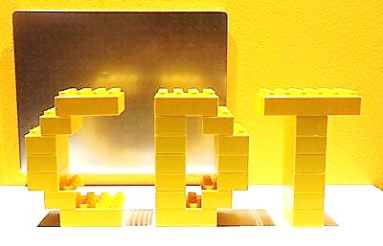
Graphic Communication
ADVANCED HIGHER,
HIGHER + NATIONAL 5

Slide 2
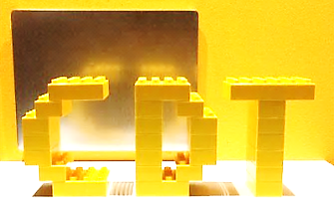
Course Outline
Learning is split into sections or units. At National 5 and Higher level these are:
2D Graphics (Manual & CAD based)
3D Graphics (Manual & CAD based)
At Advanced Higher level these sections are:
Commercial Visual Media
Technical Graphics

Slide 3
Homework
Homework tasks will be issued on a unitary basis.
Complete outstanding manual and CAD based units for a certain date.
Text books are available to support this.

Slide 4
Course Assessment: Adv. HIGHER
At Advanced Higher level, the final Assessment is also split into 2 sections.
Design Assignment (Externally marked)
Marked out of 60
(reduced from 90 for session 2021-22)
Extended Graphics Assignment from a chosen theme/product.
Completed in class and submitted before Easter Break.
Question Paper (Externally marked)
Marked out of 80
(reduced from 90 for session 2021-21)
Prelim/Formal assessment opportunity in early 2021
(provides estimate of potential grade)
Final exam in May

Slide 5
Course Assessment: HIGHER
At Higher level, the final Assessment is also split into 2 sections.
Design Assignment (Externally marked)
Marked out of 50
8 hour Graphics Assignment from a given theme/product.
Completed in class and submitted before Easter Break.
Question Paper (Externally marked)
Marked out of 75
(Reduced from 90 marks for session 2021-22)
Prelim/Formal assessment opportunity in early 2022
(provides estimate of potential grade)
Final exam in May 2022

Slide 6
Course Assessment: N5
At N5 Level, evidence of attainment will be gathered across 2 sections.
In addition to this, evidence will gathered through a number of coursework projects set throughout the year.
Design Assignment (Externally marked)
Marked out of 40
8 hour Graphics Assignment from a given theme/product.
Completed in class and submitted before Easter Break.
Question Paper (Externally marked)
Marked out of 65
(Reduced from 980 marks for session 2021-22)
Prelim/Formal assessment opportunity in early 2022
(provides estimate of potential grade)
Final exam in May 2022

Slide 7
Support materials
Additional support materials can be found in the following locations:
Course notes
SQA website
Various CDT websites
Leckie & Leckie website
PHS shared area
Class TEAM

Slide 8
Additional Teacher Support
Department has open door policy, all staff willing to support.
Specific times for support are available upon request to staff
Remember ‘Free periods’ are really study periods and staff may also be able to help then.

Slide 9
What you can do to support?
Ask to see their Presentation Folder
Ask them what manual/computer based project they are currently working on.
Ask them to bring their everyday folder home so you can have a look. If it is full then there are probably some drawings that have not been finished. These should be completed and put in their Presentation Folder

