Slide 1
Higher Geography

Slide 2
What does Higher Geography involve?
 | Course area | Topics
Exam paper 1 (100 marks;1 hour 50 mins). | Section 1: Physical geography: (50 marks) | Hydrosphere
 |  | Biosphere
 |  | Lithosphere
 |  | Atmosphere
 | Section 2: Human geography: (50marks) | Rural
 |  | Urban
 |  | Population
Exam paper 2 (40 marks; 50mins). | Section 3: Global Issues: Development and Health (20 marks | Development and Health
 | Section 4: Application of Geographical Skills (20 marks) | Variety of OS map-based scenarios

Slide 3
Assessment arrangements
End of unit class tests for all topics – generally one test with two topics.
Timed questions in class.
Prelim TBC.
Final exam – 27th April 2022.

Slide 4
Revision/study
Higher Geography skills booklet.
Each topic has a list of possible exam questions and a checklist to aid revision.
SQA past papers (Qs and answers) available online.
BrightRED and Hodder and Gibson study guides available to buy online.
All notes and PowerPoints used on Teams.
Pupils can request additional help (e.g.: at lunchtimes and during study leave) by contacting teacher via Glow email or Teams.

Slide 5
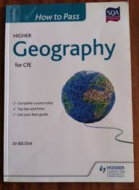
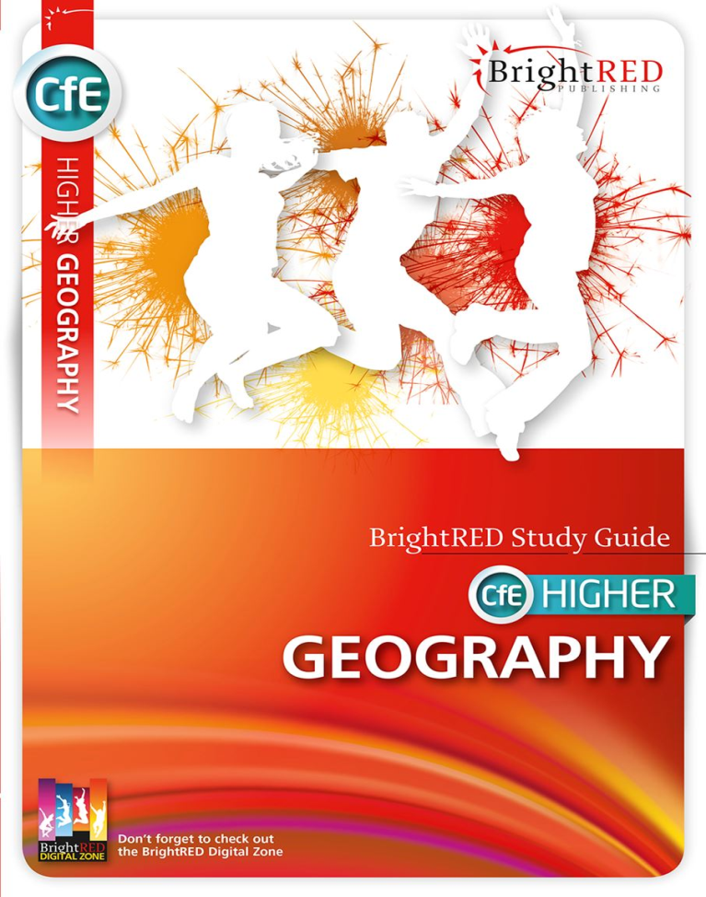
Revision guides

Slide 6
What can you do?
Help with revision (e.g. asking questions using their notes). Course content/PowerPoints available on Teams if your child logs in.
Be a sounding board.
Provide a quiet working space for revision – ‘Power Hour’
Feed them and encourage good sleep/study/downtime habits.

