Slide 1
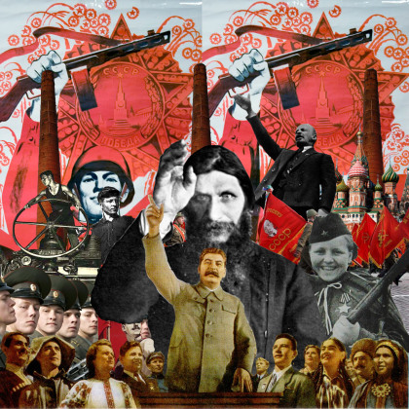
Advanced Higher History
Russia: from Tsarism to Stalinism, 1914-45
Teacher: Ms Watterson

Slide 2
How is the course assessed?
SQA Exam
90 marks (64%)
3 hours
2 essays
3 source skill questions
Dissertation
50 marks (36%)
completed in class/at home

Slide 3
Where can course content be found?
Textbook: The textbook is the main source of information. Students have access to hard copy and a digital copy of this on their iPads.
Notebook: Class work and course information can be found on the Notebook app. Students have the choice between completing work on Notebook or in a jotter.
Teams: Links to relevant articles/websites/podcasts are posted on Teams for students to access.
Books/Internet: There is a large amount of books available in class for students to borrow. Some books and articles can also be found online using Google Books.

Slide 4
Class Assessments/Homework
Class Assessments: There is a timed essay at the end of each of the topics. There will also be timed source questions throughout the year.
Homework: Homework is a mixture of reading, preparation for essays, preparation for source questions and the on-going dissertation task.
Dissertation: Started in September. Final copy submitted by the end of March (see next slide)

Slide 5
The Dissertation
The AH dissertation is a 4000 word piece of individual research and writing which we began in September. All pupils have been asked to choose a question and should have written at least an introduction and two main chapters by now.
The dissertation will not be marked in school but students will be provided with feedback throughout the year.
The final piece will be due at the end of March.
Pupils are encouraged to ask family members/friends to read over their dissertation to check for grammatical errors.
A detailed description of what is entailed can be found on the SQA website and in the students’ Notebooks.

Slide 6
The Prelim
The Prelim will consist of unseen essay questions and source questions based on the elements of the course that we have covered so far.
To prepare for this, students should engage in regular revision. They should use class notes, the textbook, previous essays + essay plans, previous source questions and SQA past papers and marking instructions.
They should look carefully at their feedback record (found in their Notebook) in order to identify what they need to improve on.
Some students find making mind maps or flashcards helpful. Others will benefit from practising exam style questions.
They need to pay particular attention to remembering detailed statistics and examples from the course as well as relevant examples of historiography for each topic.

Slide 7
What can you do to help?
Ask your young person about key topics e.g. February Revolution, October Revolution, Civil War, Stalin
Look out for documentaries on Russian history (there are quite a few on BBC iPlayer and Netflix)
Encourage your young person to stick to the agreed deadlines or ask for an extension if necessary.
Read over practice essays and dissertation chapters and tell them if anything doesn’t make sense to you as the reader.
Encourage your young person to create revision materials.
Quiz students on the thoughts of different historians (they should be able to provide you with key names and ideas for every topic)

Slide 8
Further Support
Staff: Students can ask Ms Watterson for support either in person or via Teams. They can also post more generic questions to the Teams page for either the teacher or their peers to answer.
SQA: SQA past papers + marking instructions are available on the SQA website. The Understanding Standards website also provides good exemplar answers.

