Slide 1
Higher History
A guide for parents and carers

Slide 2
Qualifications for the Course
The most suitable qualification for Higher History is a good pass at N5 History. This is because some of the skills at N5 are applicable at Higher, though the performance level will be more demanding.
Students who have not studied History before Higher will require to have a pass at N5 or better in another Social Subject.
Students not meeting either of the key requirements may be admitted after discussion with Ms Watterson, the Faculty Head.

Slide 3
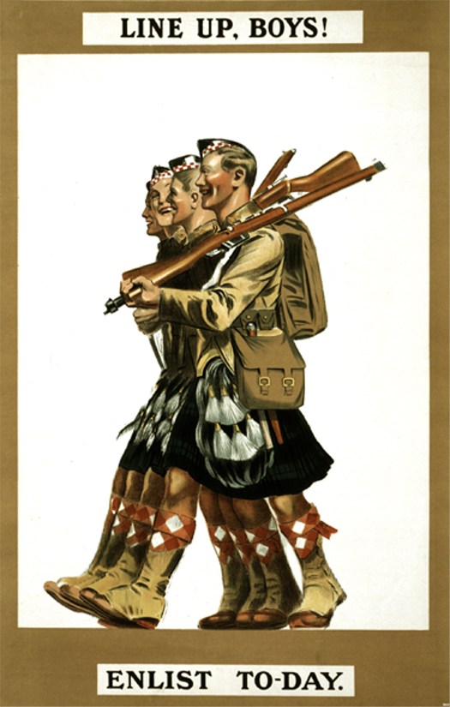
Course Content Cont.
Section 1 – Scottish
Scotland and the Impact of the Great War 1914 – 1928
The Scots on the Western Front.
The impact of war on Scottish society.
The impact of war on the Scottish economy.
The impact of war on Scottish politics.

Slide 4
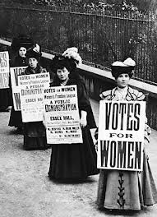
Course Content Cont.
Section 2 – British
Britain 1851-1951
The women's suffrage movement up to 1928.
The Liberal governments 1906-1914 and the problem of poverty.

Slide 5
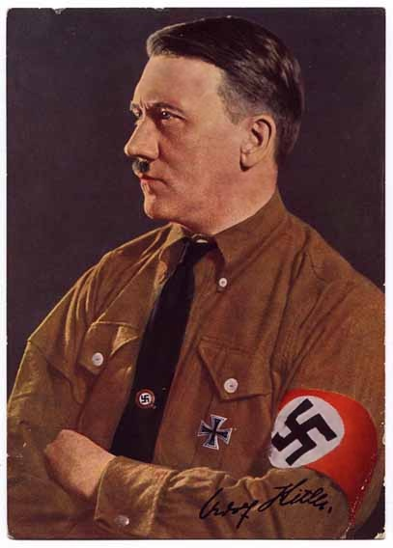
Course Content
Section 3 – European and World
Growth of Nationalism: Germany 1815-1939
The rise to power of the Nazis, 1918-1933.
The Nazis in power, 1933-1939.
The reasons for aggressive Fascist Foreign Policy, 1933-1939.

Slide 6
The Final Grade is made up of…..
The Final Exam – students will have to complete 2 papers (Wednesday 19th May)
Scottish – 36 Marks – 1 hr 30 mins
Questions are worth 8, 10, 10 & 8 marks each – based around all 4 of the Scottish Topics.
British, European and World – 44 marks – 1 hr 30 mins
- One 22 mark essay from the British Unit
- One 22 mark essay from the German Unit
There will no assignment this year for Higher History

Slide 7
What we provide….
Five periods per week of teaching (most weeks…)
An electronic textbook for each unit of learning as well as a skills booklet, supporting students to develop essay writing and source handling skills.
Opportunities for individuals to come with queries at lunchtimes, and/or after school, as issues arise (must be arranged in advance with class teacher following all COVID guidelines).
Pupils can post questions on Teams through the ‘Ask the Teacher Channel’ at any time and they will be answered by the class teacher within a reasonable time frame.
We would like to offer after school- support sessions and workshops at pinch-points, such as before prelims, before the final exam etc but this will depend on current COVID guidelines. Opportunities may arise to utilise Team meetings rather than face to face to offer additional support.

Slide 8
And…..
For much of the year, the Higher Class may well be our top priority with regard to preparation and marking.
The teachers involved meet regularly to discuss the progress of both classes and individuals, to ensure consistency of assessment marking, to ensure momentum is maintained and for simple transmission of information. The amount of cooperation between colleagues is extensive and we work as a team throughout.

Slide 9
What else?
The History department is using Teams to allow students to access extensive support materials, including course descriptors, PowerPoints, textbooks, screen-recordings, skills booklets and many more resources.
Students can access a range of support materials and past papers/marking instructions via the SQA website.
This year all tasks have been set via Teams and/or OneNote. This means pupils can take responsibility for their own learning and catch up on any work missed.
Pupils have been completed or uploading all their class notes, homework and assessments on to their History OneNote. This means there is an electronic version of written work for pupils and teachers to refer to at all times.

Slide 10
What you could do to support your child…..
Textbooks – pupils are provided with hard copy and electronic versions of the 2 main textbooks we use. These can be located in the relevant Team files folders.
It’s very important for your child to flesh out notes taken in class with extra detail/analysis.
If you think your child would benefit from a paper copy of these then relevant information is on the following slide.

Slide 11
John A. Kerr and James McGonigle
New Higher History- Britain & Scotland and Germany

Slide 12
John A. Kerr
Scotland and the Impact of the Great War 1914-1928

Slide 13
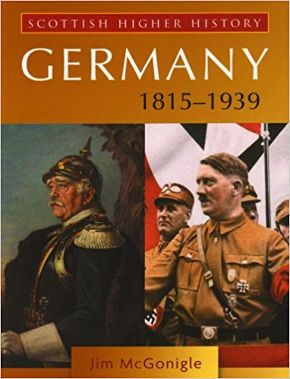
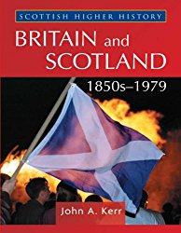
These are also available separately

Slide 14
Support students in taking responsibility for their own learning
Students will be given homework regularly – this may involve essay preparation, fleshing out of notes, reading around a topic, watching a documentary or other tasks. We really appreciate your support in encouraging your child to DO the tasks we set them.
Notice WILL be given for major assessments and students will rarely be given homework for the next day.
Senior students are expected to organise their homework accordingly.

Slide 15
What if my child is absent?
Good attendance is VITAL to the success of every Higher candidate, regardless of ability.
Missed lessons mean missed content but also, more importantly, missed teacher input and class discussion, both of which are critical to achieving success.
We will be pro-active in encouraging full attendance, as well as in supporting students who do have unavoidable absences to catch up.
Pupils that have been asked to isolate will receive all lesson content as normal and will be invited to attend a live Teams call through the ‘Isolation’ channel for every lesson to participate live will their teacher and classmates. If they require further support try should be proactive in contacting their teacher either via email or through Teams.
We would appreciate your support in encouraging students to attend every lesson as far as possible, on time and with the necessary materials.

Slide 16
Assessments
We WILL do our very best to support your child to pass all the assessments required in the course.
We WON’T “spoon-feed” them or write essays/responses for them, nor will we accept work that has been copied and pasted from the internet, plagiarised from another source or otherwise clearly not the student’s own work.
Most assessments will be done in the classroom and under timed conditions. Some will involve the use of a pre-prepared plan or the skills booklet, some won’t, and students will be advised accordingly regarding preparation for assessments.
We are happy to mark extra essays, past paper practice responses and rough plans, if students wish as part of their prelim and exam preparation.

Slide 17
Assessment Timeline
September – Women and the Vote essay
October – Liberals Issue 4 essay
November – Liberals Issue 5 essay
December – Scottish Test
January – prelim, date TBC
February – Rise of Nazis essay
March - Nazis in Power essay
April – Fascist Foreign Policy essay

Slide 18
To sum up…..

