Slide 1
Higher Modern Studies

Slide 2
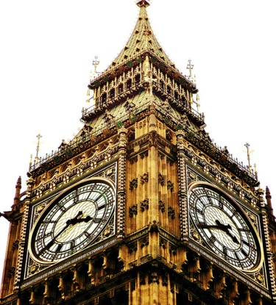
Higher Modern Studies
Overview of the course (3 units):
Democracy in Scotland and the UK
- Democracy in Scotland (and in the UK)
Social Issues:
- Social Inequality in the UK
International Issues:
- A study of a major world power / G20 country (USA)

Slide 3
Democracy in Scotland and the UK
The UK constitutional arrangements, including the role of the Scottish Parliament and other devolved bodies, and the impact of UK membership of the EU. On-going debates about the nature of the political system in the UK.
The study of representative democracy in Scotland
The impact of voting systems and a range of factors which affect voting behaviour in Scotland and the UK.
The ways in which citizens are informed about, participate in, and influence the political process in Scotland and the rest of the UK.

Slide 4
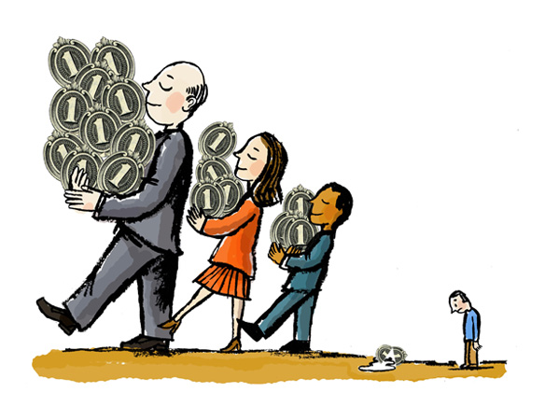
Social Inequality in the UK
The nature of social inequality in the UK.
Theories and causes of inequalities.
The impact of inequality on specific groups in society.
Attempts to tackle inequality and their effectiveness.

Slide 5
International Issues: Study of a G20 country
USA
Political system and processes.
Recent socio-economic issues.
Evaluation of the government in tackling socio-economic issues.
The role of the world power in international relations.

Slide 6
Course Assessment (two parts):
Question Paper 1 (Essays)
Question Paper 2 (Skills)
Question Paper 1 (worth 52 marks)
Time: 1 hours 45 minutes.
Three sections (Democracy, Social Issues and Int. Issues)
3 essays to complete (one 12 marker and two 20 markers- one for each section)
Externally marked by SQA.

Slide 7
Question Paper 2 (worth 28 marks)
Time: 1 hours 15 minutes.
Three questions (Conclusion, to what extent and reliability of sources questions)
All questions must be completed.
Externally marked by SQA.

Slide 8
Homework/Key Dates:
Homework: Mainly in the form of essays/source questions; preparing for timed essays/ Unit Assessments in class; past paper questions. Also, missed work due to absence.
Assessment(s):
November (Unit 1, USA, will be assessed)
January (2 of the 3 units will be assessed – USA and UK Social Issues)
March (remaining issue will be assessed – UK Democracy)
Final exam: 5th May 2021

Slide 9
Additional Support
Staff: pupils can request additional help eg: at lunchtimes and during study leave or by contacting teacher via Glow email or Teams. All course notes/Powerpoints are accessible through One Note/Teams
SQA: past papers/marking instructions available online.
Parents: can encourage students and read essays.

Slide 10
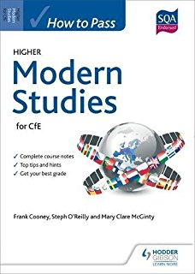
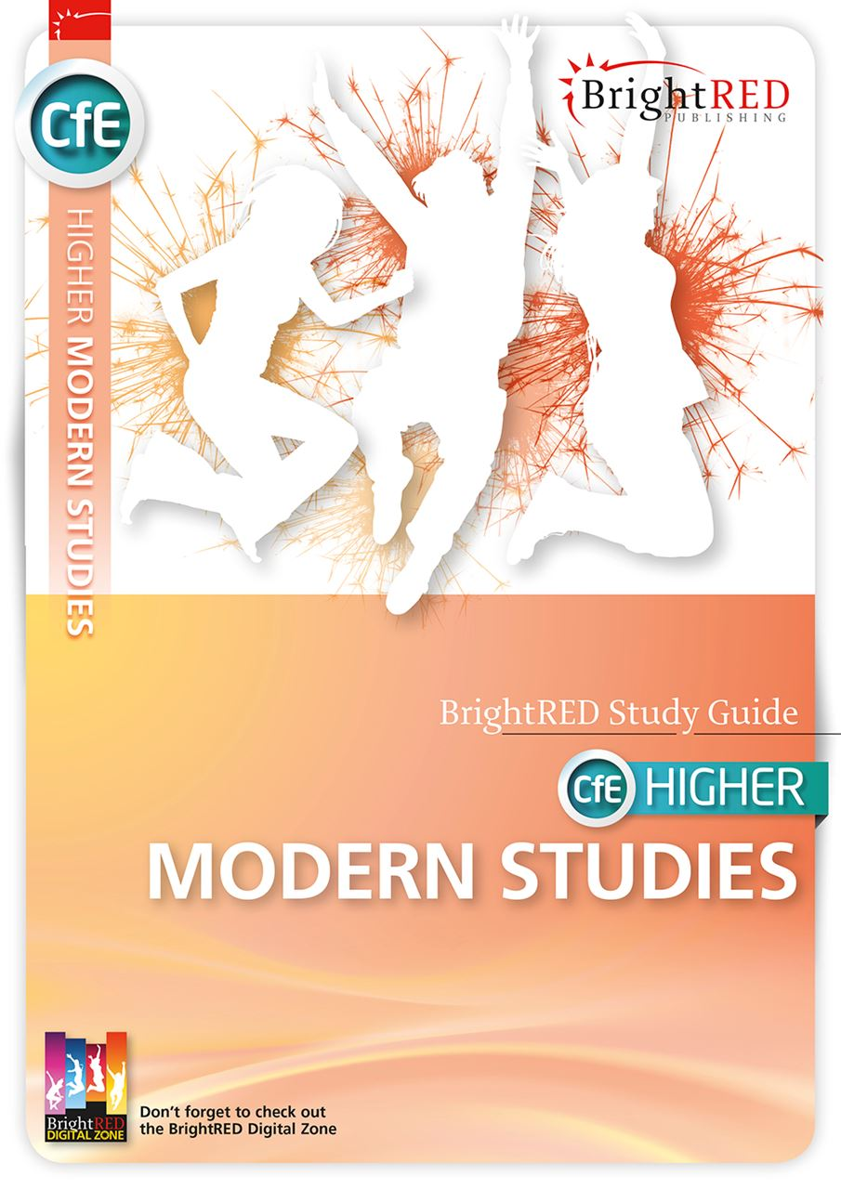
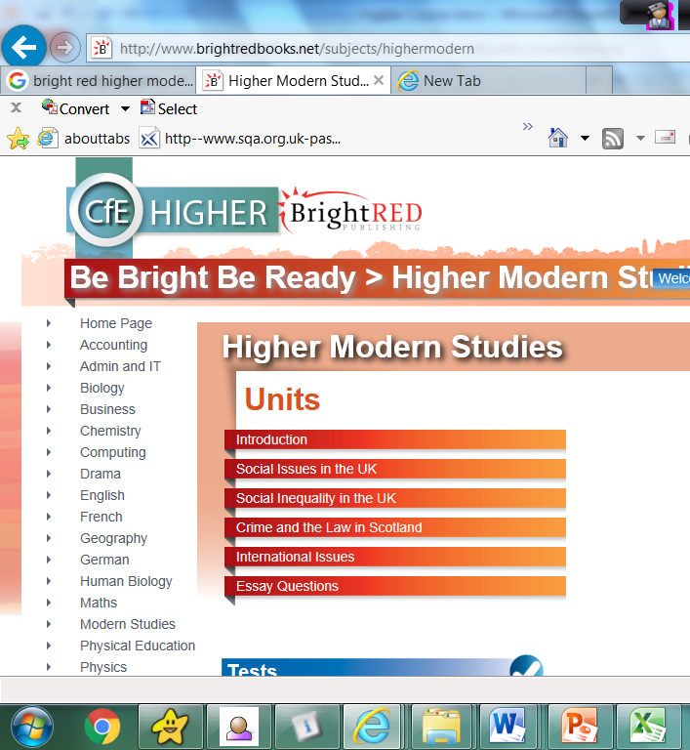
Useful Resources
http://www.brightredbooks.net/subjects/highermodern

