Slide 1
N3/4 Social Subjects
A guide for parents and carers

Slide 2
Overview
Pupils are given the opportunity to study all three Social Subjects at N3/4 level – Modern Studies, History & Geography.
They remain in the same class throughout, studying each subject separately.
Classes are led by a subject specialist teacher for each class:
History – Miss Wylie
Modern Studies – Mr Regan
Geography – Miss Marsden

Slide 3
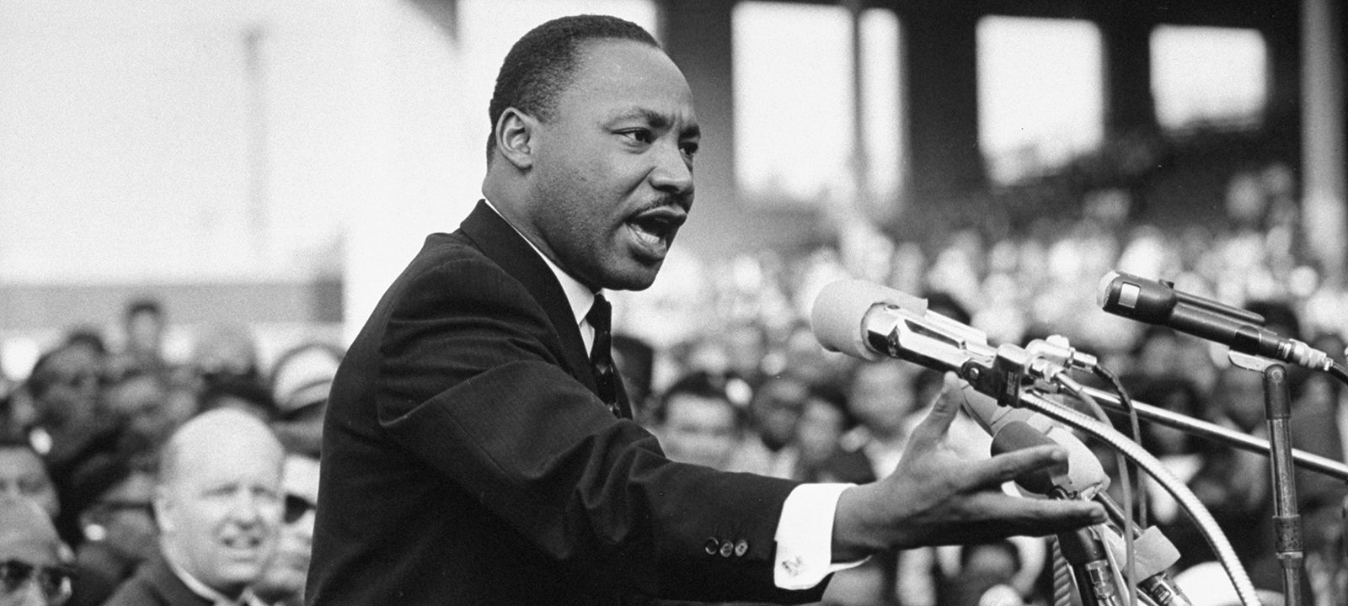
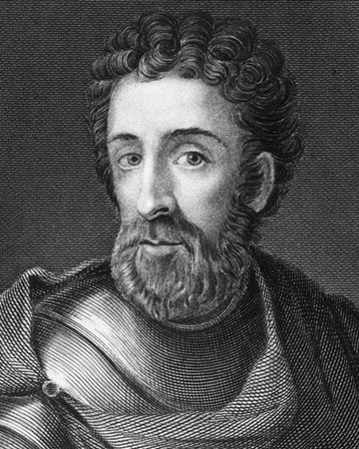
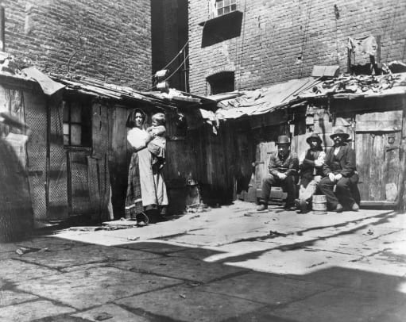
HISTORY
Pupils will study three distinct topics as part of N3/4 History:
Martin Luther King
The Life and Death of William Wallace
City Life

Slide 4
Assessment
Unit 1 – Martin Luther King
Unit 2 – The Life & Death of William Wallace
Unit 3 – City Life
Added Value Unit
* This unit has been removed by the SQA for session 2021-22.
Unit 1 – Martin Luther King
Unit 2 – The Life & Death of William Wallace
Unit 3 – City Life
N4
N3

Slide 5
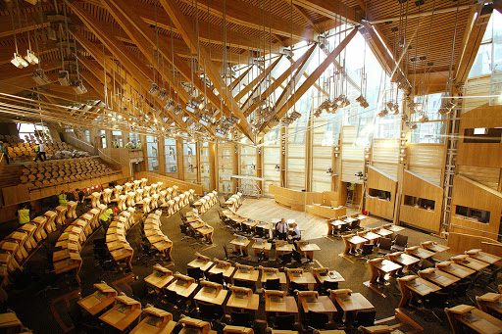
MODERN STUDIES
Pupils will study three distinct topics within N3/4 Modern Studies:
Crime and Law
China
Democracy in Scotland

Slide 6
Assessment
Unit 1 – Crime & Law
Unit 2 – China
Unit 3 – Democracy in Scotland
Added Value Unit
*This unit has been removed by the SQA for session 2021-22.
Unit 1 – Crime & Law
Unit 2 – China
Unit 3 – Democracy in Scotland
N4
N3

Slide 7
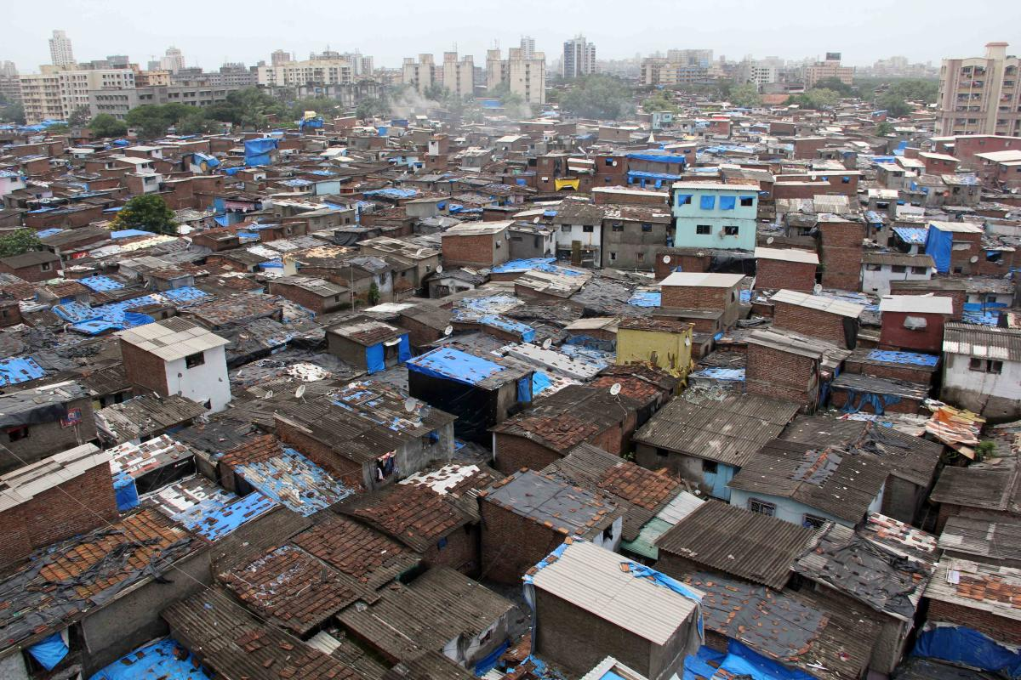
GEOGRAPHY
Pupils will study three distinct topics in N3/4 Geography:
Physical Geography
Human Geography
Global Geography

Slide 8
Assessment
Unit 1 – Physical Geography
Unit 2 – Human Geography
Unit 3 – Global Geography
Added Value Unit
*This unit has been removed by the SQA for session 2021-22.
Unit 1 – Scotland
Unit 2 – Brazil
Unit 3 – China
N4
N3

Slide 9
ASSESSMENT
Pupils will be assessed in class throughout the year by completing unit assessments, designed to meet the outcomes set by the SQA.
These are assessed and marked within the school and details of passes are then sent to the SQA.

Slide 10
Added Value Unit (N4) *Removed this year.
This will be done in class from January to March and N4 pupils will complete one for each of the three Social Subjects.
This is an extended investigation.
Pupils have to choose their own topic (with guidance) and investigate it themselves.
Pupils then choose how to present their findings. This could be as a report, presentation, poster etc.
This is the most demanding part of the N4 course, as pupils really must do it themselves and meet the deadlines set by their teacher.

Slide 11
Added Value Unit (N4)
This will be done in class from January to March.
This is an extended investigation.
Pupils choose their own topic (with guidance) and investigate it themselves.
Pupils then choose how to present their findings. This could be as a report, presentation, poster or anything else that they want to do.
This is the most demanding part of the N4 course, as pupils really must do it themselves and meet the deadlines set by their teacher.

Slide 12
What we provide.
All lessons will be delivered via a combination of Microsoft PowerPoint and OneNote and pupils will access these via their iPads.
Pupils can access these at any time for use in revision or to support them during the AVU.

Slide 13
How can you support your child?
Good attendance is essential, as this course is internally assessed throughout the year.
Catch up – if your child misses any class time, it is extremely important that they catch up with missed work.
Homework – help to create a time and space where pupils can complete homework, by themselves.
Deadlines – please help your child to be organised about recording and meeting deadlines – especially for the Added Value Unit.
Regular check-ins about what your child is doing and what deadlines are coming up would be beneficial.

