Slide 1
Welcome to Higher Politics!!

Slide 2
Course Structure
This course consists of three units:
Political Theories
Power, Authority and Legitimacy
Direct and Representative Democracy
Conservatism and Socialism
Political Systems
Comparing politics in the UK and US
Political Parties and Elections
Political campaigning and voter behaviour
Political ideas

Slide 3
Political Theories
In this unit students learn about key political concepts such as power, authority and legitimacy. We also study the nature of democracy and the arguments for and against representative democracy. Lastly this unit will consider the ideas of two political ideologies – Conservatism and Socialism.

Slide 4
Political Systems
In this unit students study and compare the political systems of the UK and the USA. This will include a study of the relevant power of the executive and legislative branches and the origins and principles that underpin them.

Slide 5
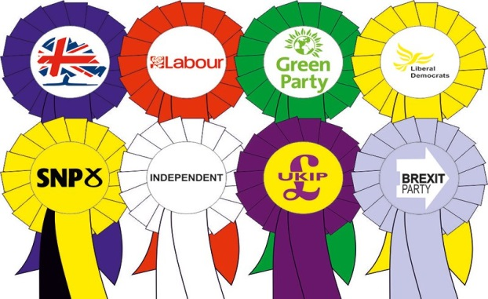
Political Parties and Elections
This unit will focus on the impact of political ideas with a focus on the Conservative Party and the Labour Party.
This will include an examination of political campaigning and voting behaviour.

Slide 6
Exam Structure
Question Paper 1 | 52 Marks | 1 hr 45
Question Paper 2 | 28 Marks | 1 hr 15

Slide 7
The Question Papers
Paper 1:
Two 20 mark essay
One 12 mark essay (Political Parties Unit)
Paper 2:
One 8 mark question comparing & contrasting 2 sources
One 20 mark question interpreting, synthesising & evaluating up to 7 sources

Slide 8
Is Higher Politics Different?
There are some similarities to Higher Modern Studies:
Some crossover topics - US political systems and voting behaviour, political parties etc.
Independent research and reading required.
Knowledge Questions are 20/12 mark essays.
But there are some differences too:
No time period constraints (can use older case studies)
Focus on the “why” rather than just the “how” of politics.
Different skills questions.

Slide 9
Homework and Key Dates
Homework: this is given out most weeks. Mainly in the form of essays/source questions; preparing for timed essays/ Unit Assessments in class; past paper questions. Also, missed work due to absence.
Prelim(s):
January (2 of the 3 units will be assessed – Political Theory and Political Systems)
March (remaining issue will be assessed – Political Parties)
Final exam: 26th April 2022

Slide 10
Additional Support
Staff: Mr McMordie and Mr Hattie are always ready to help and can be contacted in person, via e-mail or via Teams. All course notes are accessible through One Note and supported study is available one afternoon per week.
SQA: past papers/marking instructions available online at SQA Politics Homepage and SQA Understanding Standards
Parents: can encourage students by encouraging news watching, discussing topics studied in class and by reading essays. Detailed written reports to be issued November 2020.

Slide 11
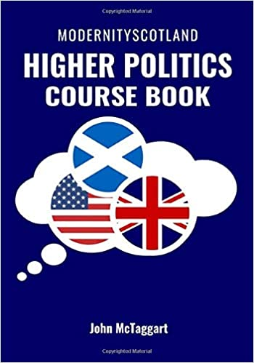
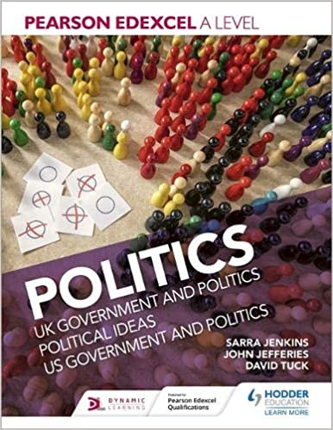
Useful Resources

