Slide 1
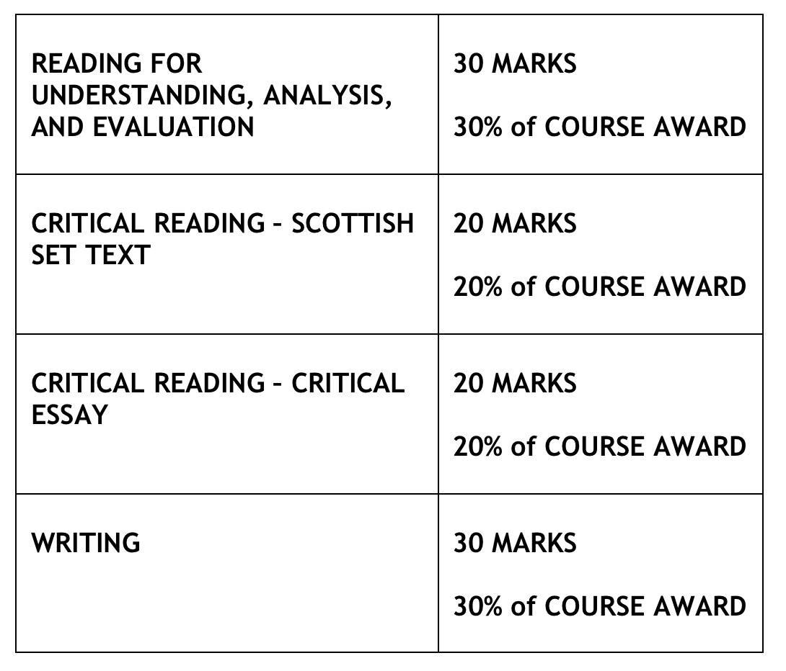
N5
ENGLISH
and LITERACY

Slide 2
PAPER 1: READING FOR UNDERSTANDING, ANALYSIS & EVALUATION
Pupils will have 60 minutes to read a non-fiction text (commonly in the style of editorials) and answer questions on it.
Just under half of the questions will test pupils’ understanding of the passage.
The remainder of the questions will mainly focus on analysing language and there is usually at least one question which encourages evaluation, for example a question on the effectiveness of the opening or ending of the passage.
Total marks for the paper: 30

Slide 3
PAPER 2: CRITICAL READING
Pupils will have 90 minutes to complete the two parts of this paper: Scottish Set Text and Critical Essay
PART 1 – SCOTTISH SET TEXT
Pupils will answer questions on one of the six poems they have studied by Carol Ann Duffy.
The poem will be printed in question paper booklet. In the final question, worth 8 marks, pupils must also refer to at least one of the other five Carol Ann Duffy poems in their answer.
PART 2 – CRITICAL ESSAY
Pupils will write one critical essay on a literature text they have studied in class.
There are two questions per genre from which to choose. Pupils should spend at least 45 minutes on this section.

Slide 4
PORTFOLIO
The portfolio is worth 30% of the total mark.
Pupils will write both a Broadly Discursive piece and also a Broadly Creative piece.
They will then choose one of those pieces to redraft very carefully. This should be independently done and reflect their best possible work.
The piece they choose to redraft will be assessed and worth 30% of the final grade.

Slide 5
HOW PARENTS CAN HELP
Please refer to our Supporting Learners in Senior Phase English – How Parents Can Help document for more information on specific things you can do to help your child achieve their potential in English.

