Slide 1
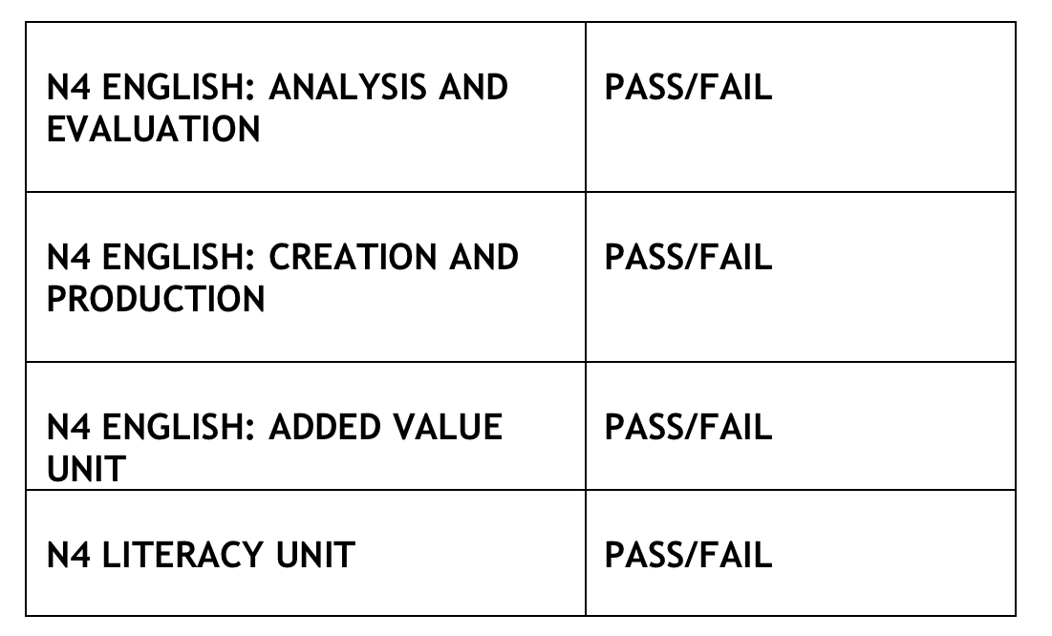
N4
ENGLISH
and LITERACY
Removed from course for 21-22

Slide 2
N4 English: Analysis and Evaluation
Pupils engage with a range of texts (both print and audio) to both develop their ability to understand unfamiliar texts and analyse the effectiveness of the language used in them.
Pupils complete a reading assessment (questions on a non-fiction text e.g. a tourist information leaflet, a newspaper article, or website content) and a listening assessment (questions on a non-fiction text e.g. extract from a documentary)
These assessments are completed in class time when pupils have demonstrated they are ready for the assessment. There is no time limit for completing the assessments.

Slide 3
N4 English: Creation and Production
We develop pupils’ their writing and talking skills in class to prepare them for assessment of these components. In 2021, there is no talking assessment.
Pupils complete a writing assessment. Pupils plan and write an extended piece of writing that is non-fiction.
These assessments are completed in class time when pupils have demonstrated they are ready for the assessment. There is no time limit for completing the assessment. Pupils have access to tools, such as spell-check, to help them to ensure that their work is technically accurate.

Slide 4
N4 English: Added Value
The AVU, which involves comparing two texts of the pupils’ choice, has been removed from the course by SQA for 21-22.
N4 Literacy
We assess using non-fiction texts for the English Creation and Production, and Analysis and Evaluation units so that we can use the same assessments for the N4 Literacy Unit. By doing these, we reduce the assessment burden for pupils.

Slide 5
HOW PARENTS CAN HELP
Please refer to our Supporting Learners in Senior Phase English – How Parents Can Help document for more information on specific things you can do to help your child achieve their potential in English.

