Slide 1
Higher Philosophy

Slide 2
Course Overview
There are 3 key units of study:
Arguments in Action
A unit which develops knowledge and understanding of arguments and the ability to analyse language.
Knowledge and Doubt
This area of study is based on two philosophical texts. Candidates gain in-depth knowledge and understanding of the following rationalist and empiricist works: René Descartes’ Meditations on First Philosophy and David Hume’s An Enquiry Concerning Human Understanding. Candidates analyse the arguments of Descartes and Hume.
Moral Philosophy
Candidates demonstrate an in-depth knowledge and understanding of utilitarianism and Kantian ethics and their application to given situations or issues, and respond to quotations.

Slide 3
Course Assessment Overview

Slide 4
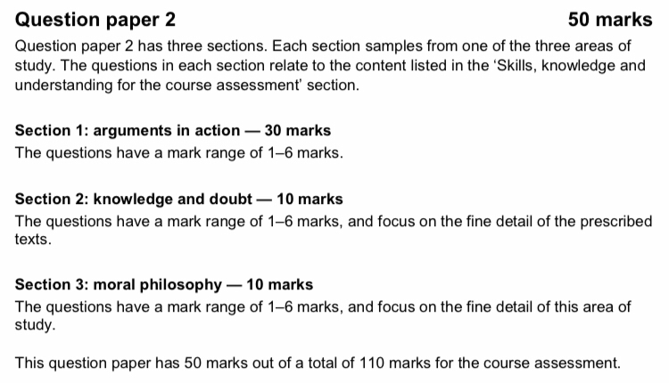
Course Assessment Overview

Slide 5
Homework
Pupils should regularly go over their notes and revise that week’s work at home.
Pupils should catch up on missed work at home or attend a catch up/revision session.
Any homework tasks will be displayed on Show My Homework.
Upcoming assessments will be displayed in the assessment calendar.
If homework or essays are late, feedback is not guaranteed.

Slide 6
Revision/Catch Up Sessions
Miss Fyfe is available 1 lunchtime per week to help pupils to catch up with missed work or go over anything that needs clarifying.
After school revision sessions may be offered before significant assessment opportunities and if there is interest. The format for this may be online this year.

Slide 7
Support Available for Pupils
Adapted booklets to make the content more accessible for pupils with literacy difficulties. Available upon request.
All lesson materials available to pupils via Teams.
Pupils are free to use iPad accessibility tools as required.
Pupils have Miss Fyfe’s email address and are free to email at any time.

Slide 8
Reading
Highly Recommended
Rene Descartes – Meditations on First Philosophy. (Meditations 1, 2 & 3)
David Hume – An Enquiry Concerning Human Understanding. (Section 2: The Origins of Ideas)
Others:
John Stuart Mill – Utilitarianism.
Immanuel Kant – Groundwork on the Metaphysics of Morals.

