Slide 1
S1 History
Based mainly in the Millennium Wing
Ms Watterson
Mr Clow
Mrs Maciver
Mr McMordie
Miss Wylie
Mr Hattie

Slide 2
S1 Social Subject Faculty
1 period History
1 period Geography
1 period Modern Studies
1 period Social Subjects = Crime and Punishment
Crime and Punishment
History – historical crime | Modern Studies – crime today | Geography – crime in the UK and beyond
Witchcraft The Gunpowder Plot Body Snatchers | Age of Criminal Responsibility Modern Punishment Life inside Prison Children’s Hearings How a Trial Works in the UK Rehabilitation Murder mystery | Local Crime Designing out Crime National Crime Laws around the World Case study - Japan

Slide 3
Our Challenge – many feeder primaries
Who is this?
What is happening here?

Slide 4
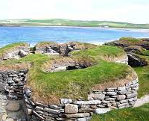
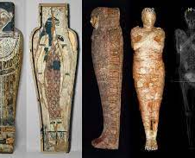
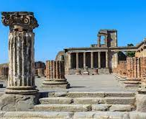
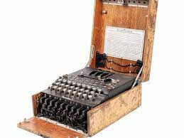
S1 History Mysteries
Types of Evidence and Chronology
Skara Brae
Egyptian Mummies and King Tut
Tolland Man
Pompei
WWII the Enigma Machine
The Assassination of JFK
Investigate and present a history mystery of your choice

Slide 5
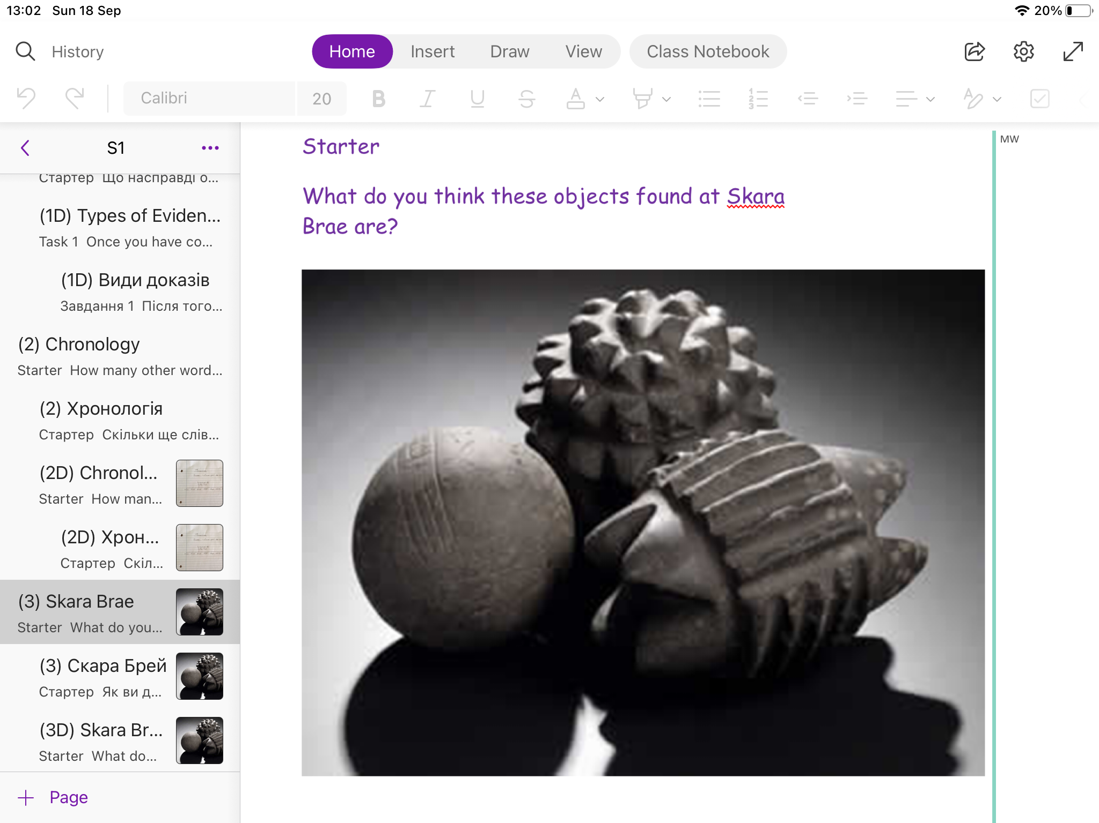
History Lessons – PHS Learning Structure
Daily Review – Pair and share; mini whiteboards; Kahoot!
Starters -

Slide 6
History Lesson Cont.
Learning Intentions/ Success Criteria

Slide 7
New Information – teacher exposition with PowerPoint/ video clips

Slide 8
Practice and Prove it!

Slide 9
Paperless Dept – One Note is the jotter

Slide 10
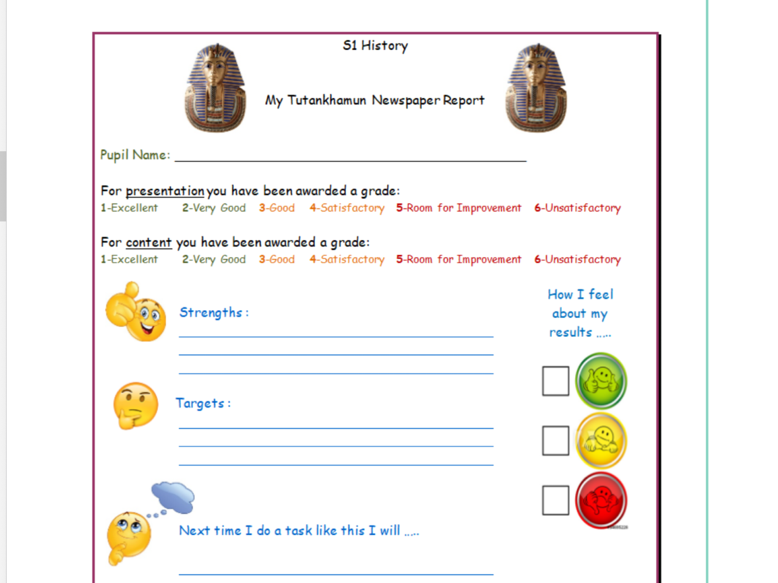
Assessment
Continuous Assessment
King Tut Newspaper Report
Formal assessment

Slide 11
Differentiation
We should be aware of any learning issues
All lessons have a differentiated version
All lessons have a Ukrainian translation
King Tut Assessment – newspaper article – differentiated version
Use of immersive reader and speech to text tools

Slide 12
What do last year’s S1 think?

