Slide 1
S2 & S3 Geography
Miss A Forster
gw21forsteramandasbc@glowmail.org.uk

Slide 2
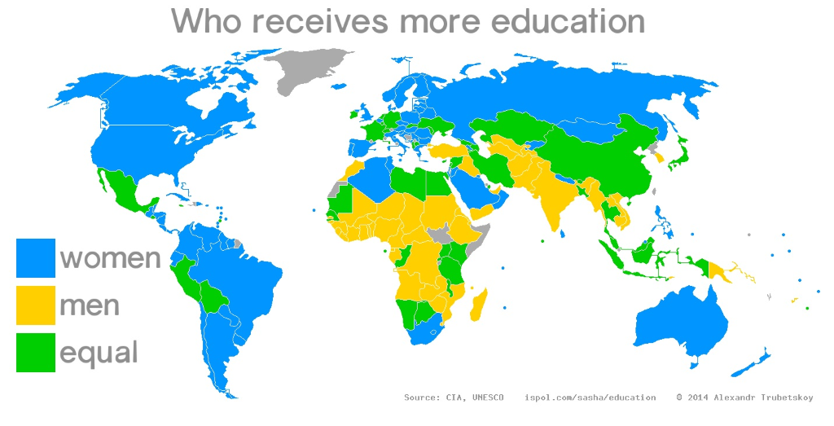
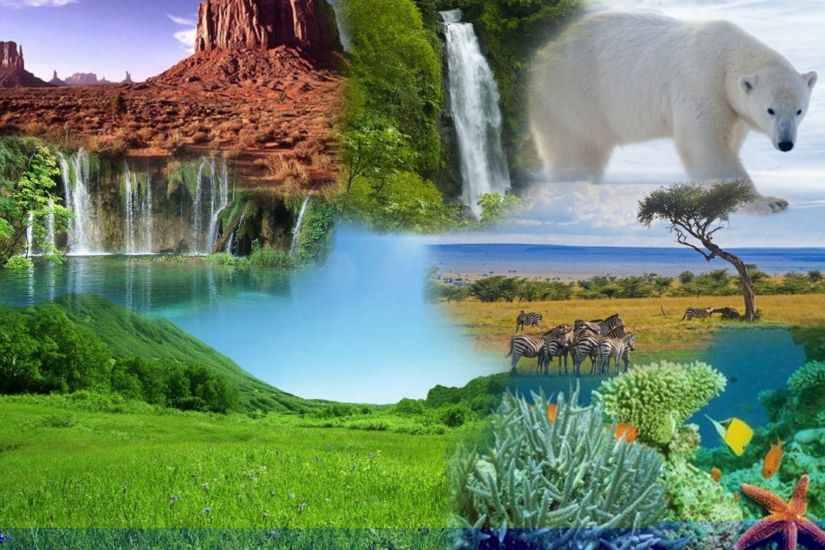
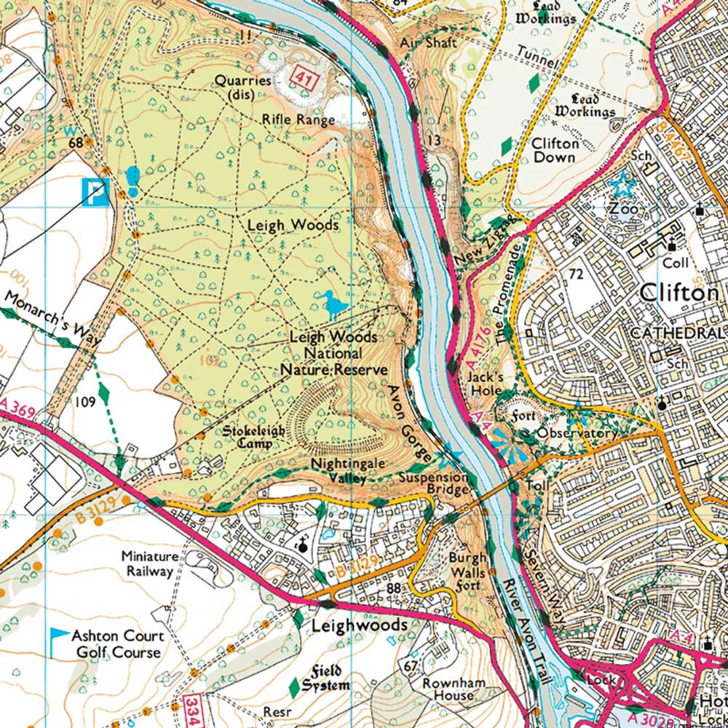
S2 Geography
Date​ | Topic​ | Why are we studying it​ | Assessment​
Aug - Oct​ | Development ​ ​ ​ | This topic explores the differences in development between countries around the world and the issues which exist in less developed countries. ​ | End of unit test​
Nov - Jan | We Are The World | This topic looks at the causes and impacts of globalisation. We also explore the associated positives and negatives and consider how we contribute to globalisation. | End of unit test
Feb-April​ | Biosphere ​ | This topic takes us around the world's different biomes. Within this we look at the climatic features of each biome, the threats they face and how we can help minimise the damage being done to each biome. | Research Assessment
May-June​ | Map Work | This topic is a skills-based topic which teaches pupils the different aspects of map work and how we can use maps in real life. ​ | N/A​

Slide 3
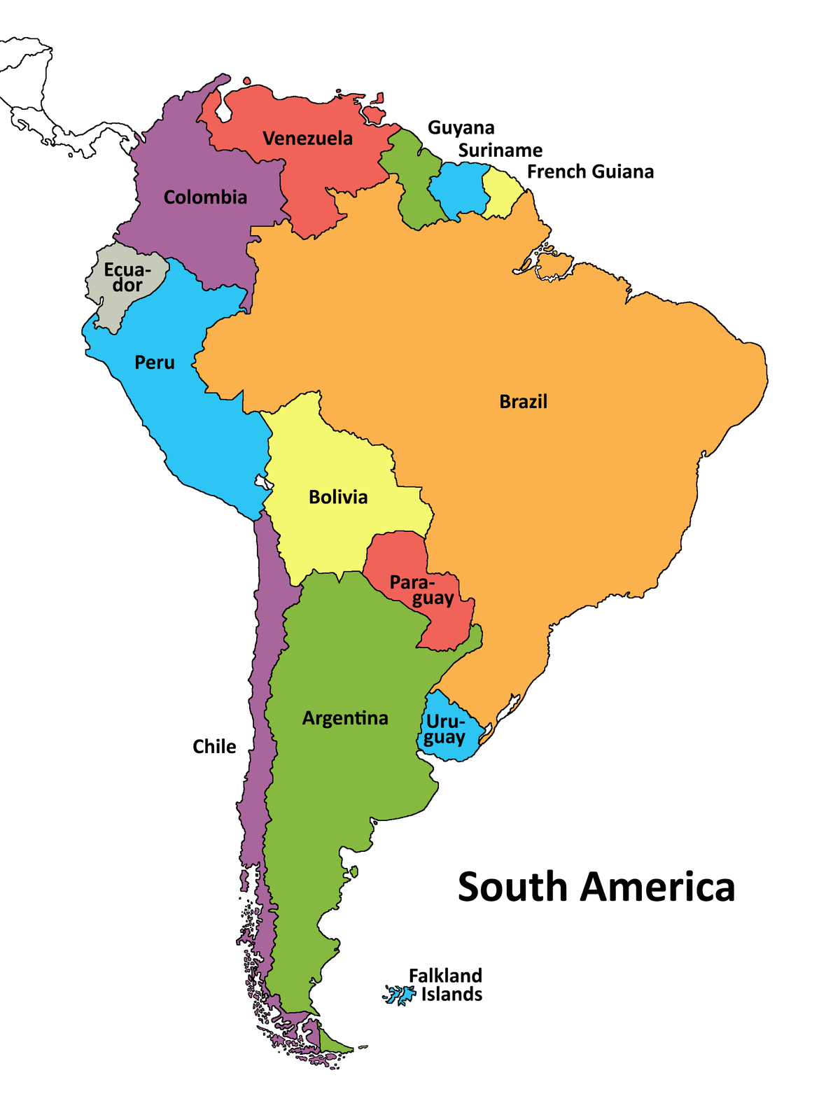
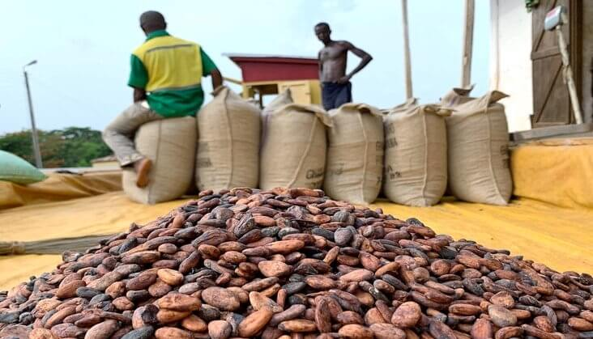
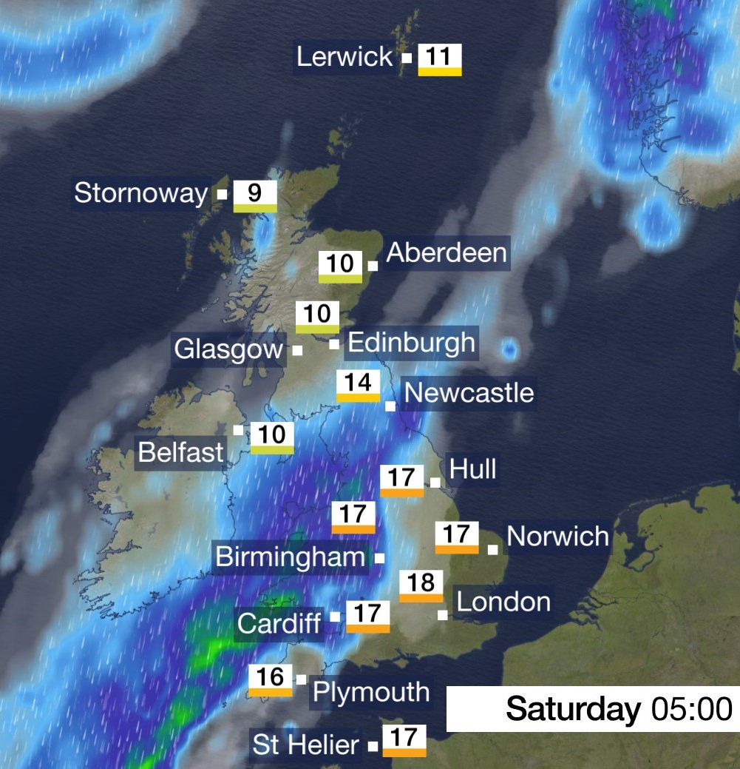
S3 Geography
Date​ | Topic​ | Why are we studying it​ | Assessment​
Aug - Nov | Survival in South America ​ ​ ​ | This topic takes us across South America; focussing on key geographical features as well as the inequalities and social issues which exist across the continent. ​ | End of unit test​
Dec - March | Food & Farming | This topic explores where key food stuffs come from around the world, the problems associated with them and the environmental impact they can have. We also look at the issue of global hunger and how we could minimise this problem. | End of unit test
April - June | Weather ​ | This topic looks at Britain's climate, how people are affected by the weather and the reasons behind the weather which we experience across the country. ​ | Research Assessment

Slide 4
How we work in class
Lessons created using PHS Learning Structure
OneNote (iPad/laptop)
Differentiated material (classwork and assessments)
Printed OneNote sheets
Jotters (if preferred)

Slide 5
OneNote

Slide 6
Homework/ “Assignments”
HW, tests/assessments posted on Teams Assignments

Slide 7
Expectations
Complete unfinished work (absent or if not done in class)
Independent learning and taking ownership of understanding
Praise: Merits, Faculty's “Fabulous Friday”
From Teachers & Pupils

Slide 8
Additional Info
Progression​
N3/4 Social Subjects​
N4/5 Geography​
N4/5 Travel & Tourism ​
Higher Geography​
Advanced Higher Geography​
(Also other faculty subjects: Modern Studies, History, Politics)​
Faculty Extra Curricular Activities
Eco Committee
Model United Nations
PHS Student Parliament
PHS Pride
Dungeons & Dragons

