Slide 1
Senior Phase History

Slide 2
The History Department
Ms Watterson (Principal Teacher) M37
Mrs Maciver M19
Mr Clow M35

Slide 3
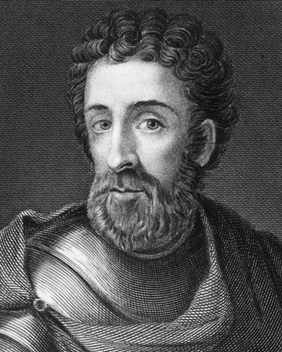
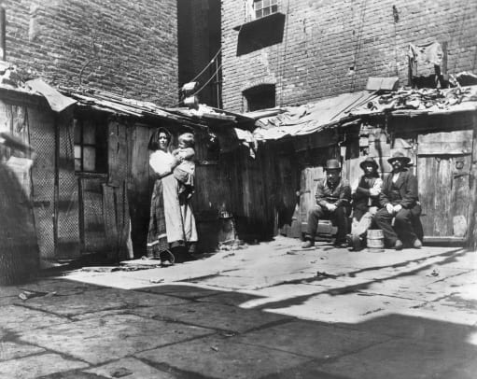
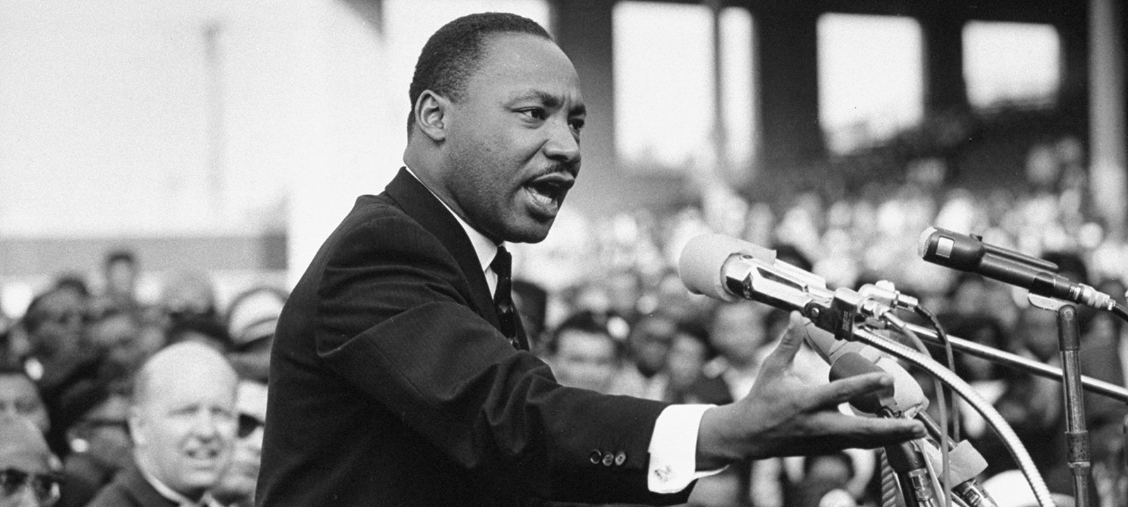
N3/4 HISTORY – Course Content
The Life and Death of William Wallace
City Life
Martin Luther King

Slide 4
Assessment All assessment is done in class and marked by class teachers. No prelim or end of year exam.
Unit 1 – The Life and Death of William Wallace (Sept)
Unit 2 – City Life (Dec)
Unit 3 – Martin Luther King (March)
Added Value Unit*
* This unit has been removed by the SQA for session 2022-23.
Unit 1 – The Life and Death of William Wallace (Sept)
Unit 2 – City Life (Dec)
Unit 3 – Martin Luther King (March)
N4
N3

Slide 5
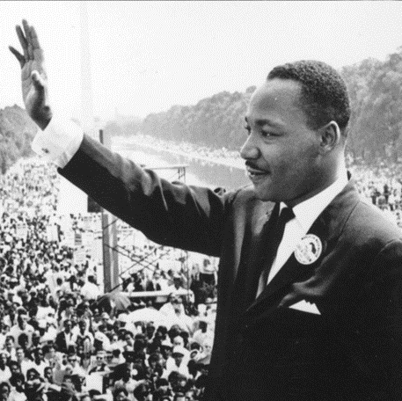
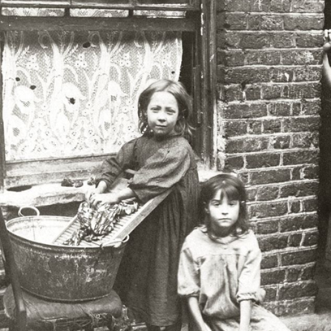
N5 History Course Content
3 units:
The Scottish Wars of Independence,1286-1328
Free at Last? Civil Rights in the USA,1918-1968
The Making of Modern Britain,1880-1951

Slide 6
N5 Assessment Timeline
September – Scottish Wars Test 1
October – Scottish Wars test 2
November – Free at Last Test 1
January – Prelim – all of Scottish Wars and Free at Last
March – Making of Modern Britain Prelim
May – Final Exam – 2h 20 minutes – 80 Marks
Students will be given at least a week's warning for tests and will be informed which content and skills to revise.
In addition to the tests and exam, we will practice regularly the different skills questions for N5 History.

Slide 7
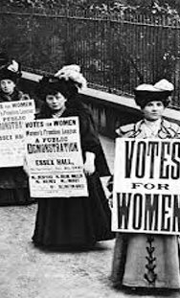
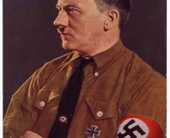
Higher History Course Content
Britain, 1851 - 1951
Germany, 1933 – 1939
Appeasement and the Road to War, 1933 – 1939
Scotland and the Impact of the Great War, 1914 - 1928

Slide 8
Higher Assessment Timeline
August – Essay 1
September - Essay 2
October – Essay 3
November – Scottish Test
December – Essay 4
January – Prelim, covering all topics
February – Essay 5
March – Essay 6
May – Final Exam – 2 Papers – 1h 30 minutes each – 80 Marks
Students will be given at least a week's warning for assessments, details of which will be posted on Teams.

Slide 9
Advanced Higher Course Content
Russia, from Tsarism to Stalinism,
1914 – 1945.
An in-depth study, including the February and October Revolutions, The Civil War, rise of Stalin, Stalinist state and Great Patriotic War.
Exam – 90 Marks
Dissertation - 50 Marks

Slide 10
Advanced Higher Assessment Timeline
August – Essay 1
September – Essay 2
October - Essay 3
November – Essay 4
December – Timed Source Questions
January – Prelim, covering all topics
February – Dissertation
March – Dissertation
April – Dissertation hand-in deadline – 50 Marks
May – Final Exam – 3h – 90 Marks
Students will be given at least a week's warning for assessments, details of which will be posted on Teams.

Slide 11
What We Provide
All the resources below are available on your young person’s iPad, via Teams and One Note.
In Team Files:
PowerPoints and other course documents
Digital copies of textbooks
Videos of how to do skills questions
Skills booklets – paper and digital copies
In One Note:
Course booklets - all the work that your young person has done in class – their notes. This should be the first place they go to for revision
All the practice skills questions that we have done in class – marked and with feedback
All their test marks, with feedback and targets on an assessment tracking sheet

Slide 12
Homework
Students should expect homework most weeks, at least once per week, duration usually 30mins – 1 hour per week. Homework will be posted on Teams.
Tasks- additional questions to support learning, ‘finishing off’ class work, extra reading, watching a recommended documentary etc.
Preparation for assessments- revision as well as more exam skills. Pupils will be given adequate notice before all assessments -1-2 weeks and this will be posted in their Team.

Slide 13
SQA Past Papers
All SQA past-papers and marking instructions are available, for free on the History SQA page:
https://www.sqa.org.uk/sqa/47447.html
We use this page in class often and students are encouraged to be proactive and practice as many past-paper questions as they can.
Ideally, these questions should be done without notes and timed.
Useful information about how marks are earned can also be found on the SQA Understanding Standards website:
https://www.understandingstandards.org.uk/Subjects/History/national5

Slide 14
How can you help?
Provide support and encouragement - take an interest
Check over work
Quiz before a test
Monitor progress and targets
Provide time and a quiet space to study
Encourage breaks, exercise and good sleep
Help your young person with organisation and planning.
Encourage attendance and punctuality

Slide 15
Useful Websites and Resources
BBC Bitesize History
https://www.bbc.co.uk/bitesize/subjects/z2phvcw
Mr Marr History
https://mrmarrhistory.wordpress.com/national-45/
If you want to invest in a study guide, the Bright Red ones are best. Avoid the ‘How to Pass’ ones for History – they aren't very good.

