Slide 1
Info
Why Modern Studies?
How and why is Modern Studies taught?
Aim: Our aim is to help students achieve the best possible outcomes in their Senior Phase. We can offer Modern Studies courses from N3/4 up to and including Advanced Higher. Our aim is to build a critical understanding of the world around our young people and allow them to be confident participants in a 21st century democracy.
Skills: In Senior Phase Modern Studies we want to support our young people in building and developing a wide array of transferable skills, such as communication, decision-making, analysis, evaluation and independent research skills. To be successful in Senior Phase Modern Studies, young people will need to be comfortable in using all these skills.
Teaching: Lessons and resources in Senior Phase Modern Studies are largely delivered on Microsoft OneNote. We look to make use of the 1:1 iPad coverage that pupils have and encourage work to be saved online through Glow. Pupils also have the opportunity to do classwork with a jotter should this suit their own preference. Pupils also do any assessments or practice question in their jotter.
Mr N. Hattie gw20hattieneil@glow.sch.uk Room: M33

Slide 2
Why?
Why Modern Studies?
What career opportunities come from Modern Studies?
Politics: Many Modern Studies students find themselves going on to study Politics and may end up find themselves working within politics. Many previous students find themselves working within the Civil Service and/or with political parties.
Law: Modern Studies offers an excellent route into the law profession due to the high volume of time focusing on crime and legality in both N5 and Advanced Higher Modern Studies. Many AH pupils will go on to university to study law.
Journalism: Due to high focus on literacy in Modern Studies, many students will find themselves working in journalism. By developing research and enquiry skills in the senior phase, journalism is a natural fit with the subject.
Police: Once again because of the focus on crime and legality, Police Scotland place a high value on Modern Studies as a subject as it provides them with informed and knowledgeable individuals on legal issues.
And lots more: you will notice around the room various flyers about possible careers with Modern Studies, please feel free to ask me about any.
Mr N. Hattie gw20hattieneil@glow.sch.uk Room: M33

Slide 3
Help
How can I help my young person?
How can I help my young person with their Modern Studies work?
Following the news: One of the best things you can do to support your young person with Modern Studies is to encourage them to watch, read and follow the news. Knowledge of current affairs helps build a strong foundation and provides real world examples that can be credited with marks in exams/assessments.
Assessments: All of our assessments are posted via Teams at least one week before they are due. We also often give students time to prepare for an assessment in class. For tests we recommend that students practice questions, summarise content and teach others in order to prepare. If any student needs any additional support, including extensions, Modern Studies teachers will be happy to help.
Supported study: In the lead up to big assessments or prelims and exams, teachers will run supported study sessions for pupils to come and prepare. These are usually done on a drop-in basis where learners will identify areas to work on. There is also opportunity for pupils in examined subjects to attend Easter school during the spring holidays.
Social Media: Check out our website and twitter feeds to keep up to date with what we’re doing.
Mr N. Hattie gw20hattieneil@glow.sch.uk Room: M33

Slide 4
Help
How can I help my young person?
How can I help my young person with their Modern Studies work?
SQA website: if you google SQA Modern Studies you will find the course page for each level. Here you will have access to a range of information such as Past Papers, Marking Instructions and Understanding Standards.
BBC Bitesize: have a range of information and supportive notes on most topics we cover in PHS. Generally, these will be less detailed than the notes pupils will have from classwork, but can still be a useful tool at revision time. https://www.bbc.co.uk/bitesize/subjects/zs48q6f
Textbooks: are generally not used by Modern Studies teachers often due to the ever evolving nature of the subject. Should you wish to purchase any books, texts by Hodder Gibson, BrightRed or Leckie are usually the best. If you do this, please ensure they are published as recently as possible. Pupils cannot use information if it is more than 10 years old.
Encourage: your young people to make their class teacher their first port of call when looking for help. We are happy to support students at all times and can always point in the direction of the best resources to use.
Mr N. Hattie gw20hattieneil@glow.sch.uk Room: M33

Slide 6
S4/5
N3/4 Social Subjects
Unit 1 | Unit 2 | Unit 3
Democracy in Scotland | Crime and the Law | China
What is a democracy? Democracy v Dictatorship Political parties How to be involved Voting | What is crime? Why does crime happen? What is the impact of crime? How can we tackle crime? | How powerful is China? Poverty in China Education in China Pollution in China Work in China
Assessment: Open book internal assessments | Assessment: Open book internal assessments | Assessment: Open book internal assessments
Mr N. Hattie gw20hattieneil@glow.sch.uk Room: M33

Slide 7
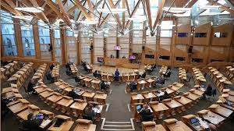
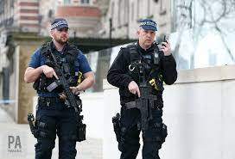
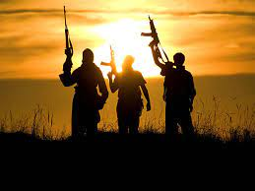
S4/5
N4/5 Modern Studies
Unit 1 | Unit 2 | Unit 3
Democracy in Scotland | Crime and the Law | Terrorism
How are decisions made? How can we participate in democracy? How are we represented? Who has influence in democracy? How do we choose our representatives? | What is crime? What are the causes of crime? How does crime impact society? How can we respond to crime? How does the criminal justice system work? | What is terrorism? What are the causes of terrorism? What is the impact of terrorism globally? How can we stop terrorism? Whose responsibility is it to tackle terrorism?
Assessment: Timed closed book assessments + SQA external exam | Assessment: Timed closed book assessments + SQA external exam | Assessment: Timed closed book assessments + SQA external exam
Mr N. Hattie gw20hattieneil@glow.sch.uk Room: M33

Slide 8
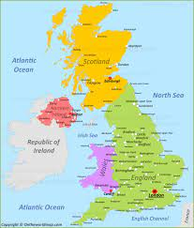
S5/6
Higher Modern Studies
Unit 1 | Unit 2 | Unit 3
Democracy in Scotland/UK | Social Inequality | USA
The pros and cons of Scottish Independence The pros and cons of Brexit How do we elect our representatives? Why do people vote the way they do? How can we be involved in politics? How can parliament limit the power of government? | Causes of Health Inequality Causes of Wealth Inequality What is the impact of inequality? Whose responsibility is it to tackle inequality? Government policies to tackle inequality. | The influence of the USA How can US citizens be involved in democracy? How does the US political system work? Inequality in the USA Government responses to inequality in the USA
Assessment: Timed closed book assessments + SQA external exam | Assessment: Timed closed book assessments + SQA external exam | Assessment: Timed closed book assessments + SQA external exam
Mr N. Hattie gw20hattieneil@glow.sch.uk Room: M33

Slide 9
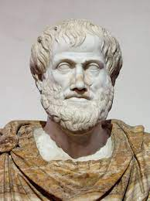
S5/6
Higher Politics
Unit 1 | Unit 2 | Unit 3
Political Theory | Political Systems – UK V USA | Political Parties and Ideas
How relevant are the concepts of Power, Authority & Legitimacy? Conservatism v Socialism Direct v Representative Democracy | Comparing constitutions and courts in the UK/USA. Comparing the power of parliament in the UK/USA. Comparing the power of the government in the UK/USA. | Campaign methods and elections Theories of voting behaviour Dominant ideas of political parties
Assessment: Timed closed book assessments + SQA external exam | Assessment: Timed closed book assessments + SQA external exam | Assessment: Timed closed book assessments + SQA external exam
Mr N. Hattie gw20hattieneil@glow.sch.uk Room: M33

Slide 10
S5/6
Advanced Higher Modern Studies
Unit 1 | Unit 2 | Unit 3
Law and Order | Research Methods | Dissertation
What is crime? Theories of crime Consequences of crime Tackling crime | Research methodologies, surveys, interviews, observation, case studies etc. Source evaluation | Students select a dissertation topics of their own choosing. Plan, research and write this dissertation of the course of the year. Around 6,000 words. Accounts for about 40% of overall grade.
Assessment: Timed closed book assessments + SQA external exam | Assessment: Timed closed book assessments + SQA external exam | Assessment: Collected in March and sent to SQA for marking.
Mr N. Hattie gw20hattieneil@glow.sch.uk Room: M33

