Slide 1
S2-S3 Modern Studies Elective
Info
How and why is Modern Studies Taught?
Aim: Our aim is to help students understand and analyse the world around them. As a Rights Respecting School, we also make sure our students learn about their rights and the rights of others. We hope Modern Studies will both encourage and empower students to participate fully in society as responsible citizens.
Skills: We are building all four PHS skills – Communication, Collaboration, Creativity and Critical Thinking across this course. These transferable skills will help our young people throughout their time in education and in their chosen careers.
Teaching: All of our teaching is fully differentiated and accessible for all students regardless of ability. Our lessons are also fully integrated onto OneNote making full use of iPad technology in the classroom. We use a wide range of innovative teaching methods from basic comprehension skills to problem-solving groupwork, from essay writing to producing videos and presentations.
Mr J. McMordie Mcmordie.james@glow.sch.uk Room: M31

Slide 2
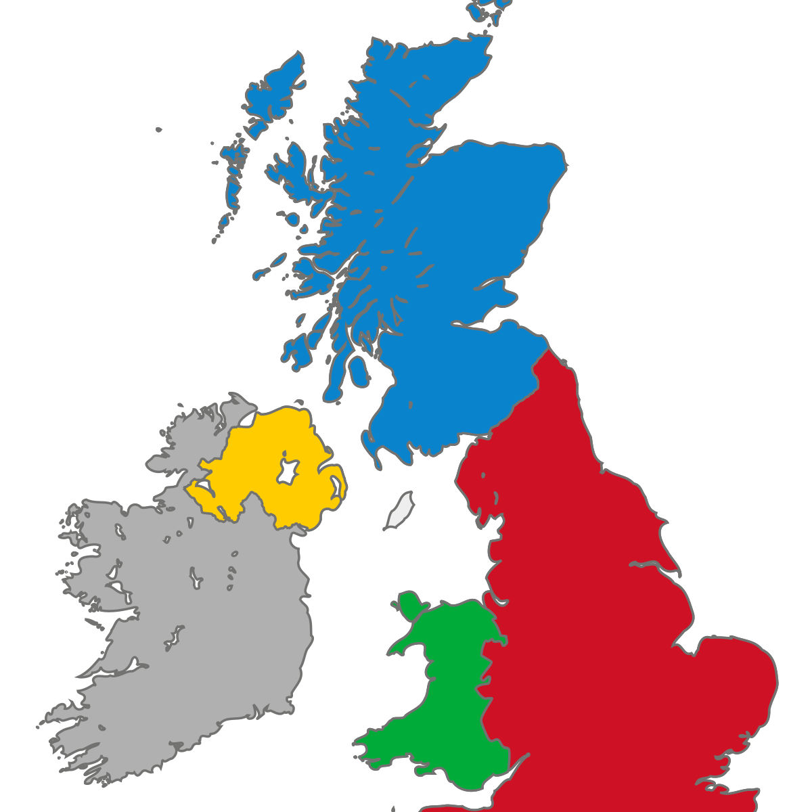
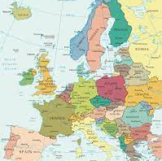
S2-S3 Modern Studies Elective
S2
Unit 1 | Unit 2 | Unit 3
Life in the United Kingdom | Local Issues in the Scottish Borders | Europe and the European Union
What is the UK and what rights do people have here? How does the UK defend itself? What social and economic issues are there in the UK? How well is the government addressing these social and economic issues? | What are the issues facing people in the Scottish Borders and how do they affect local people? Who is responsible for solving these issues? What are the best ways for local people to influence decision-makers? | What is Europe? What is the difference between the EU, NATO and other European organisations? How different is life in various European countries?
Assessment: Welcome to the UK Leaflet | Assessment: Participation Methods Essay | Assessment: EU Enlargement Dragons Den Task
Mr J. McMordie Mcmordie.james@glow.sch.uk Room: M31

Slide 3
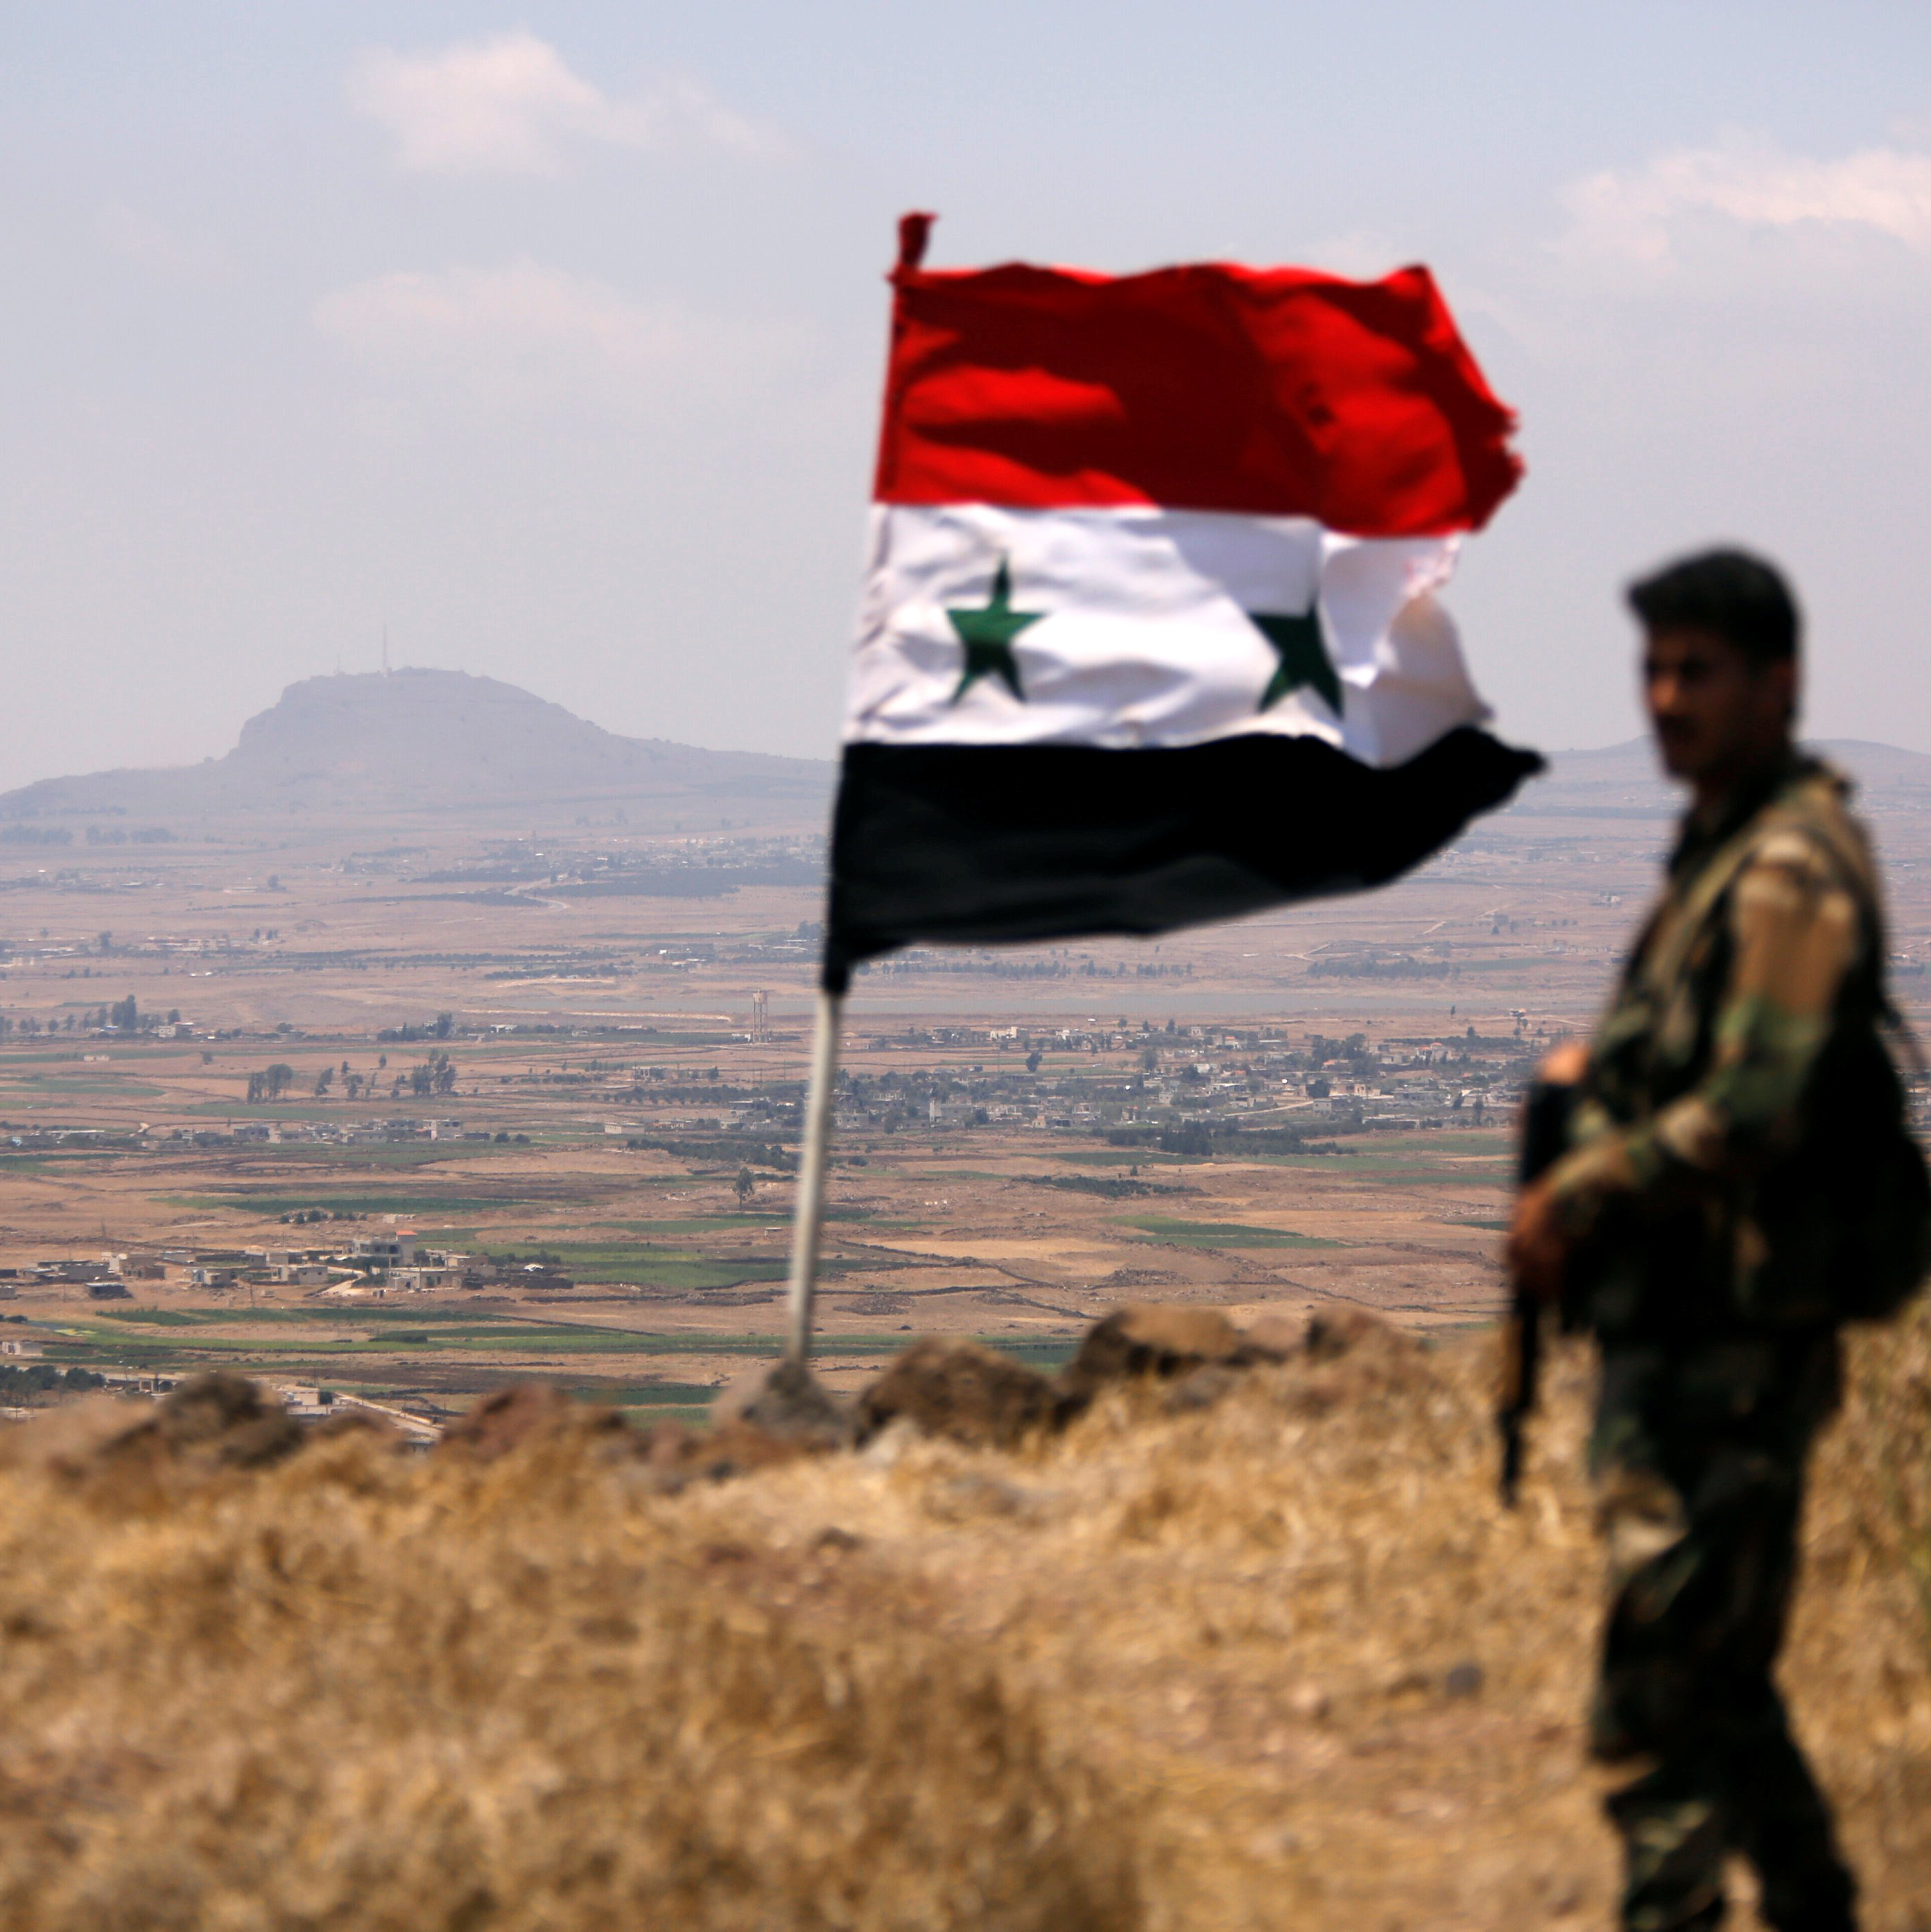
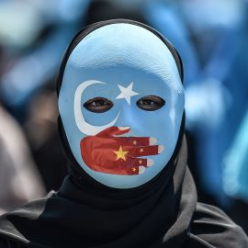
S2-S3 Modern Studies Elective
S3
Unit 1 | Unit 2 | Unit 3
The Media | The Conflict in Syria | Human Rights in China
What is the media? What is media freedom and how does it differ around the world? How can we identify fake news? How does the media affect society? How does the media affect politics? | Why is there conflict in Syria and what is the impact? Who are ISIS and what are their aims? How have the UN and other responded to the Syrian conflict? What is the experience of Syrian refugees like? | Why is China powerful? What is the nature of China’s dictatorship? How does China treat religious minorities, protestors, criminals and other groups in society?
Assessment: End of Unit Test | Assessment: Life of a Refugee Diary | Assessment: UN Report on Rights in China
Mr J. McMordie Mcmordie.james@glow.sch.uk Room: M31

Slide 4
S2-S3 Modern Studies Elective
Plus
What else does Modern Studies offer?
Hot Topics: We are always keen to help our young people understand important global events as they occur. With this in mind, we occasionally introduce “Hot Topics” lessons to explain a particular event. Over the past number of years we have covered the war in Ukraine, COP26, the fall of Kabul and the US elections in 2020.
Extracurricular Activities: Model United Nations is one of the most popular clubs in PHS with many S2s and S3s taking part. Other activities offered within the department include the PHS Student Parliament, the Eco Committee and PHS Pride. All of these activities help our students develop additional knowledge and skills which are of help to them in Modern Studies both in S2-S3 and beyond.
Progression: Many students continue with us after S3, either by taking N5 Modern Studies or the N3/4 Social Subjects course. Highers in Modern Studies and Politics, and an Advanced Higher in Modern Studies are available in S5/S6. Students may also choose related subjects such as History, Philosophy or Geography.
Mr J. McMordie Mcmordie.james@glow.sch.uk Room: M31

Slide 5
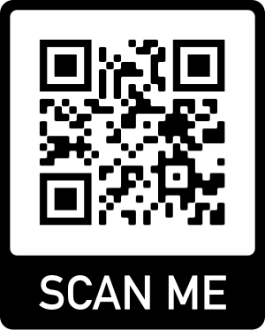
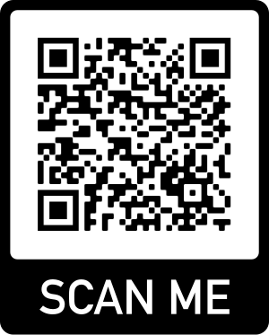
S2-S3 Modern Studies Elective
Help
How can I help my young person with their Modern Studies work?
Following the news: One of the best things you can do to support your young person with Modern Studies is to encourage them to watch, read and follow the news. Knowledge of current affairs helps build a strong foundation and adds to class debate and discussion.
Assessments: All of our assessments are posted via Teams at least one week before they are due. We also often give students time to prepare for an assessment in class. For tests we recommend that students practice questions, summarise content and teach others in order to prepare. If any student needs any additional support, including extensions, Modern Studies teachers will be happy to help.
Social Media: Check out our website and twitter feeds to keep up to date with what we’re doing.
Mr J. McMordie Mcmordie.james@glow.sch.uk Room: M31

