Slide 1
Physical Education
National 4/5 Course

Slide 2
National 4 Structure
Course is simply PASS/FAIL. No grades.
Must pass 2 out of 3 practical activities.
Written units – Factors Impacting on Performance (FIP). Ongoing throughout year.
All coursework internally assessed.

Slide 3
National 5 Structure
Portfolio – 60marks total (50%)
The portfolio has three sections:
Section 1: understanding factors that impact on performance
Section 2: planning, developing and implementing approaches to enhance personal performance
Section 3: monitoring, recording and evaluating performance development
Performance – 30marks total (50%)
Only one activity this year – previously 2 but changed in session 2020/21 due to Covid.
Course Graded on an A/B/C/D/Fail.

Slide 4
Performance
Activities taken from school choices.
Pupils choose their own – activity they think they’ll score highest in.
Marked in-house by staff.
Hockey/Football/Rugby
Athletics (speed/CRE)
Volleyball/Basketball (Usually – Covid dependant.)
Badminton/ Gymnastics (Usually – Covid dependant.)

Slide 5
Performance
Candidate must demonstrate:
a repertoire of skills — including complex skills
control and fluency
effective decision-making
using and applying straightforward composition, tactics or roles safely and effectively
conforming to rules, regulations and
controlling emotions
working co-operatively with others

Slide 6
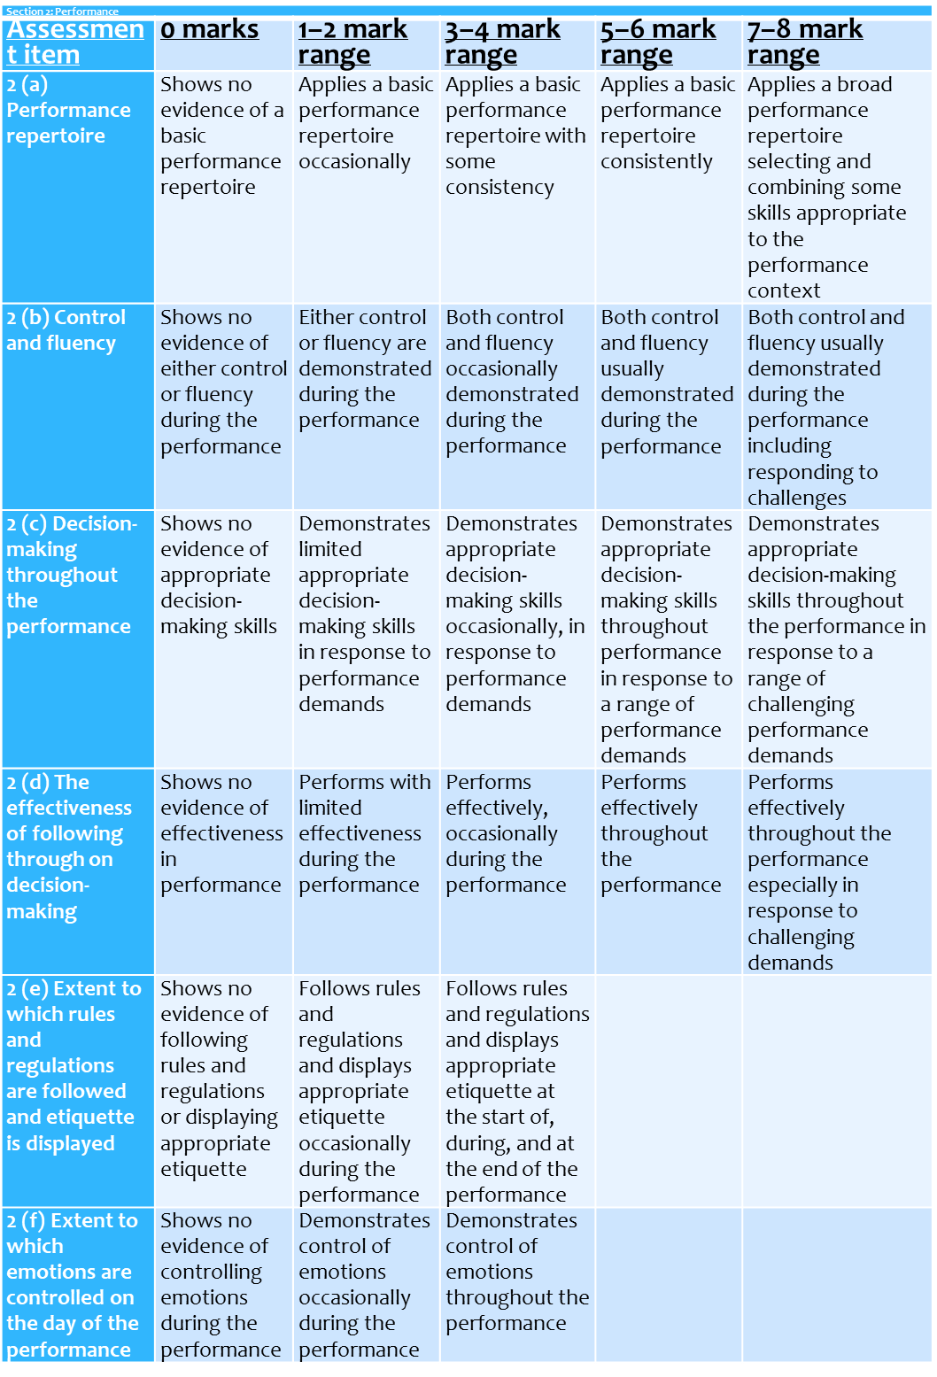

Slide 7
Portfolio
Brought together from the coursework throughout the year.

Slide 8
Portfolio
4 Factors = How do they impact??
Data Collection Methods
Training Diary
One part (8 marks) under exam conditions, the rest is open book during class time.

Slide 9
Portfolio
Section 1: For each factor, Mental, Emotional, Social and Physical, explain its impact on performance.
(8 marks)
Section 2: Planning, developing and implementing approaches to enhance personal performance
(29 marks)
Section 3: Monitoring, recording and evaluating performance development (23 marks)

Slide 10
Homework
Homework varies throughout the year – averages out at once a week.
Homework will be posted on Teams/show my homework and should be submitted in written format by given date.
Resources to support H0mework tasks can be found in the Course notes issued to each candidate. SQA website also helpful.

Slide 11
Supporting Learning
Regular 1-to-1 conversations on progress.
Tracking and monitoring reports.
Study lunchtime sessions in lead up to Portfolio work.
Any issues please contact – pupil or parent!

Slide 12
Summary
Performance – take it seriously, and it’s a chance to bag ample marks.
Portfolio – Difficult (Nat Average this year was around 20/40)… But very much a case of get out what you put in!

Slide 13
Physical education
Higher

Slide 14
Course Structure (Higher)
COURSE units: Students must pass 2 physical activities
plus the factors impacting performance (FIP) UNIT
Course Assessment:
Exam (50 marks)- marked by SQA
Practical performance X 1 (30 marks) – Internally assessed. Changed from 2 in previous years due to Covid. Weighted to 50%
Course Graded on an A-D Basis

Slide 15
Assessed Components
Practical performance (x1)
This is a “one off performance” which is completed on a pre-arranged date. If in-school, will be completed at end of activity block. Football/Hockey will be 7/12, weather dependant.
(if assessment is in an external competition, this must be DISCUSSED WITH THE TEACHER. It can be assessed live or potentially recorded and reviewed, although this is obviously activity dependant)
THE SPORT IS SELECTED BY THE STUDENT.

Slide 16
Exam
50 marks
It consists of section 1: 3 sets of questions on FIP, gathering data, analysis, monitoring and evaluating.(32 marks)
Section 2: Questions in relation to their PDP (10 marks)
Section 3: a scenario that they must interpret and evaluate. (8 marks)

Slide 17
Homework
Homework issued on average once a week, with usually minimum 5 days notice.
It should be submitted in written format by said date – sent via email or hard copy.
Resources to support H0mework tasks can be found in the workbook issued to each candidate and fip help sheets also given to all students.

Slide 18
Additional Support
Leading up to the prelim and exam additional revision classes will be offered..
These will be at a lunch time in the PE classroom

Slide 19
Supporting Learning
Tracking & Monitoring Reports
Feedback given on each piece of homework.
Range of example answers and exam question information available for students to view.
Higher PE leckie and leckie books available IN SCHOOL to sign out and borrow. Students will be advised to buy their own copy of the exam question and answer book.
SQA examples online.

Slide 20
How can you support Learning?
Discuss feedback Students are receiving.
Develop practical fitness and skills in the activity they are going to perform in their final one off performance.
In run up to written exam encourage students to complete as many of the exemplar questions as possible and submit them for marking/feedback.
See SQA webpage – “Higher PE” – several resources/ examples on here.
Feel free to contact Mr Shirra-Gibb if you have any questions/concerns.

Slide 21
Interventions
Teacher/student learning conversations with referral being sent to Pastoral Teacher.
Communication with parents.
Lunchtime revision.

