Slide 1
Friends of Peebles High School
(a Scottish Charitable Incorporated Organisation)

Slide 2
Why?
This is our “PTA”
Registered charities can attract additional funding
School Budgets are under pressure
Who?
Chair (Acting) – Tristan Compton*
Treasurer – David Flynn*
Secretary – Angela Dobie*
Trustees* – Sarah Duncan*, Kevin Ryalls*
Parent Council Events Coordinator – Gillian Moran
NB: The Charity rules require us to have between 5 and 7 Trustees

Slide 3
Fundraising Activities
Easy Fundraising
PHS Lottery
Matched Funding
Corporate Donations
Refreshments & Raffles
Supermarket Schemes
Social Events
Fundraising Projects
Grants

Slide 4
Spending
Things that go beyond what a school can normally afford
Things that benefit a wide variety and large number of pupils
Some exclusions – eg. “normal” school expenses, Trips, Sports Clubs, support for individuals
2 Funding Bid rounds each year:
Funding Bid Totals |  |  |  |  | Charity
 |  |  |  | Requested | Contribution
2021-22 Funding Bid Round |  |  |  | £ 7,675.05 | £ 7,456.00
2022-23 Funding Bid Round |  |  |  | £ 4,869.40 | £ 3,987.00
2023-24 Funding Bid Round |  |  |  | £ 7,555.00 | £ 4,572.00
2024-25 Funding Bid Round (TBC) |  |  |  | £ 8,011.00 | £ 3,891.00
 |  | 3 Year Totals >>> |  | £28,110.45 | £19,906.00

Slide 5
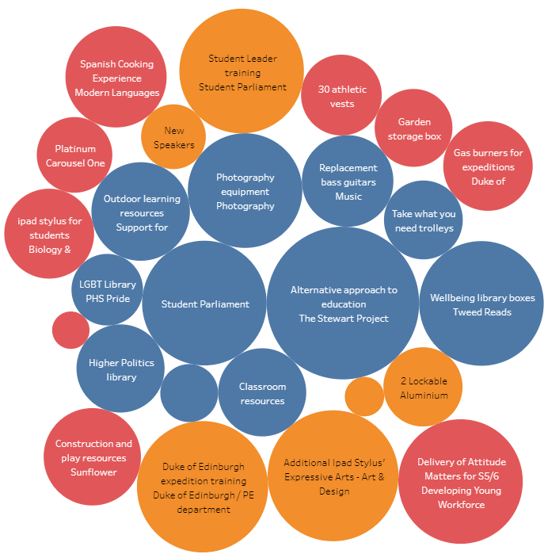
Spending

Slide 6
Current Funding Proposed (Round 1 2024-25)
Proposed grants to PHS in 2024-25
£50 for nail beauty enterprise initiative for pupils struggling to engage with standard curriculum and help build relationships with staff
£1,489 for forest schooling resources for Inclusion Service
£330 for Linguascope digital resources for Modern Languages
£2,022 for Physics:
Class set of calculators
Smart cart to support experiments investigating motion and forces
Set of Logic Boards
2 class sets of wind turbines
Total proposed £3,891

Slide 7
Help Needed !
Easyfundraising – sign up at easyfundraising.org.uk
Join the PHS Lottery if you are able
Events / Raffles – Occasional Helpers List
Matched Giving / Generous Employers
Fundraisers
Special Projects – eg: To refill the Opportunity Pot
Charity Trustees

Slide 8
Friends of PHS
The charity has a separate AGM that will be held
Tuesday September 10th at 7pm.
Any parent or carer interested in supporting fundraising activities please send your details to:
FriendsofPHS@outlook.com

