Slide 1


Slide 2
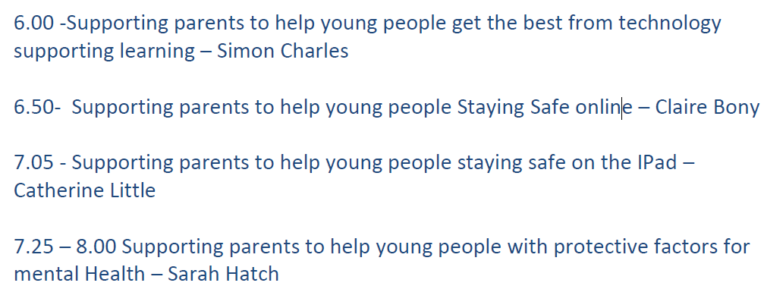


Slide 3
Supporting parents to help young people get the best from technology supporting learning –
Simon Charles and Anne Delaney

Slide 4



How technology supports learning at PHS

Slide 5
Aims
By the end of this session, you will know
how students use technology to access their learning
how teachers communicate homework
how technology helps make learning more accessible

Slide 6
how students use technology to access their learning
Teachers at PHS use technology to support all stages of the learning structure in their classes.

Slide 7
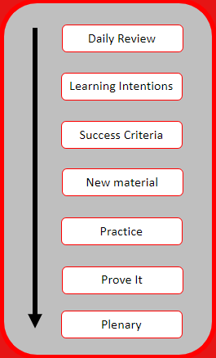
DAILY REVIEW: Kahoot, Whiteboard, Microsoft Forms
LEARNING INTENTIONS: Teams, OneNote
SUCCESS CRITERIA: Teams, OneNote
NEW MATERIAL: A range of apps and resources, shared on Teams or OneNote
PRACTICE: A range of apps including Word, Powerpoint, Teams, OneNote, Camera, Microsoft Lens
PROVE IT: Whiteboard, Quizlet
PLENARY: Post-Its, Forms, Kahoot, Glow blogs

Slide 8
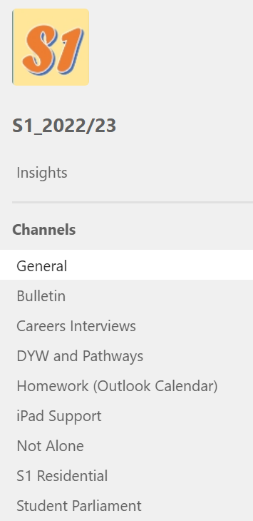
MICROSOFT tEAMS
Teams acts a central hub for classes, voluntary groups and year groups.
On the year group teams, students can :
Access the daily bulletin and assemblies
Find support about mental health or ICT issues
Communicate their views with the Student Parliament
Learn about careers opportunities, PE and school trips

Slide 9
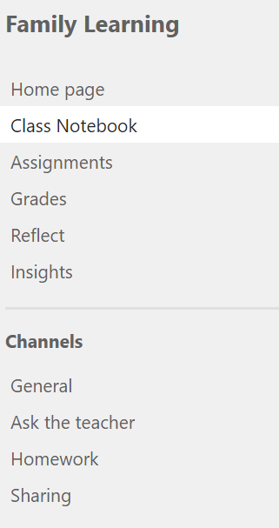
Class teams
Here, students can:
Access classwork and homework assignments
Share work they have completed in class for feedback
Ask teachers questions about their learning
Access files and the class notebook

Slide 10
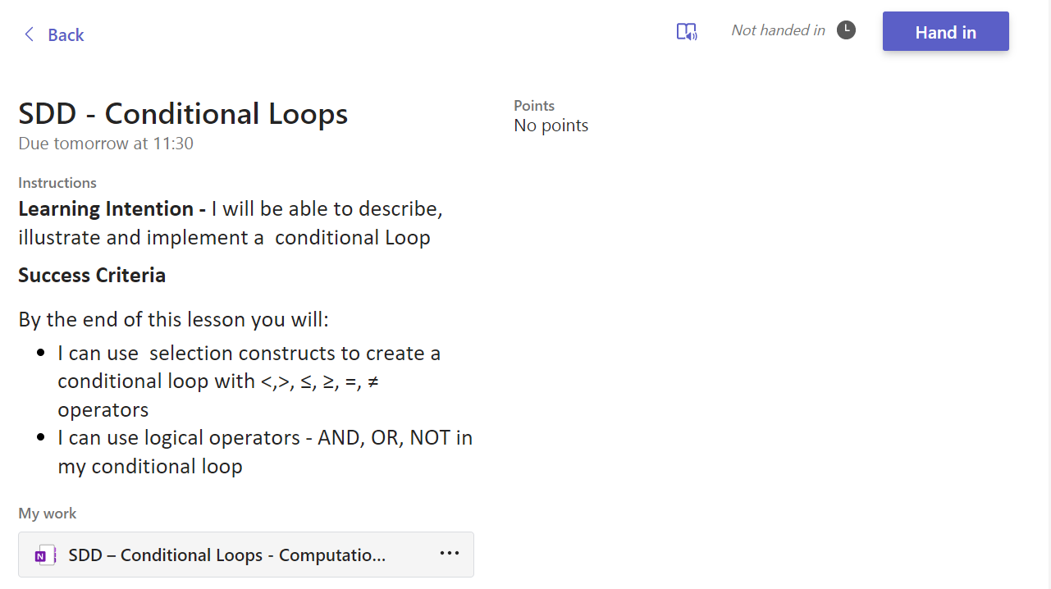
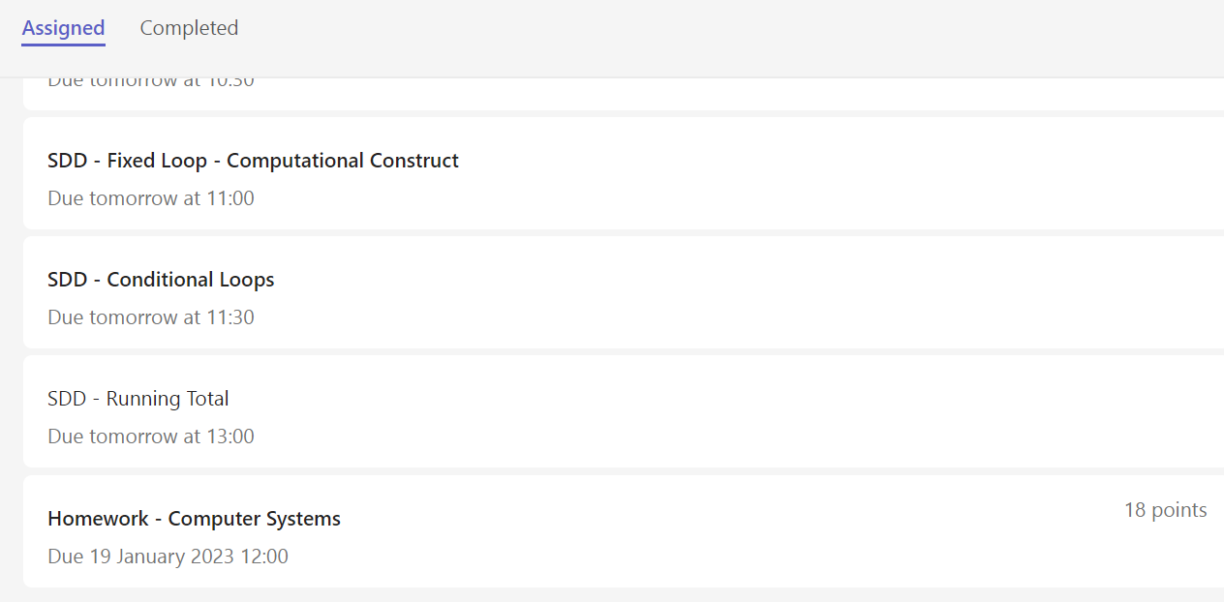
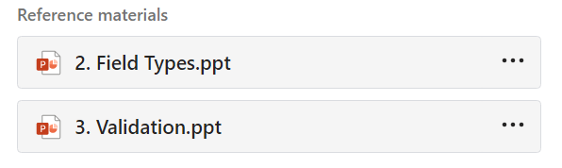
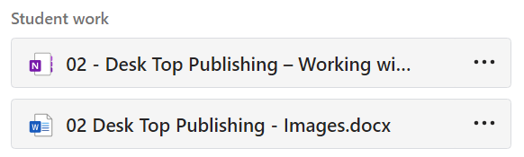
ASSIGNMENTS

Slide 11
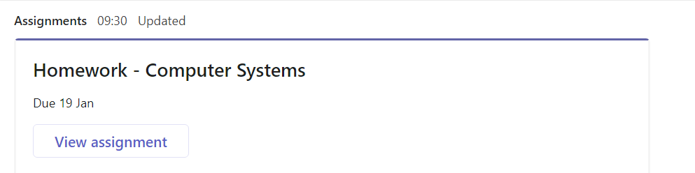
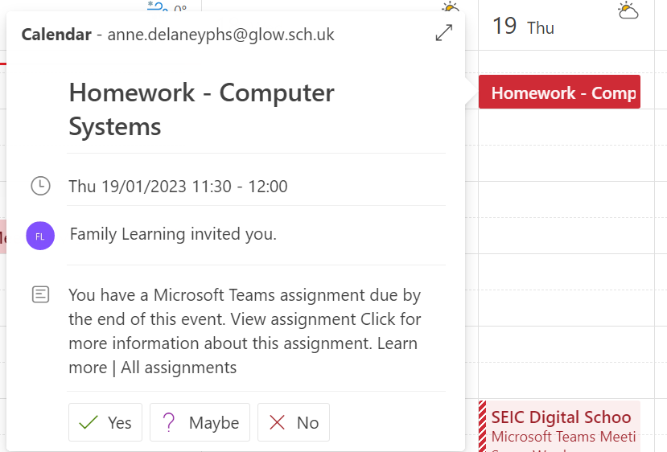
Homework

Slide 12
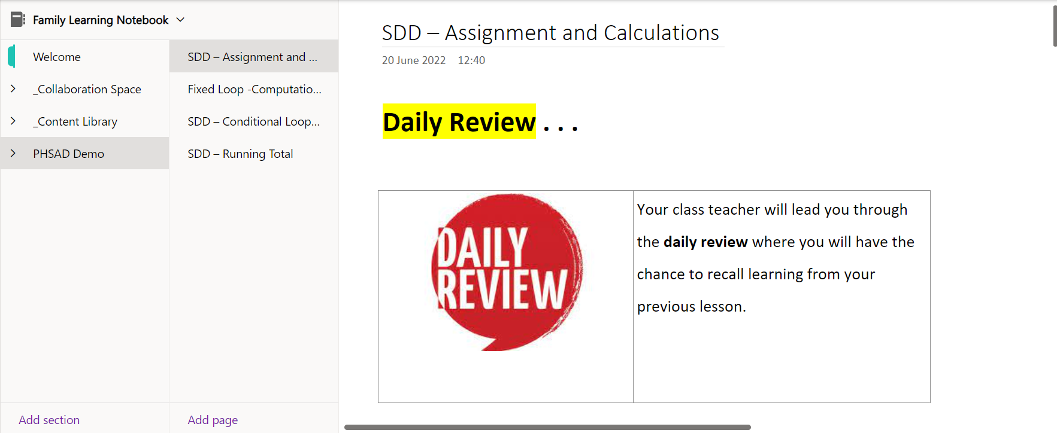
Onenote
The Content Library: Contains content that teachers have created to help pupil learning, but pupils cannot edit this.
Pupils Folder: Contains content for pupil learning that young people can edit and add to.

Slide 13
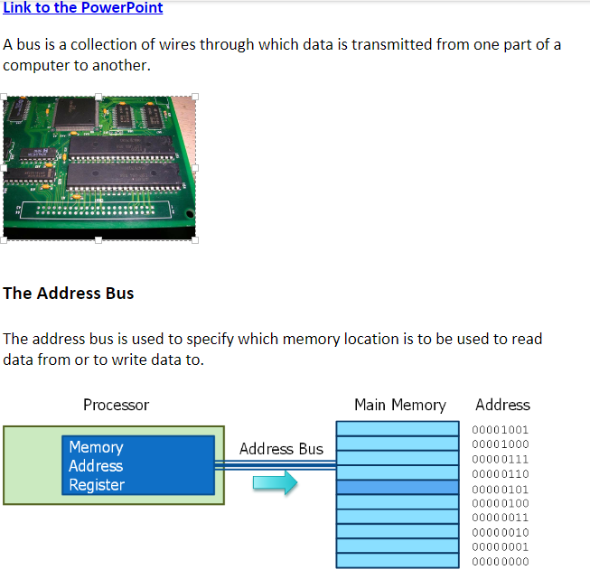
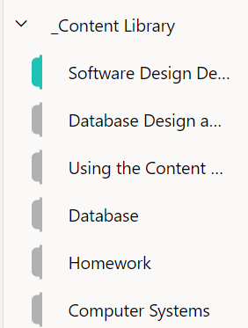
Onenote – Content Library

Slide 14
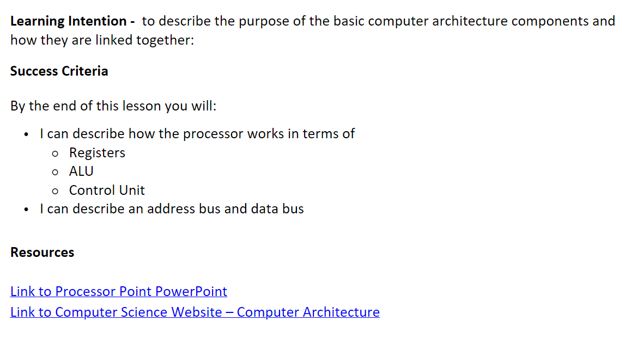
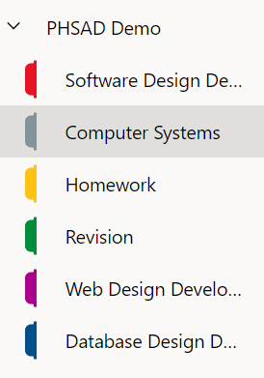
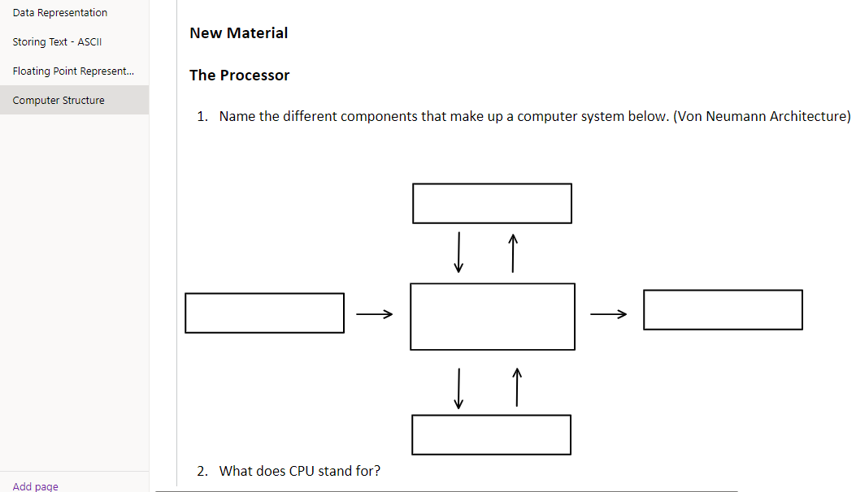
Onenote – Pupil Folder

Slide 15
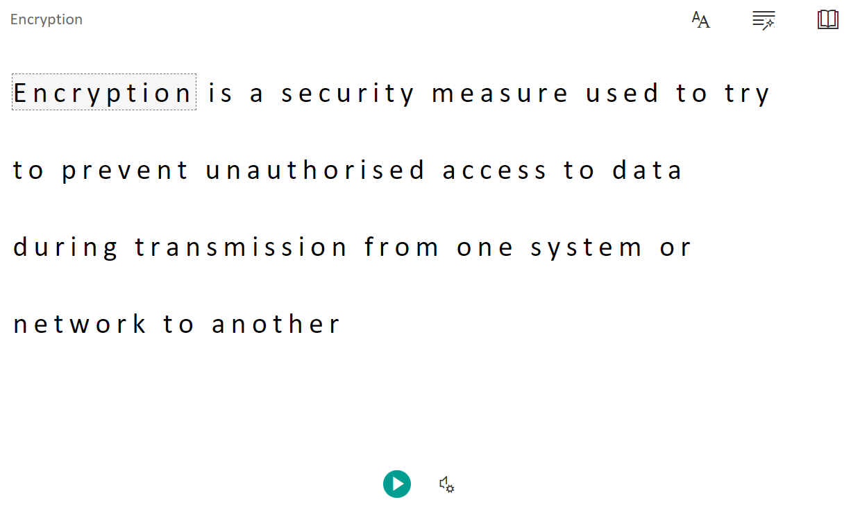
Onenote - immersive Reader
Allows the user to edit immersive reader text and background
Allows the user to display syllables and check different grammar
Allows the user to change the line focus, translate the language and add a picture dictionary

Slide 16
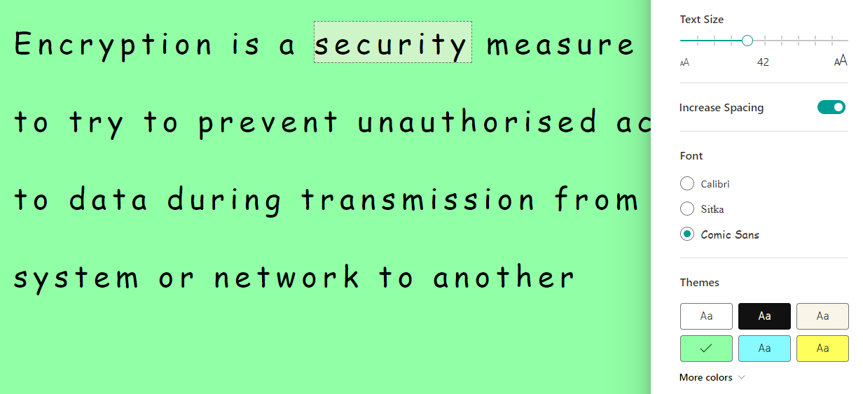
ONENOTE - IMMERSIVE READER

Slide 17
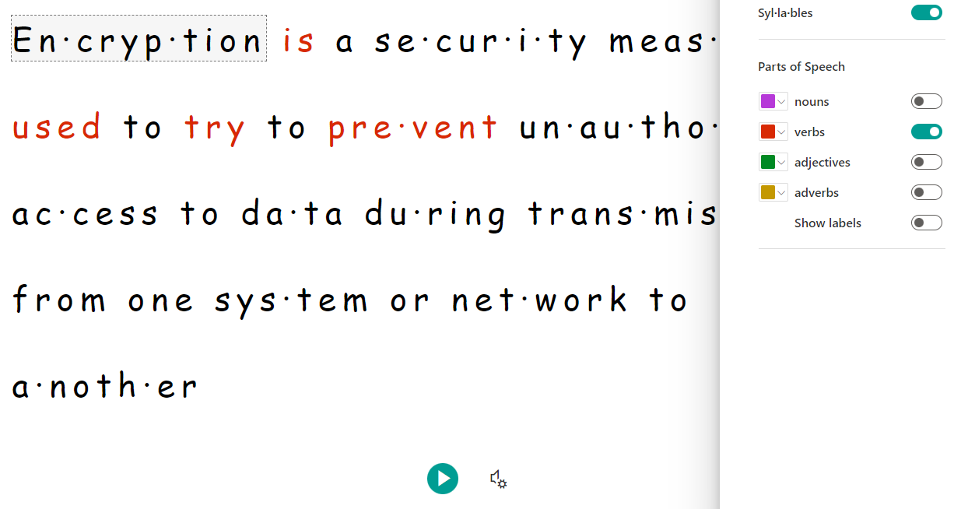
ONENOTE - IMMERSIVE READER

Slide 18
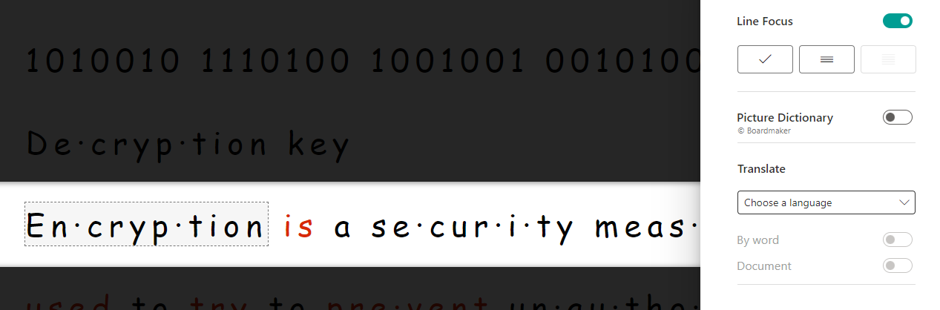
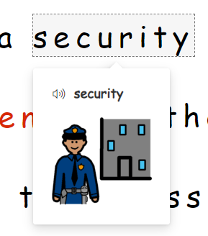
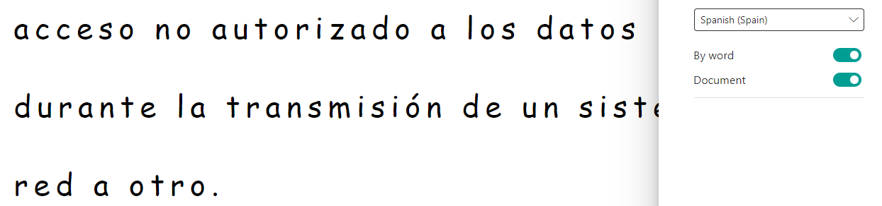
ONENOTE - IMMERSIVE READER

Slide 19
Supporting parents to help young people Staying Safe online –
Claire Bony

Slide 20

INTERNET SAFETY
Staying Safe Online
Claire Bony
Inspire Learning Team

Slide 21
Children need to:
understand healthy and unhealthy behaviours within online and offline friendships and relationships
understand the importance of permission and consent, in particular in relation to sharing images and videos
identify signs of manipulative, pressurising or threatening behaviour and respond safely to it
understand the importance of seeking help from a trusted adult when they need it

Slide 22






National Guidance
Cyber Resilience and Internet Safety are key concepts within Digital literacy from early to 4th level
Notes:
Our national policy and curriculum documents tell us digital should be at the heart of good learning and teaching.
The 2016 Review and refresh of the Technologies experiences and outcomes and also creation of benchmarks made way for Digital Literacy (previously known as ICT to enhance learning) and Computing Science sit within the technologies area of our curriculum.
Quality Indicator 3.3 in How Good is Our Early Learning and Childcare, Developing creativity and skills for life and learning, Digital Skills, talks about settings having a clear rationale for developing children’s skills in using and exploring digital technologies including staying safe online. A feature of highly effective practice states Children are enabled to take risks, learning in safe, secure and supportive environments where they are expected to make decisions and where their contributions are valued.
We have already mentioned links to the health and wellbeing curriculum and Realising the Ambition.
Other national policy that Digital Learning and Teaching strategy, Digital Strategy for Scotland , Cyber Security Strategy for Scotland and STEM Strategy.
Enhancing learning and teaching through the use of digital technology - gov.scot (www.gov.scot)
Cyber resilience: learning and skills action plan 2018-2020 - gov.scot (www.gov.scot)
STEM strategy for education and training: first annual report - gov.scot (www.gov.scot)

Slide 23

Notes:
We believe learners should have clear and simple messages about internet safety. The apps and platforms they use, and the behaviours that come with those, changes all of the time. That is why our internet safety message is:
SAFE
SMART
KIND
Children and young people should learn how to keep themselves and their reputation safe online.
They are beginning to develop an understanding of how the internet works and how to use this to their advantage, whether that is for life, learning or work.
Our learners should be kind to one another, and promote kindness to others both face to face and online.

Slide 24
What are they doing online?
Online gaming – 59% of 5-15s play games online
Connecting – 70% of 12-15s have a social media profile
Watching videos – 90% of 12-15s watch videos on YouTube
Staying informed – 27% of 12-15s see social media as their most important news source
Source: Children and parents: media use and attitudes report, Ofcom (2019)
Notes:
Slide 10: What are they doing online?
Statistics are taken from Ofcom’s ‘Children and parents: media use and attitudes report 2019’.
Online gaming – 59% of 5-15s play games online. The likelihood of children gaming online increases with age. A quarter of 12-15s who play games say they have played against people they don’t know.
Connecting– 70% of 12-15s have a social media profile. Facebook is decreasing in popularity, whereas Instagram, Whatsapp, Snapchat continue to rise.
Watching videos – 50% of 3-4s watch videos on YouTube rising to 90% of 12-15s. Children are spending less time watching the TV and more time consuming video content online. Videos can include vlogs, gaming videos, tutorials, and craft videos.
Staying informed – social media is becoming an important source of news. For 12-15s, TV is still top for media consumption but closely followed by social media. Facebook most popular social media source.

Slide 25
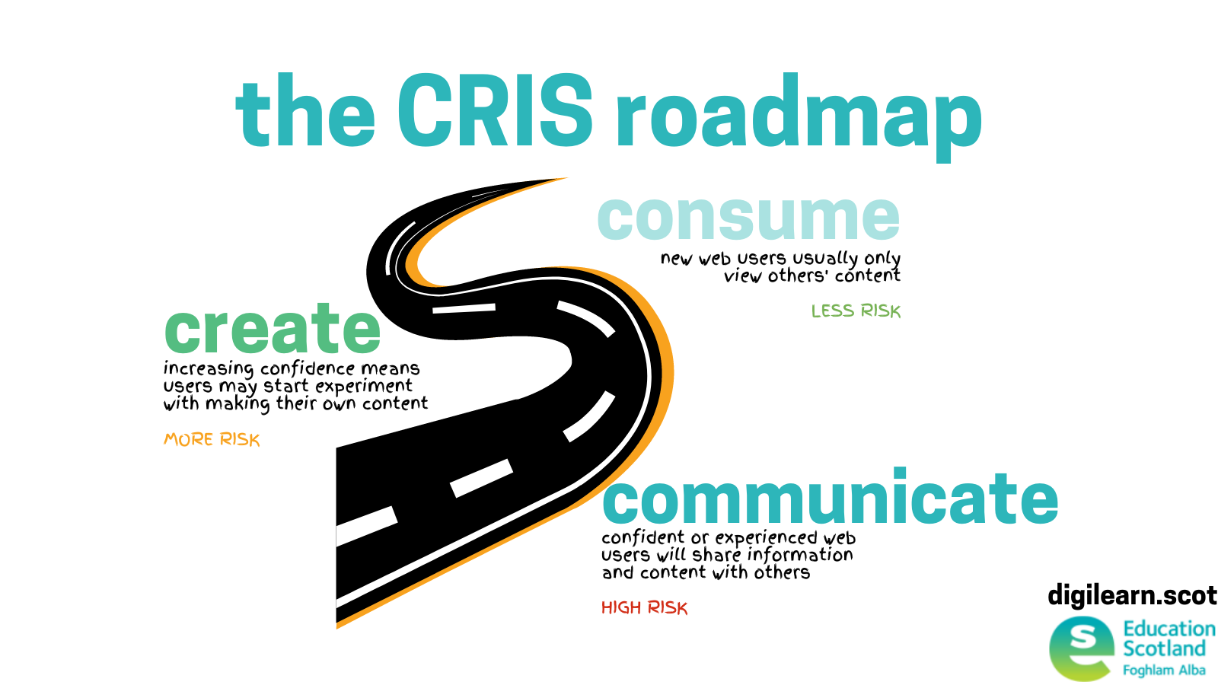
CR-IS CYBER RESILIENCE AND INTERNET SAFETY
For Scotland's learners, with Scotland's educators
Notes:
Children and young people are spending an increasing amount of time learning, playing and socialising in online environments. The risk roadmap can help you understand where your learners are on that journey and the type of support they may require.

Slide 26

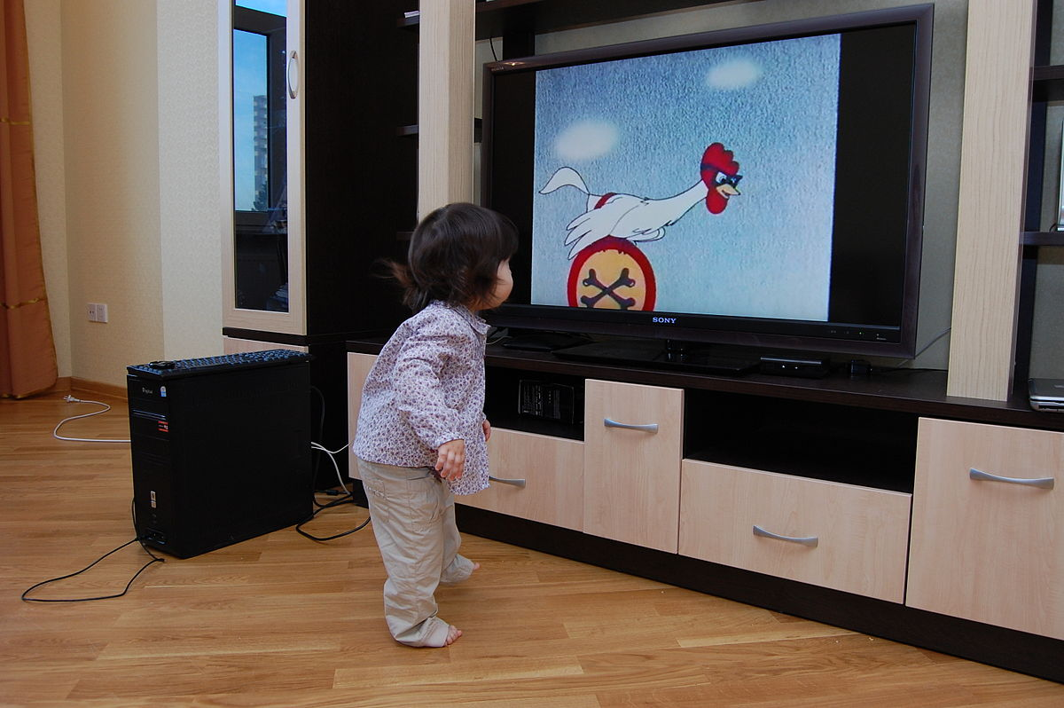
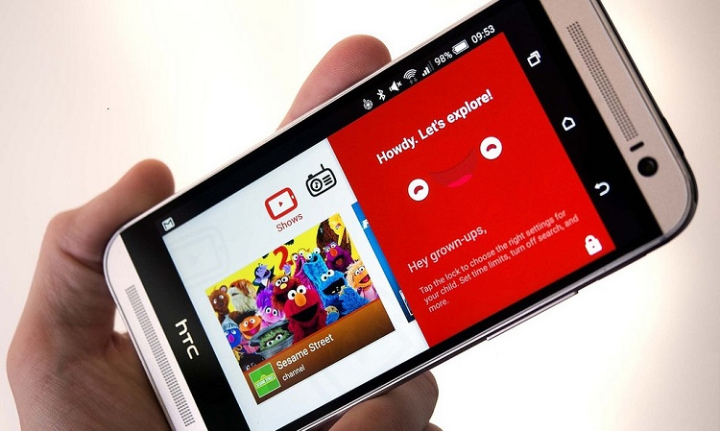
CONSUME, CREATE, COMMUNICATE
Consuming (less risk)
What content can they see/hear?
Is it appropriate?
For Scotland's learners, with Scotland's educators
Notes:
Digital technology allows us to access information at the click or tap of our fingers. If children are enthusiastic to find an answer to a particular topic, we no longer have to wait until we can access a book to help them research to find the answers. We no longer have the problems of a scratched CD or a cassette tape with the tape all pulled out and tangled because we can instantly stream music.
Click
Scotland’s national policy for Early Years, Realising the Ambition talks about digital technologies providing opportunities for us to design unique learning spaces for the children. Bringing resources and experiences virtually into the setting can lead learning well-beyond what was originally planned. There are so many wonderful opportunities for young children to learn through virtual environments that has bridged a gap in more recent times, for example, accessing recordings of their practitioners from nursery or grandparents reading them a story or joining live streams with Bookbug.

Slide 27

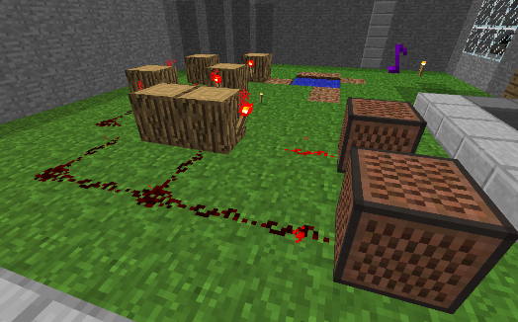

Creating
(more risk)
Do we have consent and permission?
What is appropriate/safe content to create?
Notes:
We have a key questions to be asking when children are creating content.
In terms of the health and well being curriculum, there are very obvious links here to social wellbeing around responsibility and respect for one another. It is always good practice to encourage children to ask for the permission of another child before taking their photograph or asking or inviting them to be in their video. This helps children to develop their awareness of consent and equip them with the confidence to be able to say “no thank you”, or “I am not comfortable with that photo can you please delete it?” Other important conversations to have are what sort of content is appropriate to capture and developing an awareness of what is private information and what is for sharing. For example, agreeing that it is not appropriate to capture media near the bathrooms because some part of our bodies are private or if someone is upset or has fallen over they probably won’t want you to record them in a video, or when someone is mid bite into a sandwich etc.
It is also important to talk about appropriate language and be respectful of the feelings of others when creating content.
Image credit: https://images.app.goo.gl/NdpisQ8YD5m9vSvW6

Slide 28


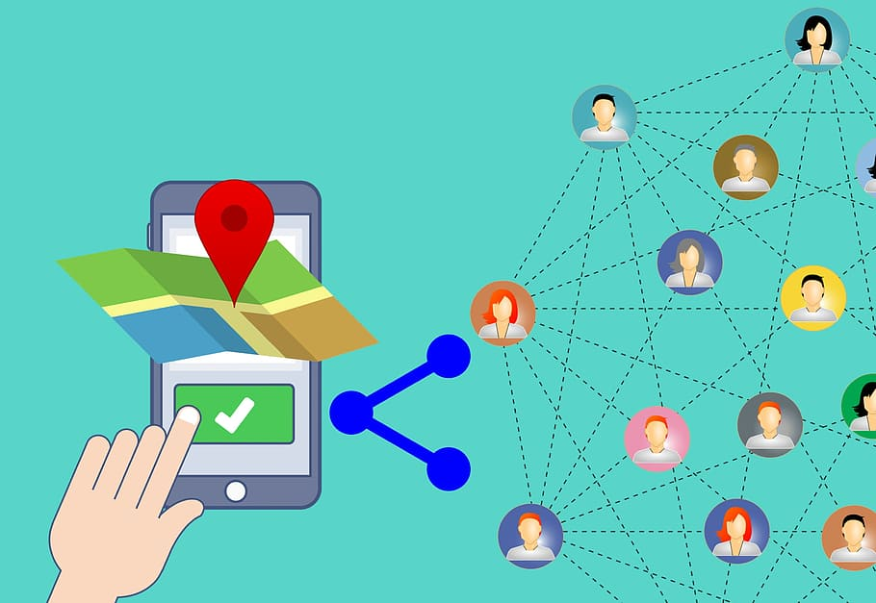


Communicating
Does the app/site have communication features e.g., chat, video chat, livestreaming?
What is appropriate/safe content for communicating/sharing?
Has everyone involved given permission and understood where content will be shared?
Where is the content being shared?
Who is the content being shared with?
Can anyone respond to the content (comments, likes, reshare etc.)?
High Risk
For Scotland's learners, with Scotland's educators
Notes:
We have a few key questions to be asking when children (and adults) are creating and sharing content.
Are we aware of the apps that enable you to connect with a stranger via chat or video call. Do we have facetime or video calling enabled and can the children access this and accidentally dial a number or accept a random call. What about livestreaming? Many social media apps have this feature built in, and at the tap of a finger you can be broadcasting with video and audio to an unknown audience.
As we have mentioned it is good practice to encourage children to express their right to have a photo deleted and to understand consent when media is being captured. It has become very normal to have your life digitally documented, from the scan photo being shared on social media, to the first day of school photos. Children are accepting of this and trusting of adults and need to be supported to understand that they have the right to protect their identify and become aware of their digital footprint from as early on as possible. Do you involve children in the process and select the content together? This is where you can have conversations that help children to develop an understanding of why it is important to keep certain information private for example later on in life when they are learning about protecting their location and sensitive information such as dates of birth and home address etc.
As well as seeking permission from parents and carers, which will differ subject to your local authority or organisation permissions, when capturing content it is important that the children are aware of where it will be shared and who will see it to ensure they are comfortable with this too. Does everyone involved understand what an online journal or a blog is? Do you clearly explain this? Who is responsible for publishing and posting content? Do you have a peer reviewing system to ensure those without permission do not accidentally appear online?
These are they types of conversations that help children to develop an understanding of why it is important to keep certain information private for example later on in life when they are learning about protecting their location and sensitive information such as dates of birth and home address etc.
Click
We also need to be aware of the types of apps that track and share locations. Do we want to be sharing our exact location when posting photos of the forest area we visit on the same day each week? Does the online space we are communicating on allow comments to be posted? Do we have control over these? Can we choose to accept or ignore, who is responsible for moderating what has been shared? Can it be reshared beyond the source? Have you explored all the privacy settings.?

Slide 29
The Importance of Talking to Young People
Notes:
Slide 13: Viewing
The internet provides lots of opportunities for young people to learn and gain information and support, but it is a public and open place, one where anybody can post and share content. This is part of what makes it such an exciting place, but it also means that children and young people could see violent or sexual content or other extreme material.
It is important to talk to young people about the things that they might see online. An example often cited is the age-inappropriate content viewed by children and young people in online gaming. Games made for an adult audience involve adult content, but they are often played by children and young people. Age restrictions exist to make viewers aware of the type of content in a game or app, and it is important that parents and carers are educated on age restrictions.
Games and apps enable children to share an incredible amount of information about themselves, have conversations with their friends and also potentially provide contact with people they don’t know. With this in mind, parents and carers should take age restrictions seriously.
PEGI (the Pan European Game Information) is an age rating system designed for gaming. It includes age ratings and content indicators to show the type of content included in the game, for example violence, sex, discrimination and drugs. Parents and carers should be informed of the PEGI rating system, as well as other age ratings for apps from the Apple store and Google, so that they can make informed choices as to whether they want their children using them.
Q. What other material can you use to inform parents/carers about the type of content included in games and apps?
A. Some examples may be YouTube clips of scenes from games, the NSPCC’s Netaware tool, videos from Internet Matters and the UK Safer Internet Centre.

Slide 30
Notes:
Slide 14: Sharing
There are many different ways to share online; photos, videos, personal information, location, live streaming and more. Some of the most popular sites and apps are designed to enable people to share information, pictures and videos. This is part of their popularity but can make it easy to share things that might present a risk.
Before information is shared, consider what they are sharing and who can see the content. Questions to consider:
What was shared? Was it a picture, video or personal information when chatting? Could the information be used to locate them? SnapMaps dangerous for locating
Who was it shared with? Many apps allow you to share with an individual or a small or large group of contacts. How many people can see the content that was shared? Do they know the people they’ve shared it with? Have they met them face-to-face? If they have never met them, what do they know about them? Have they ever felt threatened by them? Have they been asked to send inappropriate or nude images? If so, this is a matter for the police.

Slide 31
Notes:
Slide 15: Chatting
There are lots of different ways to chat online, providing young people with fun and exciting ways to communicate with their friends and family. These modes of communicating open up opportunities for young people to not only talk to friends and family, but also to gain information and support. Children and young people have said they find it easier to disclose personal feelings and private information online, which can be much easier than face-to-face. There has been an increase in young people using services such as Childline’s online chat with counsellors, for this very reason. However, online chatting can also make it much easier for offenders to build relationships and groom children and young people.
Explore the Thinkuknow websites for advice covering chatting online.

Slide 32
Notes:
Slide 16: Friending
It is not uncommon for a young person to have hundreds, possibly thousands, of friends on social media. The social web can sometimes be seen as a tool for young people to quantify their popularity by how many likes, friends and followers they have.
Children, and some adults, frequently refer to their online contacts as ‘friends’ even though they may never have met them face-to-face. They may feel comfortable disclosing private or intimate things to ‘online friends’ and are very credulous of who that person is telling them they are.
It is important for young people to know the differences between a friend in the real world, and an online friend. Some people online genuinely just want to chat or be friends, but others may put pressure on a young person or manipulate them, or may not be who they say they are. People who want to groom children will use any sites or services which are popular with young people. They can become very active in online games or communities popular with children. On social media they might send out multiple ‘friend requests’ at random in the hope that young people will accept them. In games and chat rooms they will try to start conversations with young people and then ask them to chat privately, perhaps on social media or on a mobile chat app.

Slide 33
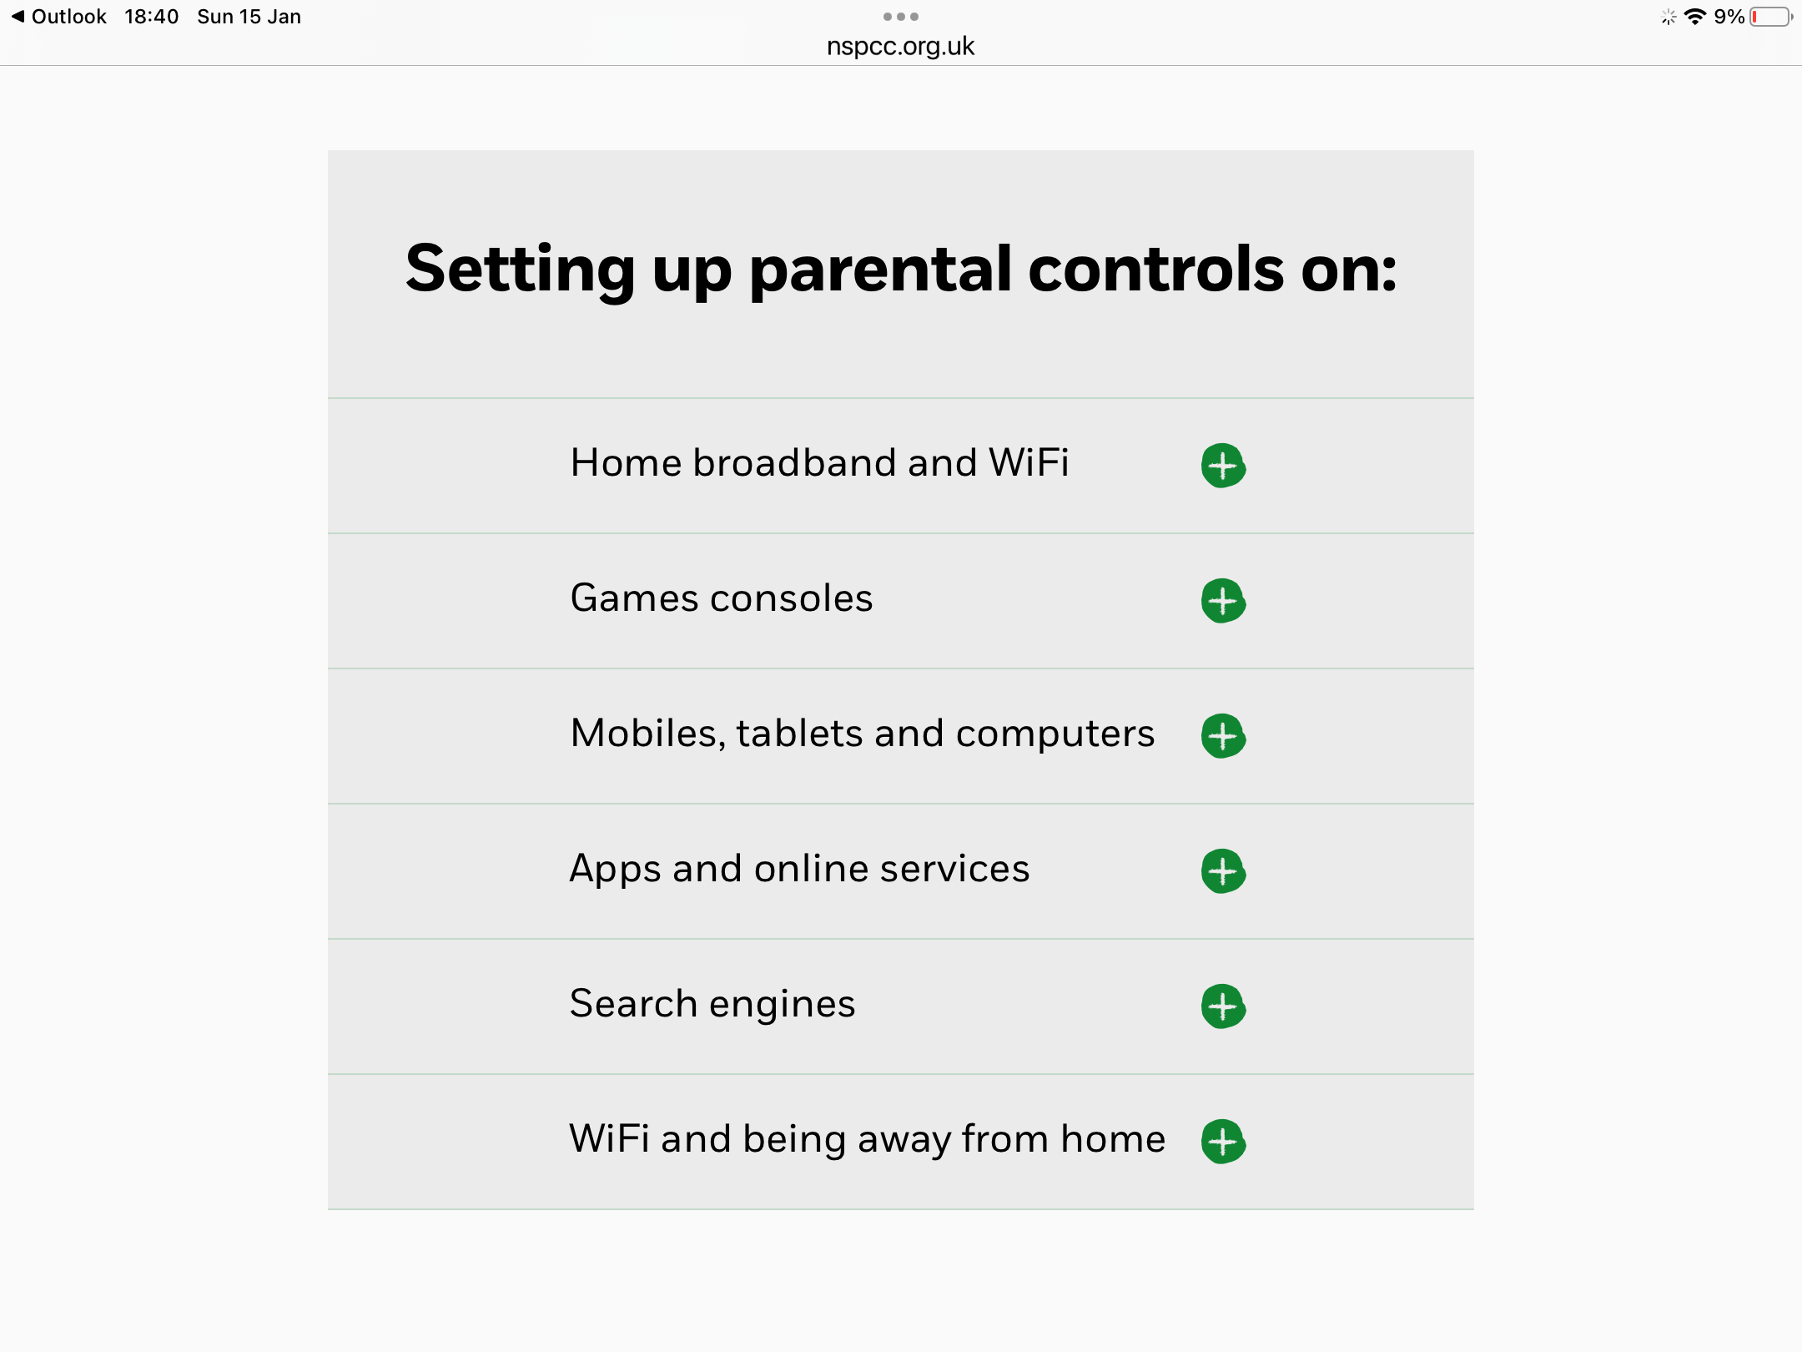
www.nspcc.org.uk

Slide 34

Manage Your Privacy Settings
National Cybersecurity Alliance https://staysafeonline.org
Change your privacy/security settings, but don’t know where to find them?
Direct links to update your privacy settings on popular devices and online services

Slide 35
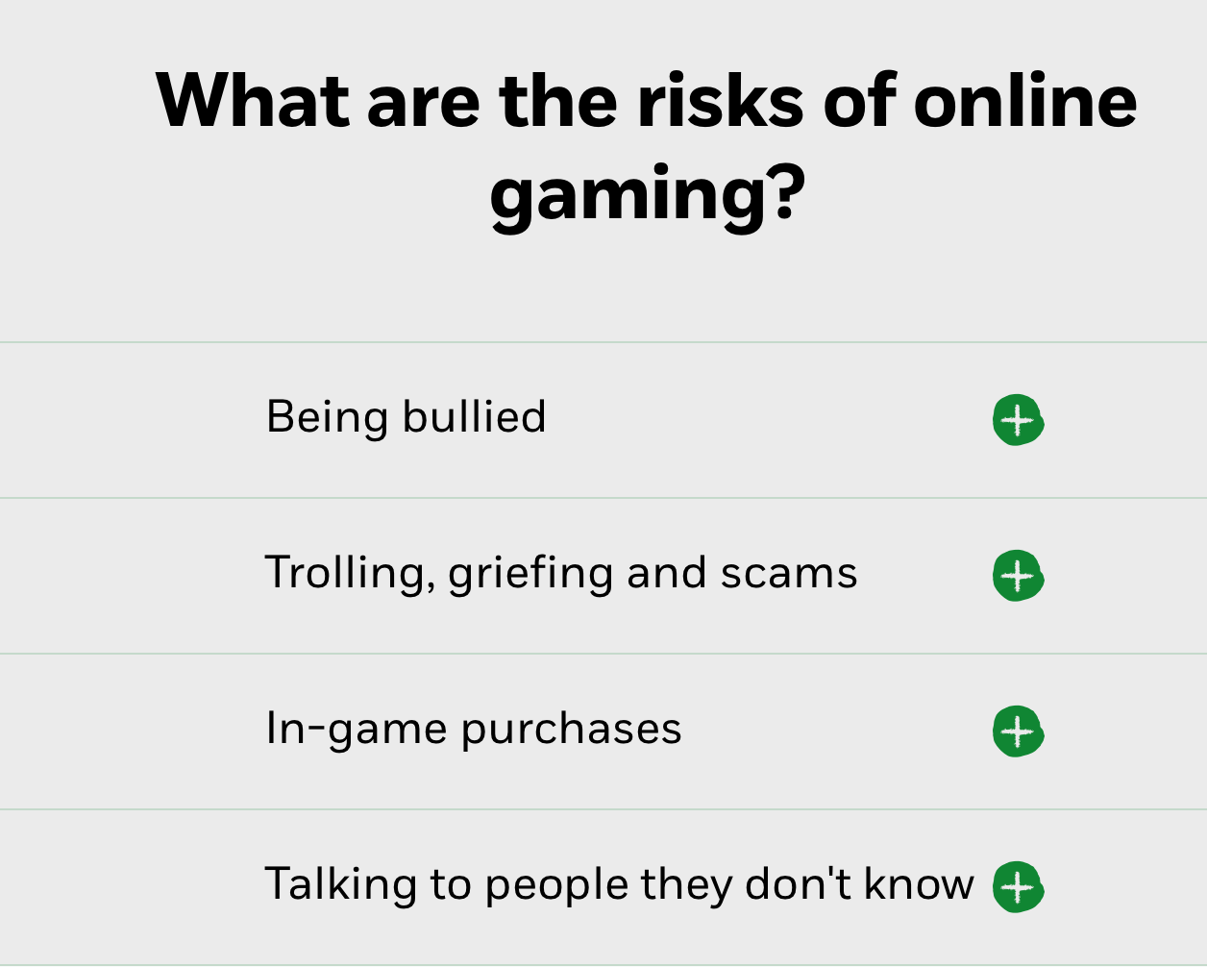


www.nspcc.org.uk

Slide 36
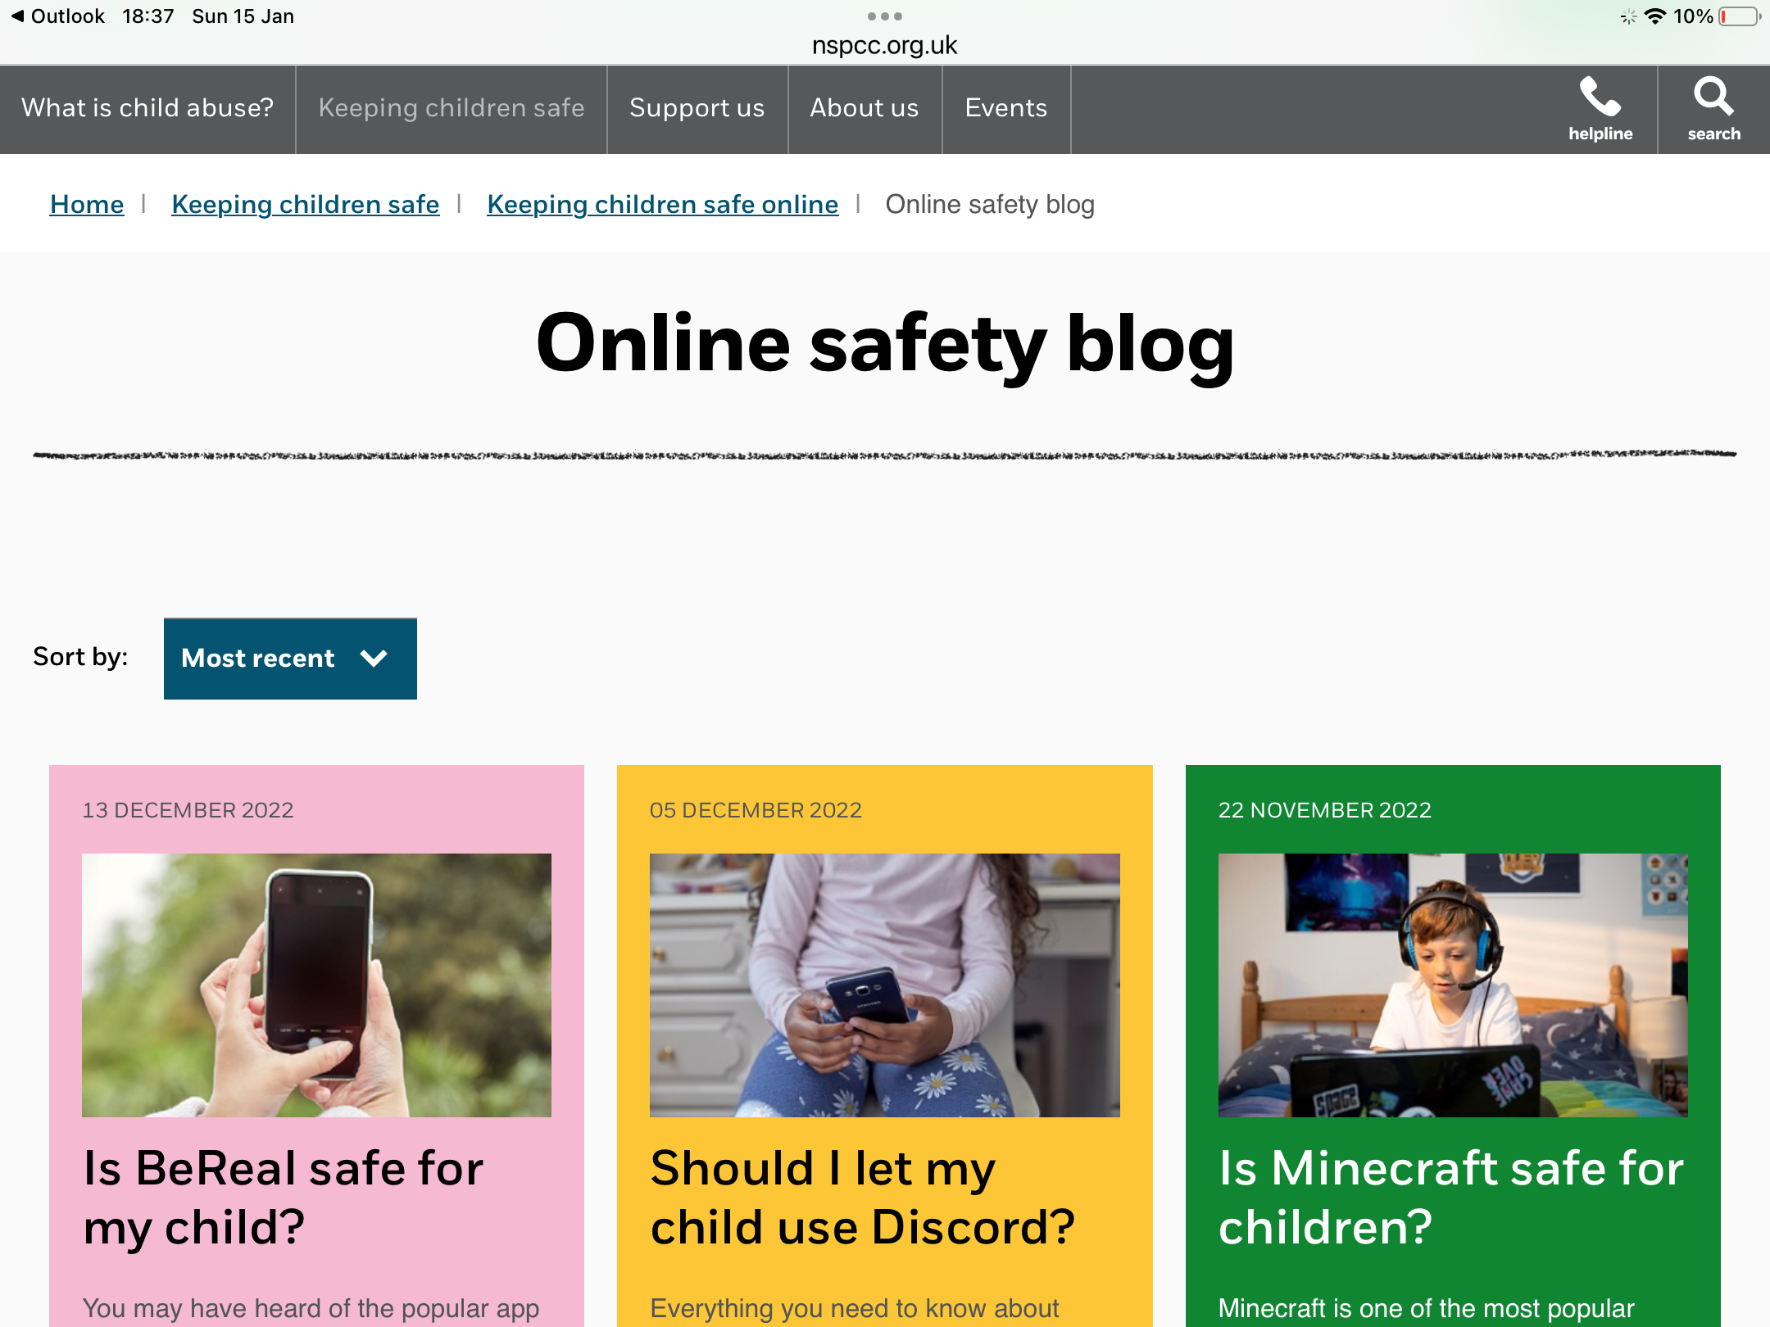
Knowing your APPS, GAMES & SOCIAL MEDIA
www.nspcc.org.uk
Notes:
Sites such as NSPCC Net Aware can help us find out more about apps and what features they have, e.g. location sharing, chat, live streaming etc but it is also important to encourage children to have open and honest conversations with adults they trust about what they are doing online. Showing that we are interested in particular apps and sensitively asking questions about it, or asking to join in and play the game from the offset can help build those relationships that will encourage children to talk about what they are doing online and come to us if they have any fears, worries or concerns. We also must take into account how we behave online and remember we are role models.
https://www.net-aware.org.uk/

Slide 37
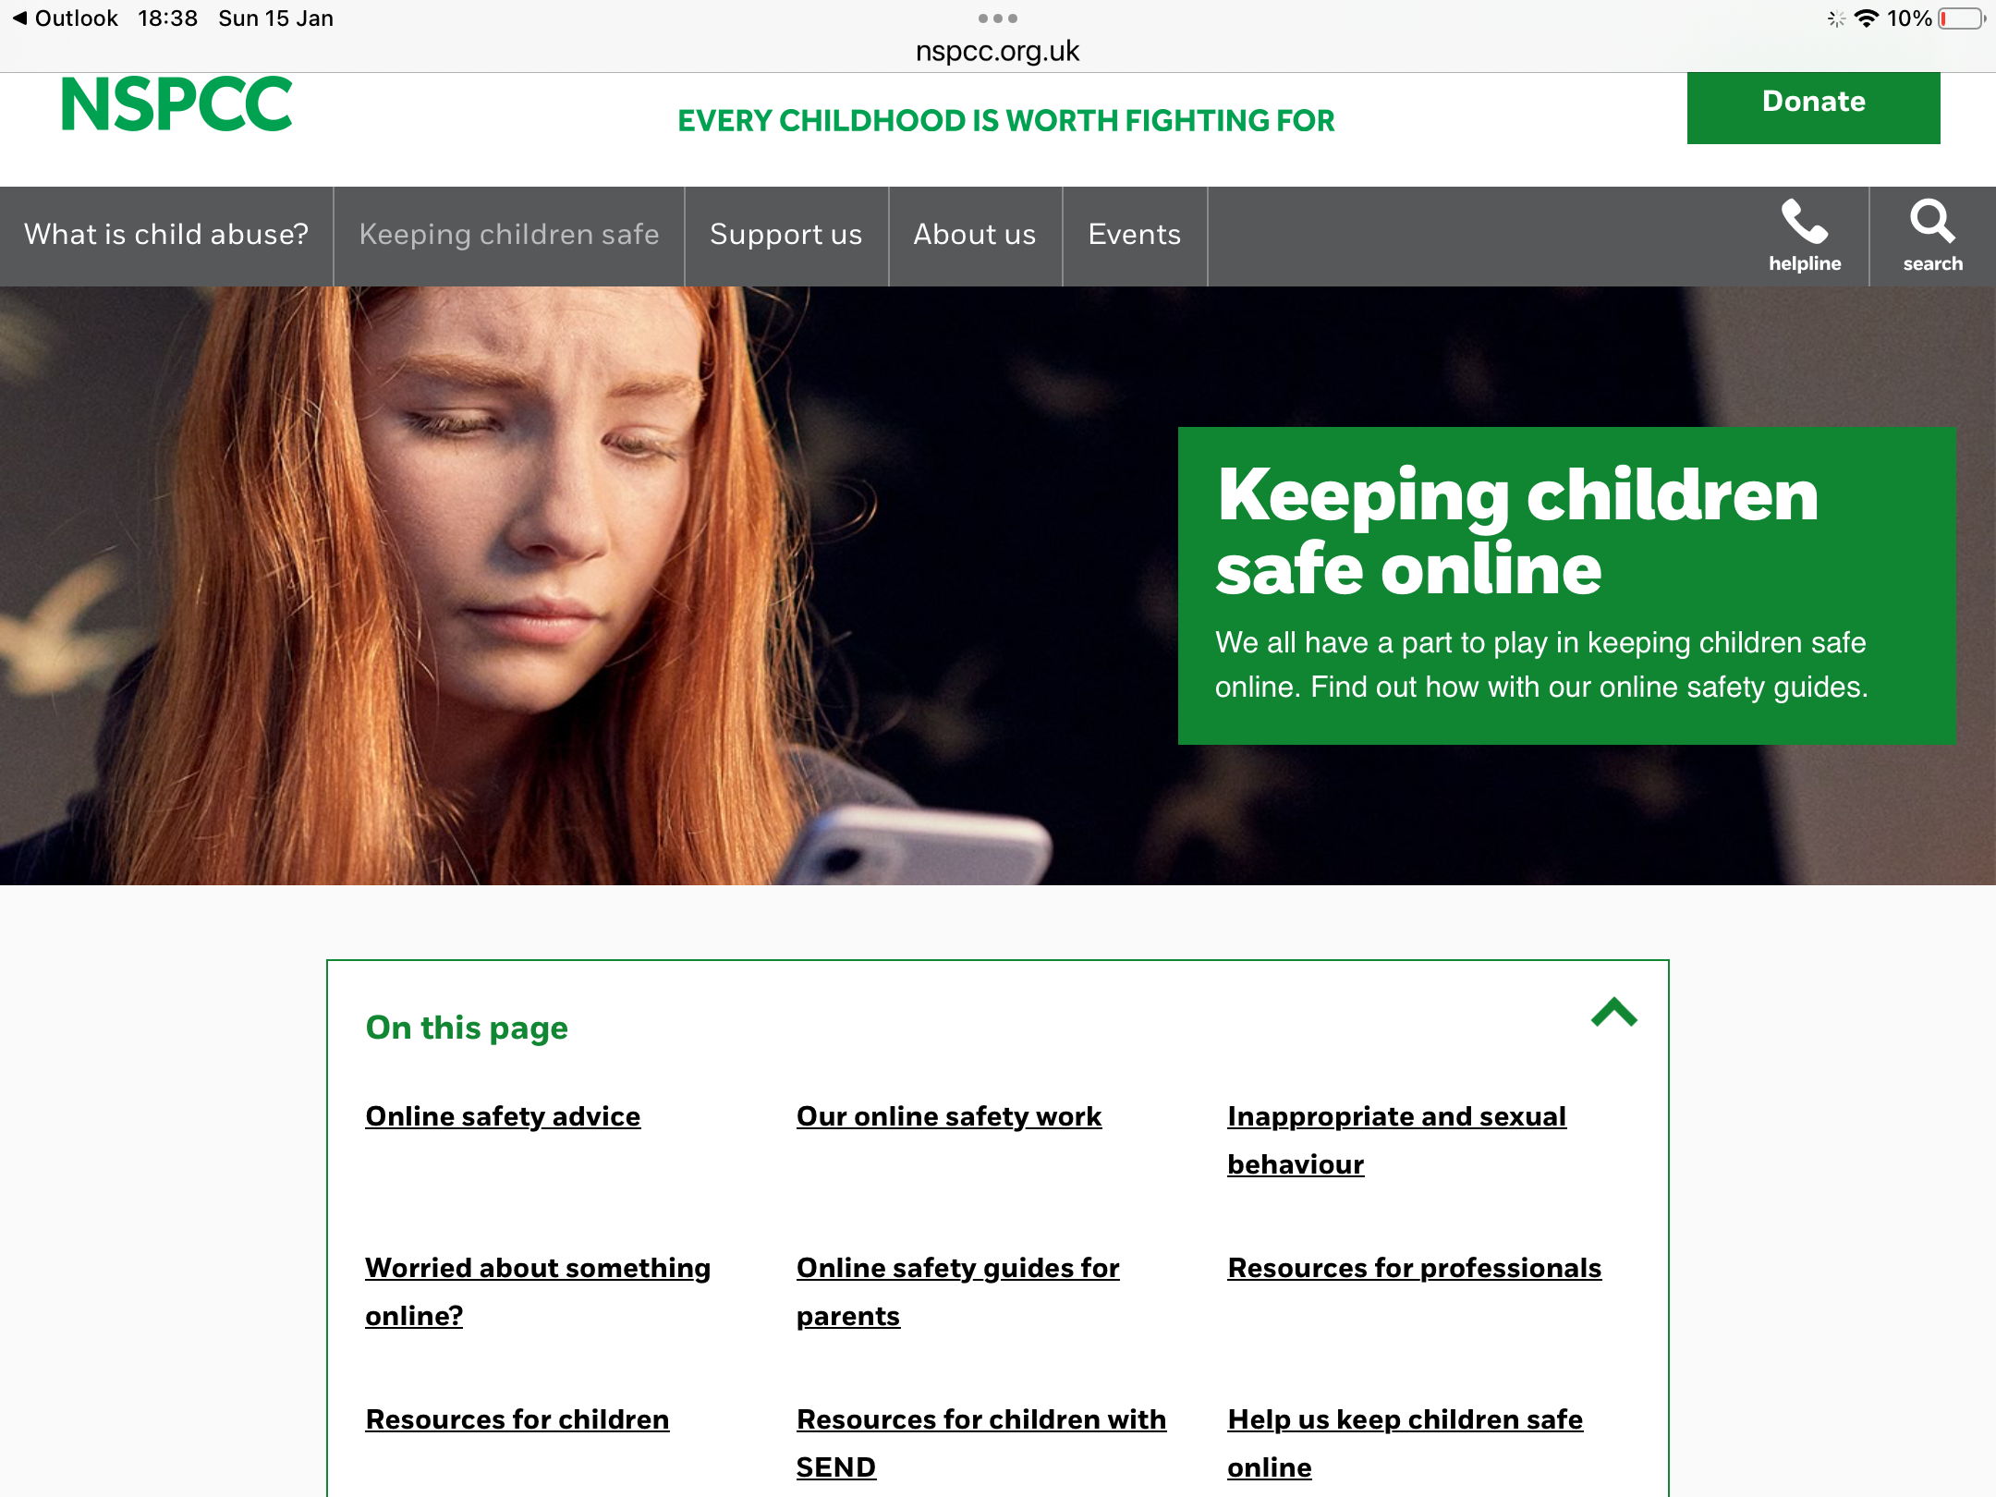
SAFETY GUIDES
nspcc.org.uk

Slide 38
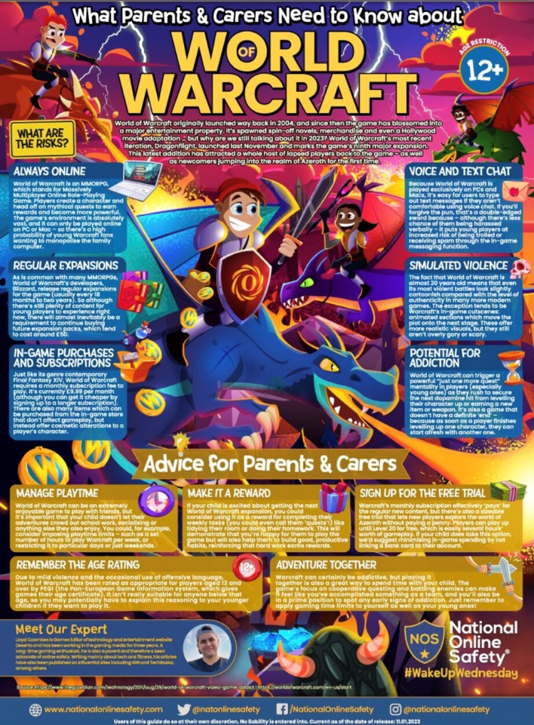

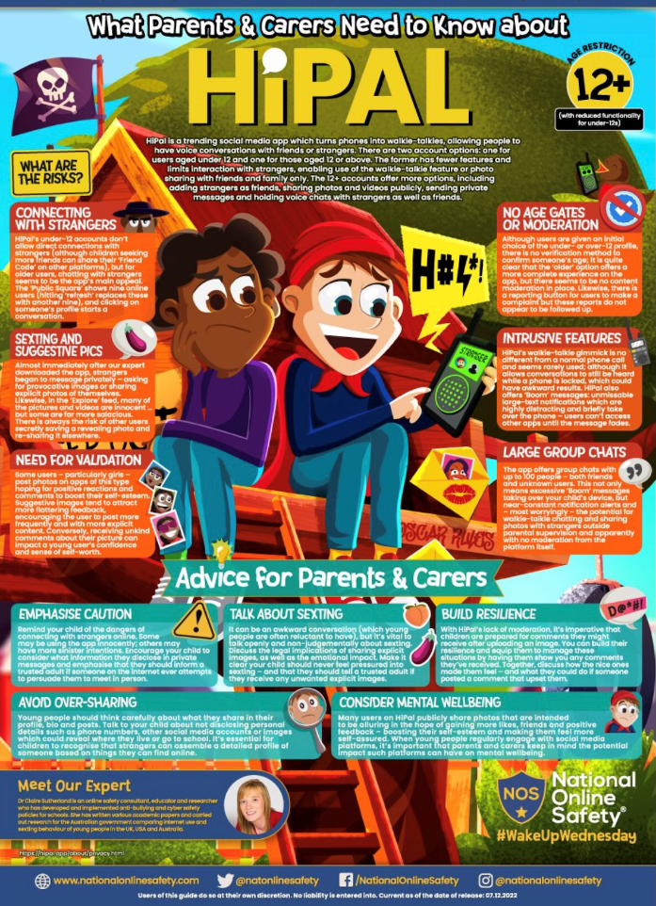

Keeping up to date #WakeUpWednesday

Slide 39
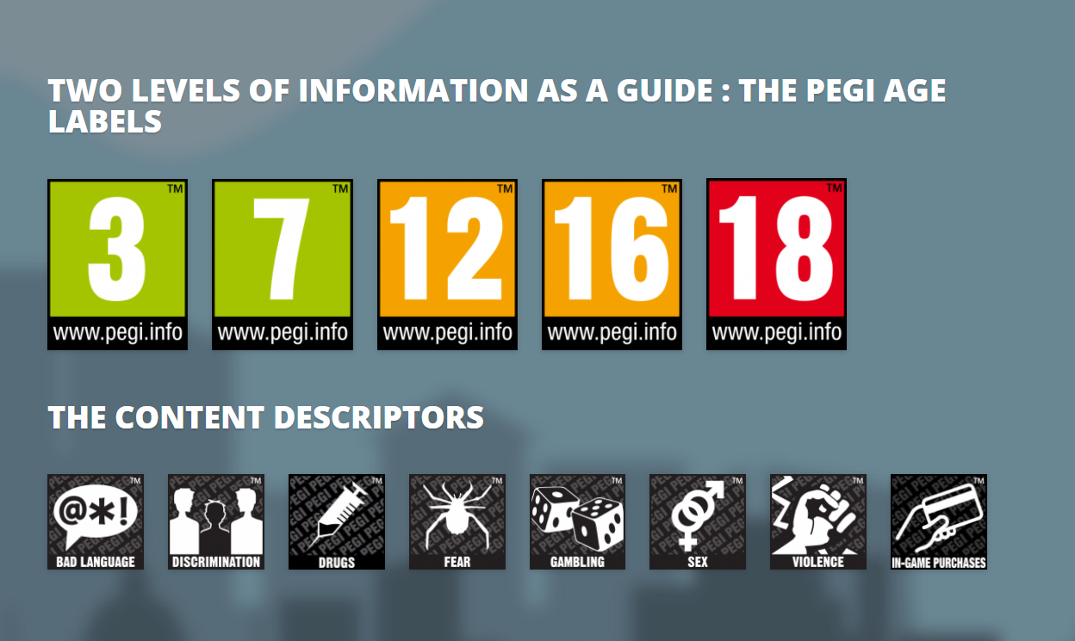
Gaming Guide
For Scotland's learners, with Scotland's educators
Notes:
Earlier we mentioned the importance of age restrictions. They exist to make us aware of the type of content in a game or app, and it is important that parents and carers are aware of this.
Games and apps enable children to share an incredible amount of information about themselves, have conversations with their friends and also potentially provide contact with people they don’t know. For example some of the animation creating apps aimed at children have a ‘share to YouTube’ feature that could mean at the click of a button children are able to share potentially sensitive information onto a hugely public online space without parents knowing.
PEGI (the Pan European Game Information) is an age rating system designed for gaming. It includes age ratings and content indicators to show the type of content included in the game, for example violence, sex, discrimination and drugs. Parents and carers should be informed of the PEGI rating system, as well as other age ratings for apps from the Apple store and Google, so that they can make informed choices as to whether they want their children using them.
Home | Pegi Public Site

Slide 40
Child Sexual Abuse and Exploitation
CEOP is the Child Exploitation and Online Protection unit within the National Crime Agency.
CEOP is committed to tackling child sexual abuse and exploitation (CSAE), both online and offline.
CEOP is a multi-disciplinary child protection agency.
Child centred approach.
Notes:
Slide 1: What is CEOP and what do they do?
CEOP is the Child Exploitation and Online Protection unit within the National Crime Agency.
CEOP is committed to tackling child sexual abuse and exploitation (CSAE), both online and offline.
CEOP is a multi-disciplinary child protection agency. Within CEOP there are law enforcement officers, social workers, education officers, intelligence officers, child psychologists and many more, all working together strategically to tackle child sexual exploitation and abuse. Working through a multi-disciplinary model enables CEOP to not only pursue offenders and protect those at risk, but also work to prevent young people becoming victims.
Child centred approach. CEOP has a dedicated Child Protection team consisting of specially trained social workers who are attached to all of CEOP’s operational investigations. All direct reports made into CEOP through the Click CEOP public reporting button are received and risk assessed by the Child Protection team, and all reports will be responded to by the relevant team within CEOP. In cases involving Child Sexual abuse And Exploitation of a child or young person, a Child Protection Advisor will respond directly. Working in this way ensures the child is always at the focus of CEOP’s work.

Slide 41
Notes:
Slide 7: New opportunities, role models and careers?
Young people today are growing up online. The internet today is very different to the ‘world wide web’ of the 1990s.
The internet has become so integrated into our lives that young people often do not distinguish between their online lives and their offline lives.
The internet plays a crucial role in the development of young people’s identities and relationships and will provide them with valuable opportunities to explore their passions and aspirations as they grow.
Amongst other things, the internet provides:
Opportunities for creativity and careers (e.g. YouTube, vloggers).
Deepening relationships with friends (e.g. connects with friends and family around the world).
Opportunities for learning (e.g online courses, YouTube tutorials).
Opportunities to gain support (e.g. peer on peer support, Childline).
Engagement in world issues and getting your voice heard (e.g. youth climate change movement, Greta Thunberg).
It is important not to lose sight of these opportunities when speaking to children and young people about their lives online. For online safety education to resonate with children and young people, it needs to reflect their perceptions of the internet, otherwise it can easily become ‘scaremongering’ and ineffective. Acknowledge the fun and exciting prospects of online life as well as looking at risks.

Slide 42
e: gw15bonyclaire@glow.sch.uk
@claire_bony

Slide 43
Supporting parents to help young people staying safe on the IPad –
Catherine Little

Slide 44

Staying Safe on iPad
Peebles High School Jan 2023

Slide 45


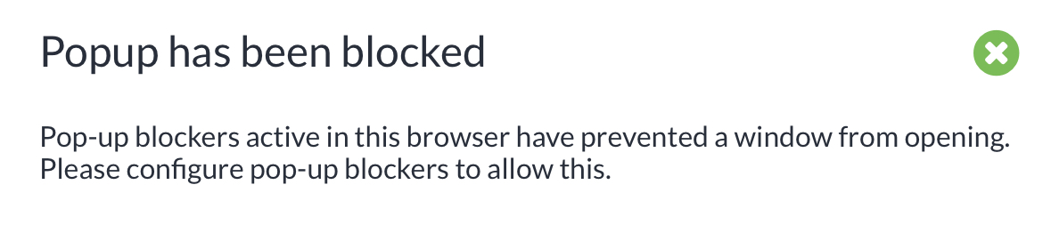
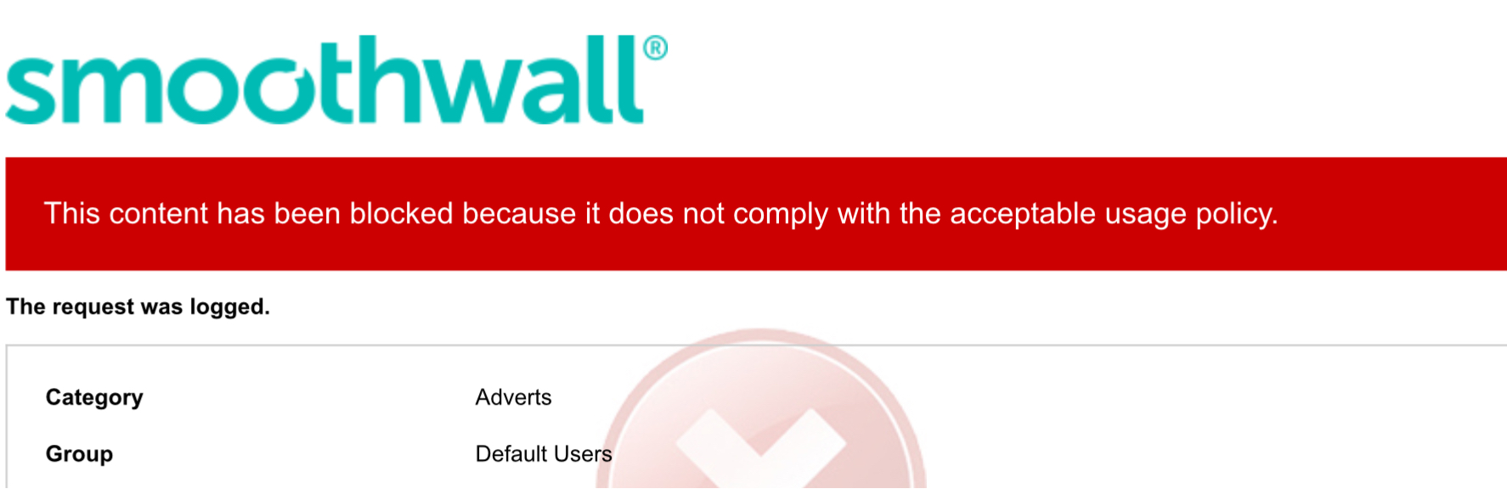

Inbuilt safety features
Remote Management System
Firewalls
Restricted setting in sites like YouTube
Ability to block websites very quickly

Slide 46
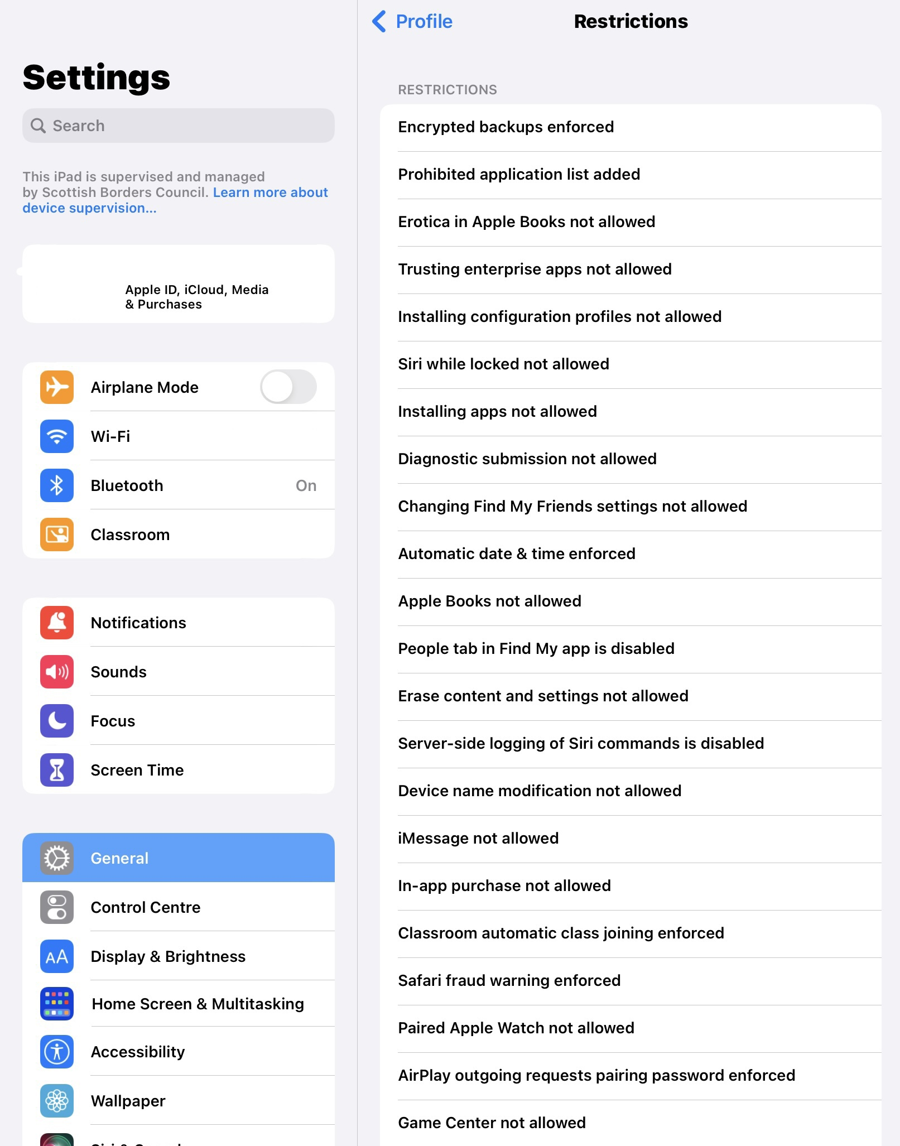
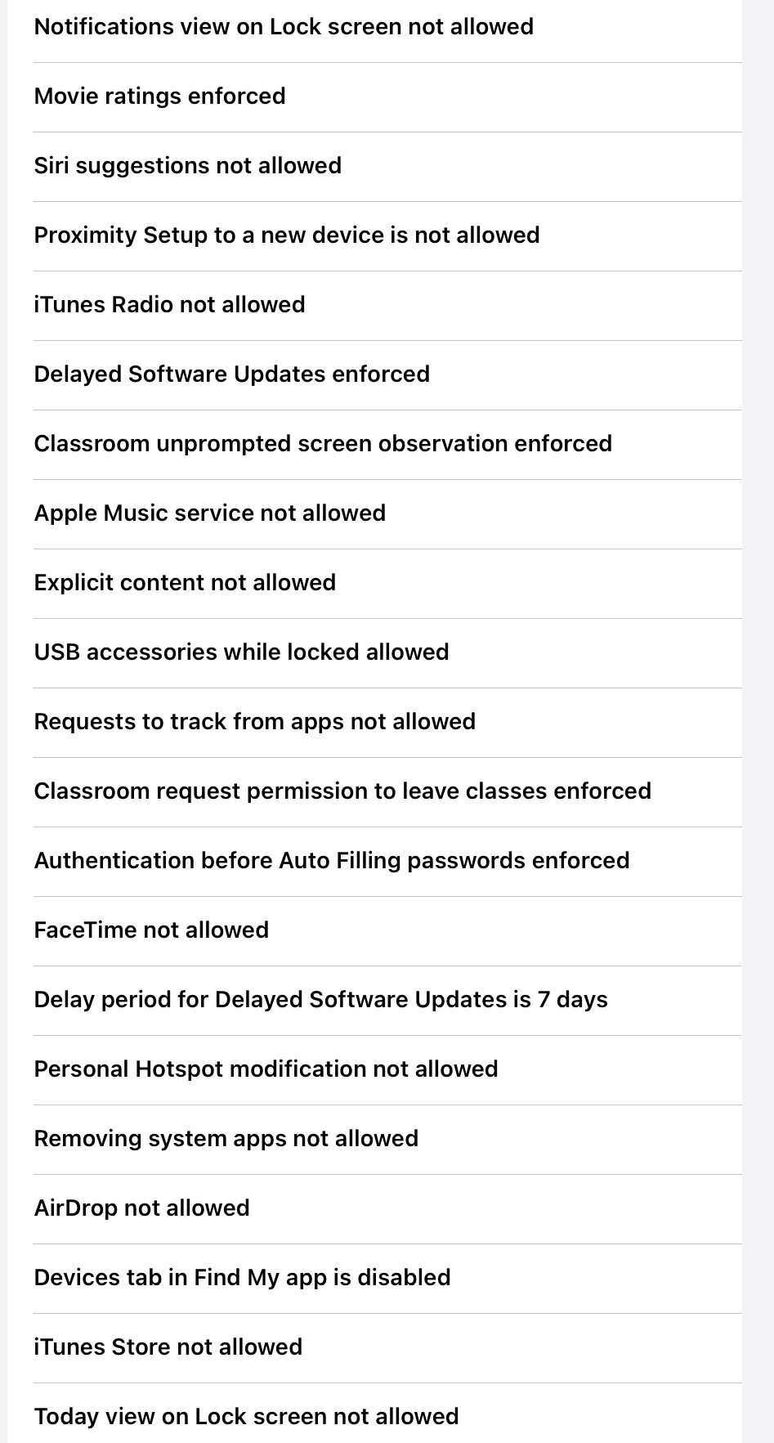
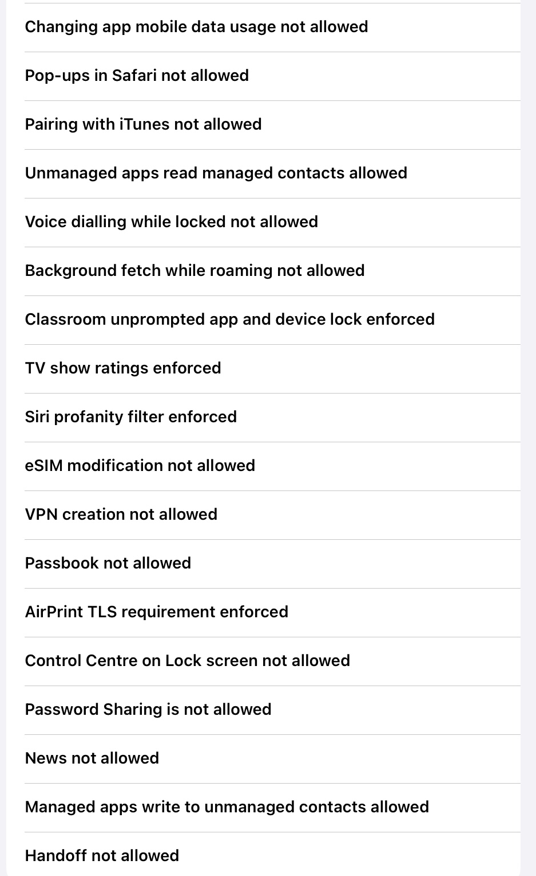

Slide 47
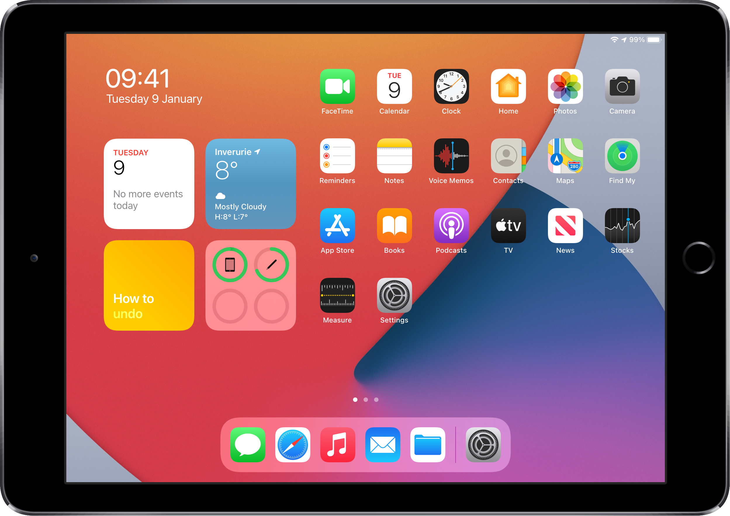

Preventing Issues
Settings
Software Updates
Apps regularly update automatically through Self Service
Stay signed in to Apple ID
Notify School if any issues

Slide 48
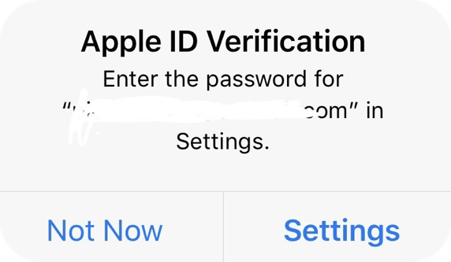
Keep Signed in to Apple ID
Apple ID Verification
Your child should know their Apple ID password and it should be entered whenever prompted to allow them to stay signed in and optimise performance of the iPad. Staff in school can reset this so please ask for help if having issues.
5
6
7
Username: jbloggs617@ea.scotborders.sch.uk
Password: usually a 6 digit number
8
9

Slide 49
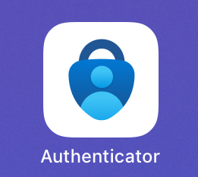
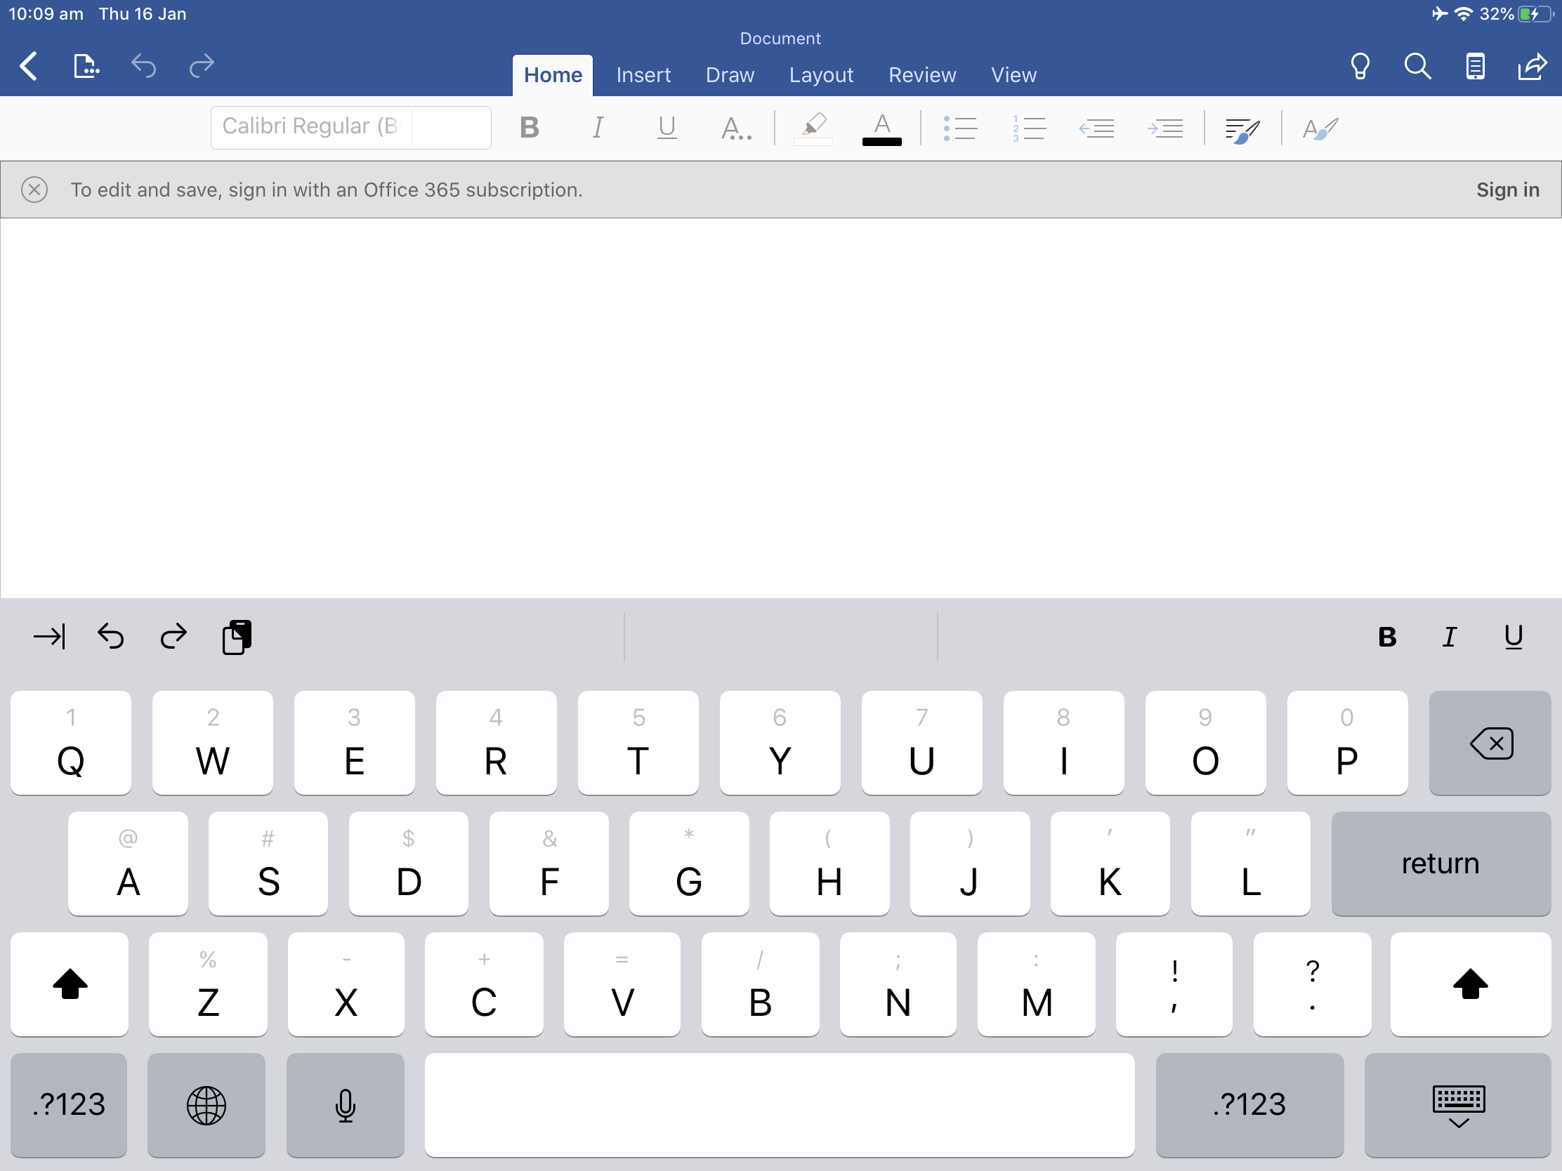
Secure login with GLOW
GLOW & Microsoft Apps
Glow login is used to access email, Teams and any of the Microsoft Apps.
If they have lost or forgotten this login/password information any class teacher can help
Username: gw17bloggsjoe@glow.sch.uk
Password: Can be reset by teacher
5
6
7
8
9

Slide 50
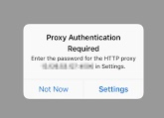
Proxy Settings
When this box pops up please do not click on Not Now, go to Settings. You will need to enter your child’s Proxy username and password. This is the beginning of their Apple ID e.g.
Username: Cluster6\jbloggs617
Password: ****
5
6
7
8
9

Slide 51

Classroom App
Allows staff to monitor iPad use in class
Teacher can lock students in an App
Students not using iPad appropriately can be locked out of their iPad
Students can Airdrop work to teacher instantly
Teacher can Airplay a student’s screen to SmartBoard so presentations can be shared directly from student device

Slide 52
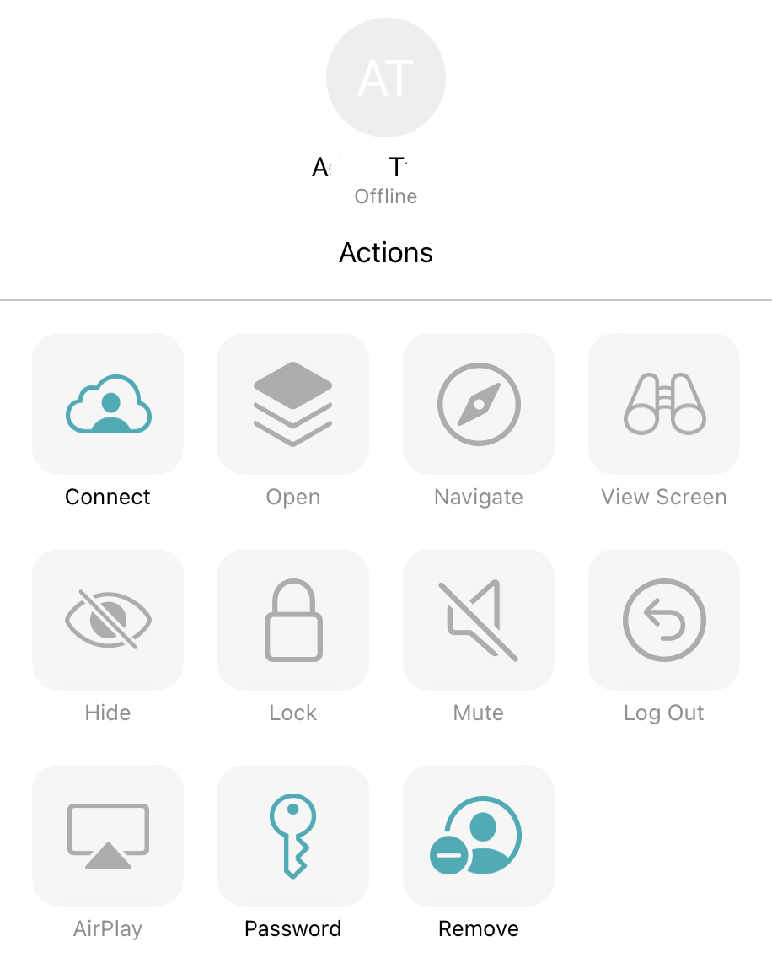
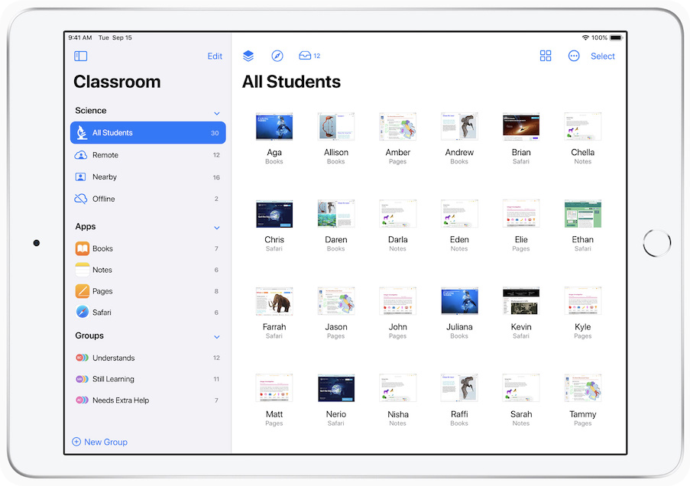
Classroom App

Slide 53

Acceptable Use Policy
Strong Passwords
Photograph Permissions
Respect

Slide 54
Additional Measures at home
Maintain open communication - ask to see their iPad occasionally & discuss use
You can install your finger print
Screen time limits can be enabled (NOT during school time please!) and a passcode set to restrict times or use of certain Apps
Use Reader View
Set up Guided Access for Apps

Slide 55
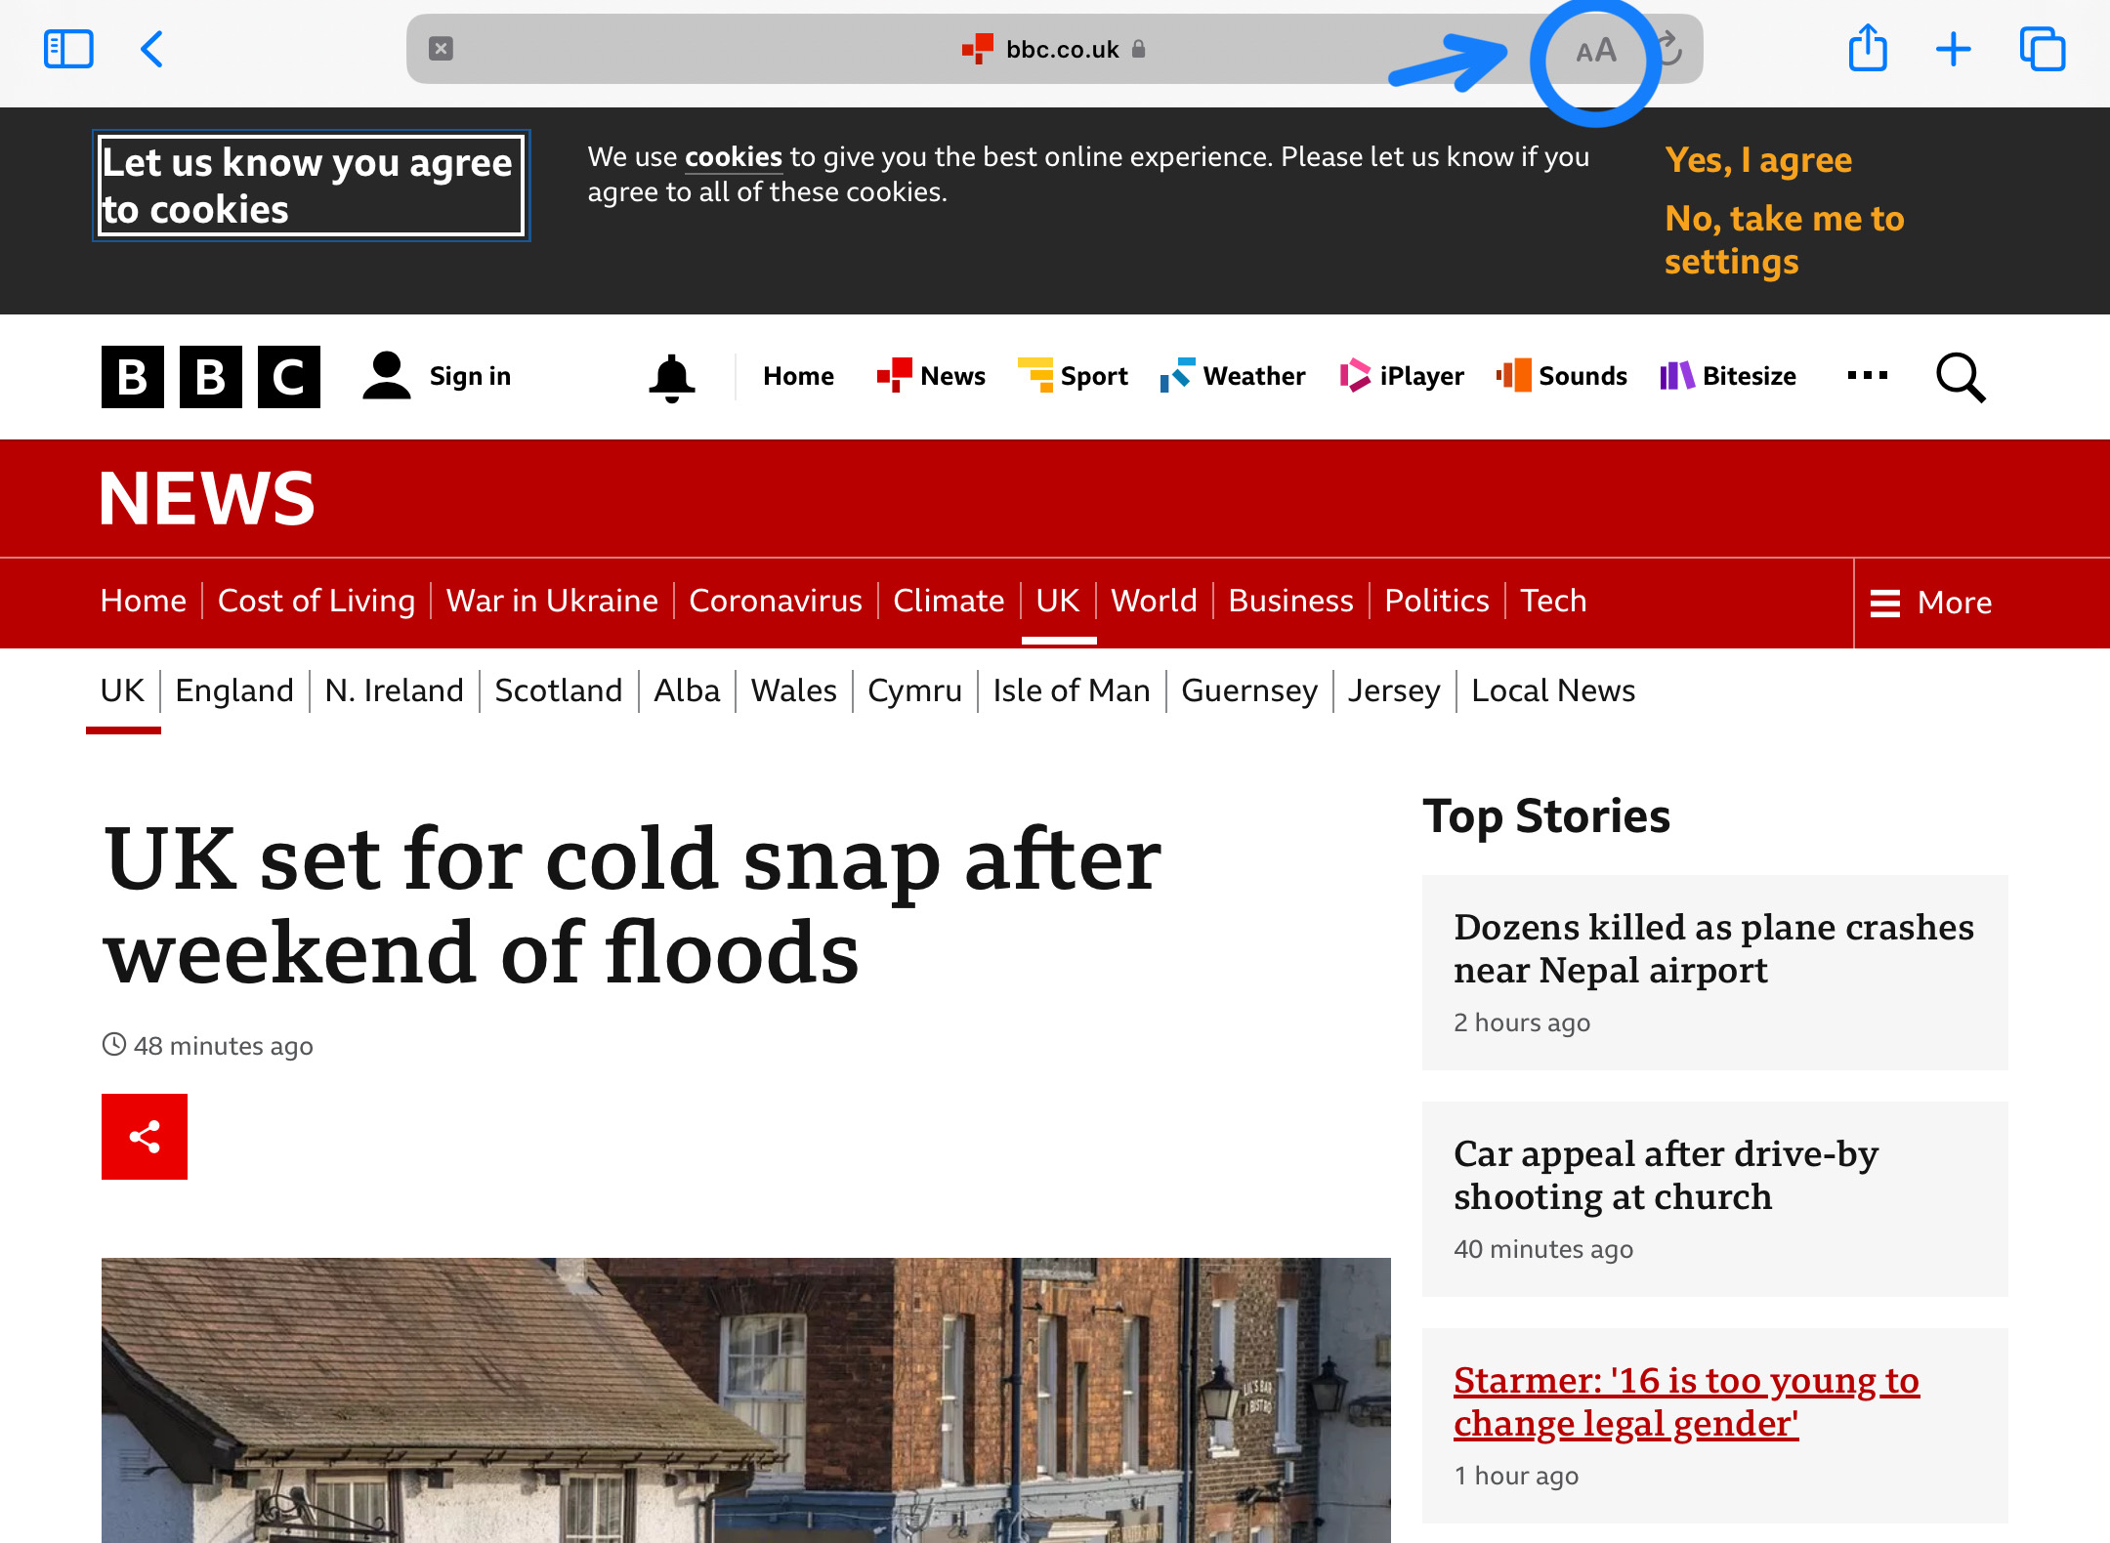
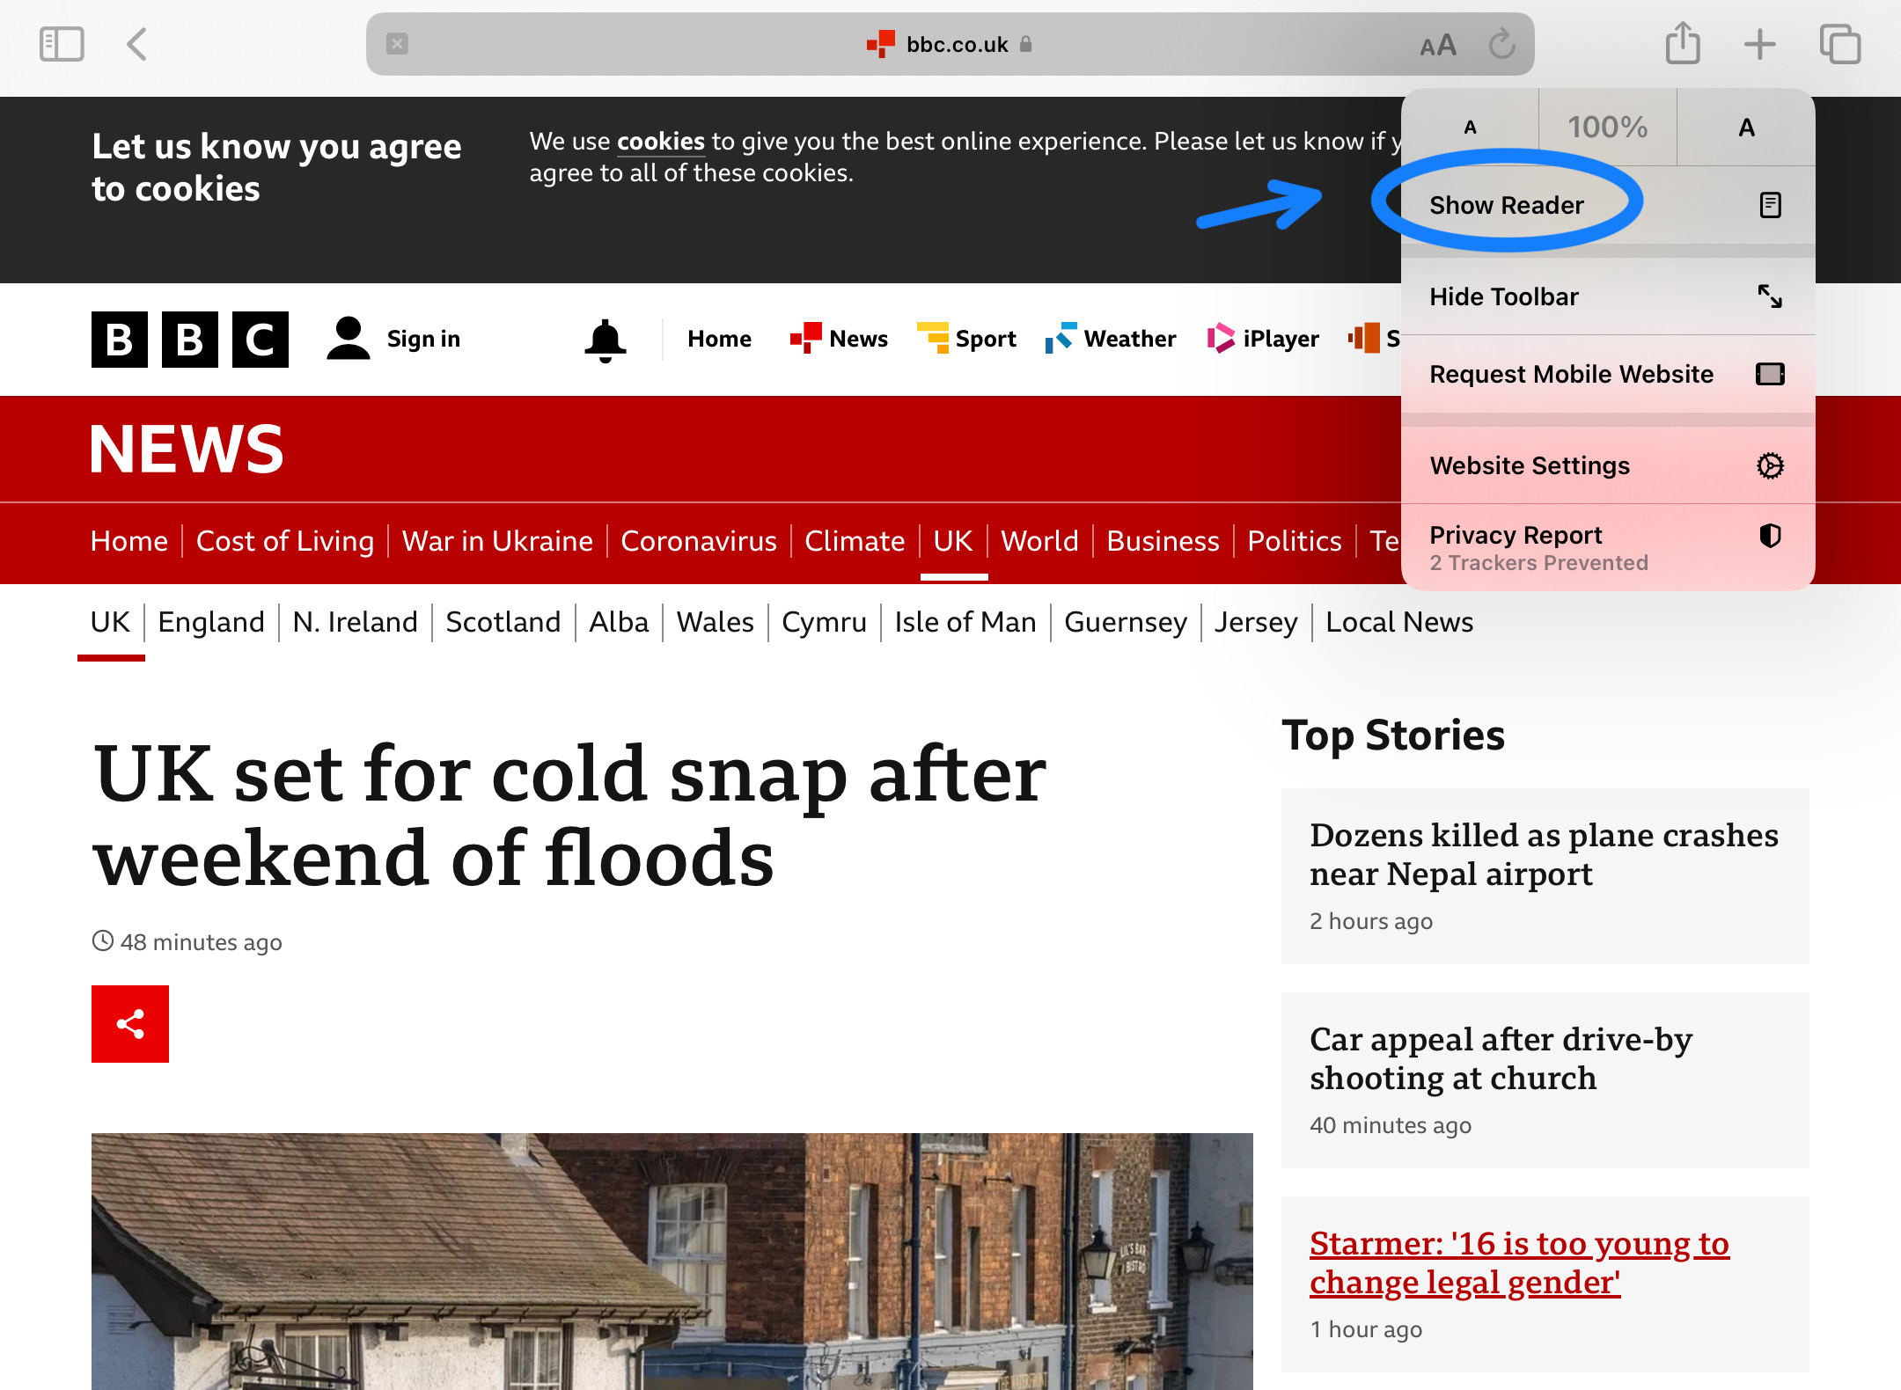
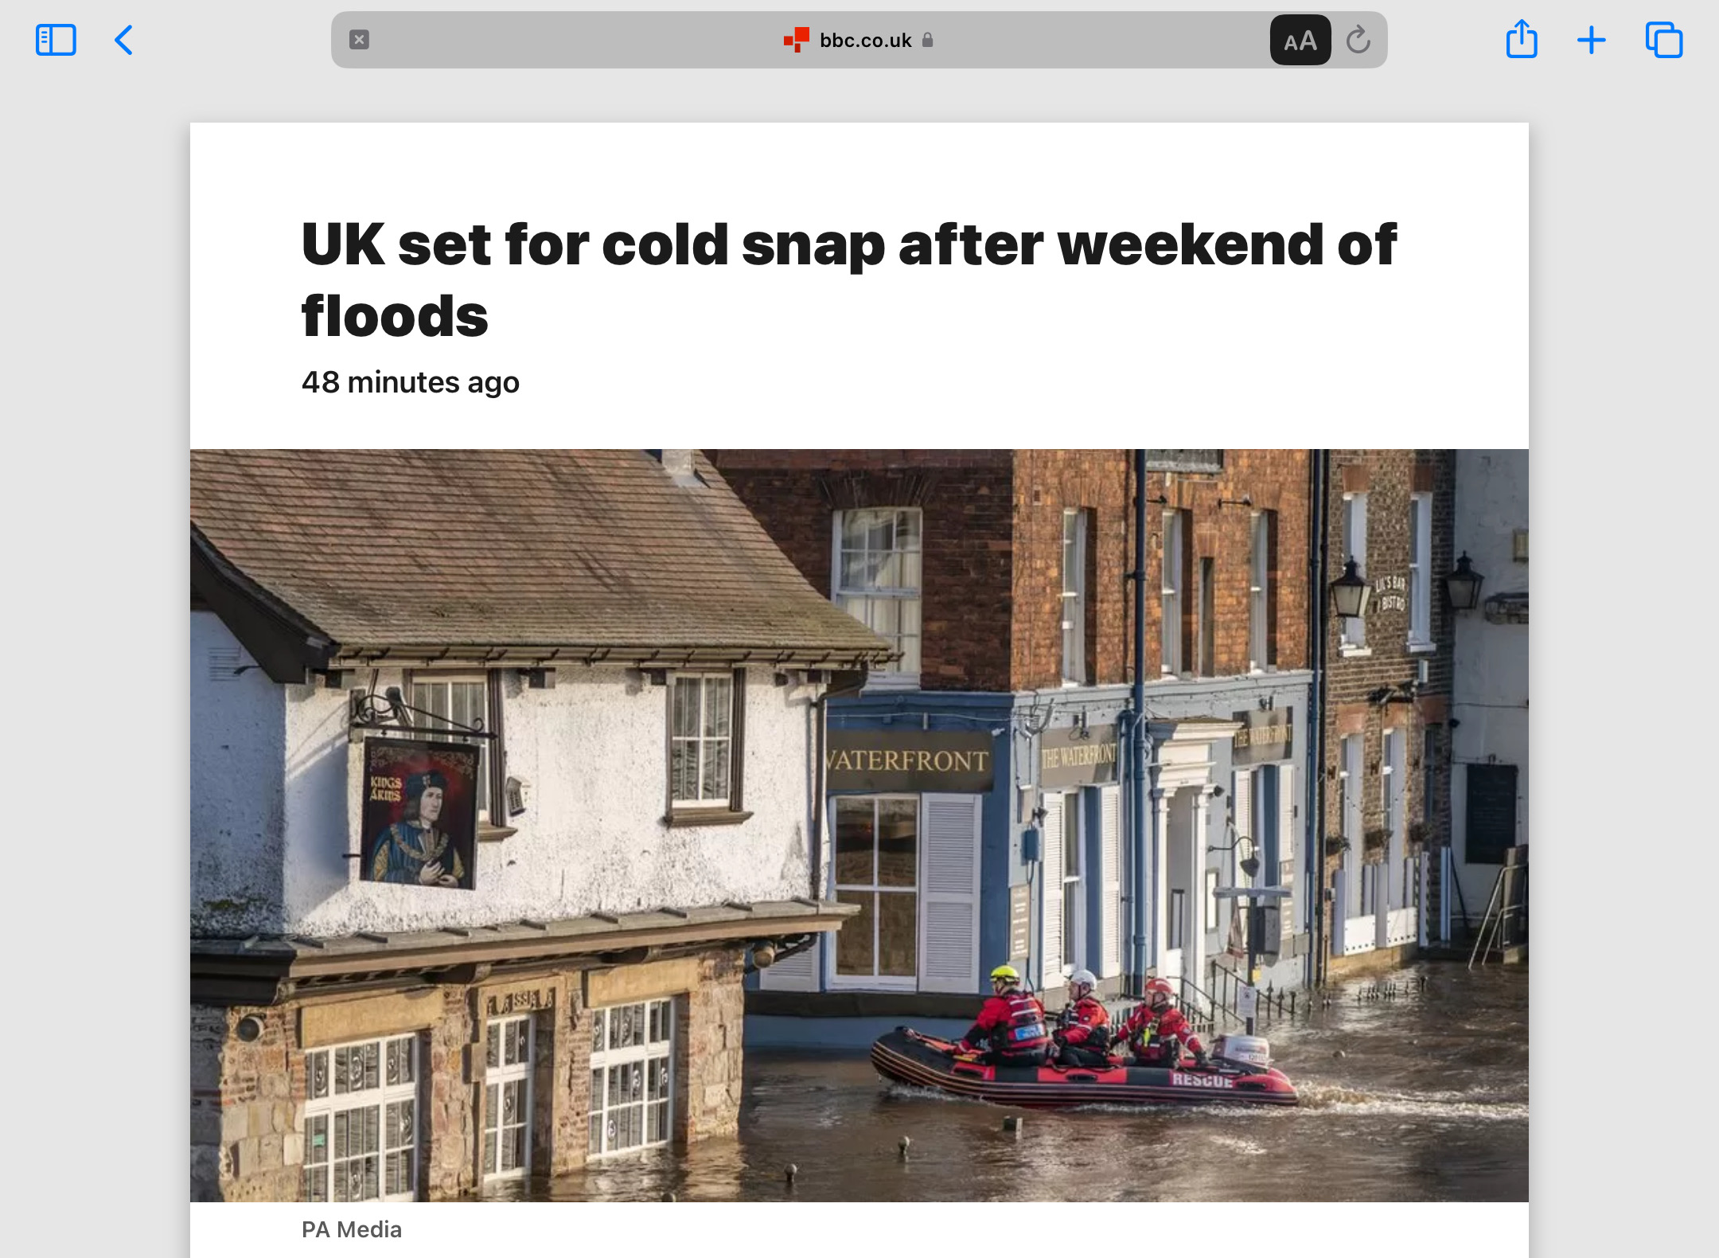
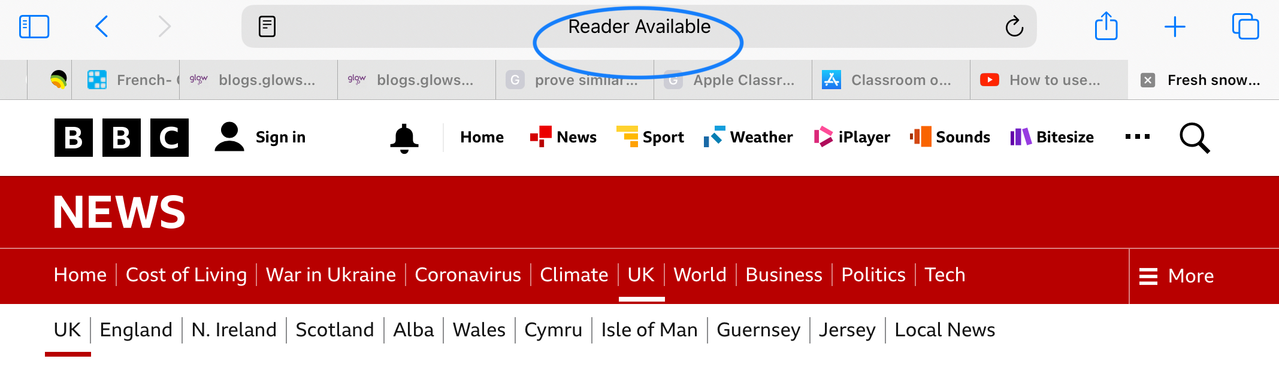
Reader View

Slide 56



Guided Access
https://youtu.be/JkDtljBD1Fw
Notes:
https://youtu.be/JkDtljBD1Fw (Susan can you post this in the chat please?)

Slide 57


What happens to old iPads?
When student leaves school or when a refresh happens (after roughly 4 years) all devices are securely wiped and returned to factory settings. They remain the property of Scottish Borders Council and will be reused.

Slide 58
Any Questions?

Slide 59
Supporting parents to help young people with protective factors for mental Health –
Sarah Hatch

Slide 60

Your online mental
wellbeing community
kooth.com
Notes:
Hi everyone,
My name is Sarah and I am here to talk to you about Kooth. Before I get into any details I just want to ask you all a question. You won’t have to answer this outloud I just want you to think about it.

Slide 61

Aims for the session
Consider what is mental health
Recognise the signs and symptoms of poor mental health
Explore helpful and unhelpful coping mechanisms
Preventative Steps
Kooth
Notes:
Here are the aims for today’s session:
Consider what is mental health
Recognise the signs and symptoms of stress
Understand how stress and anxiety can impact your exams
Explore helpful and unhelpful ways of coping with exam pressures
Find out where to go for additional help and support
Q&A
Live tour (time dependent)
Slide guidelines
Here you can bullet point the different things you’d like the audience to go away with after your session. For example, “have an understanding of what Kooth has to offer” and “Have an understanding of how we keep our platform safe”

Slide 62
Mental Health
Notes:
Mental health is a part of your overall health and can matter as much as your physical health. Mental Health is about the way that you think, feel and your behaviours.
Globally, it is estimated that 1 in 7, 10-19 year-olds experience mental health conditions, yet these remain largely unrecognized and untreated.
Most people are familiar with the developmental stage of adolescence. The independence of relying more on peers than on parents for the first time, the angst of finding one’s own identity while belonging to a social group, and the inhibitions and poor decision-making are legendary parts of the teen years.
It can be hard to make distinction between what is a sign of ill mental health and what is a normal adolescence stage for developing social and emotional habits important for mental well-being.

Slide 63



Mental Health Illness and Prevalence
Emotional Disorders
Behavioural Disorders
Eating Disorders
Self harm and Suicide
Risk Taking behaviours
Notes:
Emotional Disorders- It is estimated that 3.6% of 10-14 year-olds and 4.6% of 15-19 year-olds experience an anxiety disorder whilst depression is estimated to occur among 1.1% of adolescents aged 10-14 years, and 2.8% of 15-19-year-olds.
Behavioural Disorders- ADHD occurs among 3.1% of 10-14 year-olds and 2.4% of 15-19 year-olds(1).
Eating Disorders- More than 90% of people with an eating disorder are girls- can be bigorexia and anorexia/ bulimia
Self harm and Suicide- Suicide is the fourth leading cause of death in older adolescents (15-19 years)
Risk Taking Behaviours- Worldwide, the prevalence of heavy episodic drinking among adolescents aged 15­-19 years was 13.6% in 2016, with males most at risk(3).

Slide 64
Ill Mental Health can cause problems….
Loss of interest
Sleep
Withdrawing
Self harm
Obsessive behaviours
Outside influence
Notes:
Notable changes in sleep, weight, eating habits or other everyday patterns
Loss of interest in the things they usually love or quitting activities that they enjoy
Withdrawing more than usual from friends, family and community
Academic struggles that seem different or more intense:
Signs of drug, alcohol or other substance use
Signs of self harm

Slide 65
Unhelpful coping mechanisms could look like…
Spending too much time on hobbies and interests
Sleeping too much or not enough
Relying on caffeine and energy drinks
Eating too much or not enough
Lashing out at other people
Procrastinating
Notes:
Alice
Pause for 1 min, see notes in chat for discussion/ things shared

Slide 66
Trying to exercise daily
Breathe slow…
Using mindfulness or meditation techniques
Talking to someone you trust
Planning ahead & sticking to a revision timetable
HELPFUL coping mechanisms could look like…
Having an evening routine & getting enough rest
Notes:
Helpful examples- go through breathe slow…. Do an in breath then take a longer, slower out breath which is your calming breath. ‘Deep breaths’ cause us to mimic symptoms of a panic attack, we need to train ourselves to slow our breathing down to feel calmer
Focus on what makes you feel calm and in control

Slide 67
Preventive steps!
Protective and supportive environments in the family, at school and in the wider community are important.
Things to encourage;
Get a good night’s sleep
Eat well
Talk about feelings
Staying active.
Practice mindfulness, a way to be fully engaged and present in the moment.
Care for others
Keep in touch.
Notes:
Protective and supportive environments in the family, at school and in the wider community are important.
Talk about your feelings. Just being listened to can help you feel supported and less alone with any problems you’re going through.
Get a good night’s sleep. Sleep and mental health are closely linked: mental ill-health can affect your sleep, and poor sleep can affect your mental well-being.
Eat well. A balanced diet can improve your sense of well-being and your mood.
Stay active. Physical activity is not only good for your body, but it’s also great for your mind.
Practice mindfulness, a way to be fully engaged and present in the moment.
Care for others, whether that’s working on relationships with family, letting go of old grudges or volunteering.
Keep in touch. Supportive friends can help you deal with the stresses of life, make you feel cared for and offer a different view from whatever’s going on in your head.

Slide 68
We offer a range of support options and you have complete control of what to use.
Notes:
Kooth is a mental health support website. We offer a range of support options and you have complete control over what you want to use. I will now play a short video to give a brief explanation of what I mean.

Slide 69

Notes:
OPTIONAL SLIDE DEPENDANT ON THE TIME YOU HAVE
If you find you’re low on time, you can choose to skip this video. Equally, if your internet connection is an issue, then you can simply skip this video or share it with the school separately.

Slide 70
Professional
support
Self-directed
support
Community
support
Helpful articles
Live text-based chat
Send a message to our team
Activities
Journal Space and Goal Setting
Discussion boards
Live forums
Notes:
Now as you saw in the videos there are many ways in which Kooth can support you with your mental health.
We can provide professional support, we can provide tools for you to manage your own mental health support or we can provide community support.
I will now fully explain each of these so that when you login you will be able to use the website really easily.

Slide 71
Live text-based chat with a member of our team. We’re here to listen.
Notes:
Firstly, we have our professional support with our Live Text-based chats and messages.
These are both spaces where you can get professional support and advice via online chat sessions lasting up to 1 hour.
When we say Live text-based chat, this means there are no voice calls or video calls involved when you speak with the Kooth team.
To request a chat, simply select “chat” on the homepage and then “join that chat queue”.
We try our best to chat with everyone, but if you are unable to get a chat right away, we recommend waiting a short while or if you don’t have time
But still you feel like reaching out for support but prefer not to do this via a live chat session, then you can send a message to our team inbox and a member of our team aim to respond to you within a day or 2.
This would be in the same way you might send an email to someone and they’ll respond back to you when they can.

Slide 72
Your first chat session
When you first come to chat, we will talk with you about:
Understanding a little bit about you
Exploring your current difficulties and what's brought you to Kooth
Thinking together about the best way we can support you
Notes:
Speaker notes:
We will work with you to figure out the best way that Kooth can support you
This might be through drop in sessions in which you can pop into a chat when you feel like it and have up to 1 hour per week or more structured, weekly sessions with the same named member of our team that you’ll work with over the duration of your sessions.
We’ll also discuss with you how you can make the most of other parts of the site to help you make the most of everything Kooth has to offer.
Essentially, your first chat is a chance for us to get to know you and to understand how we can offer you the support you need.

Slide 73
Our team are
here for you
365 days a year
You can chat with us
during the following hours:
Monday - Friday
12pm - 10pm
Saturday and Sunday
6pm - 10pm
Notes:
Our Team are here for you 365 days a year. You can chat with us Monday- Friday 12pm-10pm and Saturday and Sunday from 6pm-10pm.
We offer slightly reduced hours around the Christmas and New Year Period but still are here for you.
At busier periods, you may have not be able to enter a chat with someone right away and there may be a bit of a waiting time.
However, we recommend you explore other parts of Kooth whilst you wait.
This might include reading article, Contributing to a discussion board or even trying one of our mini activities.

Slide 74
A range of self-help tools all in one place
You can use these tools at any time.
Options include:
Wellbeing mini activity hub
Journal space
Goal setting
Articles
Notes:
Speaker notes:
Our self-help options allow you to try out different parts of the site that are completely self directed by you.
We have 23 mini wellbeing activities which help you with things like connecting with others, managing emotions, building helpful habits and expressing yourself.
You can also keep track of how you’re feeling by using your own journal space.
Or you can try our goal setting exercise which help you keep track of things you might want to work on.

Slide 75
Choose from a range of helpful articles written
by both young people and our professional team.
Notes:
Speaker notes:
We have thousands of helpful articles covering a range of topics.
Some of these articles are written by our very own users whereas others will be written by Kooth’s own content team.
You’ll be able to tell if the article has been written by another young person or a member of our team because members of our team will have their first name appear on the article whereas our users names will be anonymised usernames with different characters and symbols not first names.
So get writing and send us your stories, poems or articles.

Slide 76


Article topics include:
Personal stories
Bullying
Relationships
Identity
Hobbies and interests
General health
and wellbeing
Notes:
We also have articles where you can
Write your own articles
Reading articles written by others
Joining the discussion in the comments section

Slide 77
Find support from other
young people in our
discussion boards
and live forums
You can start or join any discussion and there’s lots of different topics to choose from!
Notes:
If you just want to find a community or share how you’re feeling the community support options may be the right thing for you! As previously mentioned we have discussion boards and live forums.
A discussion board is a thread that’s based on someone’s post. You can find a topic that’s interesting to you then follow along, leave a comment or you could also start your own discussion.
A live forum is similar to a discussion board but the discussion is moderated live, meaning you can talk to others across the country in live time on a different themed topic each week. Live forums take place on a rotating basis every Monday, Wednesday or Friday evening from 7:30-9pm
We want Kooth to be a safe space for everyone. Our site is pre-moderated, which means that our moderators check everything before it's published to the site.
This means that sometimes we will edit a submission, or not publish it at all, if it contains something that might cause distress for someone else. But we will message you directly if we’re not able to publish you post or comment. Please bear with us for this process, as on busier days it can take some time between submitting your post and seeing it go up on the live site. But because of this it means it means we can keep Kooth a safe space for everyone.
You also won’t be able direct message other young people on the site but instead you’ll be able to communicate and support each other via the comments section.

Slide 78
Joining Kooth is quick and easy. Simply visit kooth.com on any internet enabled device.
Notes:
Joining Kooth is quick and easy. Simply visit kooth.com on any internet enabled device.

Slide 79
Click on the
‘Join Kooth’
button to
get started
Notes:
Speaker notes:
Once you’ve landed on kooth.com, you’ll probably notice a Join Kooth button which we’ve highlighted for you.
Simply click on the button and you’ll enter our sign up form.

Slide 80


1. Select Join Kooth.
2. Sign up by postcode or
select your location from
the drop-down list.
How to sign up
Notes:
OPTIONAL SLIDE: IF YOU’VE PRESENTED THE SIGN UP FLOW VIDEO YOU CAN DISREGARD THE 3 SIGN UP SLIDES
Speaker notes:
You’re able to choose your local area by entering the first part of your home postcode.
Or you can find your local area by choosing from our dropdown list.
This is to make sure that the service is available in your area.

Slide 81



3. Select your month
and year of birth.
4. Select your gender
and ethnicity.
5. Create an
anonymous (not your
real name) username
and secure password.
Notes:
3. Select your month and year of birth. This is to ensure the content is correct for you as an 18yo might not have the same issues as a 10 year old and vise versa
4. Select your gender and ethnicity. This is to ensure that we are helping everyone with their mental health and not just a small part of the population.
5. Create an anonymous (not your real name) username and secure password.
Your username: Our tips
Avoid using your real name
And gamertags or social media handles
Any personal information
Also avoid any swear words or inappropriate language
Keep your password in a safe place because we can’t send you a new one.
This is because we don’t collect email addresses. We want to protect your identity but it does mean we cannot send you a password reset email.”

Slide 82
Here are some
things we’d like
you to always remember about Kooth…
Notes:
Here are some
things we’d like
you to always remember about Kooth…

Slide 83
Kooth isn’t an app
so you won’t be able to find us on any app stores.
Notes:
A frequent misconception is that Kooth is an app it is a website.

Slide 84
It’s completely free.
Notes:
It’s completely free
Every part of Kooth is completely free for you to use.
The quality of support you receive will not be greater or lesser based on how much money you have.

Slide 85
You don’t need to be referred by anyone.
You can sign up anytime.
Notes:
You don’t need to be referred by anyone.
You can sign up anytime.
Unlike some other more traditional mental health services, you won’t need to be referred by an adult or a formal GP referral to start using Kooth.
You can sign up whenever you like and in any place that feels comfortable to you.
Signing up is quick and easy.
This means you can start accessing support in minutes and do it on your own terms.

Slide 86
Bullying and trolling can’t take place
on the site.
Notes:
Bullying and trolling can’t take place
on the site.
Because our site is pre-moderated it means that bullying comments or hate speech won’t be approved to appear on the site.
So you can trust that Kooth is a safe and non judgemental place.

Slide 87
No problem is ever
too small at Kooth
If it’s on your mind, we’re here to help. Some of the feelings or difficulties we can support you with could include:
Stress
Anxiety
Friendships
Life at home
Exam or coursework
pressures
Eating difficulties
Loneliness
Body image concerns
Anger
Confidence
Big changes
Social media

Slide 88
You’re anonymous
to us.

Slide 89
95%
of our users
would recommend
Kooth to a friend
Urgent support
page if you need it:
Simply visit
kooth.com/
urgent-support
You can
trust us
Our team are
real people who
want to listen
and help.
They’re not bots
Notes:
Speaker notes:
Urgent help: If you feel like you need urgent support, we highlight some crisis services that can help you on our urgent support page - You can access this at kooth.com/urgent-support.
Our team: Our team are real people who really care and want to listen and help. Although you’ll be engaging with them through a text based chat, we want to reassure you that our team are not bots who are sending automatic replies.

Slide 90
“I’m more able
to manage low periods in
my life.”
“I feel safe to explore my feelings.”
Notes:
OPTIONAL SLIDE DEPENDANT ON THE TIME YOU HAVE

Slide 91
“I’ve never felt pressured using Kooth. I’m in full control.”
“Kooth feels like a family and I can’t thank you enough.”
Notes:
OPTIONAL SLIDE DEPENDANT ON THE TIME YOU HAVE

Slide 92



Finding us outside
of Kooth.com
@kooth_uk
Kooth Podcast
Find us on Spotify and Apple Podcasts
Notes:
Speaker notes:
If you want to follow us off of the Kooth site, you can do this by following us on:
Our Instagram page @kooth_uk - Unfortunately, we won’t be able to engage with you or offer you any direct support from our Instagram account. Kooth.com is the place for you to go to access support.
Or, check out our Kooth podcast which you can find on Spotify and Apple Podcasts.

Slide 93
Thank you

