Slide 1
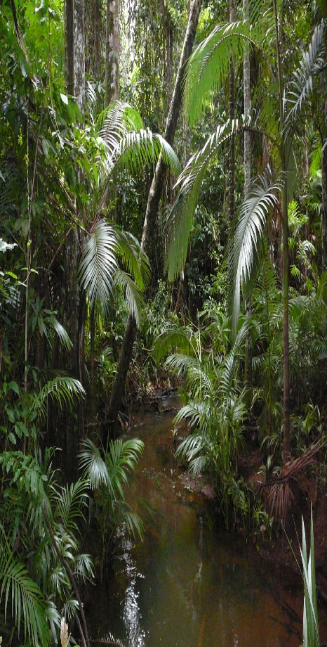
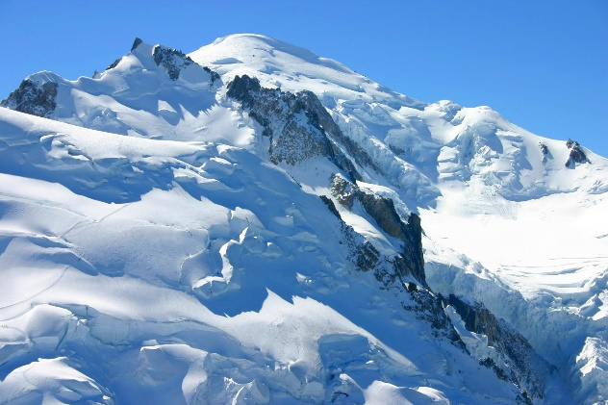
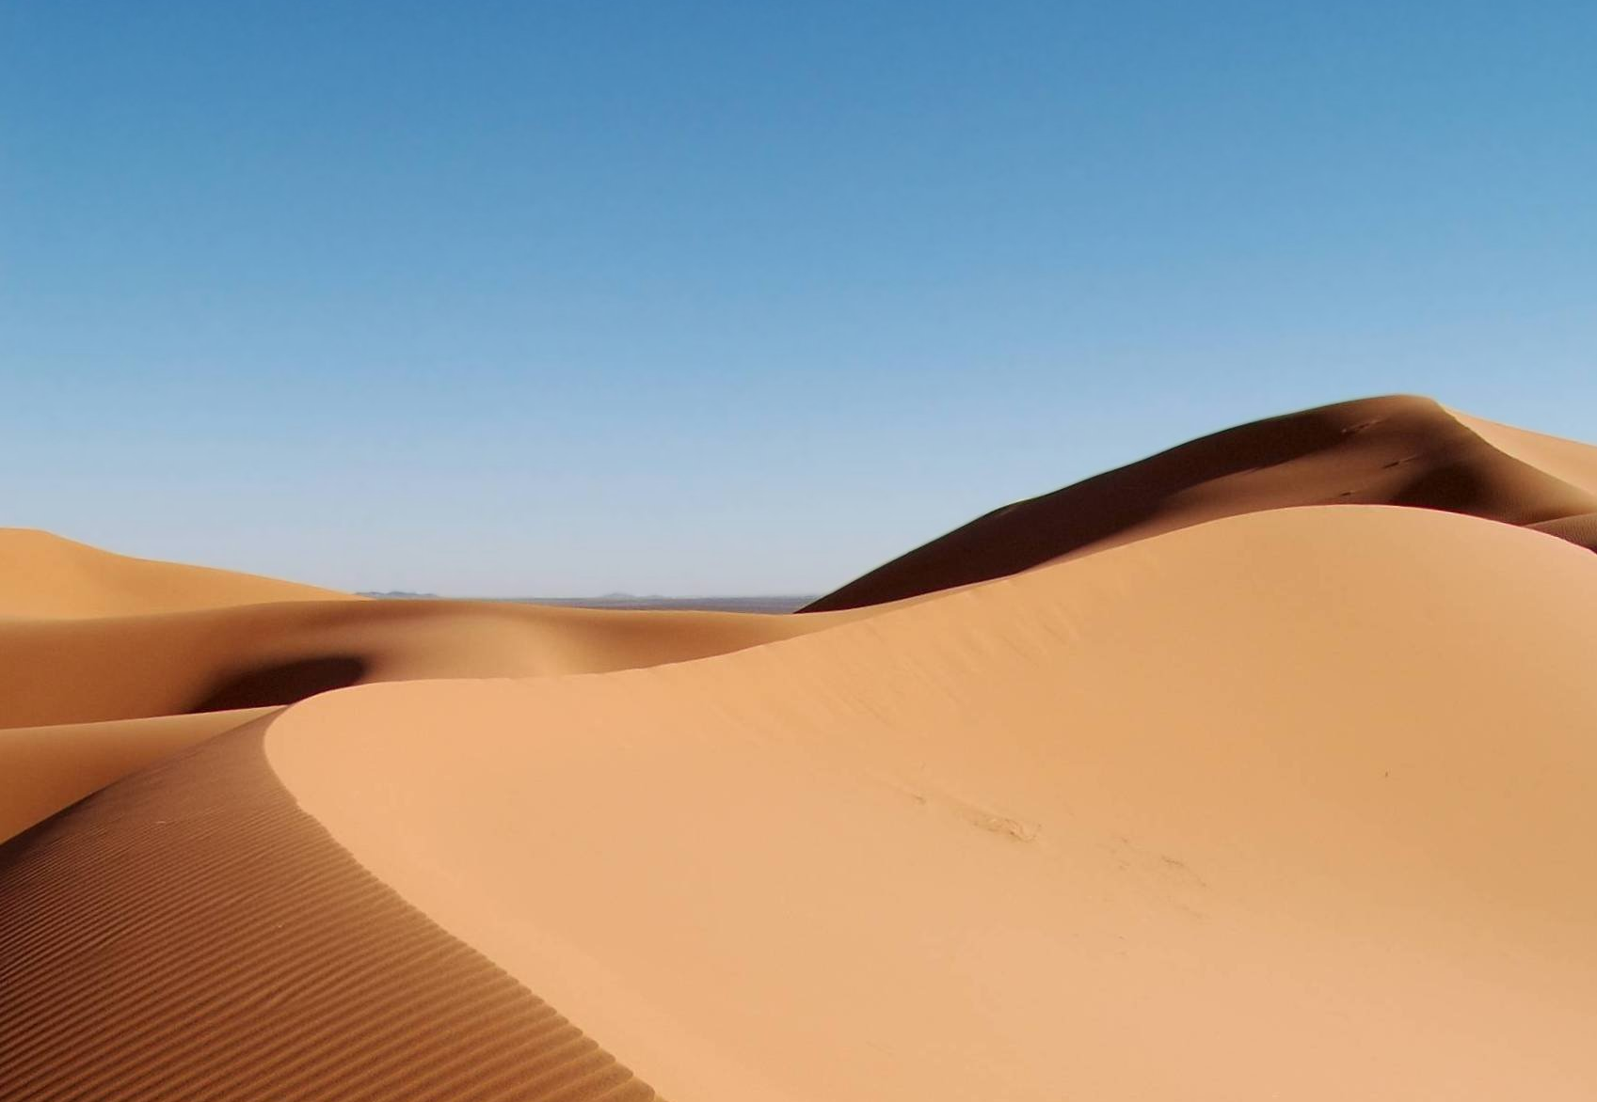
Animals in their natural habitat
By jAY Swann

Slide 2
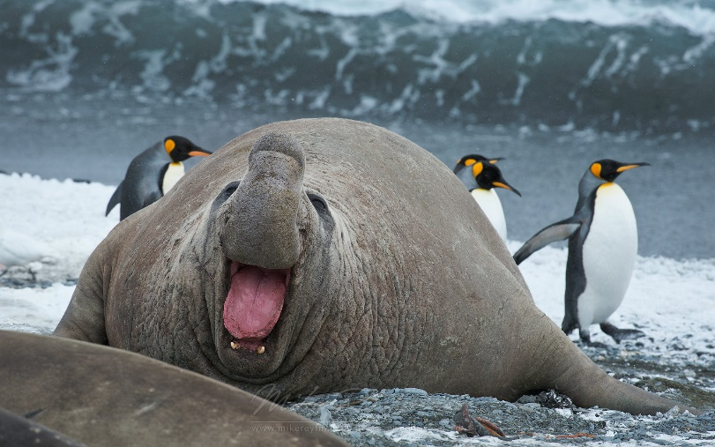
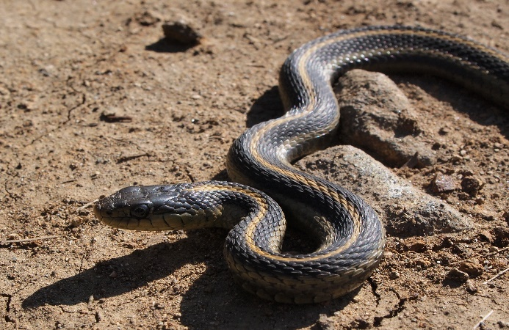
contents
How climate zones affect animals
Animals in hot countries
Animals in cold countries

Slide 3
How climate zones affect animals
Every organism has certain features or characteristics that allow it to live successfully in its habitat. These features are called adaptations ,and we say that the organism is adapted to its habitat. organisms living in different habitats need different adaptations.
home

Slide 4
Animals in hot countries
Camels have adapted to deserts in many ways
Long curly eyelashes to keep sand and dust out.
Thick bushy eyebrows to shade their eyes from the sun.
Fur inside their ears to keep sand and dust out.
Close their nostrils to keep sand out.
Feet are soft and spread out to prevent sinking in the sand. Two toes on each foot joined by a tough web and leathery padded souls.
Camels get most of the water they need from plants.
home

Slide 5
Animals in cold countries
Polar bears have adapted to Arctic in many ways
a white appearance, as camouflage from prey on the snow and ice.
thick layers of fat and fur, for insulation against the cold.
a small surface area to volume ratio, to minimise heat loss.
a greasy coat, which sheds water after swimming.
home

