Slide 1
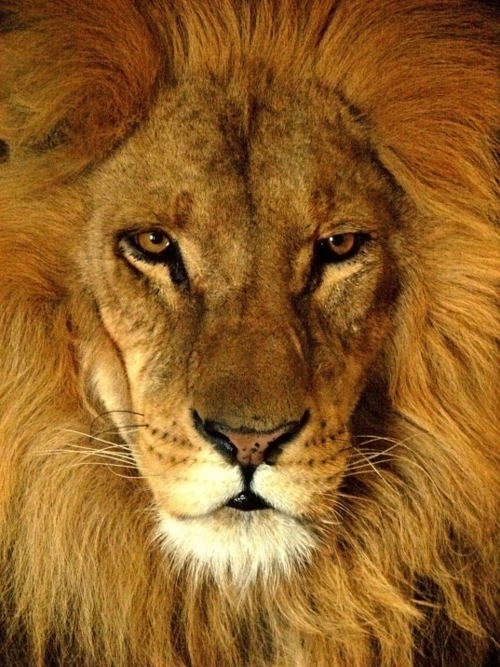
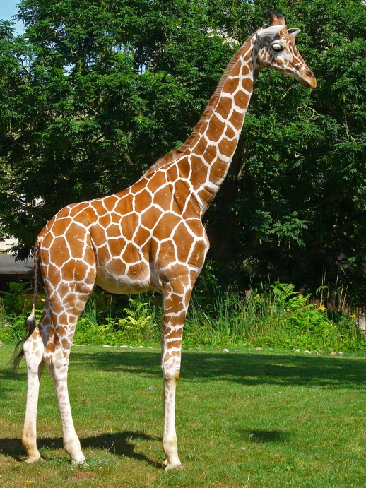
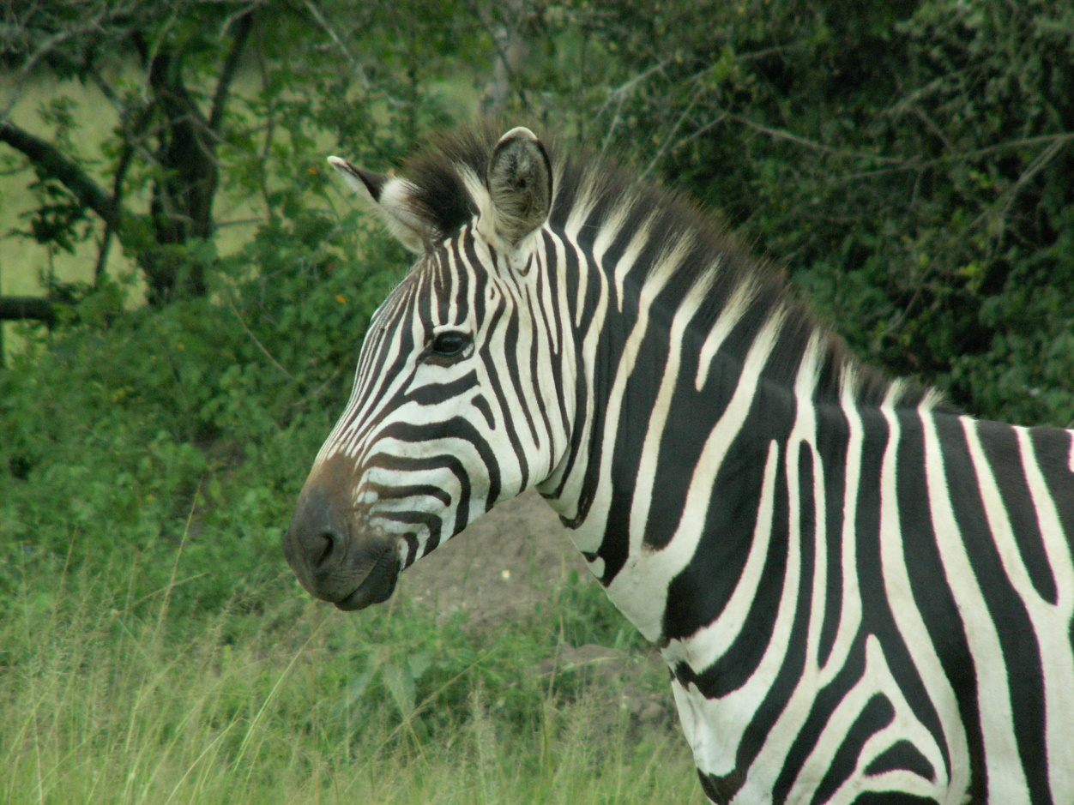
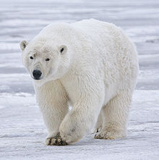
Animals

Slide 2
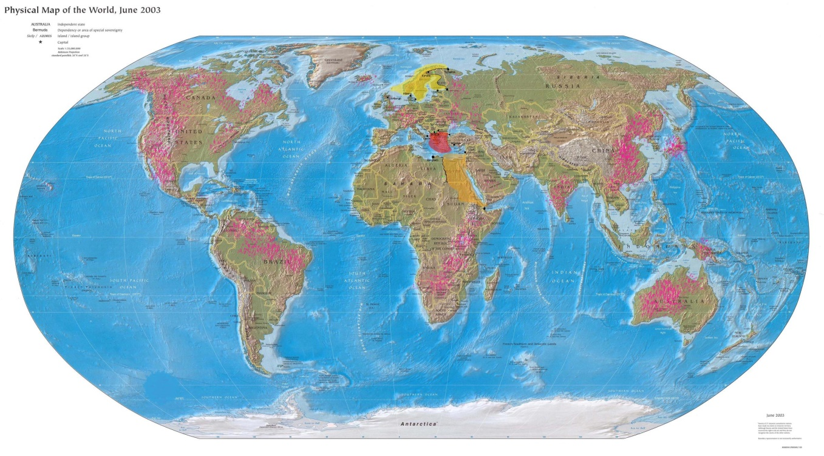
Polar bear
Polar bears can be found in the Artic, the U.S. ( Alaska ), Canada, Russia, Denmark ( Greenland ) and Norway.
Male Polar bear may grow 10 feet tall and weigh over 1400 pounds.
Females reach 7 feet and weigh 650 pounds.
In the wild Polar bears live up to age 25.
Polar bears have been known to swim 100 miles ( 161 kilometers ) at a stretch.
Polar bears primarily eat seals
Polar Bears are considered marine mammals -- just like seals, whales and dolphins.
This is the Artic

Slide 3
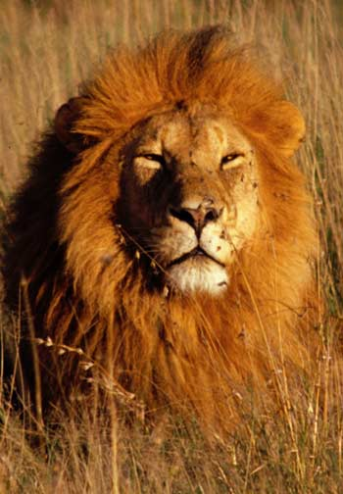
Lion
Ten facts about lions
10. African lions are the most social of all big cats and live together in groups or “prides.” A pride consists of about 15 lions.
9. Male lions defend the pride’s territory while females do most of the hunting. Despite this, the males eat first.
8. These majestic cats are threatened by habitat loss. The lion is listed as vulnerable on the IUCN Red List of Threatened Species.
7. The lion was once found throughout Africa, Asia and Europe but now exists only in Africa with one exception. The last remaining Asiatic lions are found in Sasan-Gir National Park in India, which was primarily created to protect the species. Currently, there are approximately 350-400 lions in the park.
6. A lion’s roar can be heard from as far as 5 miles away.
5. A lion can run for short distances at 50 mph and leap as far as 36 feet.
4. Even though the lion is sometimes referred to as the “king of the jungle,” it actually only lives in grasslands and plains. The expression may have come from an incorrect association between Africa and jungles or may refer to a less literal meaning of the word jungle.
3. A good gauge of a male lion’s age is the darkness of his mane. The darker the mane, the older the lion.
2. A lion’s heels don’t touch the ground when it walks.
1. A lion may sleep up to 20 hours a day.
This is where lions live.
They live in Africa.

Slide 4
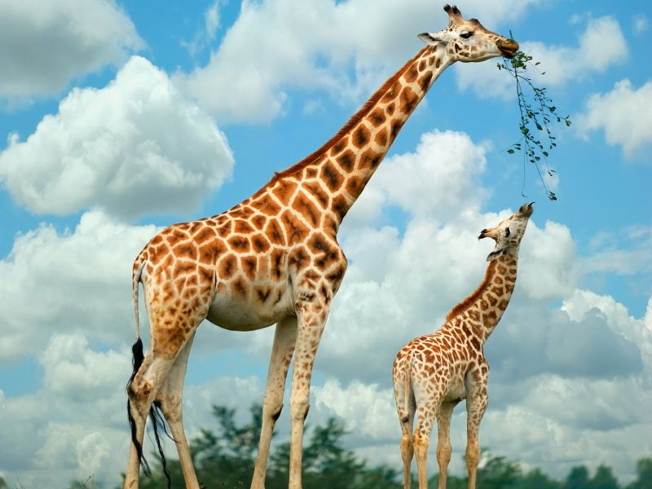
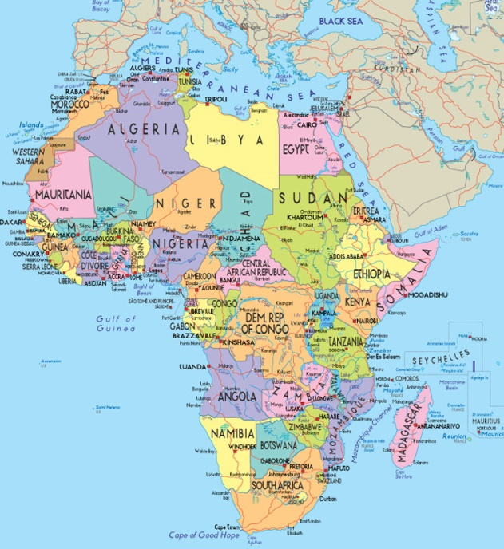
Giraffe
This is where Giraffes Live.
Giraffe have long necks so they can get food off trees to eat.
At an average height of around 5 m (16-18 ft.), the giraffe is the tallest land animal in the world.
They can reach 55 km/h (35 mph) at full speed but only in brief spurts.
Giraffes live in dry land of Africa.
birth while standing up. Newborns are about 2 m (6 ft.) tall and weigh 70 kg (150 lb.).
They live up to 25 years in the wild.
Giraffes sleep less than two hours a day.
A full-grown giraffe consumes over 45 kg (100 lb.) of leaves and twigs a day.

Slide 5
Panda
This is where pandas live. They live in china and China is near Russia.
Giant pandas have a bear like appearance. Their distinctive black and white colouring makes them one of the best-known species in the world. They can reach 6 ft (1.9 m) in height and in the wild weigh around 220–250 lb (110–115 kg), although adult males can weigh up to 350 lbs (160 kg).
Why are giant pandas black and white?
The reason behind the black and white coat is unknown, but it is thought that the colouring provides camouflage for giant pandas in their natural environment.
Giant pandas have a special bone that extends from their wrists called a “pseudo-thumb,” according to the San Diego Zoo. They use the pseudo-thumb to hold and manipulate bamboo.

Slide 6
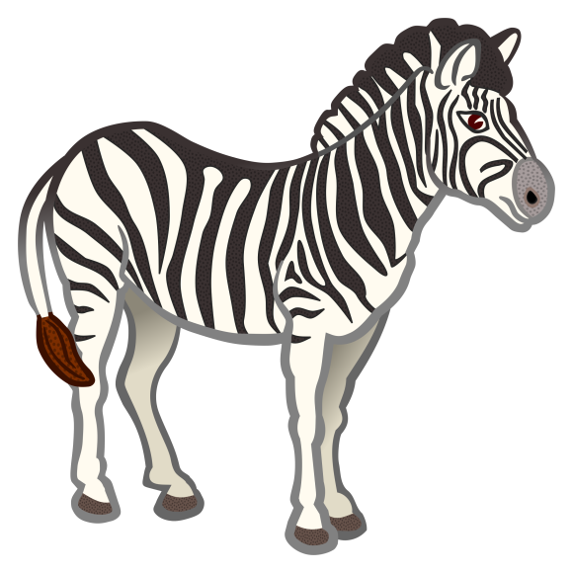
Zebras are single-hoofed animals that are native to Africa. Zebras are very closely related to horses and donkeys; in fact, they are in the same genus, Equus. The most prominent feature of zebras is the bold patterns on their coats. brown stripes, according to the San Dieg Zoo, because the stripes end at their bellies and the inner side of the legs, which are white. However, zebras have black skin under their white coats! Each species of zebra has a different general pattern of stripes. The Grevy's zebra has very thin stripes. The mountain zebra has vertical stripes on its neck and torso, but horizontal stripes on its haunches. Some subspecies of plains zebras have brownish "shadow" stripes between the black stripes, according to the San Diego Zoo.
Zebra
This is where zebras live.

Slide 7
The End.
Hope You Enjoy My Power point.
By Adam.

