Slide 1

Learner Journey & Pathways
Hawick High School

Slide 2
Clear view of the future of what pathways actually means…
Parental Influence
Knowing what you are talking about and how to access help or support to get the information you need to help your child.
Its up to us to take a long view as young folk struggle to do this
Whats up ahead and makes most sense based on the future job market.

Slide 3
Students have all sorts of options that they have been able to study S1-3 as they have moved through the school.
They get the chance to learn in different ways and in different settings.
There is flexibility in how they have learned, and this all contributes to how they make choices.
If you know about the different qualifications and awards which your child can do then it makes supporting them easier and choosing the direction of travel. Its all about the pathway your child can take through school and it starts in S4.

Slide 4
Options ahead …..
For all the pathways through S4-6 the destination point will be broadly split into 4 categories ….
Training and Work
Apprenticeships
College
University

Slide 5
Training and Work
Apprenticeships
Foundation Apprenticeships
Equivalent to Highers, can go straight into employment or onto College or University / Modern or Graduate Apprenticeship.
Modern Apprenticeships ( MAs)
Combining working and training. Start in the work place giving young folk the opportunity to work, earn and learn. There are over 80 types of MA in hundreds of job roles. Training is offered through Colleges.
Graduate Apprenticeships
Work, earn and learn whilst studying for University degree.
Employment, either full time or Part time employment.
Qualifications relevant to the job, vocational qualifications.
work related experience relevant
Career Advice / help / Guidance from Skills Development Scotland in school.
Supported Programmes – NOLB Pathways.
Outline of the day

Slide 6
University
College
Most Universities will require a minimum of 4 B’s in one sitting. There may be specifics about the Highers required and National 5 Maths & another language.
Higher grades ( 4 x A or B’s) and / or more Highers required if obtained over 2 exam diets/resits.
Highers are preferable to Advanced Highers unless stated by the University.
Career Advice / help / Guidance from Skills Development Scotland in school.
There is an average requirement for Higher National Course ( HNC) /Higher National Diploma ( HND) courses of 3 Highers. These articulate onto university courses.
National Course’s (NC) courses lead onto HNC study. National 4 or 5 level qualifications required.
Work based learning experiences with work based placements.
Outline of the day

Slide 7

More than one path to success
“... there is a widespread belief that studying for a degree will lead to a well-paid job and fulfilling professional career and whilst in many cases this is true it isn’t always the case”.
Great Expectations, City and Guilds 2015
Positive Destinations

Slide 8


Career Management Skills
Skills Development Scotland – SDS
2 Careers Advisers based in the school:
Karen Turton (Monday, Tuesday, Friday morning)
Caroline Clarke (Monday, Wednesday, Thursday)
Work Coach (School and Post School) (Karen Turton )
SDS Centre open 2 days per week: Tuesday and Thursday:
12 Howegate, Hawick, TD9 0AB
Borders College 1 day per week (Kim Ferguson)
2 Careers Advisers based in the school:
Sean McTaggart (Monday, Tuesday, Friday morning)
Caroline Clarke (Monday, Wednesday, Thursday)
Work Coach (School and Post School) (Sean McTaggart)
SDS Centre open 2 days per week: Tuesday and Thursday:
12 Howegate, Hawick, TD9 0AB
Borders College 1 day per week (Kim Ferguson)

Slide 9

Career Management Skills
CAREER MANAGEMENT SKILLS
Caroline Clarke
Caroline.Clarke@sds.co.uk
Karent Turton
Karen.turton@sds.co.uk

Slide 10
SCHOOL LEAVER DESTINATION REPORT
Higher Education – 25.7%
Further Education – 19.3%
Training – 4.3%
Employment – 46.4%
Voluntary Work – 0.7%
Unemployed ( seeking) – 3.6%

Slide 11
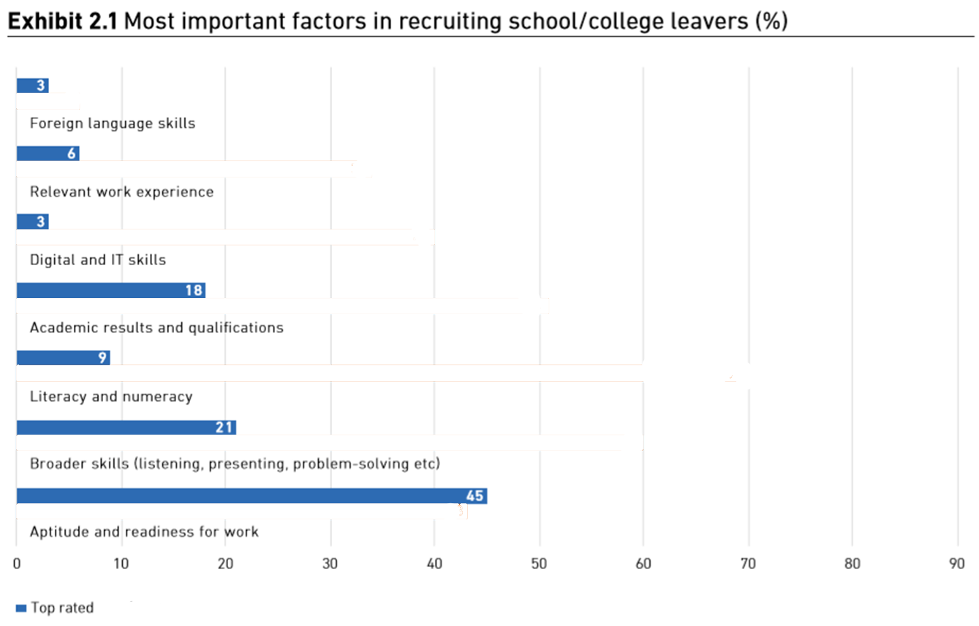
What are employers looking for?

Slide 12
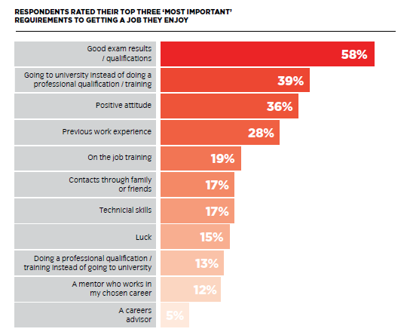
What do young people think? …….
……….. It’s mainly about qualifications

Slide 13
Next Steps in Supporting your child …….
There are some practical ways to support your child right now :
Help them access their ‘myworldofwork’ account so you can see what it has to offer.
Encourage them to speak to the school about work experience ( Stacey Grieve – Vocational Experience Coordinator)
A careers appointment – email and request an appointment.
You can tell the school if you can offer a work experience placement to other young people or give a talk to specific subject areas relating to your own work. The school is keen to hear from parents how school subjects relate to real life work.
Talk to your child about their next steps…..
Always reassure them that there are other ways or options for learning new skills and retraining if they decide to do something different in the future.
Help them get the support they need to make decisions.

Slide 14


How Can you Support Learning at Home.
Use the website ‘ My World of Work’ to research career pathways.
My Kids Career – part of the My World of Work website.
Prospects – University based.
Which? University – University life
PlanIt Plus – Job Profiles / College Courses.
Apprenticeship.scot

