Slide 1
Mild Chilli Challenge

Slide 2
The first recorded Olympic Games was held in Olympia, Greece in 776BC.

Slide 3
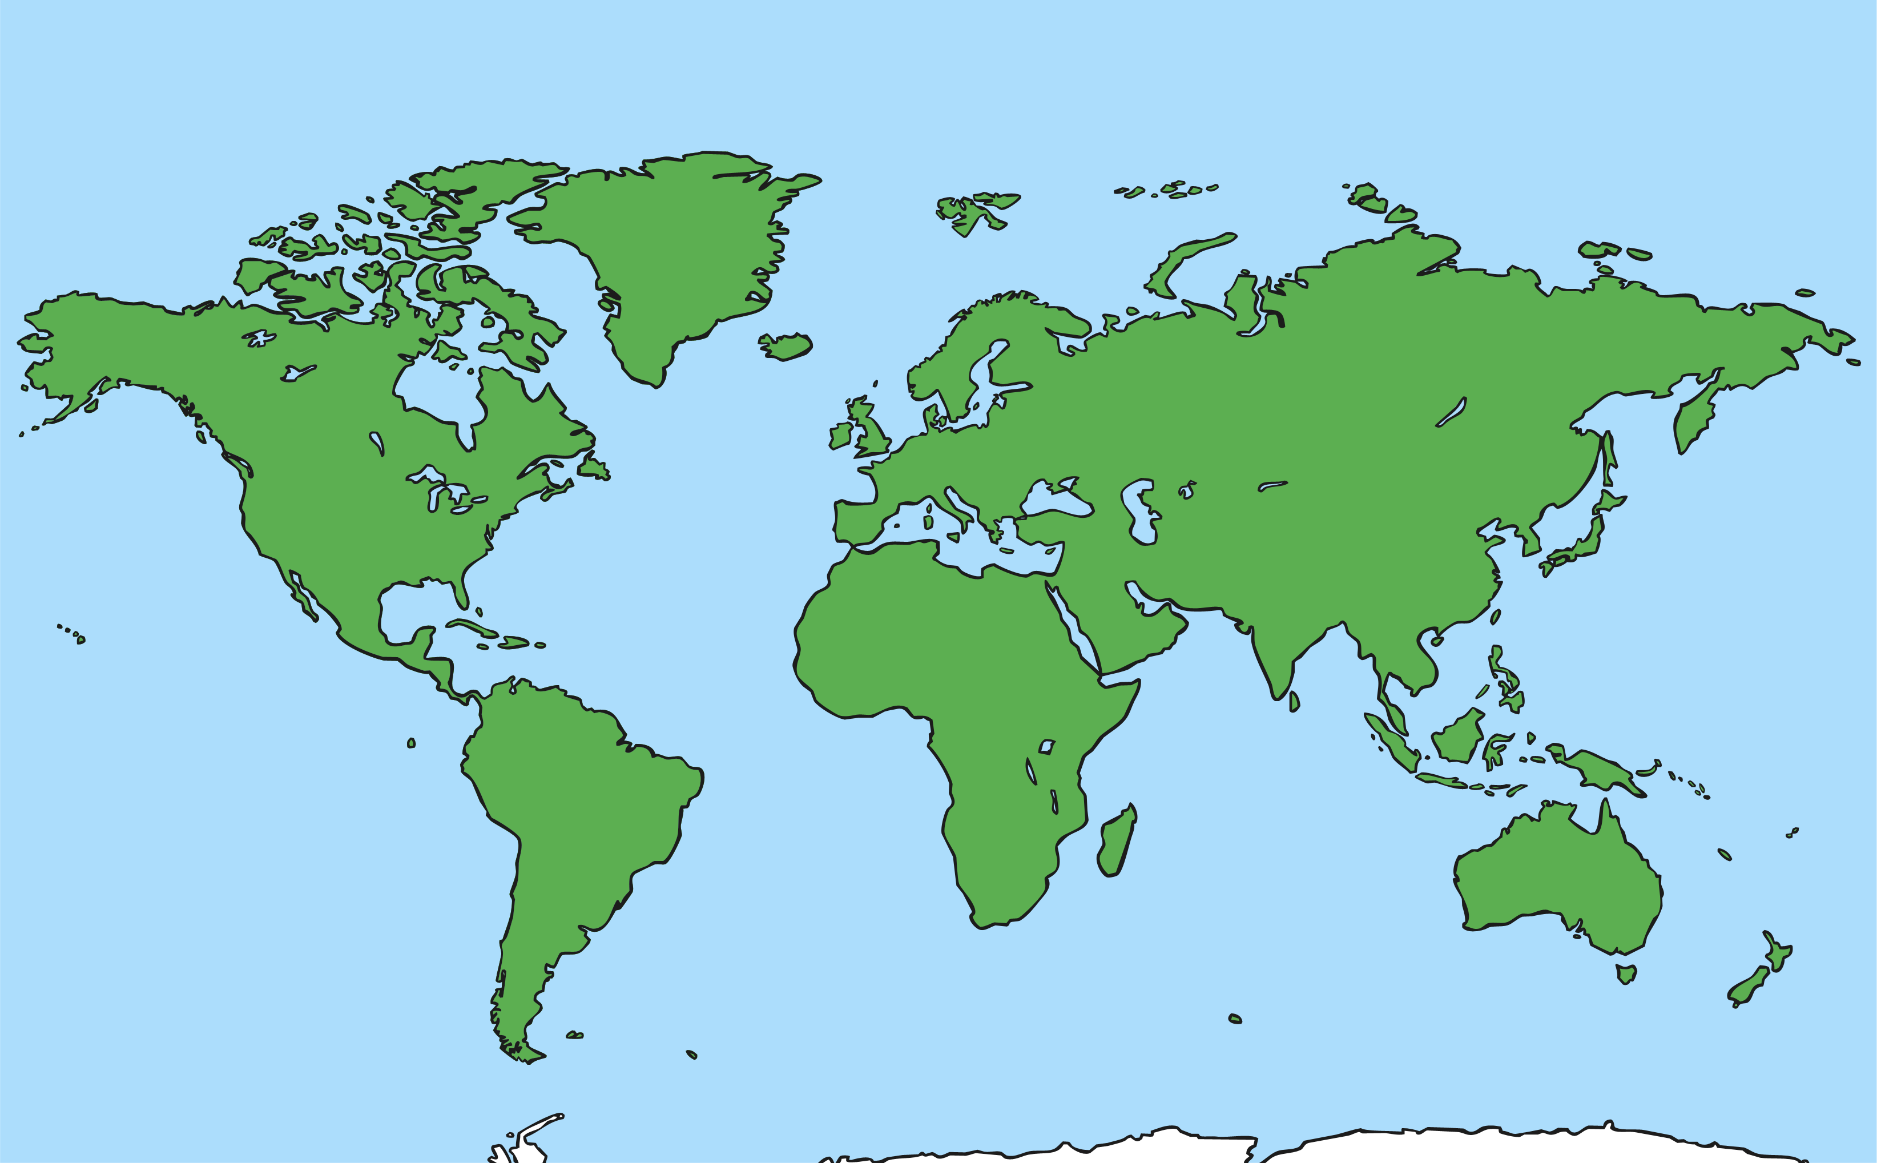
The Games were held every four years, as they are today.
Back then it was only held in Olympia, whereas now it is held in a different country around the world each time.

Slide 4
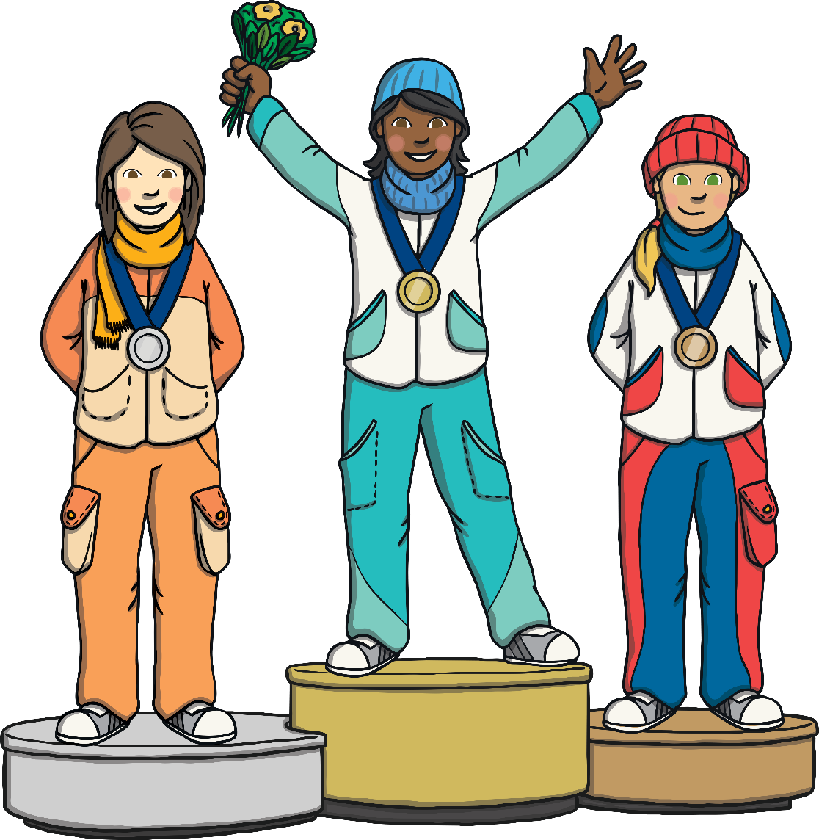
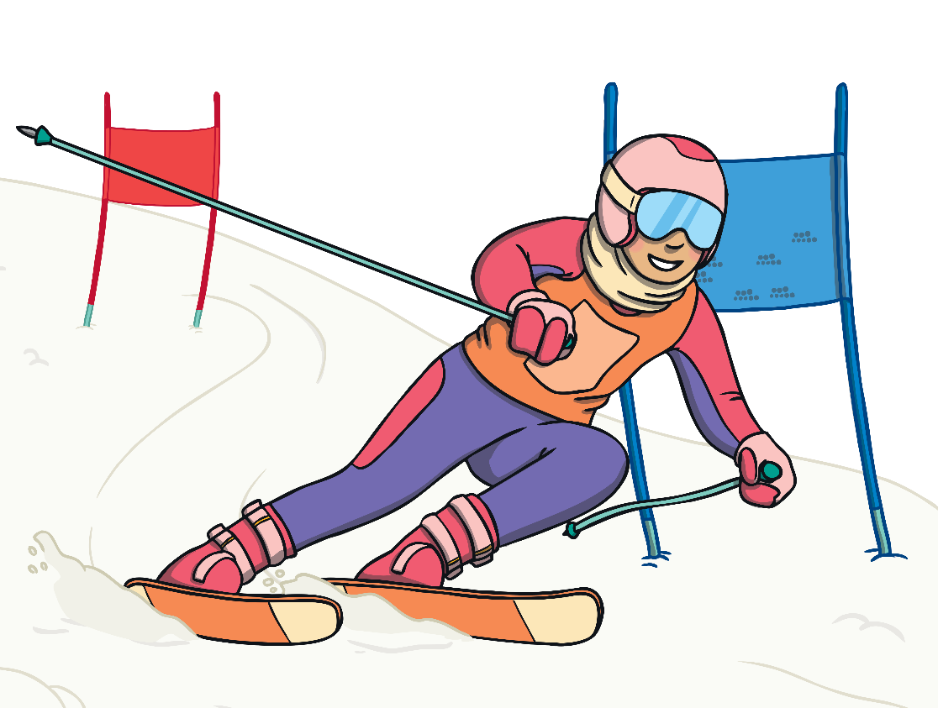
Today, as well as the Summer Olympics, the Winter Olympics are held two years after the Summer Games.

Slide 5
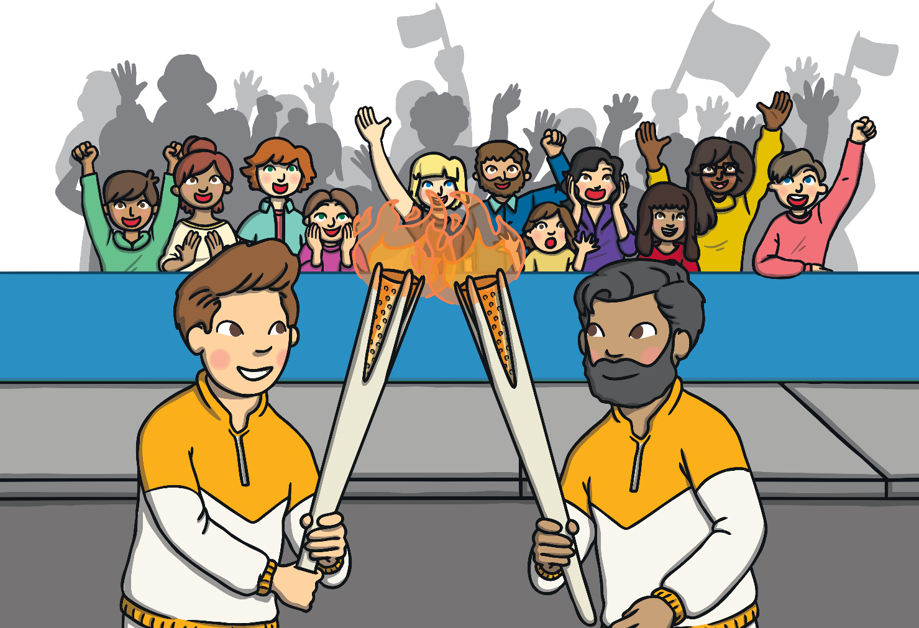
To symbolise the Ancient Olympics, the torch is carried around the country of the Games.

Slide 6
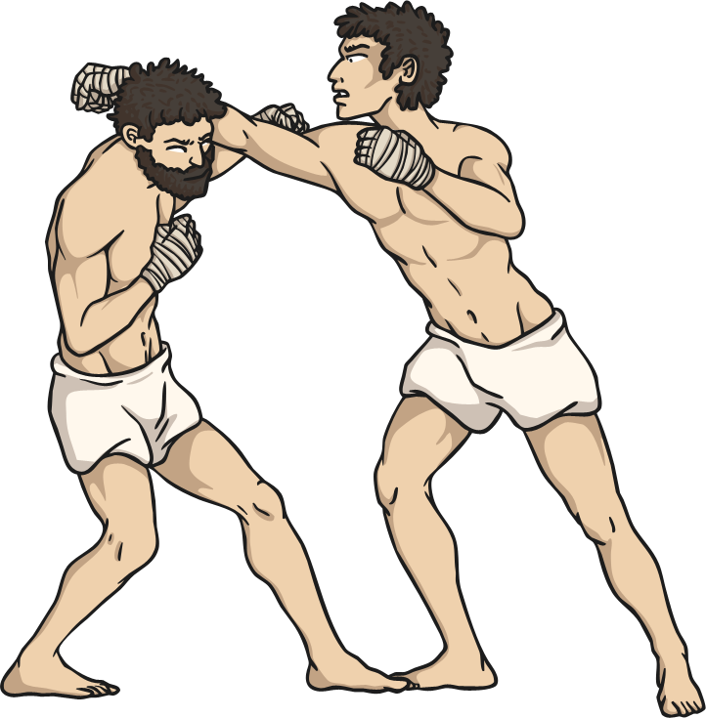
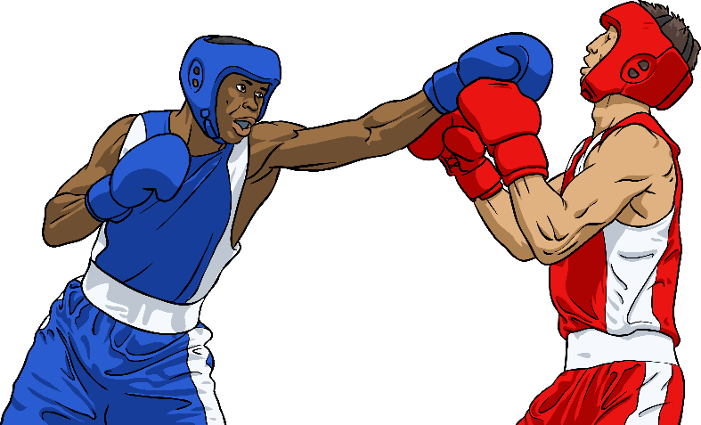
Ancient Olympics
Modern Olympics
In the Modern Olympics there are more than twenty different sports.
In the Ancient Greek Olympics there were only ten sports.

Slide 7
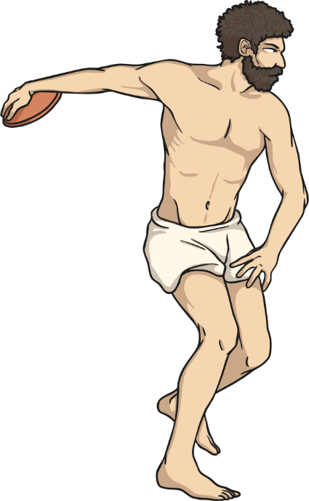
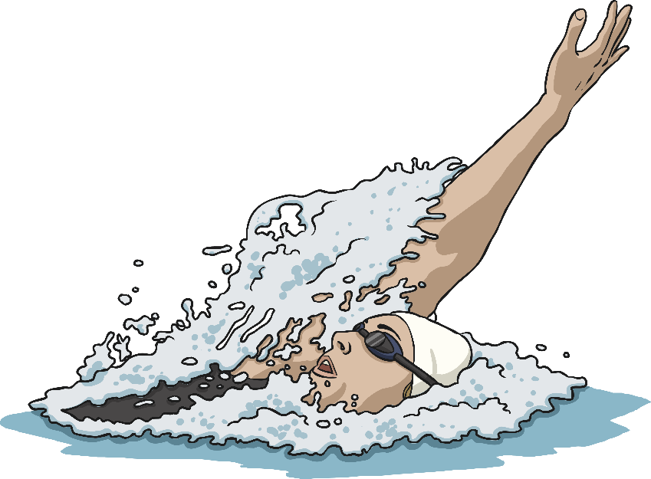
Ancient Olympics
Modern Olympics
The pentathlon consisted of running, wrestling, long jump, discus and javelin.
The modern pentathlon is made up of pistol shooting, fencing, swimming, showjumping and a cross-country run.

Slide 8
Ancient Olympics
Modern Olympics
Athletes ran barefoot and wore no clothes.
Track runners today wear special shoes that have spikes to help them grip.

Slide 9
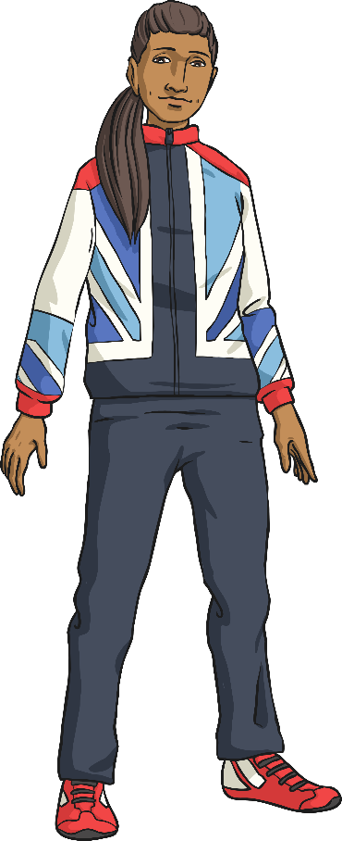
Ancient Olympics
Modern Olympics
Women were not
allowed to watch or compete in the Games.
Women and men both take part, but they do not compete against each other

Slide 10
Olympic Games Tasks
Task 1
Sort the events from the Ancient Greek Games and the Modern Olympics into the Venn diagram.
*Remember*
If the event only happened during the Ancient Olympic Games, it will go to the left.
If the event only takes place in the Modern Olympics, it will go to the right.
If the event is in both, stick it in the middle where the circles cross.
Task 2
Using the PowerPoint, answer the comprehension questions provided.
*Remember*
Read the text carefully to help you find the information needed to answer your questions correctly.
Answer your questions in full sentences, using full stops and capital letters
Task 3
Pick 3 events from the Ancient Olympics and create your own Top Trumps cards.
Look at the example provided. You can use skills of your choice and create your own scores for each one!

