Slide 1
Troon Primary Sports Week
Second Level Numeracy

Slide 2
Welcome to the Numeracy section of Sports Week
Choose your own level in the Chilli Challenges…
Are you going to go Mild, Medium, Hot or Ghost? There’s also a California Reaper chilli if you’re brave enough!
You have a choice of Maths topics as well as a choice of difficulty level.
Thinking about your personal maths targets: you can choose to work on either
Maths Olympics
Times tables or
Time

Slide 3
Troon Maths Olympics 2020
Choose your level of Challenge – you can try any level
Mild | Medium | Hot | Ghost https://www.ukmt.org.uk/competitions/solo/junior-mathematical-olympiad
Use the Olympic Hosts chart on the next slide to draw a bar chart to show how many times each continent has hosted the Olympics. | Use the Olympic Hosts chart to draw a time line graph to show how the number of Nations involved has changed. You could research how many there were in 2012, 2016 and what would have been in 2020. | Use the Olympic Hosts chart to draw a graph that compares the numbers of male and female athletes who competed between 1968 and 2008 | Sadly, the 2020 Junior Mathematical Olympiad has been cancelled…but… if you click here you can access past papers and solutions.
The continents are: Asia, Africa, Europe, Australia, North America, South America, and Antarctica. | Your x-axis (horizontal) will have the years (so you’ll need more than 30 boxes) and your y-axis should be numbered to more than 204. You’ll need to think about the scale you use so your work fits on to your page. | You will have to choose a scale and how to present the work. Try this puzzle for fun: click here | This maths competition is aimed at S2 and below so you have not been taught some of the maths concepts – but give it a go, and use the solutions to help you work backwards to understand anything that’s new to you.

Slide 4
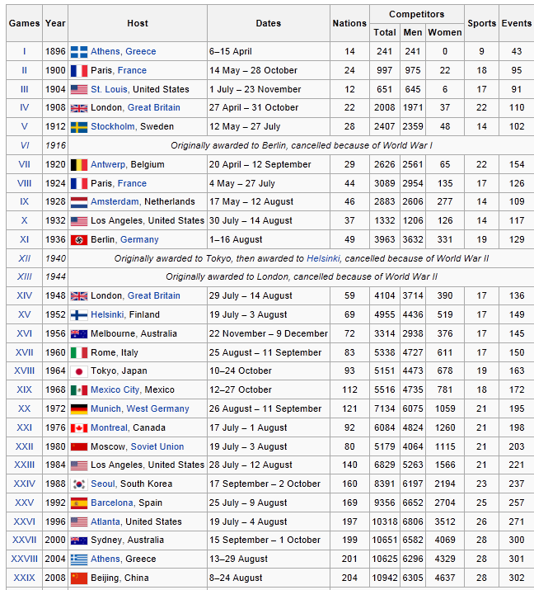
Olympic Hosts
These are the countries that hosted the Olympic Games up until 2008.
Choose your level of challenge on the Maths Olympics page, then use this table to help you complete the work.
Make sure you use a ruler and your brain – you need to read the challenges carefully to make sure you’re doing the right thing.
Remember key information for a graph includes a title, labels on both axes to say what they show, and the numbers (on the lines, not in the spaces) that make it all make sense!

Slide 5
If you need to work on Times Tables or Time, this is for you…
Click the link: www.twinkl.co.uk/resources/twinkl-partnerships/the-numbers-game
Choose whether you are working on Times Tables or Time .
Each topic has 5 activities spread over 5 days.
Every day has a video with football skills and includes the key idea for the lesson.
After you’ve watched the video for each day, choose your level of chilli challenge for your activity.
If you don’t have a printer, there are ideas for doing the work actively as well as ideas for parents to continue the learning,

Slide 6
If you want to go even hotter than Ghost… can we introduce… CAROLINA REAPER – THE WORLD'S HOTTEST PEPPER!
This task is not for the faint-hearted…don’t say we didn’t warn you!

