Slide 1

Symington Primary and EYC Newsletter
September 2026

Slide 2

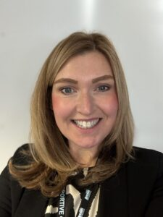
What a great term so far. I have seen some great teaching of literacy this term and it has been lovely to see the confidence in children grow.
Thank you to those who came in for maths week – the pupils enjoyed this and think our visitors enjoyed it too!
As always, I would encourage you if you have any questions or concerns to contact the school office to arrange a telephone call and/or meeting. symingtonmail@south-ayrshire.gov.uk or 01292 690074
Mrs Shields

Slide 3

Parent/Carer’s Evenings
Information has been send out regarding making appointments – please contact the office if you are unable to do so.
These will take place on Wednesday 6th October 3.30-6.30pm and Thursday 7th October 4-7pm.

Slide 4

Staffing Updates
Mrs Hillan will be continuing to teach P2 for this session after being successful at interview. This will provide continuity for the pupils and their learning.
Miss Gray has started with us and is getting to know all pupils – she is enjoying being part of the pride.
Mrs Prichard will start with us after the October holidays and is excited to join the team.

Slide 5

Supporting Wellbeing and Additional Support Needs at Symington
There has been a few questions recently regarding those pupils on Staged Intervention Plans. The plans will be shared at parent/carer’s night on 6th and 7th of October.
There will be an opportunity to look and contribute to the plans.

Slide 6

Parent Council Updates
We had our annual AGM and there are still roles to be confirmed.
The work of the parent council is most valuable and
provides opportunities to work together.
Next Meeting Thursday 22nd October at 7pm in the school.

Slide 7
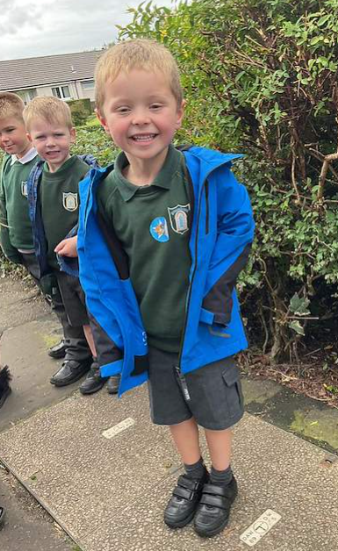
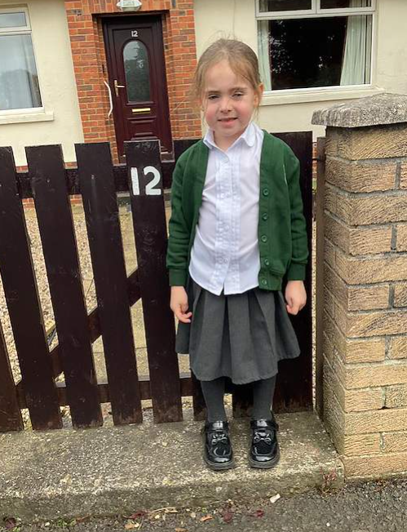
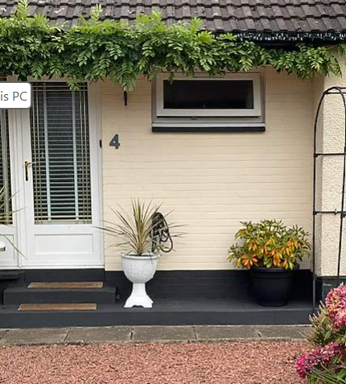
Maths Week
We had a great week celebrating everything maths from visitors talking about the jobs, number hunts and challenges.

Slide 8

School Photographer
The Photographer will be in school on Monday 26th October. There will be the opportunity for individual and family photographs and they will be taken by the photographer from The Studio in Ayr. A letter will be sent home in due course.
The Ayr Advertiser will be in school on Friday to
take a class picture of our Primary 1 pupils.
If you haven’t completed the permission forms please do so.

Slide 9
Dates for the Diary
30th September @1.45pm P1 Literacy Event
1st October P5 Swimming week 5
8th October P5 Swimming week 6
7th October Parent/carer’s evening 3.30-6.30pm
8th October Parent/carer’s evening 4-7pm
Monday 12th-Friday 16th October – School Closed
19th October In-service day
20th October P1 Open Afternoon (see poster)
22nd October P5 Swimming week 7
23rd October P7s at Prestwick Academy for Maths and English Lessons
26th October Photographer in school
26th October for 2 weeks P1 Registration
29th October Halloween disco (times tbc)
30th October Halloween parade and activities in class

Slide 10
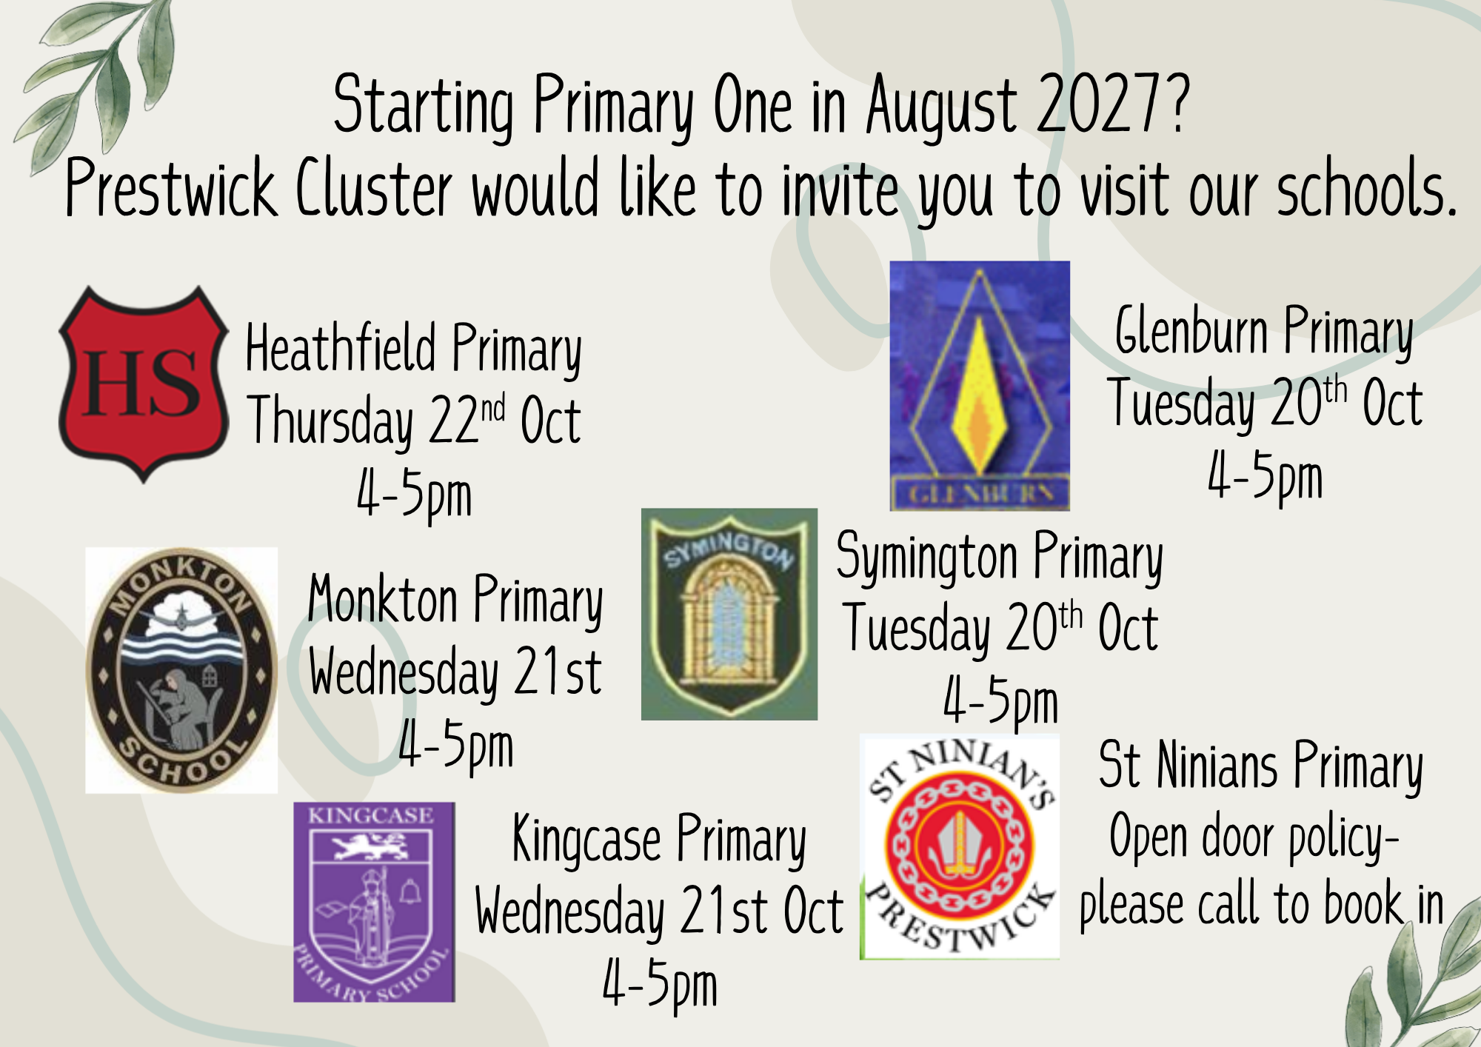

Slide 11

Football Fixtures
Please note some may be subject to change and additional games to be arranged;
01/10/2026 - Shortlees v Symington – KO 3.30pm at Shortlees Primary (2.45 pick up from school) Girls Team
28/10/2026 – Symington v Monkton – KO 3.30pm at Shaw Park

Slide 12

Attendance
In collaboration with our pupils we have created some attendance guidelines. This is now available on our school website. It details the attendance procedures and explains the importance of having, ‘Every Learner, Every Day’. Our aim this session is 95% overall attendance.
So far…
South Ayrshire Average- 91.1%
Average last session 25/26 – 95.6%
Average this session 26/27 – 94.2%
There have been a total of 69 days lost due to holidays out with term time so far!

Slide 13


Slide 14


Parking outside the School
Thank you for the improvements with this. Please do not park on the double yellow or Zig Zag lines outside
the school. We understand that the mornings can be busy and it
can be easier to do so, however, it is illegal for the majority of
drivers (unless they have a blue badge).

Slide 15
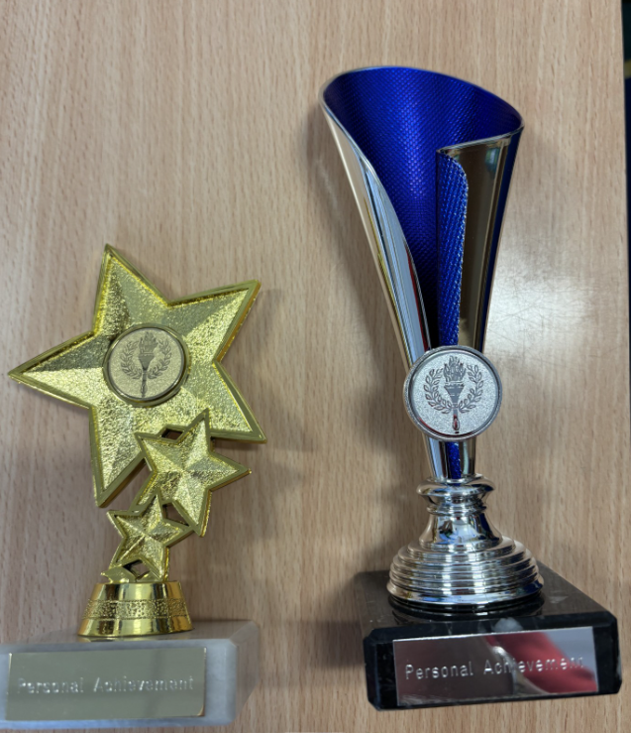
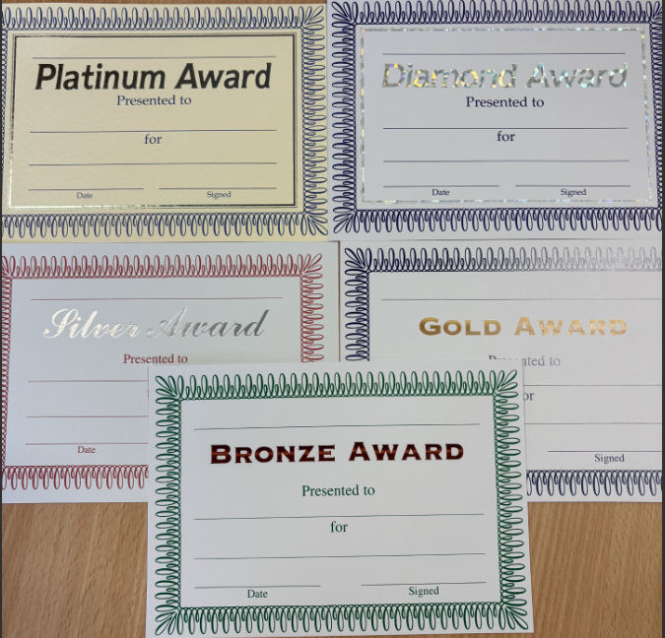
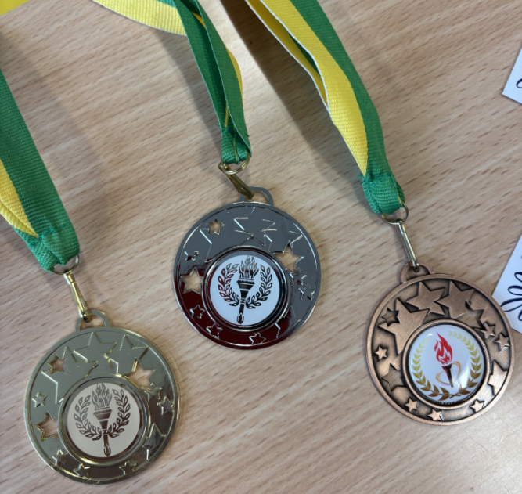
Pupil Personal Achievements
Pupils can receive Head Teacher’s Awards for achievements out of school – this could be certificates, trophies and awards from sporting activities, a new skill they have learned or something they have made. The main idea is that they have achieved something and can work towards their awards.
The awards are; bronze, silver, gold, diamond, platinum certificates, shield, bronze, silver and gold medal and finally towards a personal trophy. These awards are celebrated monthly in assemblies.

Slide 16

PE Days
P1 – Tuesdays and Thursdays
P2 – Mondays and Thursdays
P3 – Thursdays and Fridays
P4 - Tuesdays and Fridays
P5 – Tuesdays and Fridays
P6 - Tuesdays and Fridays
P7 - Tuesdays and Fridays

