Slide 1

Symington Primary and EYC Newsletter
February 2026

Slide 2

We have had a great start to the term with many pupil achievements and activities. March is a busy month ahead with our Spring Fayre, school show rehearsals and exciting learning.
If you haven’t had the opportunity to read the HMIe reports please follow the link to read the very positive report for both our Early Years Centre and School Symington Primary School | Inspection Report | His Majesty’s Inspectorate of Education in Scotland.
I would encourage you if you have any questions or concerns to contact the school office to arrange a telephone call and/or meeting. symingtonmail@south-ayrshire.gov.uk or 01292 690074
Mrs Shields

Slide 3

Communication
Thank you to those who completed the photo permission survey for our platforms for sharing information. This will allow us to share learning experiences appropriately and for you to see the successes.
You should now have our Communication Policy which sets out all communication you will have from the school and EYC.
As always, I would encourage you if you have any questions or concerns to contact the school office to arrange a telephone call and/or meeting. symingtonmail@south-ayrshire.gov.uk or 01292 690074

Slide 4
Parent Council Updates
At the last meeting we discussed the following;
Fundraising for an additional Trim Trail
Outdoor Learning and use of Garden area – an action plan with be organised by the school
Communication across the school – survey to be sent and policy will be written
Date for next meeting 4th March 2026 at 6.30pm

Slide 5


Valentine’s Disco
Thanks to our Parent Council for organising a very successful disco. This raised over £400 which will be contributed towards a Trim Trail and playground improvements.
Date of Next Meeting - Wednesday 4th March at 6.30pm

Slide 6

A Few Reminders
Pupils should bring PE kit (shorts, t shirt and shoes) on PE days;
P1 - Monday and Friday
P2 - Monday and Thursday
P3 - Monday and Thursday
P4 - Monday and Friday
P5 - Monday and Friday
P6 - Tuesday and Friday
P7 – Thursday and Friday
No Pupils should have mobile phones in the playground before school

Slide 7

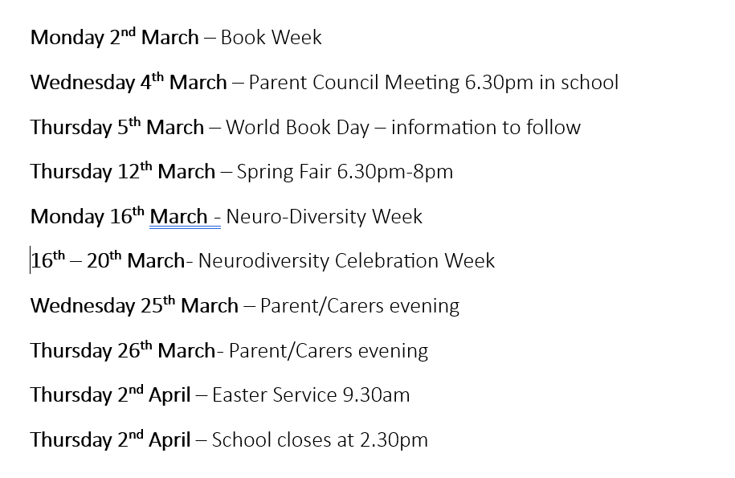

Slide 8


Parking outside the School
Please do not park on the double yellow or Zig Zag lines outside
the school. We understand that the mornings can be busy and it
can be easier to do so, however, it is illegal for the majority of
drivers (unless they have a blue badge).

Slide 9
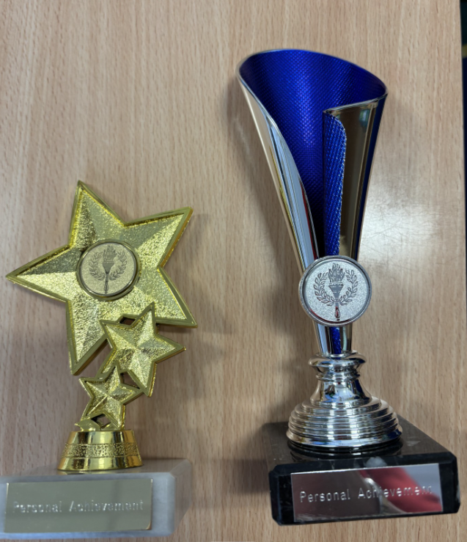
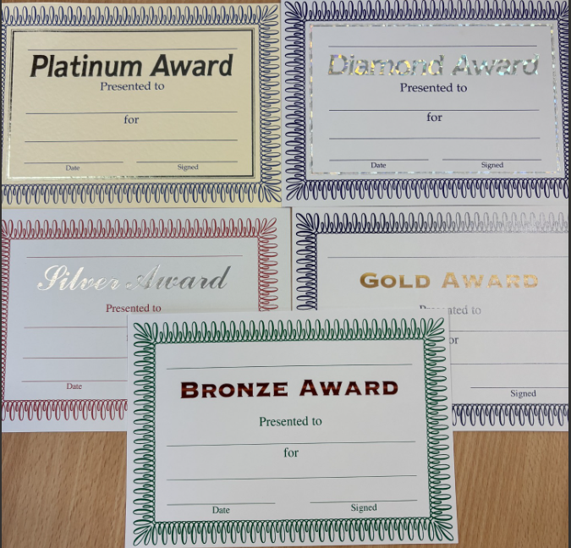
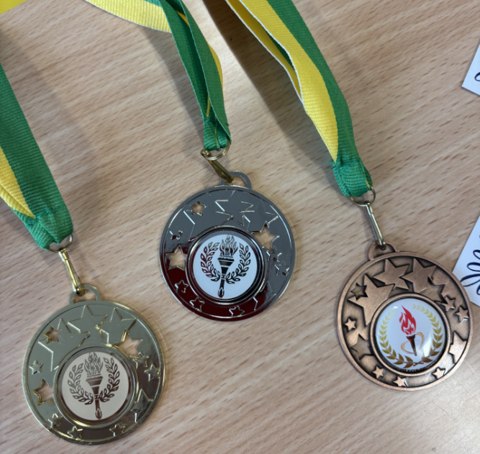
Pupil Personal Achievements
Pupils can receive Head Teacher’s Awards for achievements out of school – this could be certificates, trophies and awards from sporting activities, a new skill they have learned or something they have made. The main idea is that they have achieved something and can work towards their awards.
The awards are; bronze, silver, gold, diamond, platinum certificates, shield, bronze, silver and gold medal and finally towards a personal trophy. These awards are celebrated monthly in assemblies.

Slide 10

Football Fixtures
Please note some may be subject to change and additional games to be arranged;
Symington v Struthers - Wednesday 18th March KO 3:30pm, Marr Astro pitches
Nether Robertland V Symington – Friday 20th March KO3.30pm, Grange Academy
Braehead V Symington – Friday 27th March KO 3.30pm Whitletts’ Astro
Annbank v Symington - Friday 24th April KO 2:20pm, Whitletts' Astro
Symington v Forehill – Friday 1st May KO 3.30pm, Shaw Park
Alloway v Symington - Friday 8th May KO 3.30pm, Belmont Academy
Kincaidston v Symington - Wednesday 13th May KO 3:30pm, Belmont Academy
Doonfoot v Symington - Wednesday 20th May KO 3:30pm, Cambusdoon
Symington v Culzean - Thursday 28th May KO 3:30pm, Shaw Park

Slide 11

Book Week – World Book Day

Slide 12
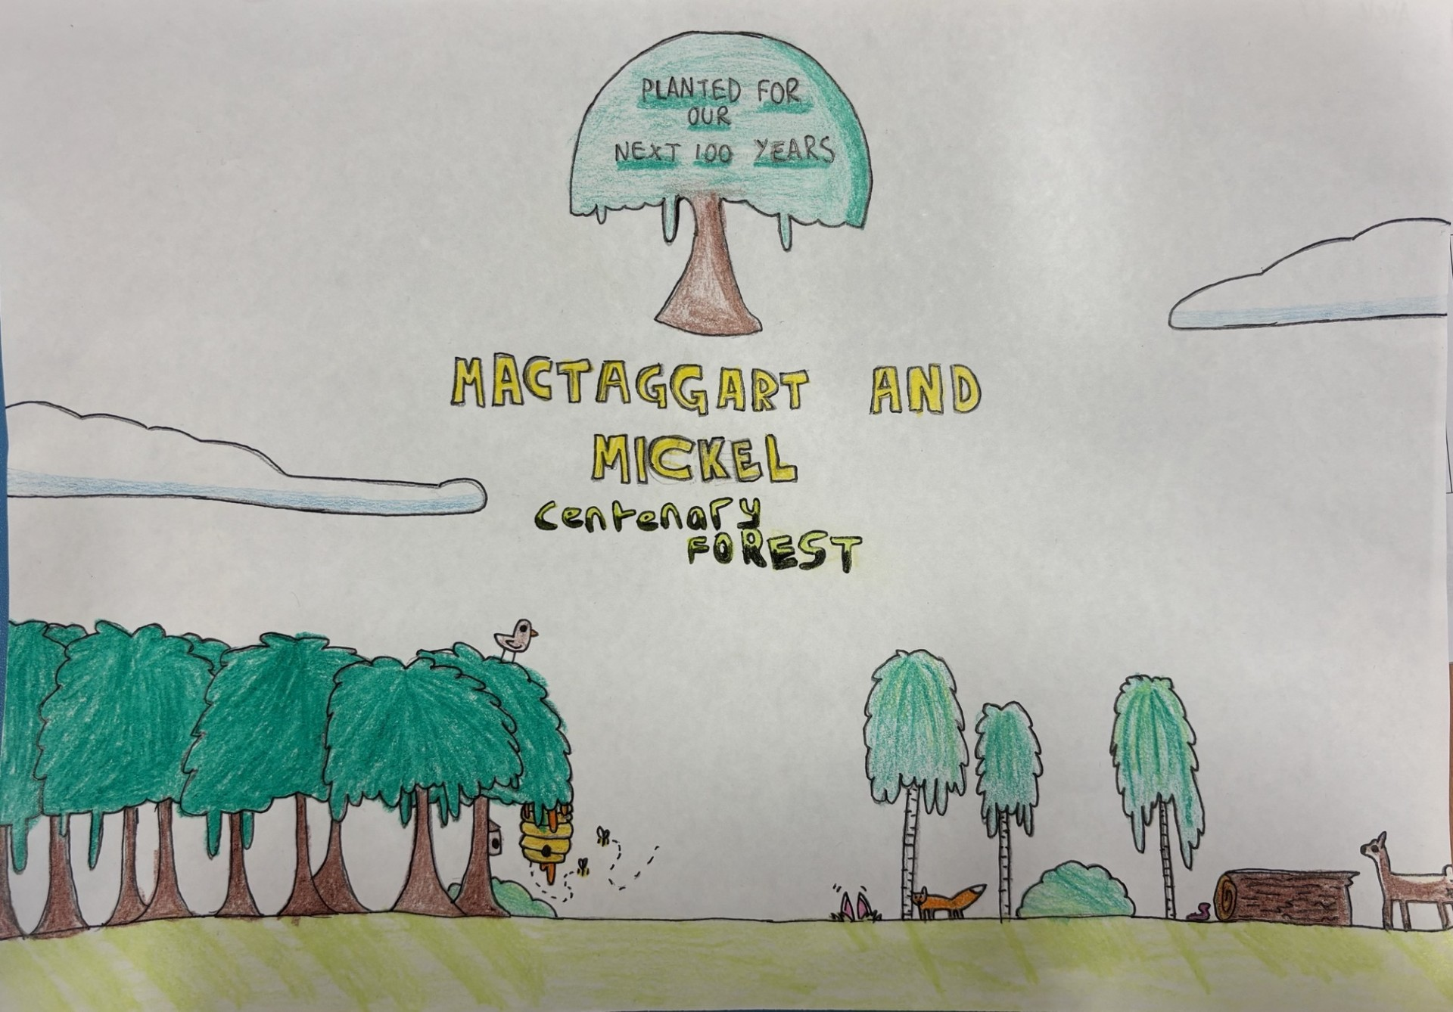
Achievements
Well done to Aleksander Dunsmuir who won a competition run by McTaggart and Mickel. He designed a panel for the entrance to the forest that will be developed.
Our Eco group were invited to plant the first trees at the McTaggart and Mickel Forest and were treated to lunch at Langholm Farm – a great time was had by all.
Our athletics team took part in the final of the Sports Hall event and did very well, winning some of the events
Our football teams have been playing many matches and demonstrating excellent sportsmanship and effort.
4 P7 pupils represented the school at the Local Authority Burns Supper in the town hall. The recited an extract from Tam O’Shanter beautifully and confidently.

Slide 13

Attendance
Current Overall attendance – 94.5%
South Ayrshire Overall attendance – 93%

