Slide 1
This is Straiton Primary School Our Vision
Improvement Plan 23/24

Slide 2
Spaces and PLaces
Live, Work, learn
Civic and Community Pride
Outstanding universal provision
Tackling Inequalities
Love and support for our Care Experienced young people and young carers
Good physical and mental wellbeing
Promoting Children's Rights
Equity, Wellbeing and Inclusion
Learning, Teaching and Assessment
Curriculum
Self Evaluation for Self Improvement
Placing the human rights of every child and young person at the centre of education
Improvement in children and young people's health and wellbeing
Closing the attainment gap between the most and least disadvantaged children
Improvement in employability skills and sustained positive school leaver destinations for all young people
Improvement in attainment, particularly in literacy and numeracy
South Ayrshire Council Plan
Children’s Services Plan
Education Services Priorities
National Improvement Framework Priorities

Slide 3
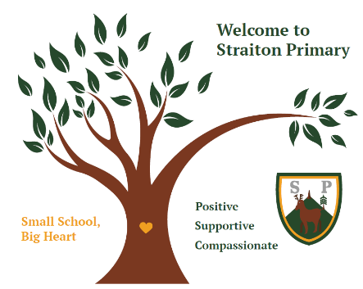
This is how we do it here (P. Dix, 2017)
Everyone in the Straiton school community aims to be the following in every interaction with one another:
Positive Supportive
Compassionate

Slide 4
A Culture of Wellbeing
38% of young people in the South Ayrshire had required access to a mental health service.
Global Problem
National Priority
Local Context
South Ayrshire Youth Forum’s
Say it Out Loud Report (Young Scot, 2020),
We need transformational
change and a whole systems approach.
Over ONE BILLION people in the world have mental health issues…only 1% of global health care professionals are trained to help mental wellbeing.
World Health Organisation (2017)
STINTS – staged intervention
Team Around the Child
Children and Young People’s Mental Health Task Force: recommendations, Scottish Government, 2019

Slide 5
A Culture of Thinking?
“Instead of learning to memorize facts and figures, students need to ‘learn how to learn’ and how to solve problems.”
Fred Swaniker, 2018
“The best moments in our lives are not the passive, receptive, relaxing times… The best moments usually occur if a person’s body or mind is stretched to its limits in a voluntary effort to accomplish something difficult and worthwhile.”
Mihaly Csikszentmihalyi (1990, p. 3)

Slide 6
School Improvement Plan 2023 AND BEYOND, NEVER STATIC…
A Culture of Thinking:
A Culture of Wellbeing:
STEM:
SSERC science programme
Making Thinking Visible (MTV):
A pedagogy to develop thinking strategies across the entire curriculum
Treehouse Mental Wellbeing Programme
Tree of Knowledge Workshops to imbed new values
Continued Focus on:
Outdoor & Play-based Learning
Community Working – environment group, community council & school garden
Partner working with Active Schools and Thriving Communities
South Ayrshire Reads
Developing a reading culture – reading for enjoyment/Giglets
New Reading Scheme - Collin’s Big Cat
New Phonics Programme – Phonics International
Continued Focus on:
CPA Numeracy – Concrete Pictorial Abstract and Maths Mastery
Talk 4 Writing
Digital Technologies

