Slide 1
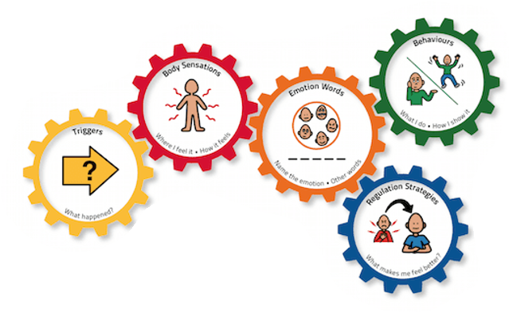
Emotion works

Slide 2
Blue Cog

Slide 3
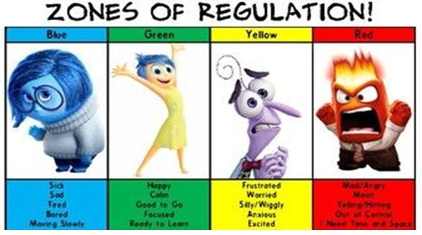

Slide 4
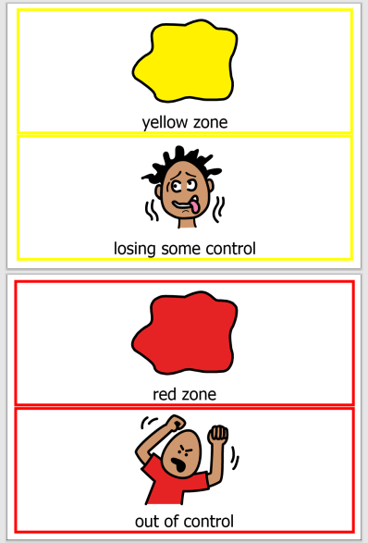

Slide 5
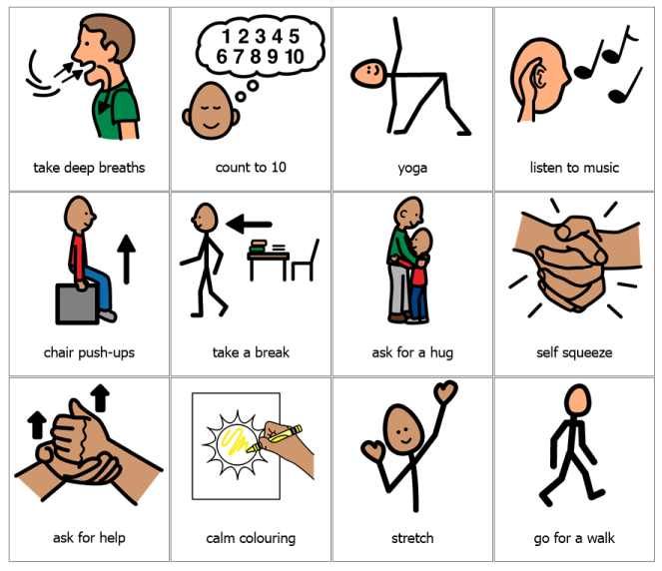
Strategies we encourage

Slide 6
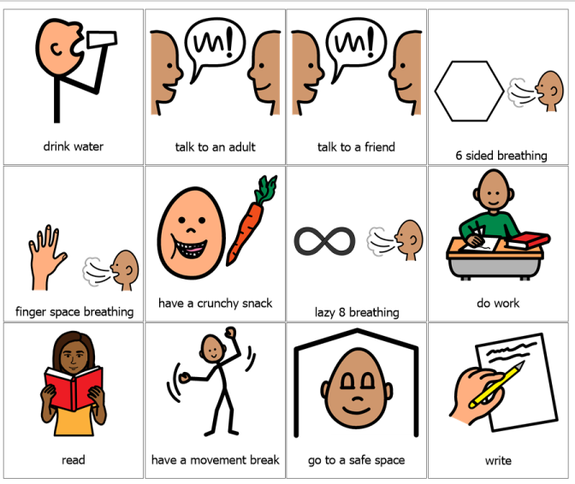
Strategies we encourage

Slide 7
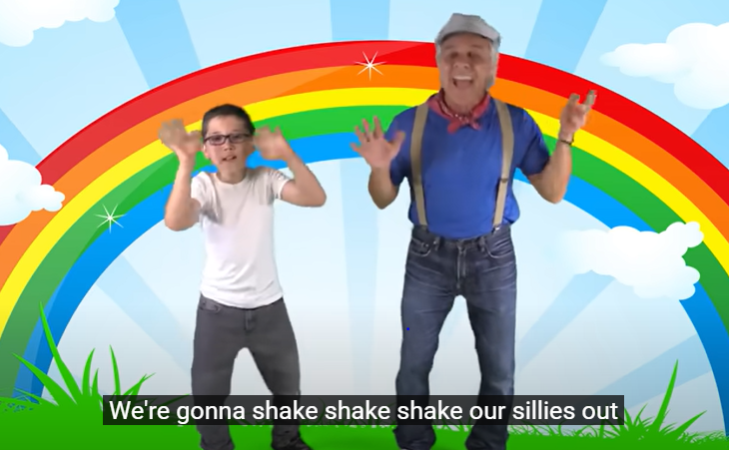
Let’s shake your sillies out!

Slide 8
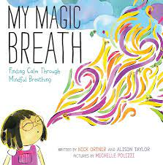
Story Time My Magic Breath by Nick Ortner

