Slide 1
Public Mental Health and COVID-19

Slide 2
Overview
Research Review Potential Issues
U of E COVID Life Survey
MHF – COVID inequality and MH update
National PMHSIG Survey
Suicide update
Substance Misuse update
Research Review Recommended Actions
Priority Actions...?
Local Public Mental Health and Wellbeing Action Plan

Slide 3
Rapid Research Review
Vulnerable groups
Children and young people
Older adults/existing health problems
Pre-existing MH problems
Frontline healthcare workers
Learning Disability
Marginalised groups – ethnic minorities
Socially excluded
Low income, financial insecurity
Digitally excluded

Slide 4
Research cont.
Psychological impact
Increase social isolation
Precipitate or aggravate MH conditions
Impact on carers
Grief reactions
Common Symptoms
Depression
Anxiety
OCD
Somatic symptoms – physical health symptoms
PTSD
Self Harm, suicide, substance misuse

Slide 5
Rapid Research Review
Expected consequences
Increased isolation, loneliness
Aggravation of MH conditions
New MH conditions
Caregivers – distress
Abnormal grief
Distrust and fear re-disease spread
Financial impact on communities, negative emotions
Psychological impact – school, health, community group closures

Slide 6
COVIDLife survey (UofE)
15,400 (80% in Scotland)
Self employed and under 40’s least confident about job security and the economy
23% mildly depressed (17% moderate to severe)
Anxiety/depression greater in younger age groups/manual workers
Loneliness, isolation – marked increase particularly in <40yr olds
Positives
58% contacted an old friend
¼ volunteered
New hobbies: Reading, exercise, music, art, board games

Slide 7
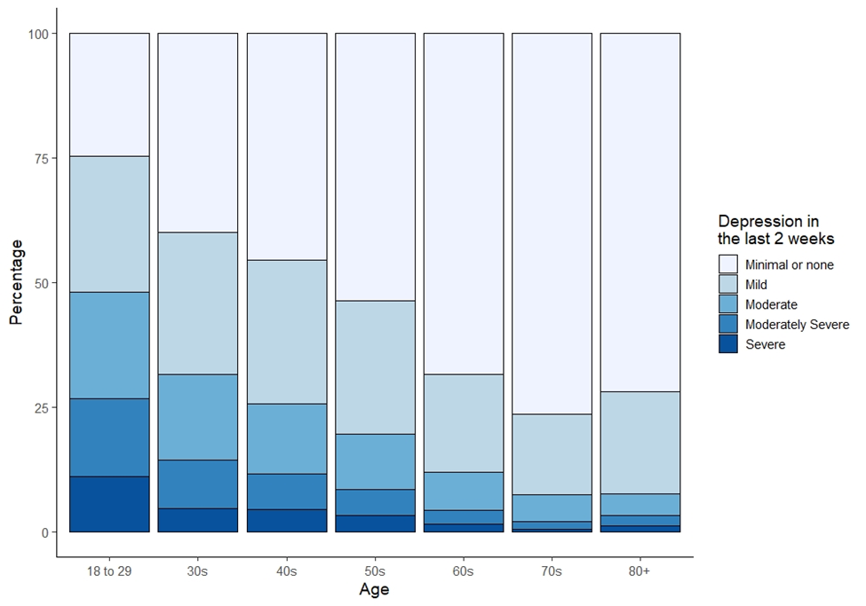
Depression under lockdown

Slide 8
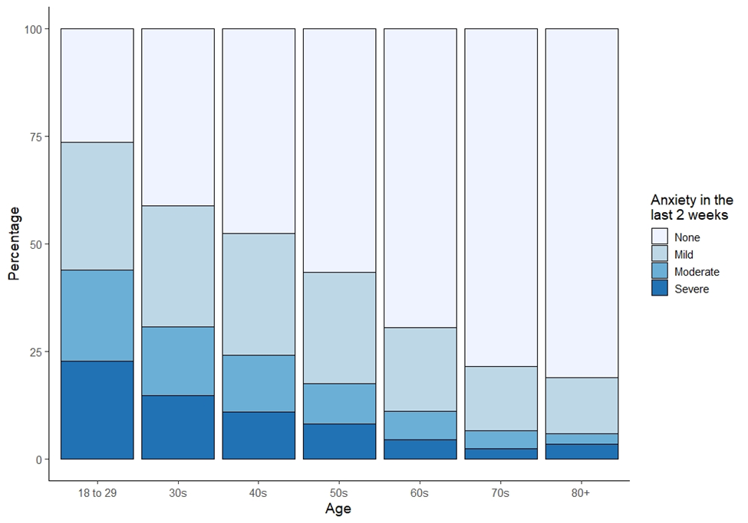
Anxiety under lockdown

Slide 9
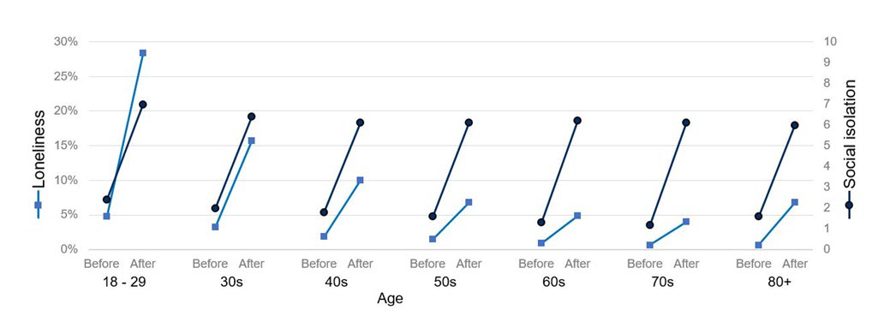
Loneliness/social isolation

Slide 10
MHF-COVID inequality MH briefing
COVID increasing inequalities
Recommendations
Economic security/tackle debt crisis
Child/in-work poverty action
Prevent stress due to risk of eviction
Ensure business measures support the vulnerable
Outreach to unemployed - psychological support
Improve infrastructure for social connectedness
Community development, peer support
Whole Government recovery plan for MH

Slide 11
PMHSIG National Survey
Key issues faced – Apr ‘20
increase in loneliness and isolation,
difficulties in access to services,
increase in mood disorders,
increase in substance abuse,
and staff-related issues.
Service Responses
Changed working practices
Sharing resources
Support for community and staff
Overall adapting well to circumstances

Slide 12
Client issues highlighted
Deteriorating MH existing clients – lack of usual supports and routines – ongoing trauma
Increased number with suicidal thoughts
Health anxiety –specific populations eg perinatal,
Financial anxieties
Substance abuse - increase

Slide 13
Staff Issues highlighted
Lack of support from employer eg PPE, IT Apr
Worry about infecting family
Redeployment concerns
Increased work stress – due to
increased MH issues in clients
Changed service delivery eg phone support
Lack of usual day to day peer support

Slide 14
Suicide Prevention
TMASRG monitoring re-COVID influence, clusters
Experts expect suicide rates will increase
Social isolation – particularly individuals with fewer social networks pre-COVID
Loss – bereavement, employment etc
Social Connectedness is protective
Priority groups: men, mental health/substance misuse disorders, discharged from custody, victims of domestic abuse, newly unemployed, bereaved, shielding individuals

Slide 15
Substance Misuse
Four significant risks in relation to drug deaths currently:
1. Direct risk from COVID-19 infection, underlying health conditions, harder to socially distance.
2. Risk of disruption to the supply of the drug, substitution, increased drug use to self-medicate mental health issues that may develop as a result of lockdown
3. Risk from disruption of health, dispensing, social and 3rd sector care provision
4. Risk from what is termed ‘excess mortality’ that is not fully understood as yet.

Slide 16
Research: Early Preventative actions
Good quality accessible information
Electronic
Paper
Other languages, BSL
Reduce loneliness and social isolation, promote belonging
Leveraging community assets
Promote positive mental wellbeing –physical activity, meaningful community activity, life skills, art/culture

Slide 17
Research: preventative actions
Identify MH problems/psychological distress –screening
Research qualitative insights with diverse communities –alleviate –ve psychosocial effects
Mitigate economic/social consequences
Support populations at risk from trauma – abuse in home, children with support needs, isolation, MH disorders
Build resilience strategies for sub-groups
Positive mitigation – kindness, altruism, pro-social behaviour – scale this up

Slide 18
Research: preventative actions
Leadership: community, healthcare, SG
Model healthy responses
Validation of public fear – ‘normal’ response
Keep public informed
Guidance around positive mental wellbeing
Capacity building – psychological first aid, suicide prevention etc
Staff wellbeing

Slide 19
Priority Actions...?
PMH Capacity
Mental health in all public health priorities and actions – community building, early years, economy etc
Whole system approach
Action - pilot and evaluate interventions
Targeted populations- young adults, teenagers, parents, deprived communities – and whole population approaches
Target issues – social connectedness, loneliness, anxiety, employability etc

Slide 20
Local Public Mental Health and Wellbeing Action Plan
Focus on 3 areas
Sustaining inner resources
Increasing social connectedness, relationships and trust in families and communities
Increasing financial security and creating mentally healthy environments for working and learning
Three action areas using a lifecourse approach

Slide 21
Mental Health and Wellbeing Activities
Training
Development of new and ongoing review of resources and information
Development of communication/digital resources
Children and young people’s seminars
Campaigns and social marketing
Mentally healthy workplaces

Slide 22
Public Mental Health Planning and Advocacy
North, South, East – Education Operational and Strategy groups
Ayrshire College Promoting Wellbeing Group
South Ayrshire Youth Forum support
South Ayrshire flowchart for mental health support
Parental engagement
Social Isolation and Loneliness
Regional planning
National public mental health and wellbeing group

Slide 23
Public Mental Health Intelligence
Ongoing review of evidence
Mental Health and Wellbeing Outcomes information – children and adults
Social isolation and loneliness review
Whole school approach to mental health and wellbeing
Social marketing project – mental health perspectives

