Slide 1
AYRSHIRE MULTI-AGENCY GUIDANCE FOR THOSE WORKING WITH CHILDREN & YOUNG PEOPLE AT RISK OF SELF-HARM OR SUICIDE
Notes:
Double check with audience that the topics (especially suicide) will be ok for them to discuss. Also remind people that if they have to leave to indicate they are ok – otherwise they will be followed out by co-presenter/support person to make sure.

Slide 2
G U I D A N C E
“Ayrshire Multi-Agency Guidance for those working with Children and Young People at risk of Self-Harm or Suicide”
Introduction (definitions and aims)
Influencing Factors (emotional resilience)
Self-Harm (why, who, types, action and risk assessment)
Suicide (information, myths, action and after a suicide)
Support for staff
Training
Services
References

Slide 3
D E F I N I T I O N S
Suicide
An act of deliberate self-harm which results in death
A death resulting from an intentional, self-inflicted act
Self-Harm
Self poisoning or self-injury, irrespective of the apparent purpose of the act
Suicide and Self-Harm Links
Self-harm is generally a way of coping with overwhelming emotional distress. Many young people self-harm where there is no suicidal intent. Research, however, shows that young people who self-harm can be at higher risk of suicide. The risk of suicide is higher for those who repeat self-harm

Slide 4
A I M S
Ensure the child or young person is seen as central to the whole process and accorded appropriate priority by agencies involved
Ensure a consistent response to and understanding of self-harm across all staff working or in significant contact with children and young people
Provide an agreed set of procedures for dealing with disclosure
Minimise harm and support emotional health and well being of the child and young person through collaborative working
Provide children and young people with opportunities and strategies for hope and recovery from the effects of self-harming or attempting suicide and minimise the risk of future harm
Support the service to carry out a risk assessment and make appropriate referrals.
Notes:
After this slide – do exercise: ‘Why do people/young people self harm?’ Write on flipchart answers given

Slide 5
E M O T I O N A L & P S Y C H O L O G I C A L D I S T R E S S
Self-harm is generally a response to underlying emotional and psychological distress.
Factors may include problems with family/relationships, school, sexuality, substance misuse, bereavement, mental health issues
The list of factors is not exhaustive and neither these factors nor emotional distress are automatically proof of self-harm or suicide risk.
However knowledge of distress at an early stage may help prevent possible future self-harm i.e. early intervention to address underlying issues
Notes:
After this slide do exercise: discuss types of self harm – write answers on flipchart/discuss, remember things like overeating, eating disorders

Slide 6
For Trainer only (say as part of presentation)
S E L F – H A R M
Research suggests 1 in 4 young people have self-harmed or knows someone who has (“Truth Hurts” report)
The average age of onset is 12 years old
Types of self-harm may include cutting, biting, burning, picking skin, punching, hair pulling, head-banging, overdosing
Why do Young People Self-Harm?
Self-harm is a coping mechanism which enables a person to express difficult emotions. They may feel physical pain is easier to deal with than emotional pain but the behaviour only provides temporary relief and fails to deal with the underlying issues that a young person is facing

Slide 7
R E A S O N S F O R S E L F – H A R M
The reasons people gave for self-harming are varied and include:
Self-harm temporarily relieves intense feelings
Self-harm provides a sense of being real
To feel pain on the outside instead of the inside
Self-harm is a way to control and manage pain
Some people who self-harm are punishing themselves for having strong feelings
Self-harm followed by tending to wounds is a way to be self-nurturing
To ask for assistance in an indirect way
On rare occasions self-harm is used to manipulate others
Self-harm can be influenced by alcohol and drug misuse
Notes:
After this slide do exercise (verbally with participants only) – ask about what things we need to do/remember when dealing with self harm?

Slide 8
T H I N G S T O R E M E M B E R
Don’t panic
Listen
Explain
Involve young person
Keep safe
Stopping self-harm may be a longer term aim
Safety and understanding are short-term aims

Slide 9
R I S K A S S E S S M E N T
Consider using flowchart , safety plan
Nature and Frequency
Other Risk Taking Behaviours
Child Protection
Health
Underlying Issues
General Distress
Suicidal Intent
Future Support

Slide 10
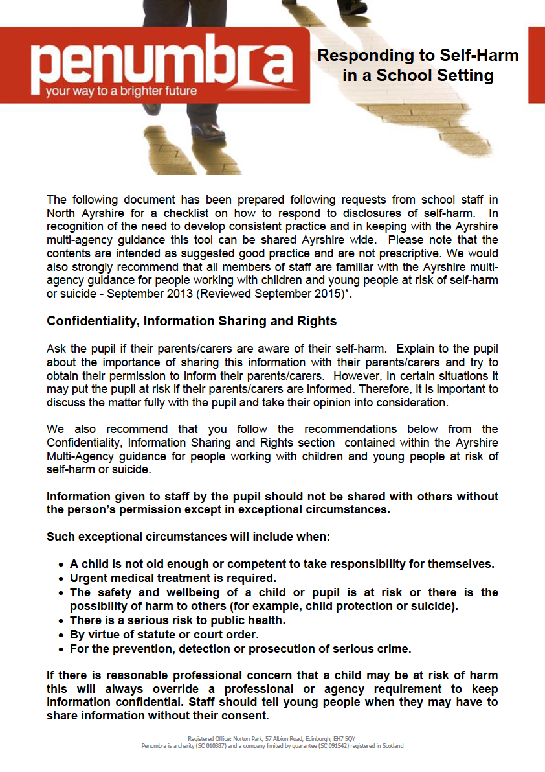
Notes:
Advise these docs are available from presenters (contact details at end) & will also be emailed out after presentation (via Kate McDonald)

Slide 12
*Copies of Ayrshire multi-agency guidance available from: https://www.east-ayrshire.gov.uk/Resources/PDF/C/Multi-agency- guidance-for-people-working-with-children-&-young-people-at-risk-of-self-harm-or-suicide.pdf
Penumbra Safety Plan and Parents Frequently Asked Questions can be downloaded from the North Ayrshire Self Harm Section on our website: http://www.penumbra.org.uk/service-locations/ayrshire/self-harm-services/
Copies of “Helping Parents understand self harm leaflet can be downloaded from: http://www.nhsaaa.net/media/296862/sharmaug14.pdf

Slide 13
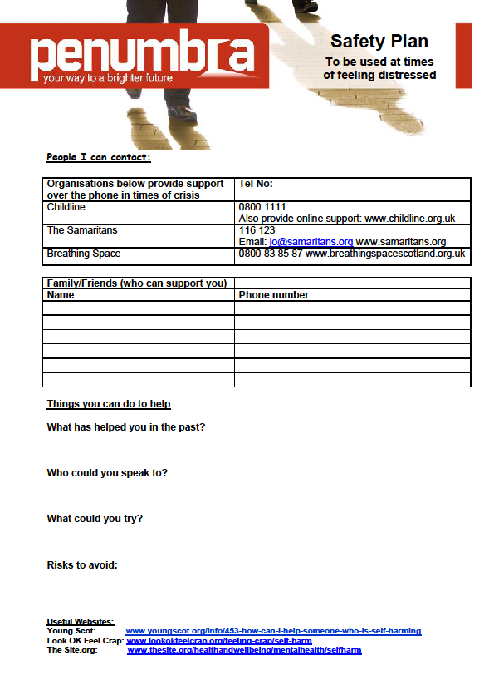

Slide 14
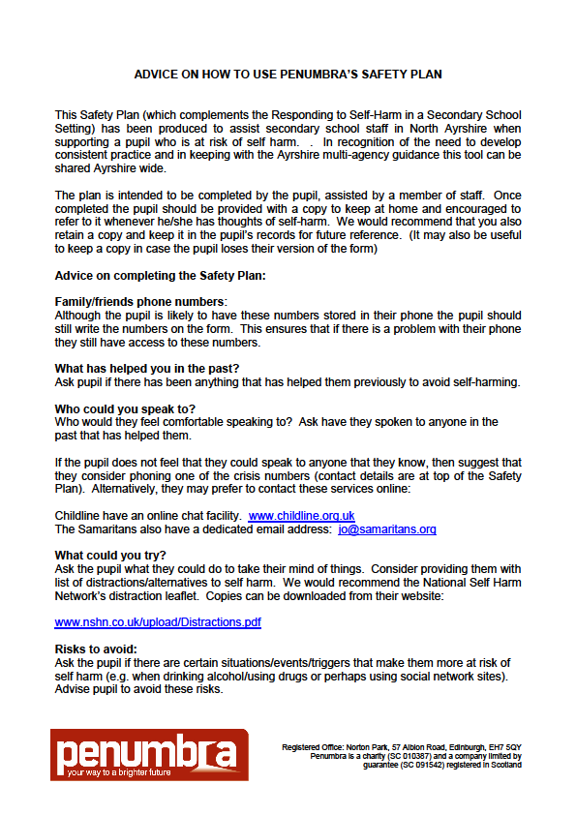
Notes:
Advise these docs are available from presenters (contact details at end) & will also be emailed out after presentation (via Kate McDonald)

Slide 15
S U I C I D E
Some higher risk groups:
Those who misuse drugs/alcohol
Looked after children/young people
Men
People with mental health problems
Those who have previously attempted suicide
Homeless
LGBT groups
There are other groups and not all those who fall into these groups are at risk.
Notes:
After this slide do exercise: Ask ‘Why don’t we talk about suicide’ – write down answers on flipchart or just verbal?

Slide 16
S U I C I D E
MYTHS
“Those who talk about suicide are the least likely to attempt it”
“Talking about suicide encourages it”
“If a person has made previous attempts they won’t do it for real”
There are indications people may be thinking of suicide e.g. language, previous attempts, sense of hopelessness, changes in behaviour, life events
All of these (and more) may be a reason to ask someone if they are thinking of suicide-it is the only way to be sure.

Slide 17
S U I C I D E
If someone is expressing suicidal thoughts remember;
Don’t panic
Listen to them
Keep them safe
Involve them in decisions
If they are in the act of trying to take their life
Keep them safe
If their life is in danger-phone 999 or take to A and E
Remove the means
Encourage talking and listening
Do not put yourself in danger

Slide 18
C O M P L E T E D S U I C I D E
If someone has completed suicide there some things to remember:
The death by suicide of a young person is a tragic event
Remember other vulnerable young people may need extra support at this time
Anyone who has previously been affected by suicide may feel old feelings coming to the surface
All staff, service users and parents will need support-provide a safe grieving environment
Be aware of copycat responses from other vulnerable young people
Normal routines should continue as much as possible with support available
Agree who and how any media responses are dealt with
Be clear that no-one is to blame for the death. Suicide is complex

Slide 19
G E N E R A L S U P P O R T
Staff Support
Staff members need to monitor and care for their own mental wellbeing on an on-going basis.
Parental Support
The Age of Legal Capacity (Scotland) 1991 and Data Protection Action 1998 make it very clear that the views of all children and young people must be both listened to, respected and their views taken into account
It is very important to identify whether the child or young person wants their family to be a source of support for them. They may prefer to identify another adult family member

Slide 20
T R A I N I N G
Suicide Prevention Training
Self–Harm Training
Mental Health First Aid
Others

Slide 21
S E R V I C E S
CAMHS
LAAC Nurses
Penumbra Self-Harm Project (North Only)
Penumbra (National)
Choose Life
Breathing Space
Childline
Young Minds
Samaritans – Step by Step Service – ‘Help When We Needed it Most’ Guide, for before & after a suicide

Slide 22
Contact Details:
Margo Taylor
Choose Life Development Officer
mtaylor14@nhs.net or (01292) 513146
Fiona Longmuir
Choose Life Coordinator/ Primary Care Mental
Health Charge Nurse
fiona.longmuir@aapct.scot.nhs.uk or
(01292) 559710

