Slide 1
Removal of Network Drives
Information for Head Teachers and SLT
March/April 2024

Slide 2
Agenda
Network to Cloud
Accessing Teams
Using Glow & Corporate Teams
Corporate Team
Glow Team(s)
What next?
Questions

Slide 3
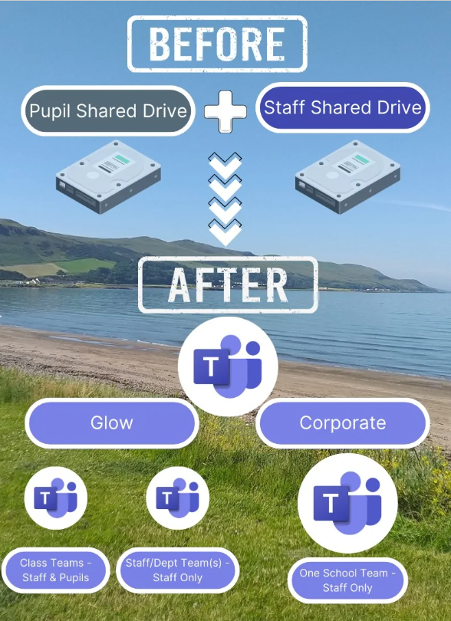
Network to Cloud
Content on servers moving to cloud-based storage
Using Microsoft Teams
Multiple Teams in Glow
One school Team in Corporate
Notes:
Schools need to ensure they do the housekeeping of their Staff and Pupil shared drives
There isn’t the storage capacity to move everything on the shared drives and move it to Teams
Shouldn’t be storing content about pupils if they’re no longer in your school
Don’t keep duplicates of files, only keep the most up to date version

Slide 4
Glow & Corporate Teams
What goes where & why?
Notes:
This table summarises where content should be stored. If you work in an EYC, Invergarven, Southcraig or are a member of clerical staff you will probably only use the Corporate Team to store the content currently in your shared drives.

Slide 5
What every staff member needs
OneDrive Glow in File Explorer
OneDrive Corporate in File Explorer
Access to Microsoft Teams
Notes:
All staff should make sure their Glow and Corporate OneDrives are showing in File Explorer (if you work in an EYC, Invergarven, Southcraig or are a member of clerical staff you might only need to have your Corporate OneDrive set up in File Explorer, but you can have your Glow one set up too if required).
All staff should also be able to access Teams

Slide 6
Accessing Teams
Multiple options available
Office.com (Corporate – Edge and Glow - Chrome)
Sign in to Glow in Google Chrome
Teams app
Desktop and Browser apps
Desktop app only and switch between Glow and Corporate (New Teams)
Notes:
There are different ways to access Teams, it’s up to each individual how they get access to Teams.

Slide 7
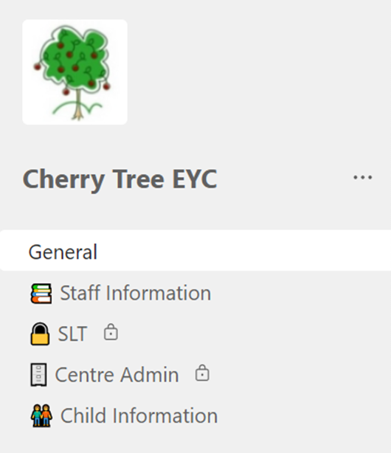
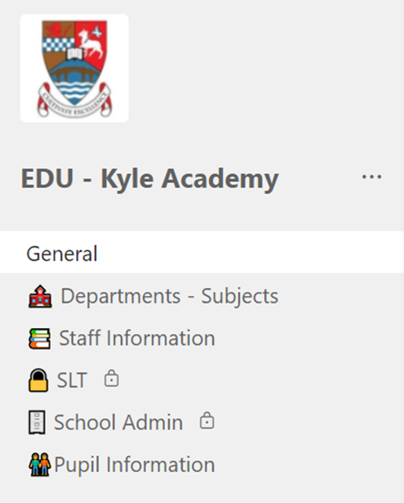
Corporate Team - Structures
Notes:
Screenshots of some of the Corporate Schools Teams that have been set up.
Default structure, agreed with colleagues on the Working Party. Slightly different depending on whether an EYC, Primary School, Primary School with Early Years Class or a Secondary School.
A minimum of 2 Team Owners (SLT, Digital Champion, nominated person) all other staff will be Members.
Teams are made up of channels, File sections and Folders.
Team Owners can create and delete channels. 200 channels per Team (including any that are deleted) 30 of which can be Private channels.
Use of Private channels should be minimised; only staff in the school have access to the Team and therefore no need to create multiple private spaces.
The channels with the small padlock icon at the right of the channel name are Private channels and access to them can be restricted. The other channels are standard channels and anyone who has access to the Team can access the standard channels.

Slide 8
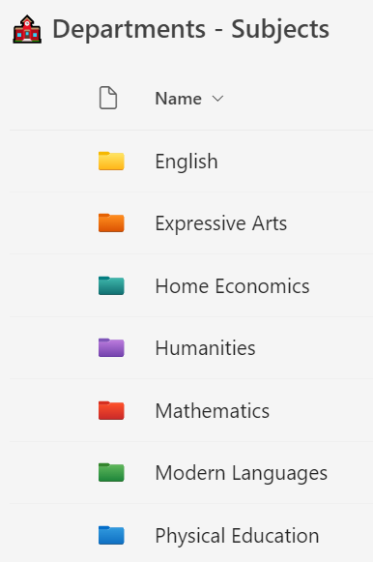
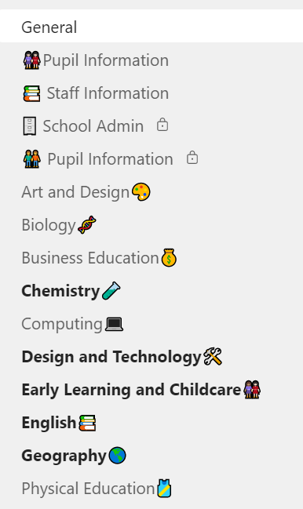
Corporate Team – Channels vs Files Sections
Notes:
We have a blank canvas, start as we mean to go on. Create folders and sub-folders where necessary to organise content and avoid just dumping in files.
The screenshots on the left and right are examples of how a secondary school can store departmental information.
The screenshot on the left is using one channel called Departments-Subjects and then created a Folder structure within the channels Files section for each of the departments/subjects.
The screenshot of the right is using a channel for each department/subject.
There is no right or wrong way to do this, just be mindful that there are only 200 channels available over the lifetime of the Team (including deleted channels).

Slide 9
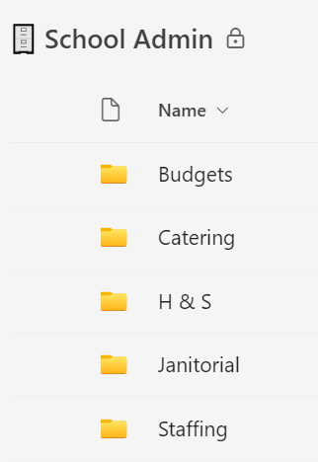
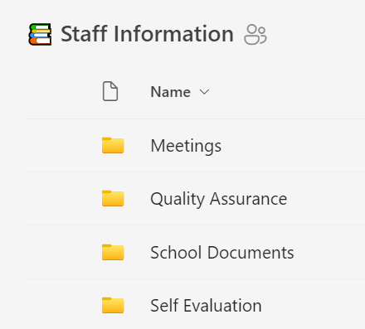
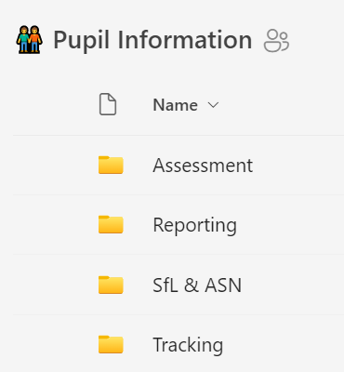
Corporate Team – Channels vs Files Sections
Notes:
The Teams are a blank canvas, start as we mean to go on. Create folders and sub-folders to organise content and avoid just dumping in files. Folders can be renamed and deleted by any member of staff in the Team.

Slide 10
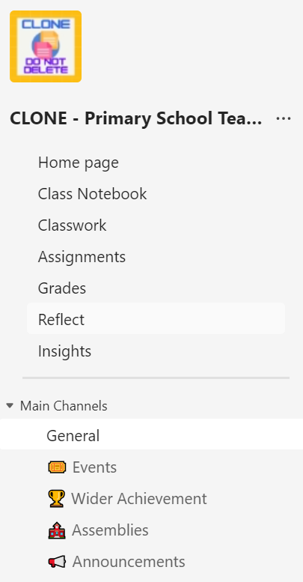
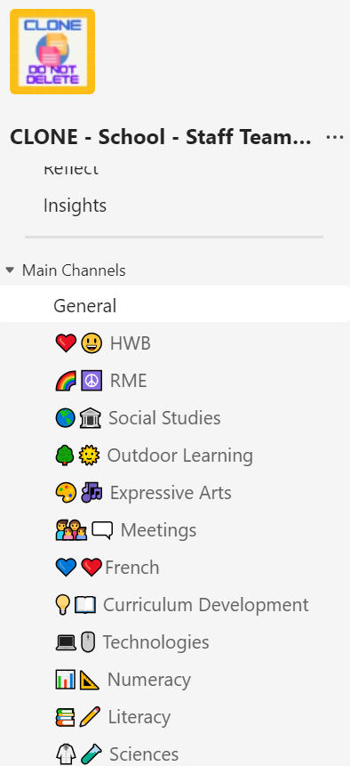
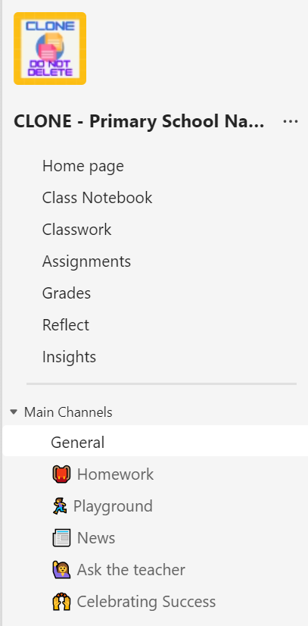
Primary Glow Team(s)
Clone Teams
Purpose
Content
Ownership & membership
Notes:
Schools may already be using Teams in Glow and can continue to use these Teams.
Clone Teams (templates) have been created to help schools to get started with Teams, these can be used by the Digital Champion to create Teams for their schools/colleagues.
Above you will see 3 Clone Teams that can be used by Primary Schools
Whole school team – SLT Owners, Staff Owners or Members, Pupils Members – this is a space for the whole school to have access to and can be used to share information on Events, Wider Achievements, hold whole school virtual assemblies, make announcements etc.
Staff Team – SLT Owners, Staff Members – this is a space to hold all the learning and teaching content currently stored in the shared drives.
Class Team – Class Teacher Owner, Stage partner Owner, SLT Owners, pupils Members – this is a space for the teacher to share learning resources with pupils, pupils to share work with their teachers, assignments to be set, communicate and collaborate.

Slide 11
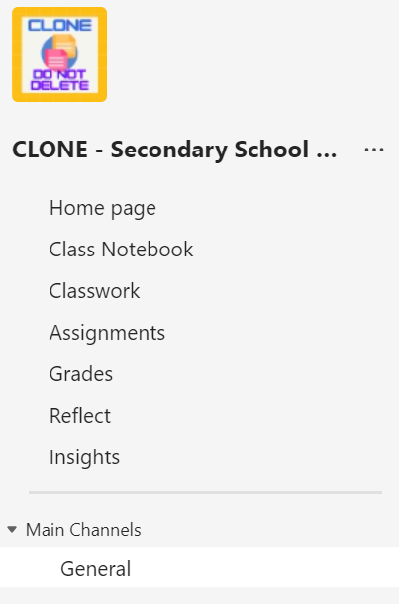
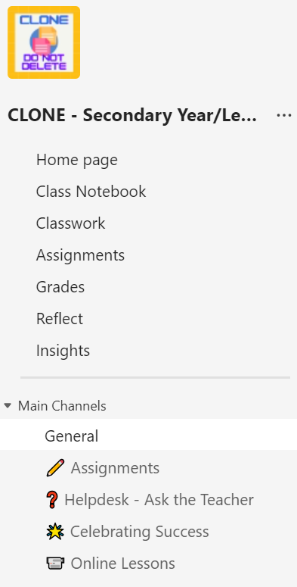
Secondary Glow Team(s)
Clone Teams
Purpose
Content
Ownership & membership
Notes:
Schools may already be using Teams in Glow and can continue to use these Teams.
Clone Teams (templates) have been created to help schools to get started with Teams, these can be used by the Digital Champion to create Teams for their schools/colleagues.
Above you will see 2 Clone Teams that can be used by Secondary Schools
Department Team – Department staff Owners, SLT Owners – this is a space to store a departments/subjects learning and teaching content that’s currently stored in the shared drives.
Class Team – Class Teachers Owners, SLT Owners, pupils Members - this is a space for the teacher to share learning resources with pupils, pupils to share work with their teachers, assignments to be set, communicate and collaborate.

Slide 12
What next? – Accessing & Using Files
Teams
Channels
Shortcut to OneDrive
All content in a channel – folders & documents
Individual folders within a channel
Sync
All content in a channel – folders & documents
Individual folders within a channel
Creates a copy on the device
Storage space
Notes:
Once shared drive content is migrated to the appropriate Teams staff will need to ensure they’re able to access and use the content that’s in Teams.
They can choose to access the content by opening Teams – Microsoft, image, video, audio and DPDF files will open in Teams (either within the Teams window, a browser window or in the Desktop app)
Non Microsoft files – prompted to download before accessing and using.
Can also access all content (any file types) via File Explorer. Add a Shortcut to OneDrive is used to create a link within File Explorer to the Channels and/or Folders you regularly access in Teams.

Slide 13
Support and Guidance
Online Support Sessions
HT/SLT Sessions
School Office sessions
EYC SLT sessions
All Staff Sessions
Digital Champion/Nominated Person Monthly Catch Ups
Adhoc support requested by schools
Step by Step Guide – work in progress
Full Guidance – work in progress

Slide 14
Support Session Dates – March/April 2024
All Staff Thursday 21st March - 3:30pm to 4:30pm Wednesday 27th March – 1pm to 2pm Tuesday 23rd April – 4pm to 5pm Wednesday 24th April – 9:30am to 10:30am | Clerical Staff Tuesday 19th March – 1pm to 2pm Friday 22nd March – 11am to 12pm Friday 22nd March – 1pm to 2pm Monday 25th March – 1pm to 2pm
HT/SLT Monday 22nd April 11am to 12pm | EYC SLT Tuesday 19th March – 11am to 12pm Monday 25th March – 9:30am to 10:30am
Notes:
More dates to be added through May and June.

Slide 15
Questions?

