Slide 1
Removal of Network Drives
Information for Clerical Staff
March/April 2024

Slide 2
Agenda
Network to Cloud
Accessing Teams
Corporate Team
What next?
Questions

Slide 3
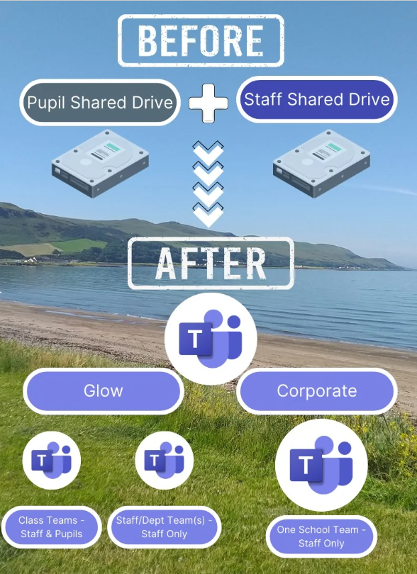
Network to Cloud
Content on servers moving to cloud-based storage
Using Microsoft Teams
Multiple Teams in Glow
One school Team in Corporate
Notes:
Schools need to ensure they do the housekeeping of their Staff and Pupil shared drives
There isn’t the storage capacity to move everything on the shared drives and move it to Teams
Shouldn’t be storing content about pupils if they’re no longer in your school
Don’t keep duplicates of files, only keep the most up to date version
Clerical staff will mostly be using their Corporate Team and therefore can focus on the right side of the image

Slide 4
Glow & Corporate Teams
What goes where & why?
Notes:
This table summarises where content should be stored. If you work in an EYC, Invergarven, Southcraig or are a member of clerical staff you will probably only use the Corporate Team to store the content currently in your shared drives.

Slide 5
What every staff member needs
OneDrive Glow in File Explorer
OneDrive Corporate in File Explorer
Access to Microsoft Teams
Notes:
All staff should make sure their Glow and Corporate OneDrives are showing in File Explorer (if you work in an EYC, Invergarven, Southcraig or are a member of clerical staff you might only need to have your Corporate OneDrive set up in File Explorer, but you can have your Glow one set up too if required).
All staff should also be able to access Teams

Slide 6
Accessing Teams
Multiple options available
Office.com (Corporate – Edge and Glow - Chrome)
Sign in to Glow in Google Chrome
Teams app
Desktop and Browser apps
Desktop app only and switch between Glow and Corporate (New Teams)
Notes:
There are different ways to access Teams, it’s up to each individual how they get access to Teams.

Slide 7
Corporate Team
One Team to replace 'non-learning and teaching content stored in the staff shared area
Created for the school/setting
Use default structure or adapt to suit own setting
Add staff to Team
Owners and Members
Notes:
Default structure, agreed with colleagues on the Working Party. A minimum of 2 Team Owners (SLT, Digital Champion, nominated person) all other staff will be Members.
Teams are made up of channels, File sections and Folders.

Slide 8
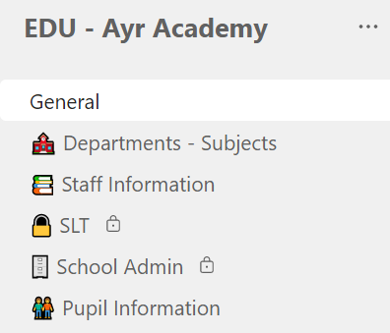
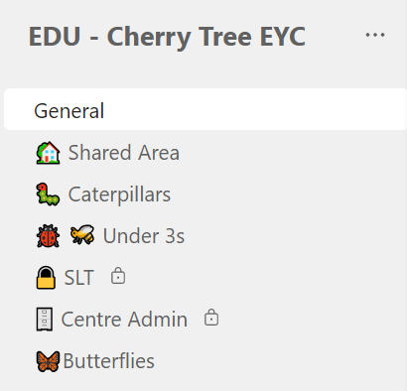
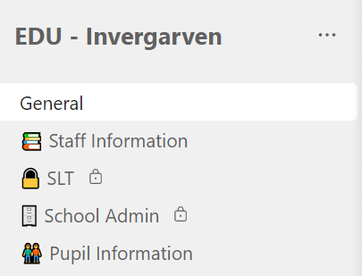
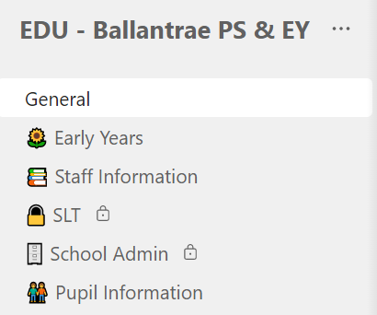
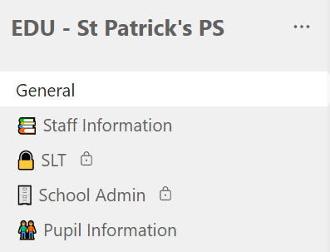
Channels and Files Sections
Notes:
Some examples of channel structures depending on your setting type. Channels can be created, renamed and deleted by Team Owners.
200 channels per Team (including any that are deleted) and this includes 30 Private channels.
Use of Private channels should be minimised; only staff in the school have access to the Team and therefore no need to create multiple private spaces.

Slide 9
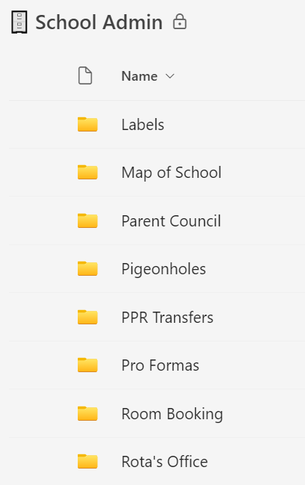
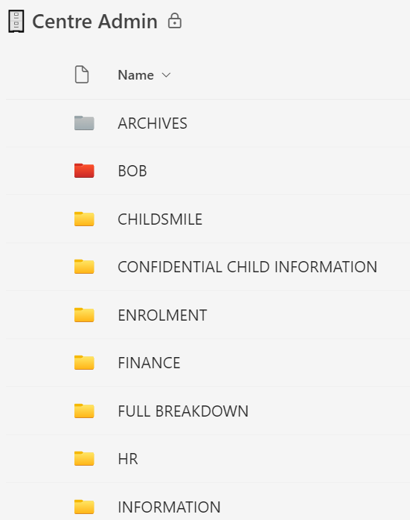
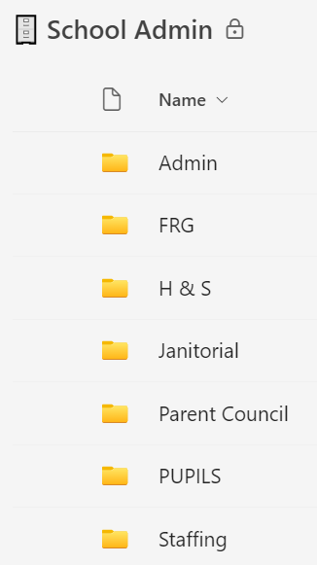
Channels and Files Sections
Notes:
Default structure, agreed with colleagues on the Working Party, set up when Team was created. Slightly different depending on whether an EYC, Primary School, Primary School with Early Years Class or a Secondary School.
Folders can be created, renamed and deleted by all members of the Team (Owners and Members).

Slide 10
What next? – Accessing & Using Files
Teams
Channels
Shortcut to OneDrive
All content in a channel – folders & documents
Individual folders within a channel
Sync
All content in a channel – folders & documents
Individual folders within a channel
Creates a copy on the device
Storage space
Notes:
Once shared drive content is migrated to the appropriate Teams staff will need to ensure they’re able to access and use the content that’s in Teams.
They can choose to access the content by opening Teams – Microsoft, image, video, audio and DPDF files will open in Teams (either within the Teams window, a browser window or in the Desktop app)
Non Microsoft files – prompted to download before accessing and using.
Can also access all content (any file types) via File Explorer. Add a Shortcut to OneDrive is used to create a link within File Explorer to the Channels and/or Folders you regularly access in Teams.

Slide 11
Support and Guidance
Online Support Sessions
HT/SLT Sessions
School Office sessions
EYC SLT sessions
All Staff Sessions
Digital Champion/Nominated Person Monthly Catch Ups
Adhoc support requested by schools
Step by Step Guide – work in progress
Full Guidance – work in progress

Slide 12
Support Session Dates – March/April 2024
All Staff Thursday 21st March - 3:30pm to 4:30pm Wednesday 27th March – 1pm to 2pm Tuesday 23rd April – 4pm to 5pm Wednesday 24th April – 9:30am to 10:30am | Clerical Staff Tuesday 19th March – 1pm to 2pm Friday 22nd March – 11am to 12pm Friday 22nd March – 1pm to 2pm Monday 25th March – 1pm to 2pm
HT/SLT Monday 22nd April 11am to 12pm | EYC SLT Tuesday 19th March – 11am to 12pm Monday 25th March – 9:30am to 10:30am
Notes:
More dates to be added through May and June.

Slide 13
Questions?

