Slide 1

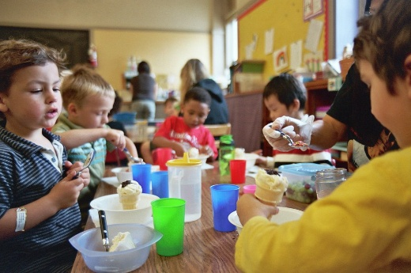

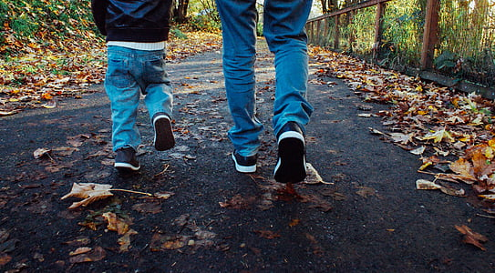

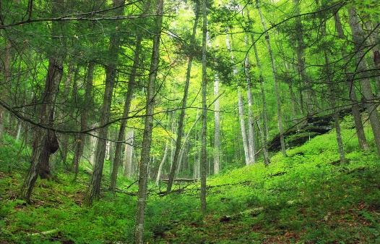
Monkton EYC Newsletter​
September 2026​
​
Our Learning journey so far.....​
At Monkton EYC, we have been
enjoying making friends and building relationships. We have also been learning / reminding ourselves of all the EYC routines including snack, lunchtime and handwashing. ​​
Home Learning​
We plan every fortnight as a team and share our planning on Seesaw and on the noticeboard – please talk to your child about their learning. There is a lending library in the foyer area. Please feel free to take a book from there to borrow then return when finished.
Keeping Healthy ​
On a Wednesday and a Friday, we go to the Gym Hall for our P.E. sessions. We are learning to take part in dancing, action songs, gymnastics and relaxation activities.
​
Dates for the Diary​
Thursday 17th September 2026 – South Ayrshire Reads Parent Workshop.
Friday 18th and Monday 21st September 2026 – EYC closed.
​End Sept / beginning Oct 2026– Personal Plans to be completed and shared with parents.​
Monday 5th October 2026 - EYC PEEP Welcome Book Bug session at 9:15am.
Thursday 8th October 2026 – Stay and Play at 2:20pm.
Keep a look out for more PEEP sessions in November!
We have started going out for a ‘Monday Mile’ walk each week. The children have been enjoying exploring our local area and eating snack out in the community.
​
Children will start going to the woods for 'Forest Kindergarten' on a Tuesday morning (see further information below).​ The EYC class will be split into 2 groups so each child will attend every fortnight.
Keep an eye on our notice board and Seesaw for further information about our learning and events.​
Reminders​
Children do not need to bring water bottles / drinks or snacks to the EYC as milk, water, snacks and hot lunches are provided. ​
Please encourage your child to leave toys and personal items at home as if they bring them into the EYC with them, they may get lost or broken.
We like to be creative in the EYC so would appreciate if you could hand in any of the items below for our ‘junk modeling’ activities. We are looking for kitchen roll tubes, clear plastic fruit tubs, empty fabric conditioner / washing up liquid / detergent bottles, small boxes (any shape), loose packaging like polystyrene chips, paper, bubble wrap, shredded paper etc.

Slide 2

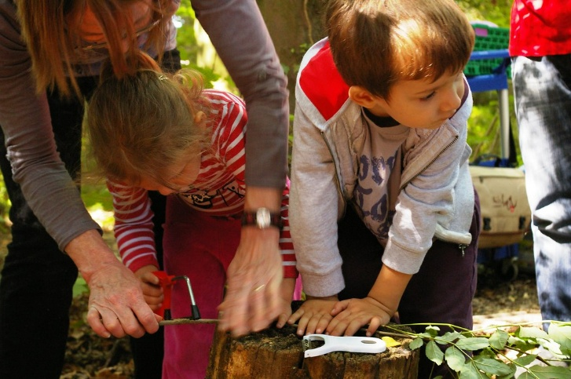
Forest Kindergarten – Information for Parents
Each Tuesday we will be running Forest Kindergarten sessions in the local woods. To begin with, we are taking children in small groups but we are hoping to build this up so that eventually we will take the whole EYC out on a Tuesday (subject to weather). You will be sent a message to say that you child is going to the woods the afternoon before. Please dress your child in their puddle suit and wellies for arrival at the EYC or help change them once inside in the morning before their forest Kindergarten session. We have spare wellies and waterproof clothing so there is no need for you to go and buy these for your child.
What is the Forest Kindergarten programme?
Our Forest Kindergarten programme models a forest school approach for the early years and is based around child-centred learning through play.
Forest Kindergarten offers young children frequent, regular play opportunities outdoors in a natural setting, often woodland, in almost all weathers throughout the year.
What is involved?
Young children learn most effectively through play experiences. During outdoor sessions, they’re free to play, explore, have fun and learn.
Sessions are led by the creativity, imagination and problem-solving skills of the learner. Staff extend learning through thoughtful interactions, materials, resources and other appropriate support.
Using local woodlands or outdoor green space for play and learning can help deliver the Curriculum for Excellence.
What are the benefits?
Forest Kindergarten connects children with the natural world, leading to long term environmental awareness and understanding. It has many benefits:
· It’s suitable for all learning styles
· It provides a stimulating environment
· It helps children thrive and learn through a real-life context
Sessions positively impact:
· physical, cognitive, social and emotional development
· health and wellbeing
· self-esteem and confidence
* Information taken from the Scottish Forestry and Scottish Government website.

