Slide 1





Monkton EYC Newsletter​
September 2025​
​
Home Learning​
Later this term, we will all be getting a chance to bring a book home to share with our family. We can keep the book overnight, then return it the next day so it can be passed on to the next child. There is also a lending library in the foyer area. Please feel free to take a book from there to borrow then return when finished.
Our Learning journey so far.....​
At Monkton EYC, we have been
enjoying making friends and building relationships. We have also been learning / reminding ourselves of all the EYC routines including snack, lunchtime and tooth brushing. ​
Staff have been focusing on responsive planning where children lead the learning and provide ideas that they are interested in to explore further. As a result, the children have been enjoying learning about forces and friction – brought about from talking about the airshow. ​
Keeping Healthy ​
On a Monday and a Thursday, we go to the Gym Hall for our P.E. sessions. So far, we have been enjoying group games, races, dancing, relaxing and parachute games. We have also been practising our throwing and catching skills.
​
Dates for the Diary​
Thursday 18th September 2025 – Sponsored Bouncy Castle
​
Friday 19th and Monday 22nd September 2025 – EYC closed
​
End Sept / beginning Oct 2025– Personal Plans to be completed and shared with parents.​
​Thursday 9th October 2025 – Stay and Play 2:30pm.
​​
Keep a look out for more PEEP sessions in November!
Children will go to the woods for 'Forest Kindergarten' on a Tuesday morning (see information below).​
​
Keep an eye on our notice board and Seesaw for further information about our learning and events.​
Reminders​
Children do not need to bring water bottles / drinks or snacks to the EYC as milk, water, snacks and hot lunches are provided. ​
Please encourage your child to leave toys and personal items at home as if they bring them into the EYC with them, they may get lost or broken.

Slide 2

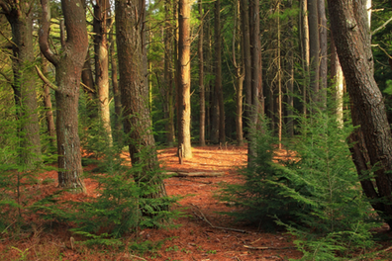
Forest Kindergarten – Information for Parents
Each Tuesday we will be running Forest Kindergarten sessions in the local woods. To begin with, we are taking children in small groups but we are hoping to build this up so that eventually we will take the whole EYC out on a Tuesday (subject to weather). You will be sent a message to say that you child is going to the woods the afternoon before. Please dress your child in their puddle suit and wellies for arrival at the EYC or help change them once inside in the morning before their forest Kindergarten session. We have spare wellies and waterproof clothing so there is no need for you to go and buy these for your child.
What is the Forest Kindergarten programme?
Our Forest Kindergarten programme models a forest school approach for the early years, and is based around child-centred learning through play.
Forest Kindergarten offers young children frequent, regular play opportunities outdoors in a natural setting, often woodland, in almost all weathers throughout the year.
What is involved?
Young children learn most effectively through play experiences. During outdoor sessions, they’re free to play, explore, have fun and learn.
Sessions are led by the creativity, imagination and problem solving skills of the learner. Staff extend learning through thoughtful interactions, materials, resources and other appropriate support.
Using local woodlands or outdoor green space for play and learning can help deliver the Curriculum for Excellence.
What are the benefits?
Forest Kindergarten connects children with the natural world, leading to long term environmental awareness and understanding. It has many benefits:
· It’s suitable for all learning styles
· It provides a stimulating environment
· It helps children thrive and learn through a real life context
Sessions positively impact:
· physical, cognitive, social and emotional development
· health and wellbeing
· self-esteem and confidence
* Information taken from the Scottish Forestry and Scottish Government website.

