Slide 1



Screens Awareness Week 2025
Saoirse Higham & Claire Morrison (Speech and Language Therapy)
Notes:
S

Slide 2
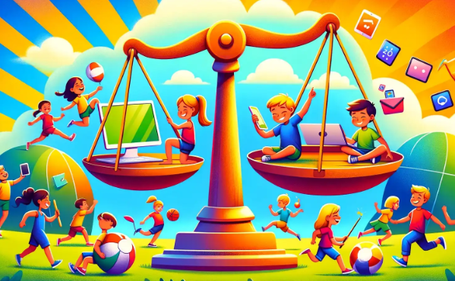
Unrealistic to completely cut it out…
We totally understand that it is unrealistic to ask you to completely cut out screen time.
Screens have become such a big part of our society today and it is important that we do still remember the positives.
What we are asking is that we start being mindful over our screen time, cutting it back and finding a balance.
Notes:
Saoirse – disclaimer before we start…some of the facts & research we talk about today may shock or surprise you...explain unrealistic to cut out completely etc. Wouldn’t be able to get SLT degree or create this Powerpoint without screens!
We use technology/screens to stay in touch with people, plan things, answer emails, make arrangements etc so they are useful tools.
Remember Cbeebies motto – ‘there when you need us’ (all about moderation - useful when need to get things done e.g. do ironing, make dinner etc).

Slide 3

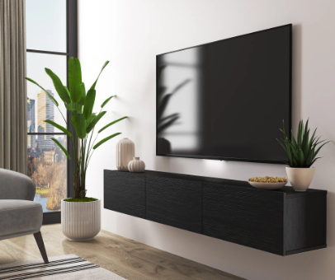
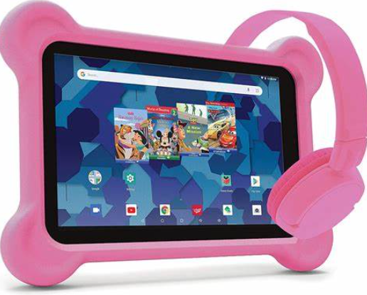

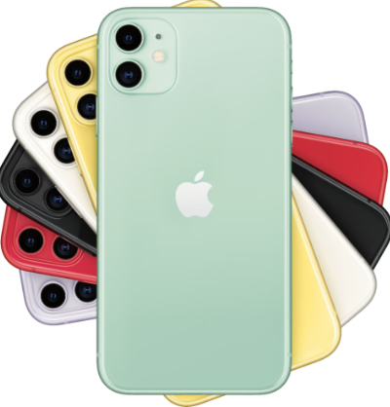

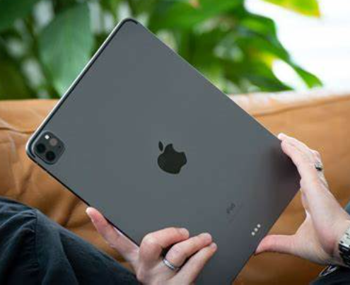

What do we mean by screen time?
The amount of time spent using an electronic device with a display screen.
We are living in a screen saturated world!
Notes:
Saoirse
Non-educational:
A lot of the children we interviewed said their screen time was really low but that was because they were only thinking about phones. How much time are they spending watching TV, iPads etc after they put their phones away for the night?
We are also not including those who use tech as a communication aid.

Slide 4
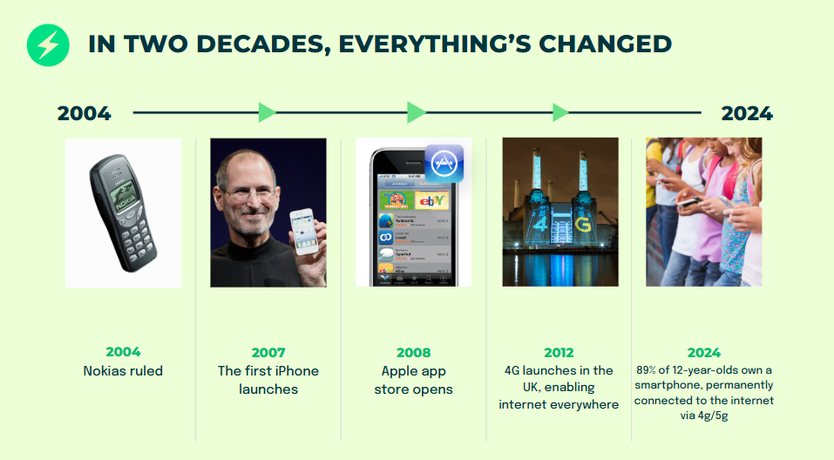
Technology evolution…
@smartphonefreechildhood
Notes:
Claire

Slide 5
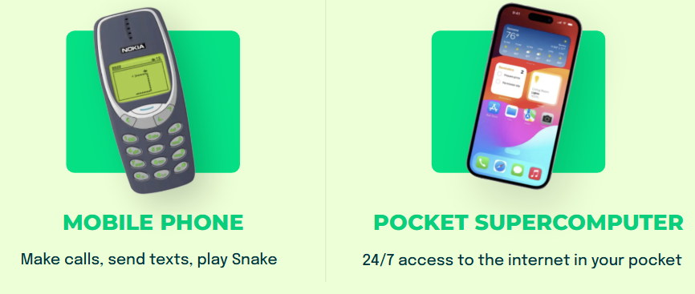
Think back to your first phone…
@smartphonefreechildhood
Notes:
Claire

Slide 6
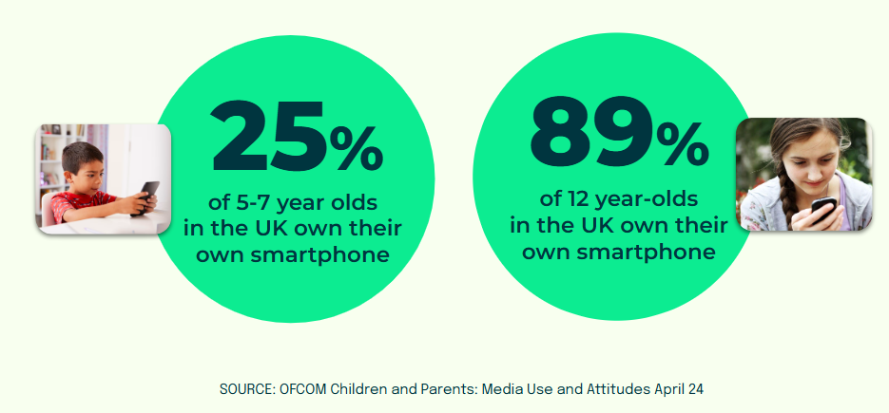
Smartphones have become the norm…
Half of children under 13 are on social media
Notes:
Claire
Half of children under 13 are on social media – explain P6/7s keeping up with latest Tik Tok trends, Snapchat streaks etc.

Slide 7

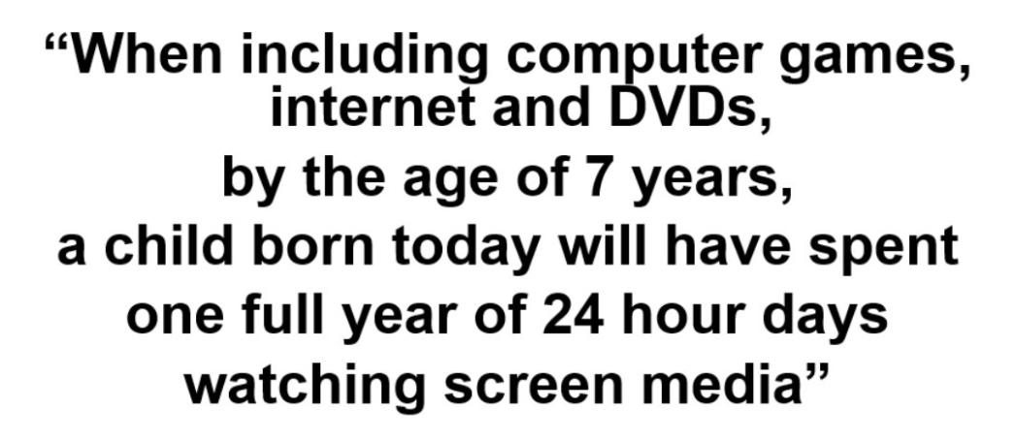
An interesting fact…
Notes:
Claire
This was from 2012. So wonder how big it would be now…

Slide 8
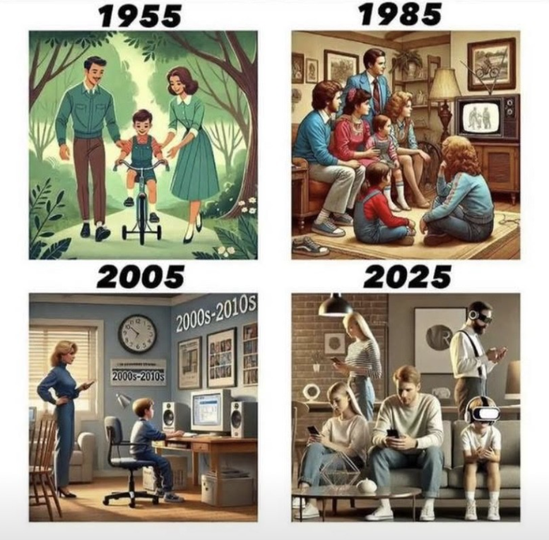
The world has changed…
Notes:
Claire – image in 2025 is commonplace nowadays…

Slide 9
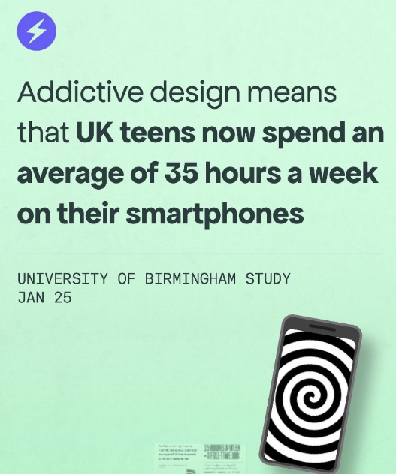
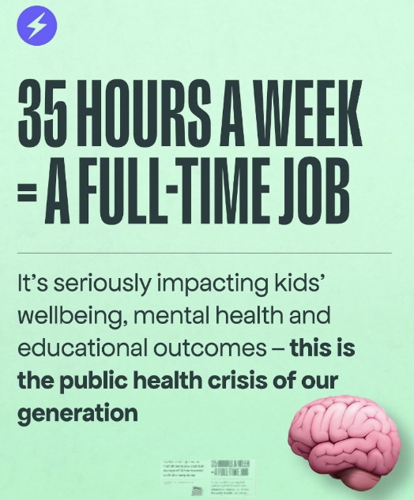
Teen use…
@smartphonefreechildhood
Notes:
Claire – this is just smartphones…not TV etc so likely more screen use. New term = SCREENAGERS!

Slide 10
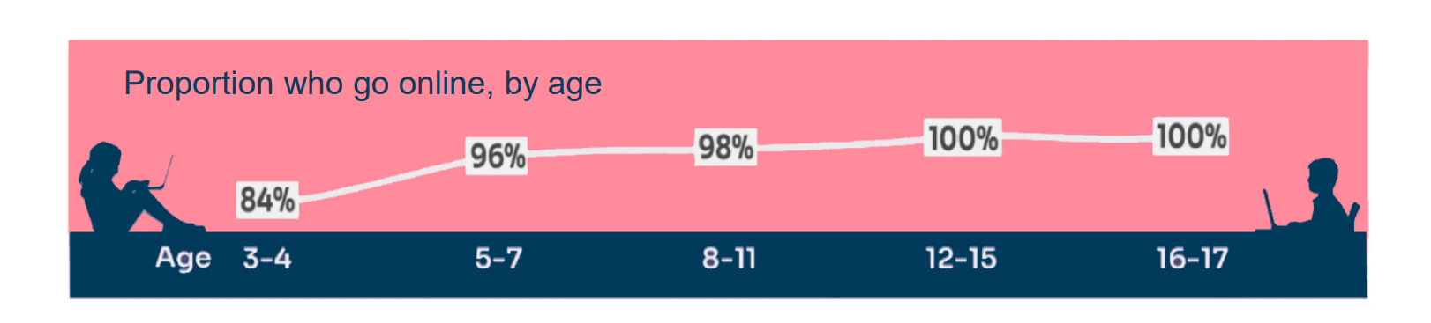
Online use increases with age…
@healthprofessionalsforsaferscreens

Slide 11
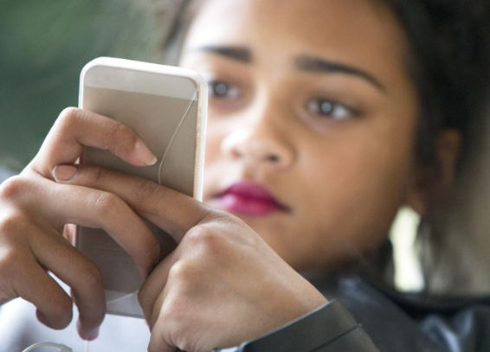
How screen use has changed…
Many young people often spend more time online than ever before.
Teens now spend an average of eight hours a day on screens, two hours more than in 2015.
Preteens (children aged 8 to 12 years) spend about 5 ½ hours daily on devices, up an hour from a decade earlier.
That means that some young people spend half of their waking day in front of a screen.
@healthprofessionalsforsaferscreens
Notes:
Claire

Slide 12

Benefits of screens:
Educational Content: Many apps and programs are designed to support learning in subjects like maths, science, reading and art.
Communication: Screens facilitate communication with family and friends, especially in long-distance situations, helping children maintain relationships.
Access to Information: The internet provides a wealth of knowledge and resources for research and exploration.
Digital Literacy: Technology helps children develop necessary digital skills for future education and careers.
Entertainment and Relaxation: Screens can provide fun and relaxation through games, movies and shows which can be important for downtime.
@healthprofessionalsforsaferscreens
Notes:
Saoirse – 10 MINS IN (50 TO GO).

Slide 13
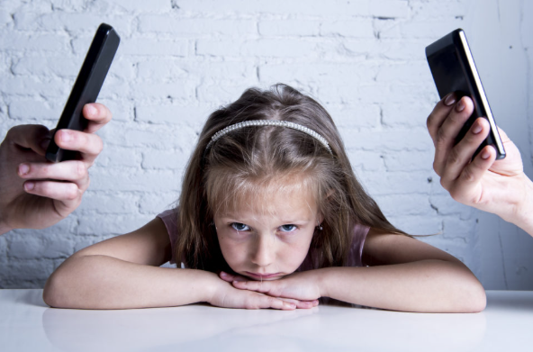
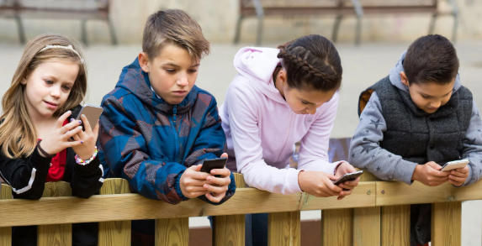
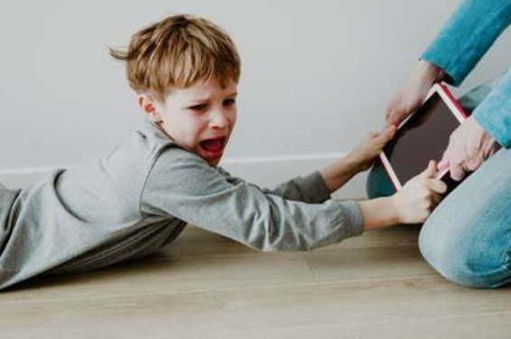
When iPads, tablets and smartphones first appeared in the early 2010s we didn’t understand the impact…
Now we do and the evidence is overwhelming…
Notes:
Saoirse

Slide 14

Development:
Screen technology can be useful tools for learning and communication for older children, teens and adults, however there is very little evidence that screen use has any benefits for babies, toddlers and young children.
Early use of technology is associated with executive function challenges e.g. behaviour difficulties & delayed milestones.
Regular swiping can also affect fine motor skills.
Can reduce attention spans as children instantly get what they want – no waiting is involved!
Notes:
Saoirse

Slide 15
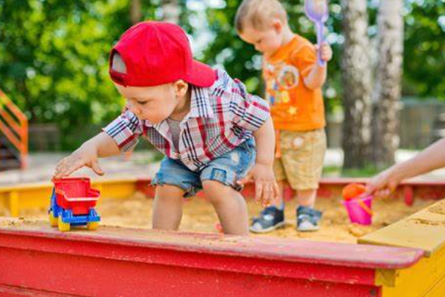
Development:
90% of the child’s brain is developed through interactions with others, NOT IMAGES on a screen.
Children learn through ‘real-life’ play.
Discovery and exploration should be an organic interactive experience.
Notes:
Saoirse

Slide 16



Speech and Language:
Lots of recent evidence shows increased screen use = poorer language skills and delays in communication.
Age 12 to 24 months – children who spent two hours a day in front of a screen are six times more likely to have a language delay.
@healthprofessionalsforsaferscreens
Notes:
Saoirse
There is compelling evidence across many longitudinal studies that show that greater screen use is associated with lower language skills and developmental delays in communication.

Slide 17
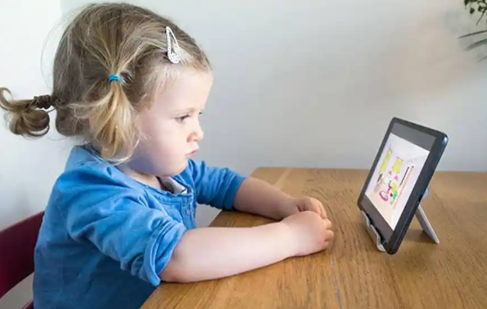
Speech and Language:
For 3 year olds - each minute of screen time leads to them hearing fewer adult words, speaking fewer words and having fewer conversations.
On average, they miss out on 1,100 adult words, 840 sounds and 194 conversations each day due to screen time.
@healthprofessionalsforsaferscreens
Notes:
Saoirse
There is compelling evidence across many longitudinal studies that show that greater screen use is associated with lower language skills and developmental delays in communication.
We know the impact that this can have on lifelong outcomes and literacy. Early spoken language is the most important factor impacting literacy at age 11.
Studies show that children with higher screen usage are less ready for school, particularly regarding language and cognitive
development.

Slide 18

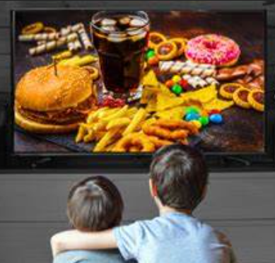

Health:
Obesity: using screens during meals relates to 15% more likely to be overweight due to not sensing fullness.
Research shows that children who spend more time with screens are less likely to take part in exercise and are at greater risk of obesity.
Eyesight: high levels of smartphone use are linked to increased chance of developing myopia (short-sightedness = cannot see far away objects clearly).
Links have been found between increased smartphone use and blurred vision, eye fatigue and burning eyes.
@healthprofessionalsforsaferscreens
Notes:
Claire – 20 MINS IN (40 TO GO).

Slide 19
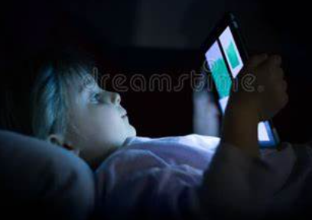

Sleep:
The blue light emitted from screens impacts children’s sleep…pushes back sleep twice as long as coffee!
Bedtime use of smartphones doubles children’s risk of poor sleep.
Can affect attendance, attainment and mental health.
@healthprofessionalsforsaferscreens
Notes:
Claire

Slide 20

Behaviour/habits:
Persuasive design – companies purposely make the design of apps addictive. YouTube is set to ‘autoplay’ via an algorithm to keep children watching video after video to serve more ads.
Imagination – technology undermines children’s ability to entertain themselves, by promoting dependency on external entertainment/stimulation.
Smartphones/tablets are often used to keep children calm – this can work in the short term but can hinder the development of self-regulation skills.
Research shows that using devices to calm children could lead to difficulties in controlling behaviour and managing anger. This could also lead to patterns where tantrums are linked to screen time.
@healthprofessionalsforsaferscreens
Notes:
Claire
Using screen reduces control and leads to more tantrums. Particularly important for younger kids.
The earlier children start using screens and more time they spend on it, the lower their self regulation skills may be.

Slide 21
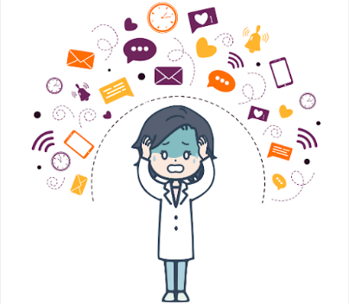
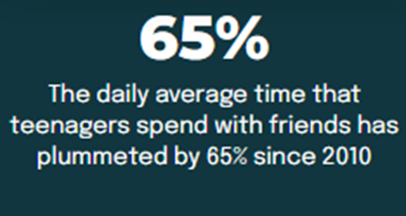
Wellbeing:
Rates of depression, anxiety, self-harm and even suicide among pre-teens & teens have all dramatically spiked globally since 2010 – when children started getting smartphones (girls particularly vulnerable).
Constant pressure of social media and comparing oneself to others.
Bullying: 84% of bullying now takes place on a device.
@smartphonefreechildhood
Notes:
Claire

Slide 22
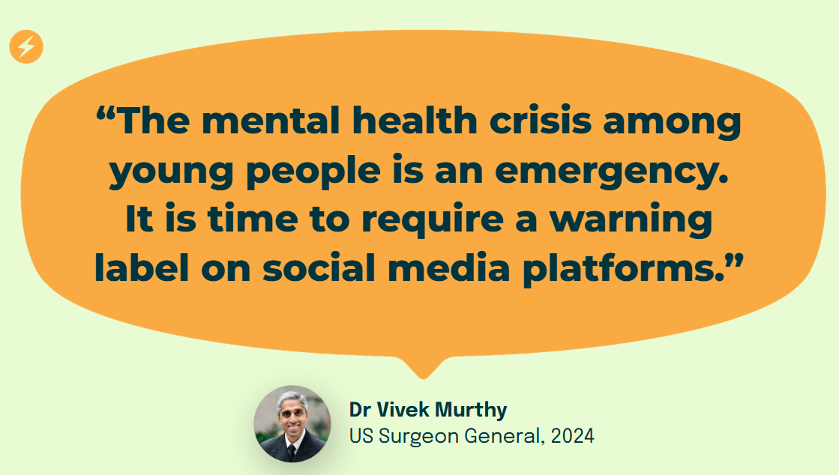
@smartphonefreechildhood

Slide 23
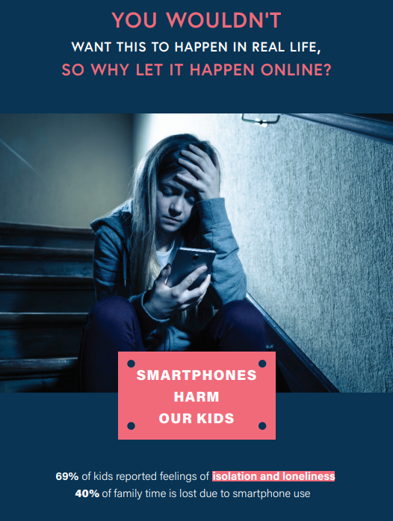
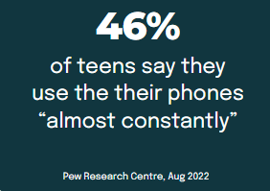
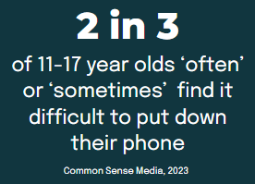
@smartphonefreechildhood

Slide 24
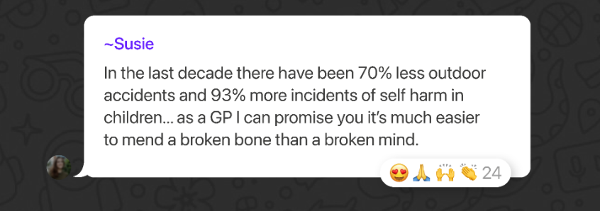
The reality…
@smartphonefreechildhood
Notes:
Claire
This was a quote from a GP
“It’s easier to mend a broken bone than a broken mind”

Slide 25
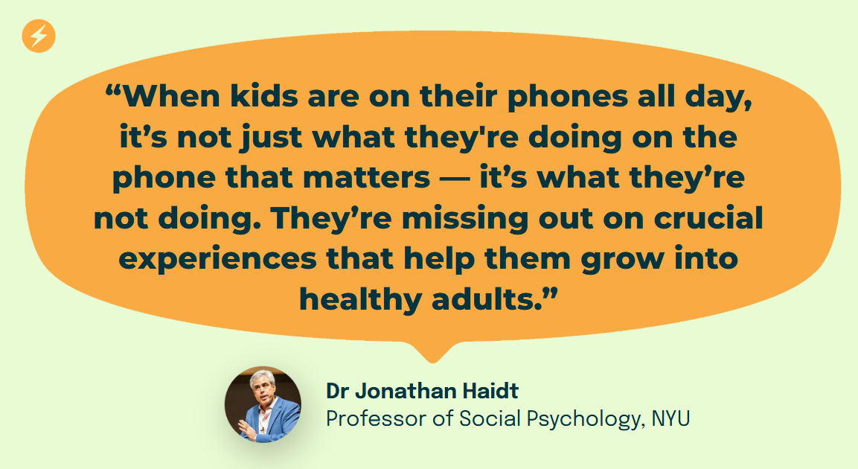
Notes:
Saoirse – 30 MINS TO GO (HALF WAY!)

Slide 26


What children are missing out on:
Screens are everywhere in our children’s lives and time on them adds up fast.
It’s not just the impact of screens that are affecting our children, it’s also what they miss out on due to spending time indoors with their devices:
Movement
Play
Social interaction
Exploration
Screens are ‘experience blockers’ i.e. distracting children from engaging in real world activities that are vital for development.
Notes:
Saoirse
Missing out on the world around them when engrossed by screens.
Smartphones are experience blockers.
Missing out on crucial experiences that lead them to be healthy habits

Slide 27
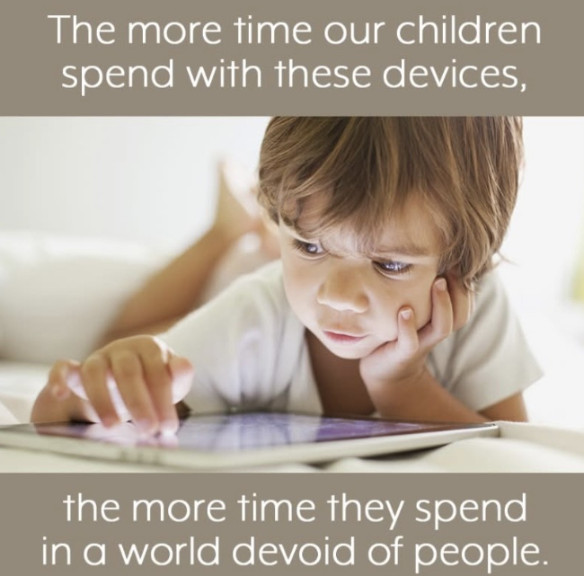
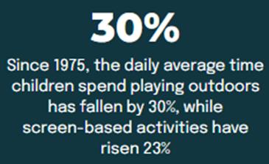
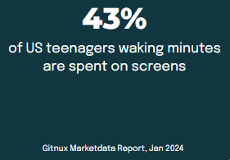
@healthprofessionalsforsaferscreens
Notes:
Saoirse

Slide 28
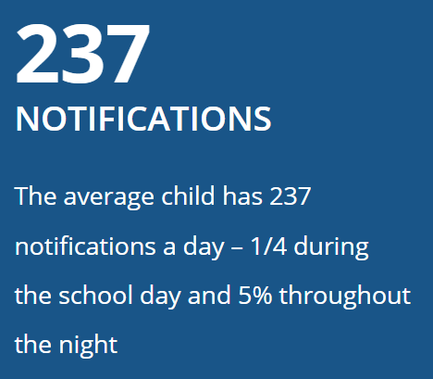
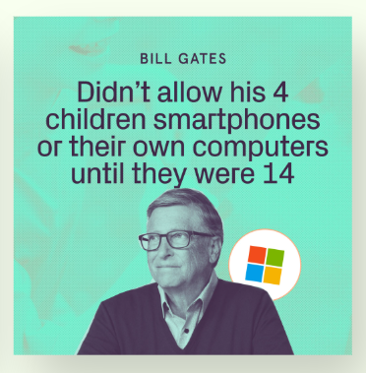
Children wish things were different…
52% of the young people who spend most of their free time on their phone, wish they could spend less time on their phone.
67% of 16-18 year olds think smartphones are harmful.
@healthprofessionalsforsaferscreens

Slide 29
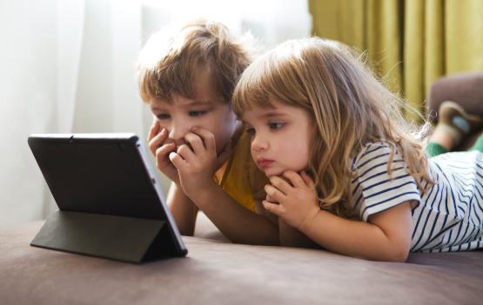
Guidelines
Under 2:
Age 2-4:
Age 5-12:
No screen time except video calling
No more than 1 hour per day
No more than 2 hours per day
@World Health Organisation, 2025
Notes:
Saoirse
This is non-educational.
Remember this includes all screens, not just phones.
Again, it’s about balance – remember Cbeebies motto of ‘here when you need us.’

Slide 30
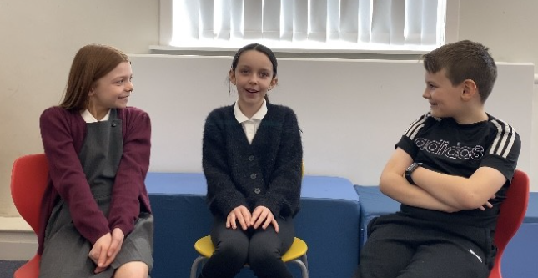
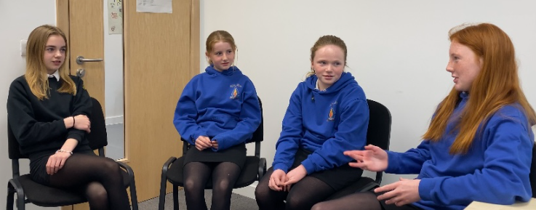
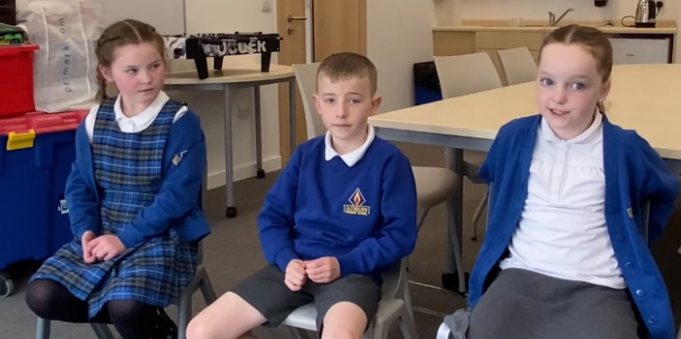
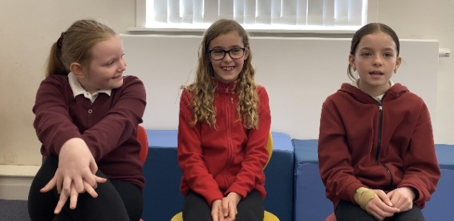
What do South Ayrshire pupils think?
(10) Screens Awareness Week 2025 - YouTube
https://youtu.be/ybbvqeoFYpw
Notes:
Saoirse
This will be available on social media by the end of screens awareness week (Q&A on Friday and Top Tips already posted). Keep an eye out for them.
25 MINS TO GO (35 MINS IN).

Slide 31

Let’s have a look at our own screen time…
Notes:
Saoirse – 15 MINS TO GO (45 MINS IN).

Slide 32
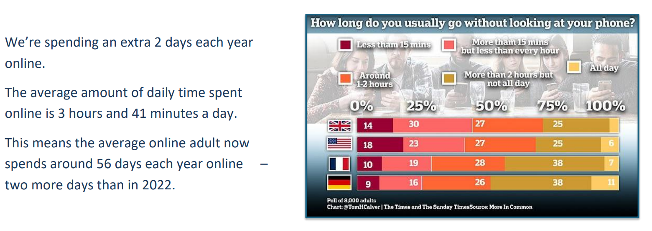
Screen use for adults…
Notes:
Saoirse

Slide 33
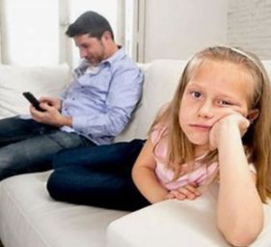
Impact of parental screen time on children:
50% of children think their parents check their phones too much, with 36% saying their parents get distracted by their phones during conversations.
Distraction – parental screen use draws attention away from children, reduces the amount and quality of engagement between adult/child.
Development – from birth, parental response to baby’s vocalisations are essential in the development of their brains as well as their speech and language.
@fairplayforkids
Notes:
Saoirse – we realise phones are used for work, emails, making plans etc. Almost all the children we interviewed for screens videos wished their parents spent less time on their phone, so try to be mindful of your own habits and using your phone around your children.

Slide 34
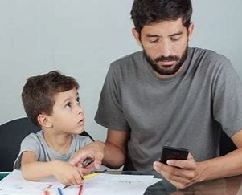
Impact of parental screen time on children:
Challenging behaviour – children may act out to get attention due to parental screen use.
47% of parents said they have had a disagreement with their child over screen time in the last few weeks.
‘Technoference’ = how technology can get in the way of interpersonal relationships and engagement.
@fairplayforkids
Notes:
Saoirse

Slide 35
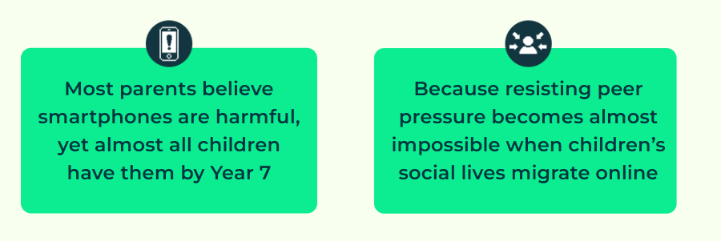
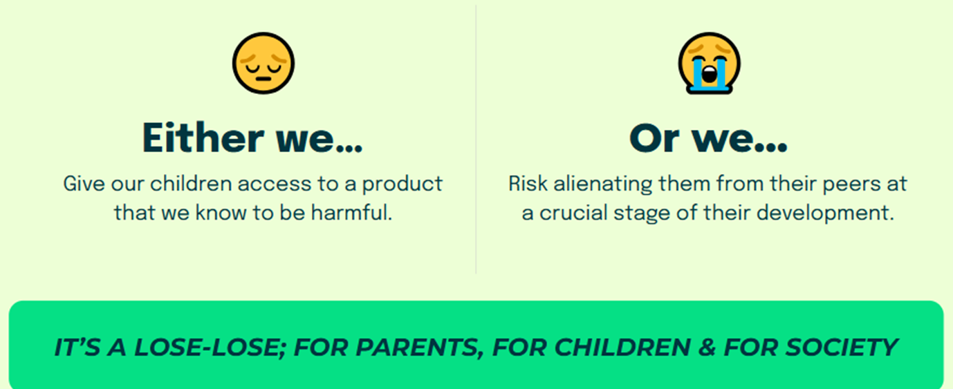
What choice do we make?
Notes:
Claire – stuck between rock and hard place…don’t want their child to be the only one missing out.

Slide 36


Ways to implement healthy screen use:
Screen free meal times…talk to each other and enjoy their company.
Try make bedrooms screen free zones.
Be a role model – be mindful of your own screen use.
Put screens away when not in use – out of sight, out of mind!
Notes:
Claire – ‘top tips’

Slide 37
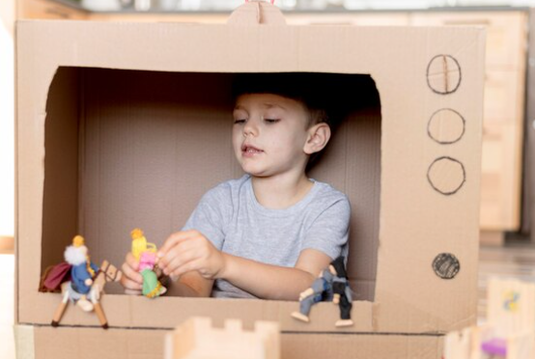
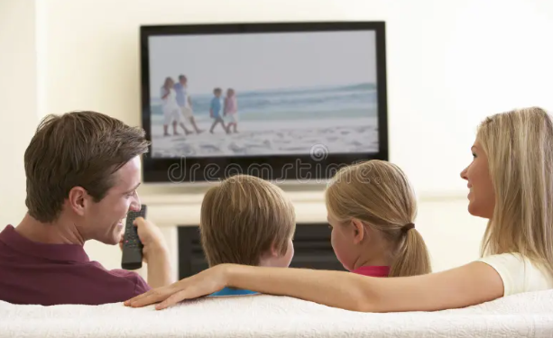
Ways to implement healthy screen use:
Avoid using screens for reward, punishment or distraction.
Let children be bored. It’s good to use their imagination.
If the TV is on - watch it together, talk it through with your children, help them to understand what they are watching and answer any of their questions.
Notes:
Claire

Slide 38
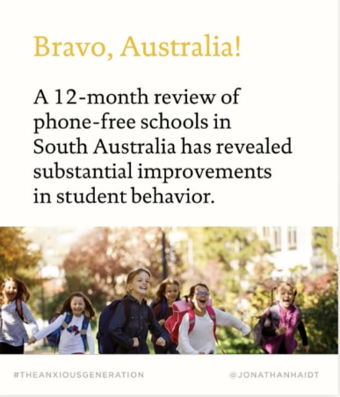
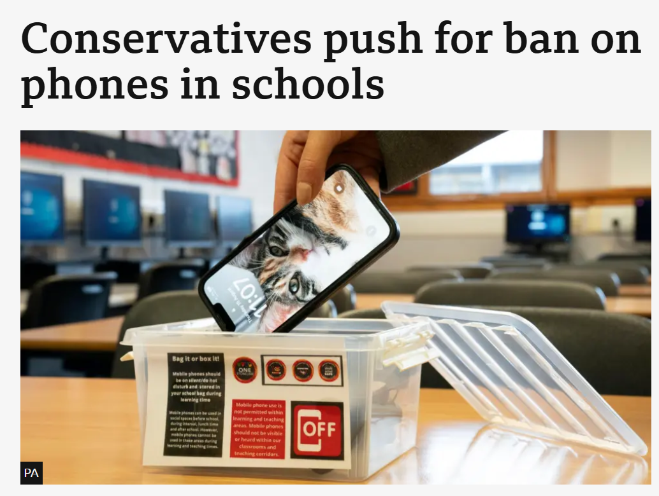
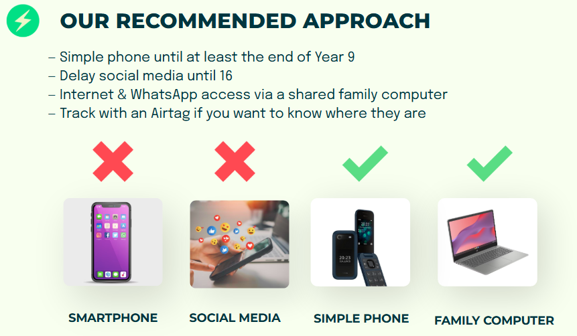
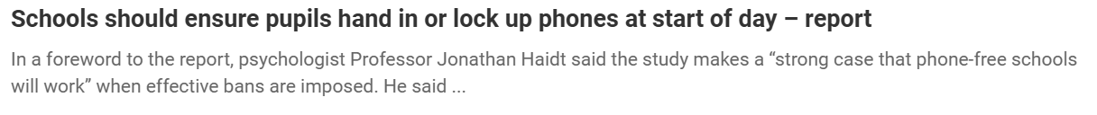
How others are taking action:
Notes:
Claire

Slide 39


How others are taking action:
Notes:
Claire – pupils place phones in pouches at start of school day which has a strong magnet to lock it.

Slide 40

What’s happening at Kyle Academy…
‘Phone Free Friday’ – took a ‘challenge’ approach.
Aims to encourage pupils to look at their screen time & habits.
Trialled on 2nd May – no phones throughout the day (included classes, playground & lunch time).
Pupils recorded how long they were able to stay off their phones in their Daily Support Profiles.
Staff to stay off phones too.
Followed up with Screens Awareness input in PSE and pupils tracking their screen time.
Notes:
Claire
KYLE – didn’t include pupils with medical conditions e.g. using phone to monitor blood sugar for diabetes.
Any phones seen = taken away.
SLT linking in with Kyle as a local screens awareness example in secondary to gather data, feedback, impact etc.

Slide 41

What’s happening at Kyle Academy…
Notes:
Claire
KYLE – pleasantly surprised at how well the pupils in S1 to S3 got into the spirit of it - very few had to be asked to get off their phones at lunch and interval, even in the playground.

Slide 42




Organisations & books for further information:
Smartphone free childhood – sign the pledge
Resources - Health Professionals For Safer Screens
Fairplayforkids.org
Anxious Generation
Stolen Focus

Slide 43




Follow us on social media…
Notes:
Claire

Slide 44
References
The hazards of excessive screen time: Impacts on physical health, mental health, and overall well-being – PMC
Screen Aware Early Childhood Action Kit – Fairplay
Smartphone Free Childhood
Screens-our-children-and-the-evidence-.pdf
Key Issues - Health Professionals For Safer Screens

