Slide 1



Gardenrose
Primary School & EYC
Parent Guide to Talk for Writing
February 2021

Slide 2
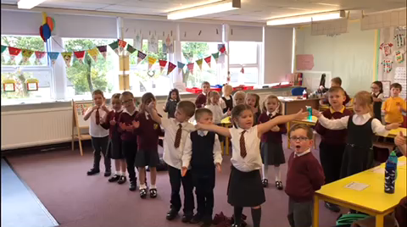
P.1 in action ☺

Slide 3
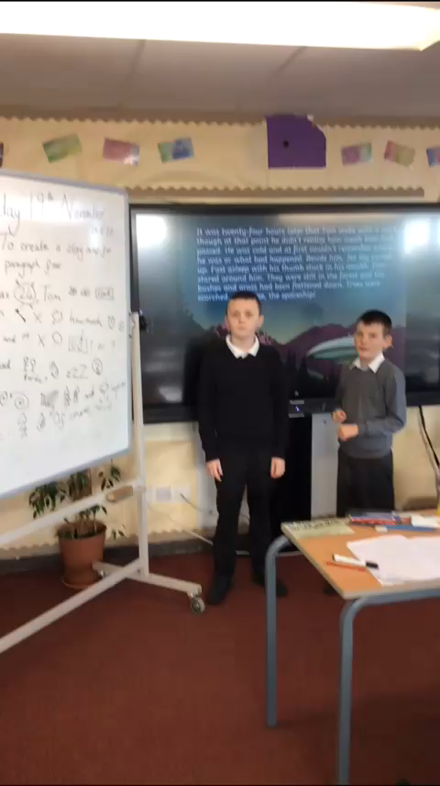
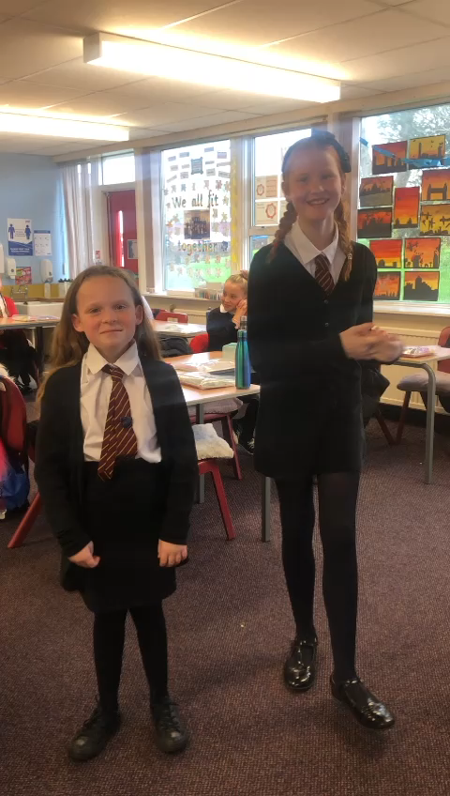
Pupils in action ☺

Slide 4


What is Talk For Writing?
Talk for Writing was developed by the author Pie Corbett. It is a fun, creative yet also rigorous approach to develop writers.
Talk for Writing starts with enjoying and sharing stories. Children learn to tell a story off by heart. They tell the story with expression and actions.
Once a story is learnt the children are encouraged to adapt it to make it their own, for example by changing the characters or the setting.
https://www.youtube.com/watch?v=VI2OWdZo6nY

Slide 5
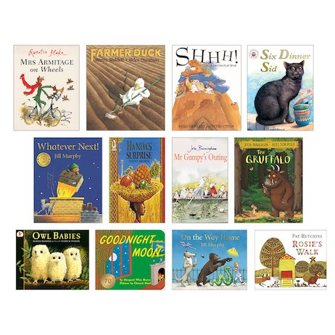
The Building Blocks
Talk for Writing starts with enjoying and sharing stories. There is a strong emphasis on children reading stories and enjoying a range of literature. Through regular reading, we want children to build up an extensive and rich vocabulary for use in their own writing. Reading regularly, no matter what age your child is, is the key element in developing their writing.

Slide 6
Fiction- So what do we write about?
Journey tale
Portal tale
Wishing tale
Rags to riches
Suspense tale
Losing tale
Finding tale
Warning tale
Tale of quest
Defeating the Monster tale

Slide 7
The Hook
https://www.youtube.com/watch?v=8u5NpCYmEiE

Slide 8
The Talk for Writing Process
There are three stages in the Talk for Writing process:

Slide 9

Stage 1- Imitation
This stage helps build children’s memories, allowing them to learn patterns so that they can change them in their own writing. Children learn the text orally. By doing so they internalise:
Building blocks of narratives eg. Characters, setting, events
Vocabulary
Children internalise flow of sentences
Patterns of stories

Slide 10
Pie Corbett and pupils retelling a text using story map and actions ☺
https://www.youtube.com/watch?v=JdvJZD-cplg

Slide 11
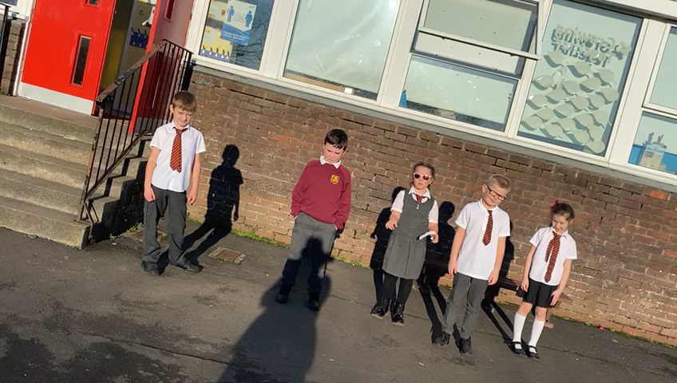
P.3 pupils have internalised their model text ☺

Slide 12
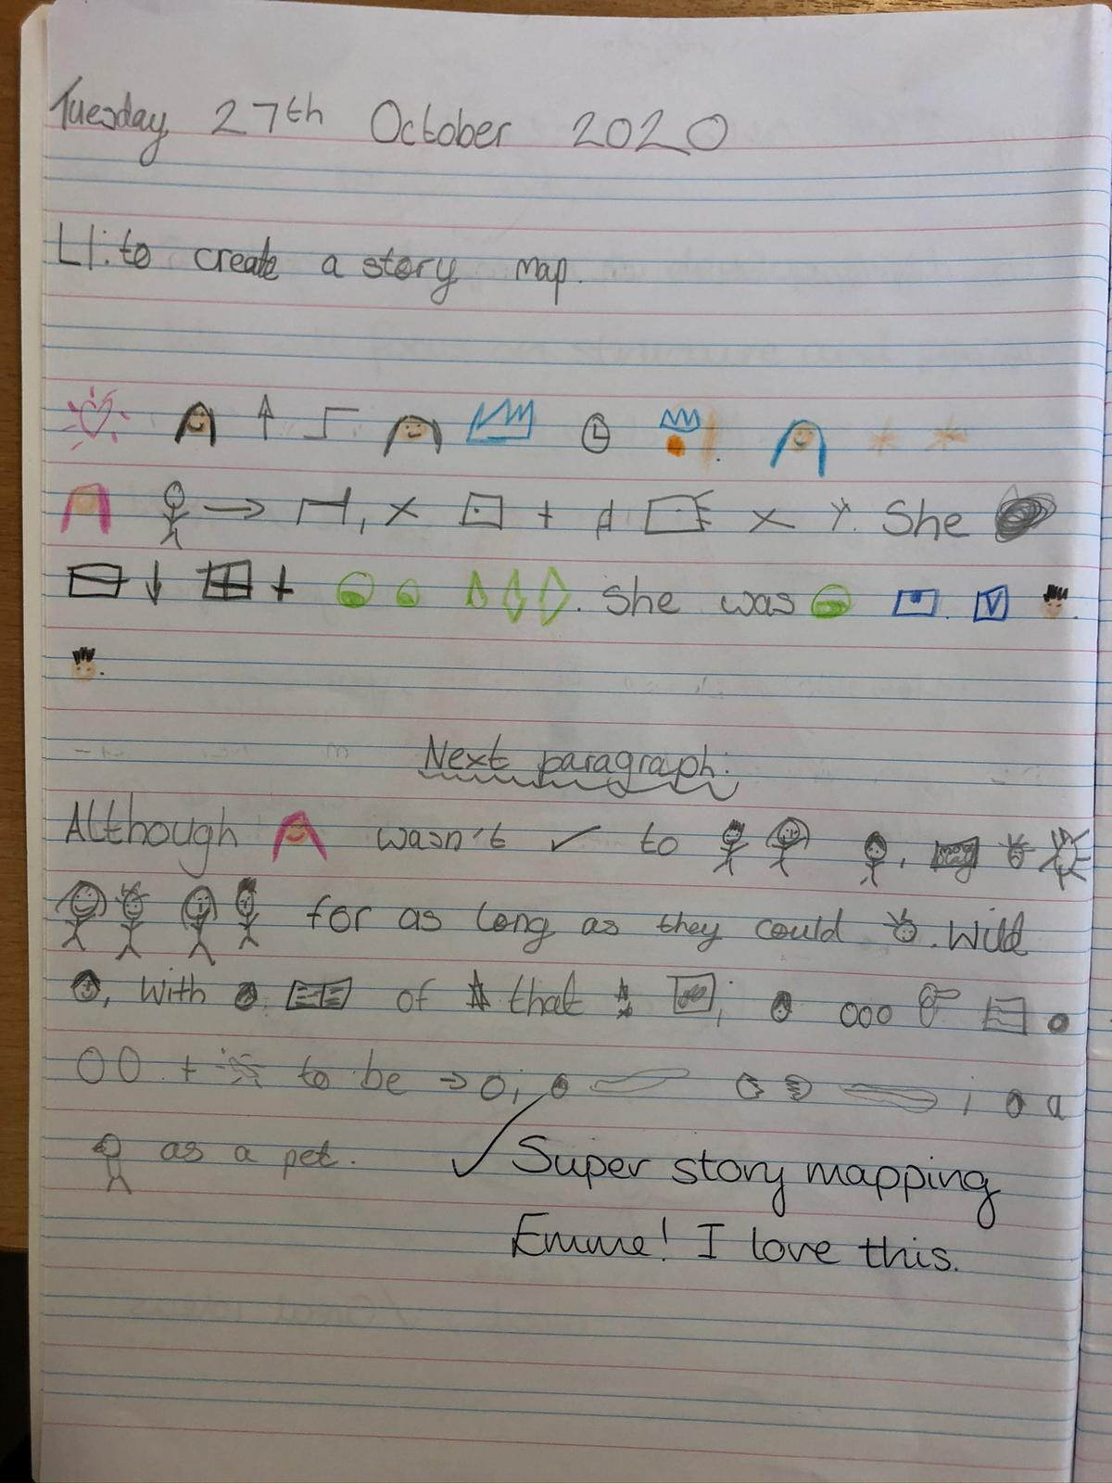
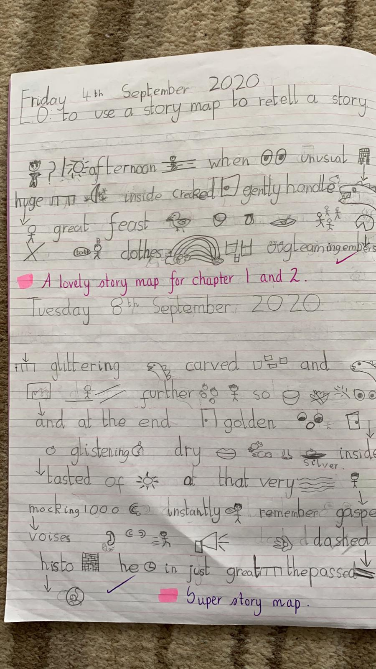
Map it out! Some examples of Gardenrose story maps ☺

Slide 13

Stage 1- Imitation (continued)
During this stage, pupils explore the text on a deeper level.
Reading as a reader
Reading as a writer
Gain a deeper understanding of a text

Slide 14
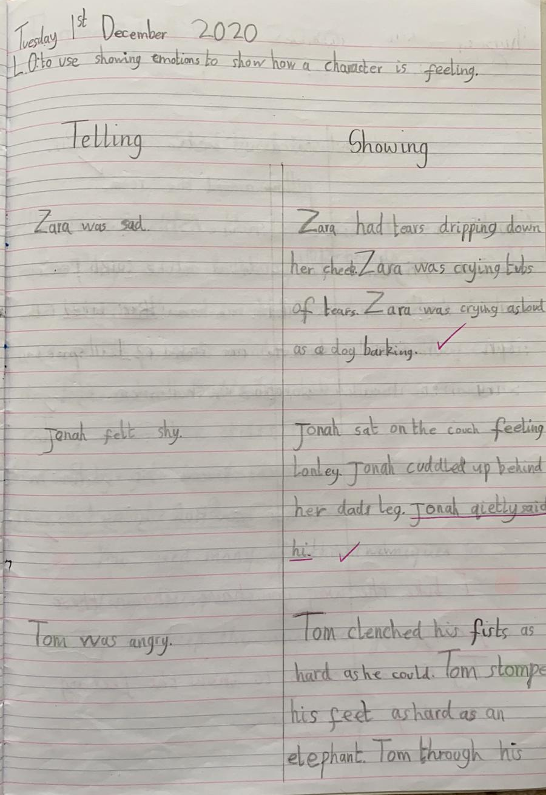
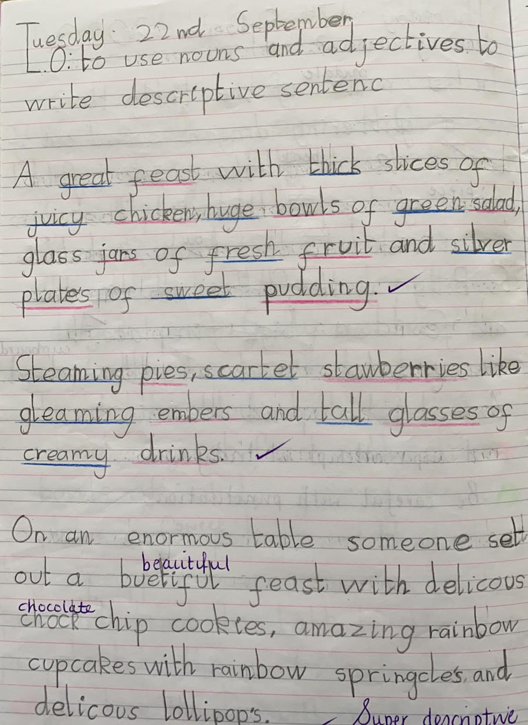
Dialogue
Description
Characterisation
Endings
Grammar and skills for writing are taught through the context of the story ☺
Openings
Dilemma

Slide 15
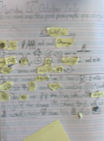
Stage 2-Innovation
During this stage, the pupils begin to alter the model text slightly. They ‘hug’ close to the text and change one aspect of the text, depending on the focus (character, setting etc)

Slide 16
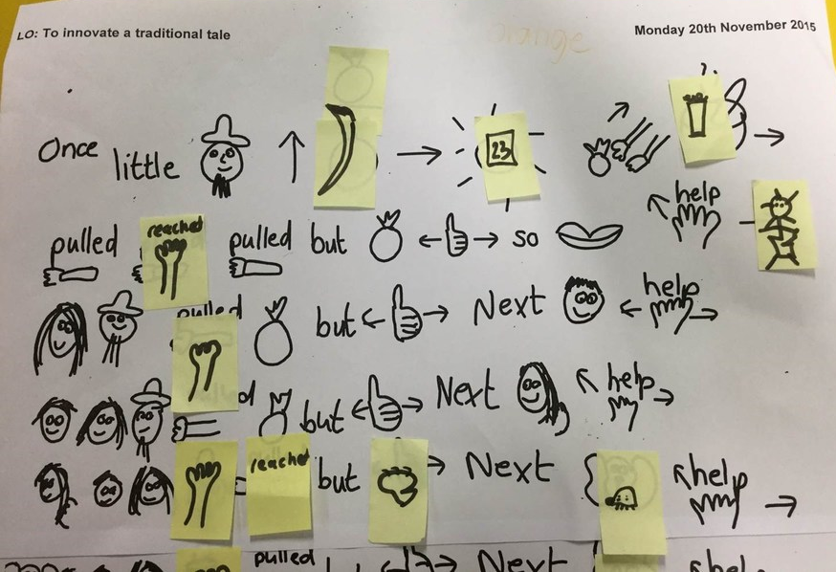
Innovation stage work sample ☺

Slide 17
ACTIVITY TIME ☺
Change the opening
The cat sat on the mat.
1.How -add an adverb
2.When -time connective
3.Where ? -prepositional phrase
4.Simile using like or as
5.Change a noun
6.Add in an adjective

Slide 18

Stage 3- Invention
During this final stage, children invent their own texts
‘Boxing it up’- what makes a suspense tale?
Clear and specific criteria
HOT PIECE- culmination of everything learned
Get creative and use their own ideas

Slide 19
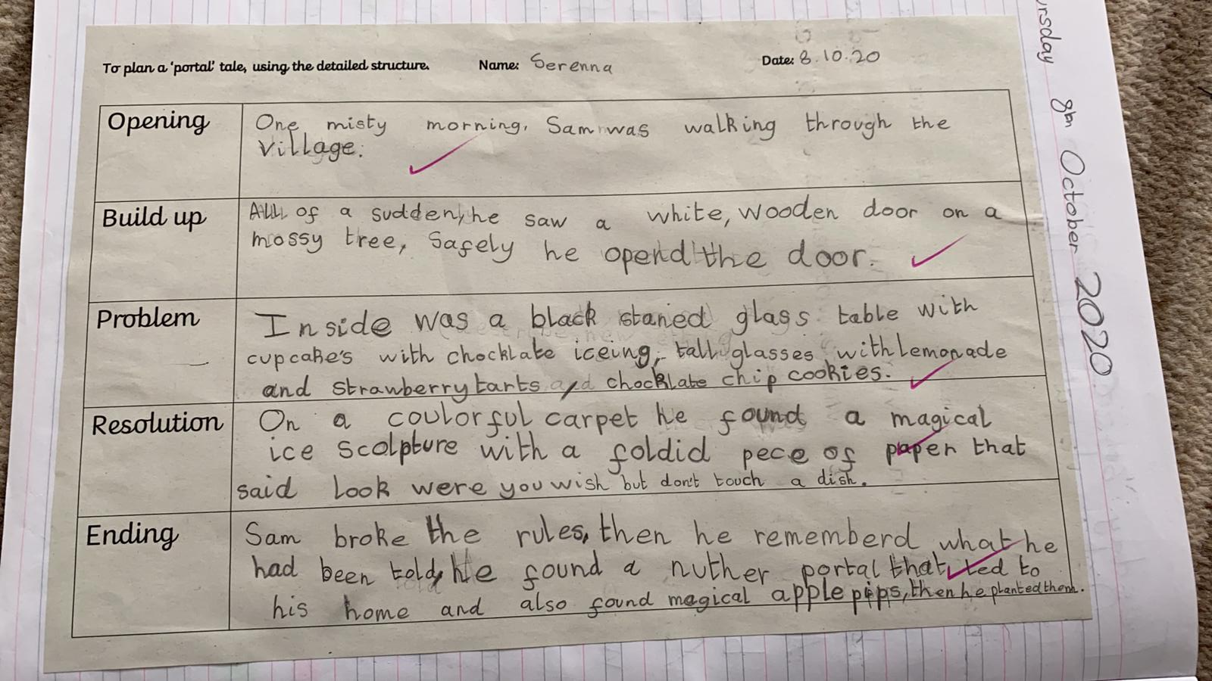
Invention stage- Boxing up a tale ☺

Slide 20
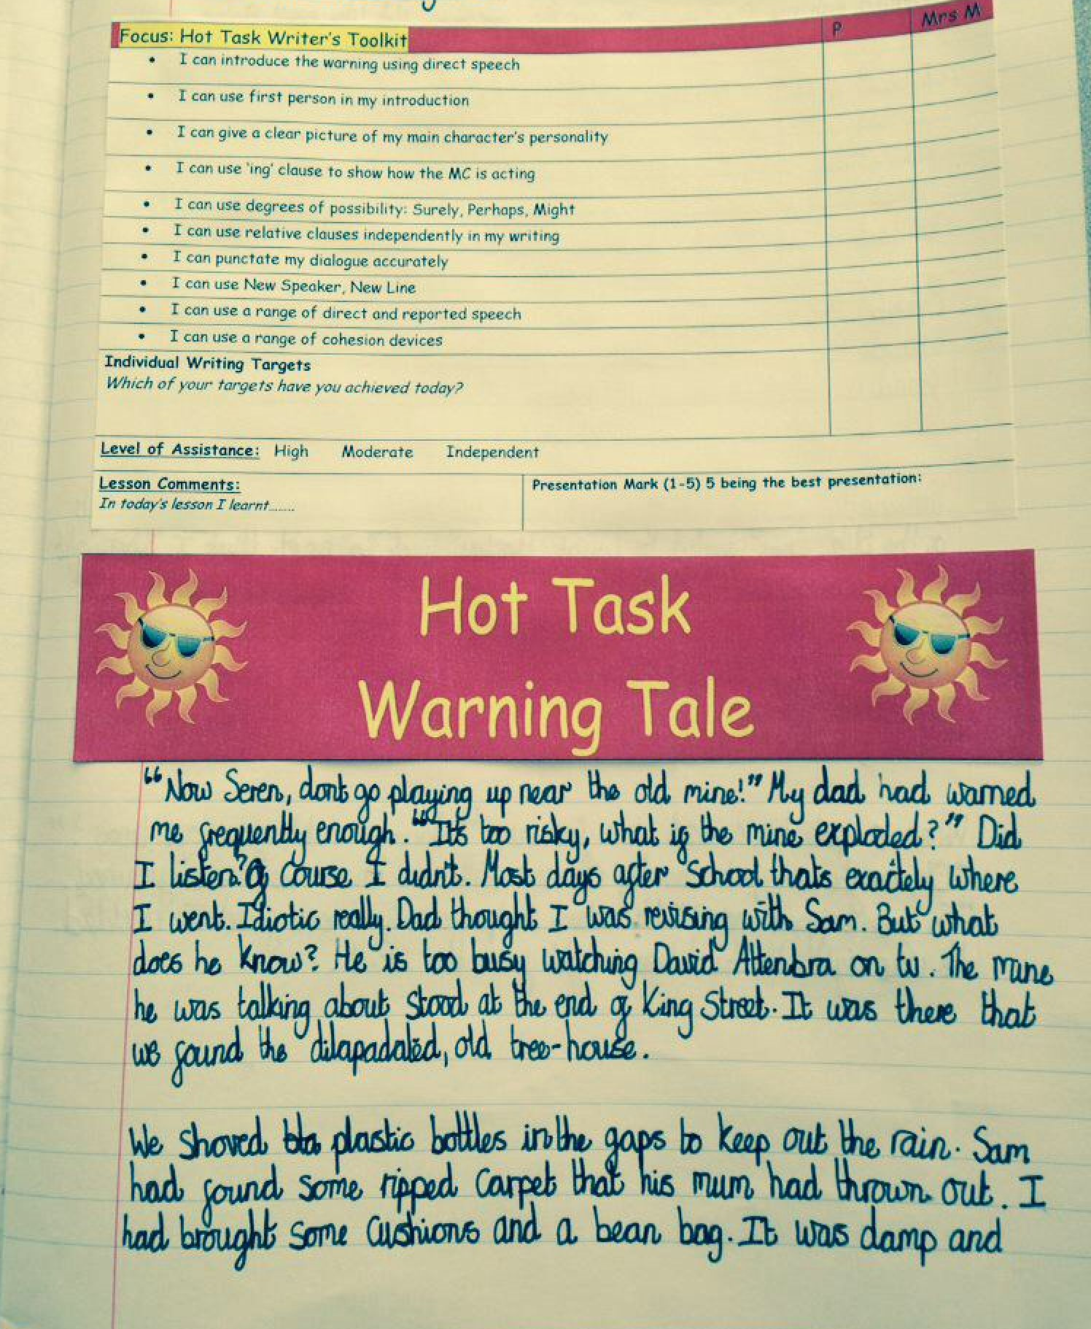
Invention stage- Hot Piece ☺

Slide 21
ACTIVITY TIME ☺
Language and Creative Games
Cloze procedure – negative or positive
Barry stared at the burger. Outside the _______ window, a wind swept across the _______town. cars purred by and on the promenade,_____newspapers tumbled along, driven by the wind. The sea rolled up the _________beach, crashing against the ________rocks that fringed the ______ shoreline.

Slide 22

What are the benefits?
There is a real buzz in our classrooms!
Children are excited and enthusiastic about their literacy and writing
Inclusive
Cold piece vs Hot piece

Slide 23
What our pupils have to say…
Its good that you get to know the text really well. I liked learning Beowulf! Connor P. 6/5
I like seeing the pictures for the story map.
Harris P1
I like making up my own actions!
Archie P1
I like story mapping!
Breagh P.6/5
I like learning the actions!
Naomi P1

Slide 24

Talk For Writing at Home
Read, read, read!
Talk for Writing begins and ends with enjoying stories and reading books. Children who read for pleasure are also more likely to succeed as writers because of the way in which reading develops language development. •
If your child brings home text maps then allow them to share and practise them with you.
Play with words and vocabulary – who can find the best word to describe something?
More information available at: https://www.talk4writing.com/about/

Slide 25
