Slide 1
Primary 7
Term 3
Miss Caldwell

Slide 2
Weekly Timetable
Monday | 9:00am – Live lesson 9:30am - Maths | 11:00am – Live Lesson 11:30am - T4W | Spelling (GL words in files on teams) | China Topic – 1pm: Ms Ryding’s group live lesson with Mrs Briggs
Tuesday – Have meetings with Carrick most of the day so will have limited TEAMS/Seesaw access. | 9:00am – Live lesson 9:30am - Maths | 10:00am – Live Lesson 11:00 – T4W | Spelling (GL words in files on teams) | 2pm: Ms Ryding’s group live lesson with Mrs Briggs 1:00pm – RME 2:00pm – PE – workout of your choice
Wednesday In school all day. | 9:15amam – Live Lesson 9:30am - Maths | 11:15am – Live Lesson 11:30 – T4W | Spelling (GL words in files on teams) | China Topic 2pm: Ms Ryding’s group live lesson with Mrs Briggs
Thursday | Mrs Briggs | 11am – Live Glockenspiel Lesson Mrs Briggs |  | 1:00pm – Live Lesson 1:30pm – Writing a recount
Friday – | 9:00am – Live Lesson PE | Mental Maths practice |  | Live check in – 1pm Art | 2:30pm – Fun 31

Slide 3
Number Talks

Slide 4
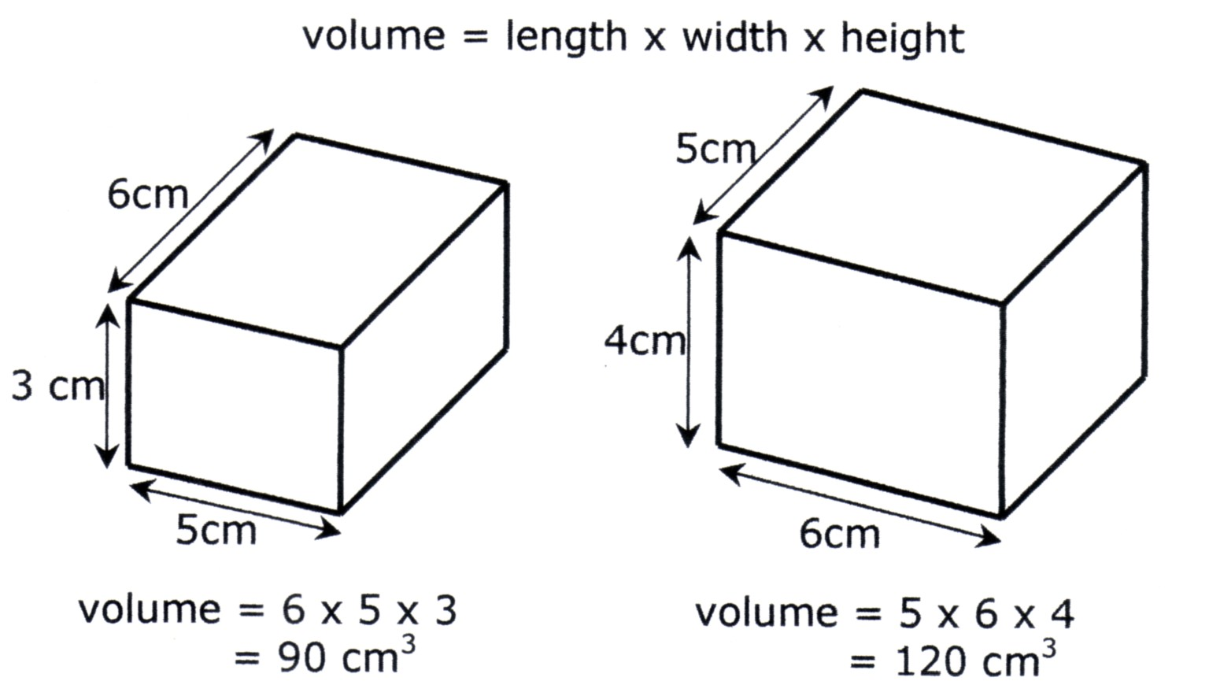
NUMERACY & MATHS – Volume
LI: to calculate volume using the formula (LxWxH)
Task Board
Live lesson or use https://www.bbc.co.uk/bitesize/topics/zjbg87h/articles/z3jrxfr to help calculate the volume of cubes and cuboids. The daily tasks have been split into mild, medium & spicy tasks. Please check the following slides to choose your task. Complete AT LEAST 1 level and challenge yourself to do 2 or 3 if possible ☺. I am looking for you to push yourself. Create a poster showing examples of how to calculate the volume of cubes and cuboids.

Slide 5
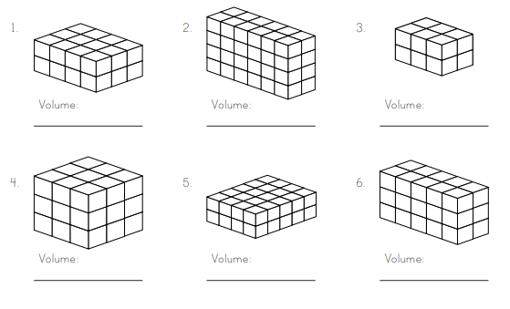
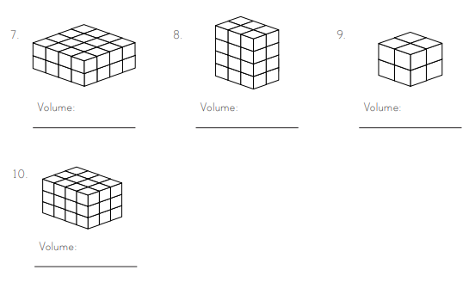
Mild
2
2
2
4
2
4
3
2
4
4
3
2
2
4
3
6
2
2
3
2
3
3
3
3
3
3
4
5
5
2

Slide 6
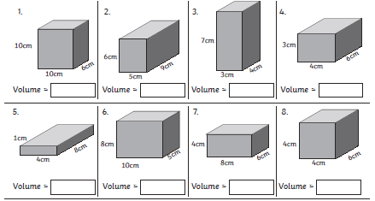
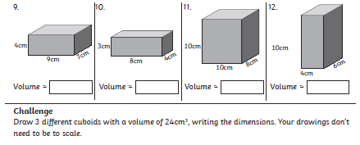
Medium

Slide 7
Spicy
6. Ansel was playing with a dice. He measured one side of the dice. The side measured 2cm. What is the volume of the dice?
7. Antoine had a box in his room that measured 42 cubic centimeters. If it was 3cm wide and 2cm long, what was the height of the box?
8. Pressley received a gift for her birthday. The present measured 36 cubic feet. If the gift was 4 feet wide and 1 foot high, what is the length of the gift?
9. Tony is packing a suitcase for a trip. The suitcase measures 50 cubic feet. If the suitcase is 5 feet long and 5 feet wide, how tall is the suitcase?
10. Mrs Vincent bought several boxes for packing up her house. Each box measured 30 cubic feet. If all the boxes were 3 feet high and 5 feet wide, what is the length of each box?
1. James is packing a box. The box is 3 feet high, 4 feet long, and 2 feet wide. What is the volume of the box?
2. Margaux bought a suitcase online. The suitcase is 2 feet tall, 3 feet wide, and 3 feet deep. What is the volume of her suitcase?
3. Tilda received a jewellery box for her birthday. The box is 5 inches wide, 4 inches tall, and 6 inches long. What is the volume of the jewellery box?
4. Enzo wants to buy a block of cream cheese that is 4cm tall, 8cm long, and 3cm wide. What is the volume of the block?
5. Viv has a safe in her basement. The safe is 4 feet high, 3 feet deep, and 4 feet wide. What is the volume of the safe?

Slide 8
Literacy – T4W
Monday 8th March 2021
LI: to read as a reader, giving opinions and thoughts on a text.
Task Board
Live Lesson Read the passage on the following slide or listen here https://soundcloud.com/talkforwriting/keep-off-the-tracks/s-7QnBMQuWOlb Complete the grid task to show your opinions and thoughts on the model text.

Slide 9
Literacy – T4W
Monday 8th March 2021
Keep off the tracks!
“Don’t go playing near that railway track!” Jake’s dad warned, “You know it’s dangerous. That’s why it’s illegal!”
Jake and Nazeem nodded in agreement but then grinned secretly at each other as they turned to go. Whilst they raced through the park on their bikes, Nazeem shot off shouting, “Last one to the tracks buys the ice creams!”
Jake set off in pursuit, puffing and panting. They both zipped under the barrier onto the railway track just before it came down. Nazeem punched the air triumphantly like Usain Bolt. Victory! Up ahead, brambles choked the stony tracks, an old shopping trolley lay discarded and empty crisp packets were pinned to the thorny hedge. The tracks gleamed, reflecting the harsh, midday sun.

Slide 10
Literacy – T4W
Monday 8th March 2021
There was nobody to be seen so Jake dropped his bike and went to explore, ignoring the bright red warning signs. Without a care in the world, he balanced like a tightrope-walker along the cold, rusty rail. He felt vibrations shudder through his body. The train was coming! At that moment, his foot slipped and jammed in the sleepers*. “Ow!” he howled, desperately tugging at his foot. It was stuck fast. There was no escape.
Nazeem span around and, with his heart pounding, ran to rescue his friend. He pulled with all his might but to no avail. The colour drained from Nazeem’s face; this was serious! Panicking, he scrambled down the track and screamed for help. As he heard the train rumbling closer, he spotted Jake’s dad screeching to a halt in his red car. Desperately, Nazeem blurted out the problem. “Where is he?” Mr Newton shouted frantically. With fear in his eyes, he ran as fast as he could to his son’s rescue.

Slide 11
Literacy – T4W
Monday 8th March 2021
With all his might, he tugged on Jake’s leg, dislodging his trainer. Jake was free! A second later, an Intercity 125 sped past in a blur with its horn blaring. After their narrow escape, Jake’s dad ranted at the shaken boys. They bowed their heads in shame. That day, they learned a valuable lesson: playing on railway lines is insane. And, of course, there were no ice creams … (*A sleeper is the name of the strong planks of timber that support railway lines.)

Slide 12
Literacy – T4W
Monday 8th March 2021
LI: to read as a reader, giving opinions & thoughts on a text.
What parts of the text did you like? | What parts of the text did you not like? | What questions do you have about the text? | How could you describe the character’s? | What do you think will happen next? | Can you make up 10 questions about the text for a friend to answer? | What lesson do you learn from this story?

Slide 13
China Topic
Monday 8th March 2021
LI: to compare the life of a child in China to your own life.
Task Board
Watch the following video: https://www.bbc.co.uk/teach/class-clips-video/geography-a-child-led-introduction-to-the-chinese-city-of-shanghai/zdrtvk7 Write a comparison between your life and that of Juewen. You could do a paragraph on similarities and a paragraph on differences, or lay it out as a table. Take notes on the transportation mentioned in the video – what information do you learn from this? Do you think Juewen lives a more pressured life to you or do you have the same pressures? Explain your answer.

Slide 14
Number Talks

Slide 15
MATHS – Volume
LI: to calculate and compare volume of shapes.
Task Board
Live lesson or use https://www.bbc.co.uk/bitesize/topics/zjbg87h/articles/z3jrxfr to help calculate the volume of cubes and cuboids. The daily tasks have been split into mild, medium & spicy tasks. Please check the following slides to choose your task. Complete AT LEAST 1 level and challenge yourself to do 2 or 3 if possible ☺. I am looking for you to push yourself.

Slide 16
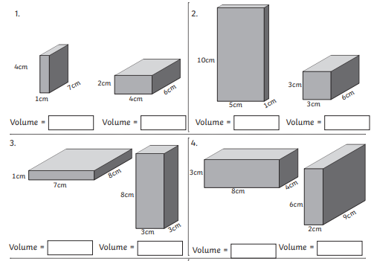
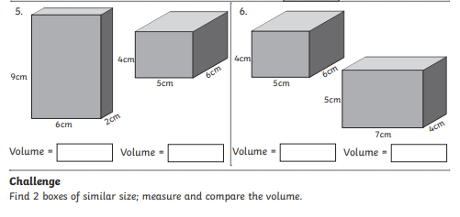
Mild

Slide 17
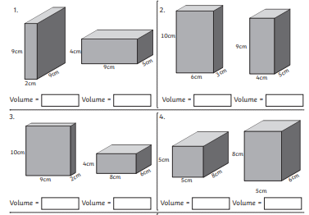
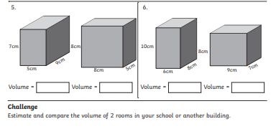
Medium

Slide 18
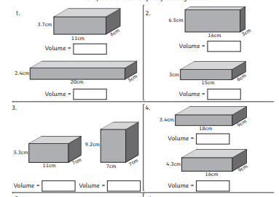
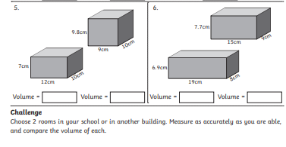
Spicy

Slide 19
Talk 4 Writing
Tuesday 9th March 2021
LI: to use descriptive techniques to create setting.
Task Board
Live Lesson Read the passage on the following slide or listen here https://soundcloud.com/talkforwriting/keep-off-the-tracks/s-7QnBMQuWOlb Create your own setting for your warning story. Use the techniques in the task slide.

Slide 20
Literacy – T4W
Tuesday 9th March 2021
Keep off the tracks!
“Don’t go playing near that railway track!” Jake’s dad warned, “You know it’s dangerous. That’s why it’s illegal!”
Jake and Nazeem nodded in agreement but then grinned secretly at each other as they turned to go. Whilst they raced through the park on their bikes, Nazeem shot off shouting, “Last one to the tracks buys the ice creams!”
Jake set off in pursuit, puffing and panting. They both zipped under the barrier onto the railway track just before it came down. Nazeem punched the air triumphantly like Usain Bolt. Victory! Up ahead, brambles choked the stony tracks, an old shopping trolley lay discarded and empty crisp packets were pinned to the thorny hedge. The tracks gleamed, reflecting the harsh, midday sun.

Slide 21
Literacy – T4W
Tuesday 9th March 2021
There was nobody to be seen so Jake dropped his bike and went to explore, ignoring the bright red warning signs. Without a care in the world, he balanced like a tightrope-walker along the cold, rusty rail. He felt vibrations shudder through his body. The train was coming! At that moment, his foot slipped and jammed in the sleepers*. “Ow!” he howled, desperately tugging at his foot. It was stuck fast. There was no escape.
Nazeem span around and, with his heart pounding, ran to rescue his friend. He pulled with all his might but to no avail. The colour drained from Nazeem’s face; this was serious! Panicking, he scrambled down the track and screamed for help. As he heard the train rumbling closer, he spotted Jake’s dad screeching to a halt in his red car. Desperately, Nazeem blurted out the problem. “Where is he?” Mr Newton shouted frantically. With fear in his eyes, he ran as fast as he could to his son’s rescue.

Slide 22
Literacy – T4W
Tuesday 9th March 2021
With all his might, he tugged on Jake’s leg, dislodging his trainer. Jake was free! A second later, an Intercity 125 sped past in a blur with its horn blaring. After their narrow escape, Jake’s dad ranted at the shaken boys. They bowed their heads in shame. That day, they learned a valuable lesson: playing on railway lines is insane. And, of course, there were no ice creams … (*A sleeper is the name of the strong planks of timber that support railway lines.)

Slide 23
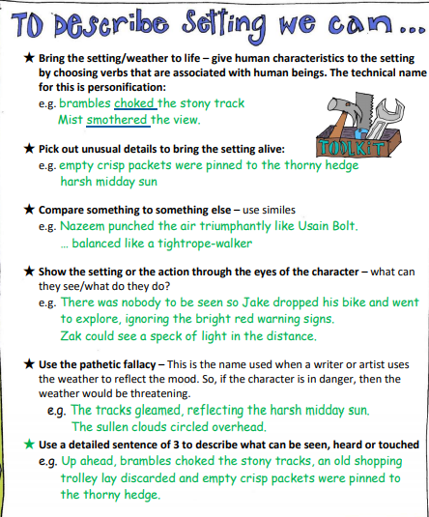
Task
Using these techniques – write your own setting.

Slide 24
RME – Islam
LI: to discuss opinions on the teachings in religious stories.
Task Board
Read & watch the text and video to learn about the Islamic story of The Prophet, the Ants and the Camel. https://www.bbc.co.uk/bitesize/clips/z9tqb82 Re-write the story or create a comic strip showing the story. Answer the following question: What do you think the message behind this story is?

Slide 25
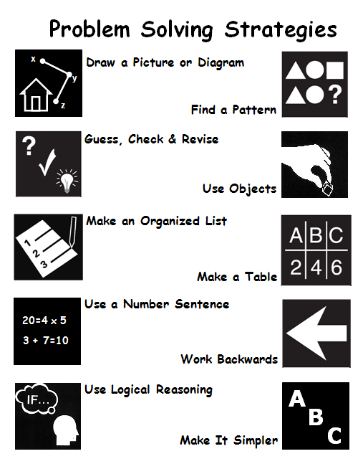
MATHS – Problem Solving
LI: to use problem solving strategies effectively.
Task Board
Live lesson – problem solving. Choose some of the following problem solving blether station cards to complete. Think about which strategy is best for solving each one. CHALLENGE – make up your own problem solving cards for a friend to solve!

Slide 26
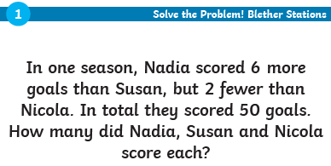
LI: to use problem solving strategies effectively.

Slide 27
LI: to use problem solving strategies effectively.

Slide 28
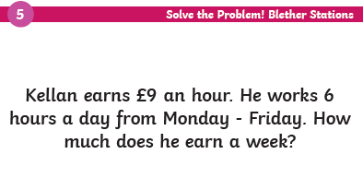
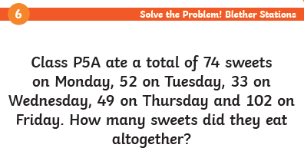
LI: to use problem solving strategies effectively.

Slide 29
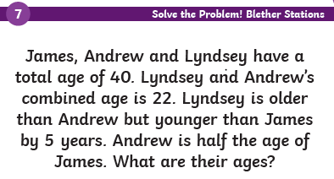
LI: to use problem solving strategies effectively.

Slide 30
LI: to use problem solving strategies effectively.

Slide 31
Talk 4 Writing
Wednesday 10th March 2021
LI: to create a setting description.
Task Board
Live Lesson Read the passage on the following slide or listen here https://soundcloud.com/talkforwriting/keep-off-the-tracks/s-7QnBMQuWOlb Create a setting description for the picture on the task slide. Include as many techniques as you can.

Slide 32
Literacy – T4W
Wednesday 10th March 2021.
Keep off the tracks!
“Don’t go playing near that railway track!” Jake’s dad warned, “You know it’s dangerous. That’s why it’s illegal!”
Jake and Nazeem nodded in agreement but then grinned secretly at each other as they turned to go. Whilst they raced through the park on their bikes, Nazeem shot off shouting, “Last one to the tracks buys the ice creams!”
Jake set off in pursuit, puffing and panting. They both zipped under the barrier onto the railway track just before it came down. Nazeem punched the air triumphantly like Usain Bolt. Victory! Up ahead, brambles choked the stony tracks, an old shopping trolley lay discarded and empty crisp packets were pinned to the thorny hedge. The tracks gleamed, reflecting the harsh, midday sun.

Slide 33
Literacy – T4W
Wednesday 10th March 2021
There was nobody to be seen so Jake dropped his bike and went to explore, ignoring the bright red warning signs. Without a care in the world, he balanced like a tightrope-walker along the cold, rusty rail. He felt vibrations shudder through his body. The train was coming! At that moment, his foot slipped and jammed in the sleepers*. “Ow!” he howled, desperately tugging at his foot. It was stuck fast. There was no escape.
Nazeem span around and, with his heart pounding, ran to rescue his friend. He pulled with all his might but to no avail. The colour drained from Nazeem’s face; this was serious! Panicking, he scrambled down the track and screamed for help. As he heard the train rumbling closer, he spotted Jake’s dad screeching to a halt in his red car. Desperately, Nazeem blurted out the problem. “Where is he?” Mr Newton shouted frantically. With fear in his eyes, he ran as fast as he could to his son’s rescue.

Slide 34
Literacy – T4W
Wednesday 10th March 2021.
With all his might, he tugged on Jake’s leg, dislodging his trainer. Jake was free! A second later, an Intercity 125 sped past in a blur with its horn blaring. After their narrow escape, Jake’s dad ranted at the shaken boys. They bowed their heads in shame. That day, they learned a valuable lesson: playing on railway lines is insane. And, of course, there were no ice creams … (*A sleeper is the name of the strong planks of timber that support railway lines.)

Slide 35
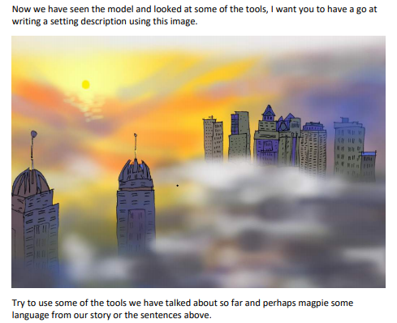
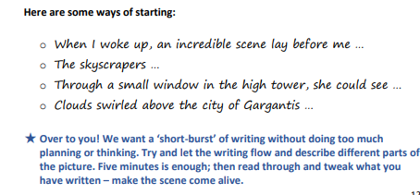
Literacy – T4W
Wednesday 10th March 2021
LI: to write a setting description.

Slide 36
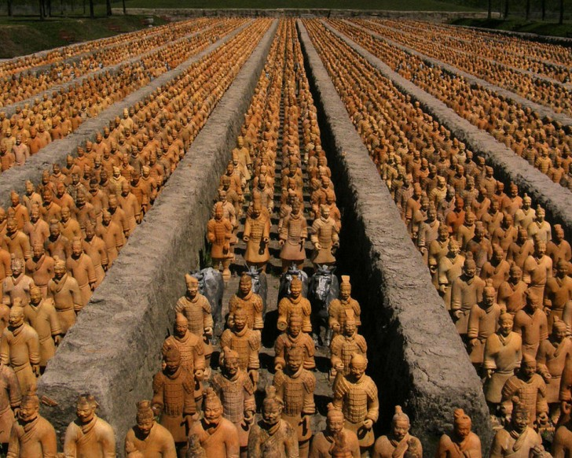
China Topic – Terracotta Army
Wednesday 10th March 2021
LI: to research the Terracotta Army.
Task Board
Read the following information on the Terracotta Army: https://www.ducksters.com/history/china/terracotta_army.php (at the bottom of the page there is a section where you can play a reading of the page). Create a fact file/powerpoint/poster/quiz/sway all about the information you have found from your research. Pictures/illustrations would be a bonus ☺

Slide 37
Final Week of Lockdown!
Thursday 11th March 2021
LI: to write a recount.
Task Board
Live Lesson 1. Write a recount of your experiences of lockdown. Which parts have you enjoyed? What has been difficult? What are you most looking forward to about coming back to school?

Slide 38
HWB
LI: to keep physically healthy.
Task Board
Join in with Live PE session at 9am OR Complete exercise of your choice!

Slide 39
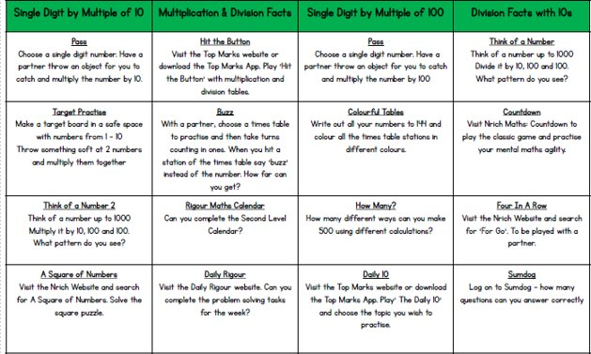
Mental Maths
Friday 11th March 2021
LI: to improve speed and accuracy in basic numeracy skills.

Slide 40
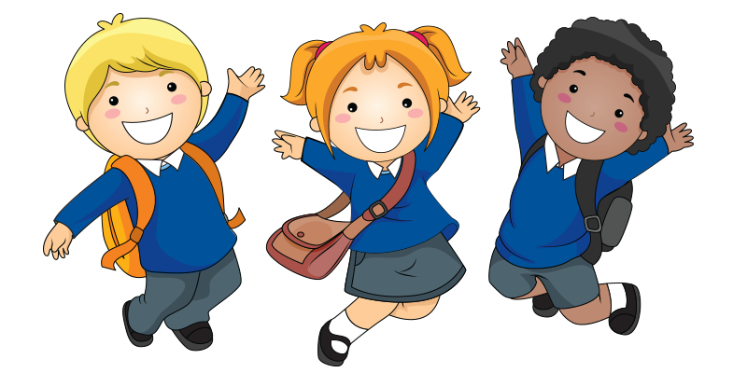
Art
Task Board
Get creative! If you could design your own school uniform – what would it look like? Design your own school badge and tie to go along with it ☺ Think about styles, colours, textures, material, practicality etc. Label your illustration!

Slide 41
Fun 31!
Task Board
You have worked SO hard over the past couple of months and I am so so so so so proud of you!!! Enjoy your fun 31 time! Try to get away from the laptop/tablet for a wee while and enjoy your time off. See you back at school on Monday ☺ I CAN’T WAIT!!!!!!!!!

