Slide 1
Primary 7
Term 3
Miss Caldwell

Slide 2
Weekly Timetable
Monday | 9:00am – Live lesson 9:30am - Maths | 11am – Live Lesson 11:30am - T4W | Spelling (GL words in files on teams) | China Topic – 2pm: Ms Ryding’s group live lesson with Mrs Briggs
Tuesday - In school all day. | 9:00am – Live lesson 9:30am - Maths | 11am – Live Lesson 11:30 – T4W | Spelling (GL words in files on teams) | 1:00pm – live RME lesson 2pm: Ms Ryding’s group live lesson with Mrs Briggs 1:30pm – RME 2:00pm – PE – workout of your choice
Wednesday | 9:00am – Live Lesson 9:30am - Maths | 11am – Live Lesson 11:30 – T4W | Spelling (GL words in files on teams) | China Topic 2pm: Ms Ryding’s group live lesson with Mrs Briggs
Thursday | Mrs Briggs | 11am – Live Glockenspiel Lesson Mrs Briggs |  | 1:00pm – Live Lesson 1:30pm – Reading Comprehension
Friday – In school all day. | 9:00am – Live Lesson 9:30am - Maths | HWB |  | Live check in – 1pm Art | 2:30pm – Fun 31

Slide 3
Number Talks

Slide 4
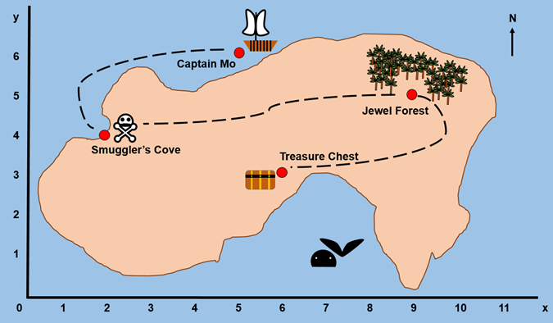
NUMERACY & MATHS – Co-ordinates
LI: to use co-ordinates to give directions.
Task Board
Live lesson or use https://www.bbc.co.uk/bitesize/topics/zgthvcw to learn about finding co-ordinates. The daily tasks have been split into mild, medium & spicy tasks. Please check the following slides to choose your task. Complete AT LEAST 1 level and challenge yourself to do 2 or 3 if possible ☺. I am looking for you to push yourself. Create your own treasure map (using a co-ordinates grid) and give directions using co-ordinates.

Slide 5
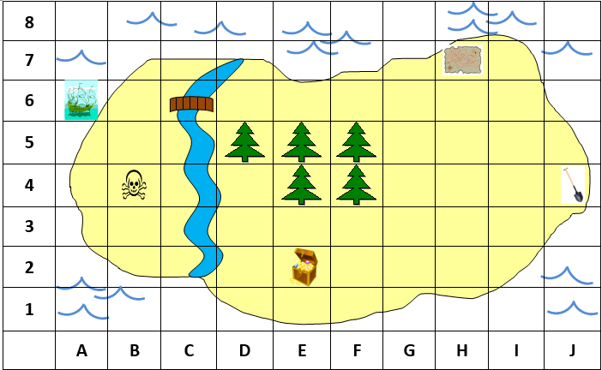
Mild Map

Slide 6
Mild Questions

Slide 7
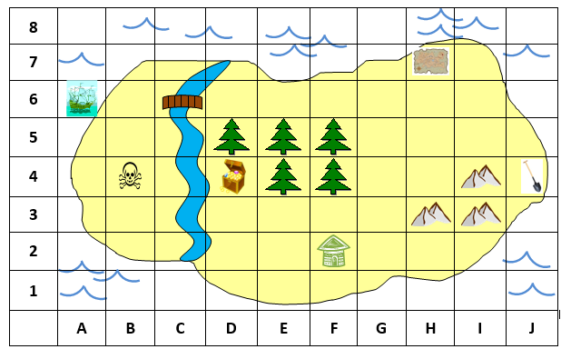
Medium Map

Slide 8
Medium Questions

Slide 9
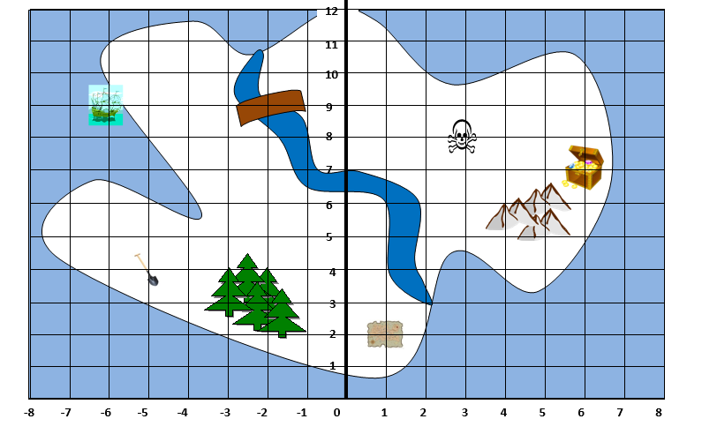
Spicy Map

Slide 10
Spicy Questions

Slide 11
Literacy – T4W
Monday 1st March 2021
LI: to read as a reader, giving opinions and thoughts on a text.
Task Board
Live Lesson Read the passage on the following slide or listen here https://soundcloud.com/talkforwriting/keep-off-the-tracks/s-7QnBMQuWOlb Complete the grid task to show your opinions and thoughts on the model text.

Slide 12
Literacy – T4W
Monday 1st March 2021
Keep off the tracks!
“Don’t go playing near that railway track!” Jake’s dad warned, “You know it’s dangerous. That’s why it’s illegal!”
Jake and Nazeem nodded in agreement but then grinned secretly at each other as they turned to go. Whilst they raced through the park on their bikes, Nazeem shot off shouting, “Last one to the tracks buys the ice creams!”
Jake set off in pursuit, puffing and panting. They both zipped under the barrier onto the railway track just before it came down. Nazeem punched the air triumphantly like Usain Bolt. Victory! Up ahead, brambles choked the stony tracks, an old shopping trolley lay discarded and empty crisp packets were pinned to the thorny hedge. The tracks gleamed, reflecting the harsh, midday sun.

Slide 13
Literacy – T4W
Monday 1st March 2021
There was nobody to be seen so Jake dropped his bike and went to explore, ignoring the bright red warning signs. Without a care in the world, he balanced like a tightrope-walker along the cold, rusty rail. He felt vibrations shudder through his body. The train was coming! At that moment, his foot slipped and jammed in the sleepers*. “Ow!” he howled, desperately tugging at his foot. It was stuck fast. There was no escape.
Nazeem span around and, with his heart pounding, ran to rescue his friend. He pulled with all his might but to no avail. The colour drained from Nazeem’s face; this was serious! Panicking, he scrambled down the track and screamed for help. As he heard the train rumbling closer, he spotted Jake’s dad screeching to a halt in his red car. Desperately, Nazeem blurted out the problem. “Where is he?” Mr Newton shouted frantically. With fear in his eyes, he ran as fast as he could to his son’s rescue.

Slide 14
Literacy – T4W
Monday 1st March 2021
LI: to learn and re-tell a model text.
With all his might, he tugged on Jake’s leg, dislodging his trainer. Jake was free! A second later, an Intercity 125 sped past in a blur with its horn blaring. After their narrow escape, Jake’s dad ranted at the shaken boys. They bowed their heads in shame. That day, they learned a valuable lesson: playing on railway lines is insane. And, of course, there were no ice creams … (*A sleeper is the name of the strong planks of timber that support railway lines.)

Slide 15
Literacy – T4W
Monday 1st March 2021
LI: to read as a reader, giving opinions & thoughts on a text.
What parts of the text did you like? | What parts of the text did you not like? | What questions do you have about the text? | How could you describe the character’s? | What do you think will happen next? | Can you make up 10 questions about the text for a friend to answer? | What lesson do you learn from this story?

Slide 16
China Topic
Monday 1st March 2021
LI: to plan a holiday to China.
Task Board
Your challenge for today is to use the internet to make a plan for a trip to China! You must write down your findings for the following: How are you going to get there? How long will it take? Where are you going to stay? (Which region, town, city, hotel/apartment etc) What will you eat while you are there? (Plan a day of breakfast, lunch, dinner with traditional Chinese food) What attractions will you visit? (These must be near to where you have chosen to stay) Are there any famous Chinese people you would like to meet? What kind of money will you need to take? How will you say hello to people in Mandarin?

Slide 17
Number Talks

Slide 18
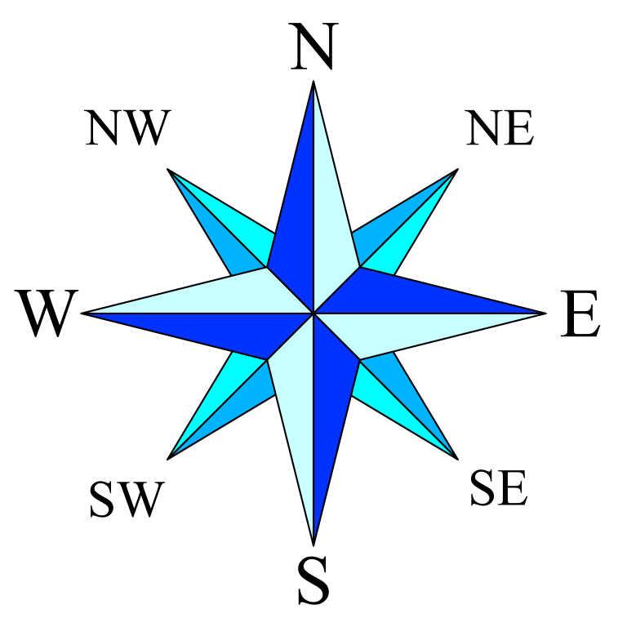
MATHS – Directions
LI: to use compass points and co-ordinates to give directions.
Task Board
Live lesson or use https://www.bbc.co.uk/bitesize/topics/zgthvcw to learn about finding co-ordinates. https://www.bbc.co.uk/bitesize/topics/zvsfr82/articles/zdk46v4 for information on compass points. The daily tasks have been split into mild, medium & spicy tasks. Please check the following slides to choose your task. Complete AT LEAST 1 level and challenge yourself to do 2 or 3 if possible ☺. I am looking for you to push yourself. CHALLENGE – using the maps on the tasks, add co-ordinates to the x and y axis. Give direction using these co-ordinates.

Slide 19
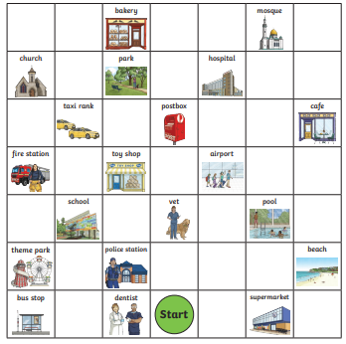
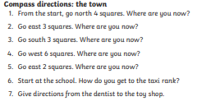
Mild

Slide 20
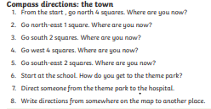
Medium

Slide 21
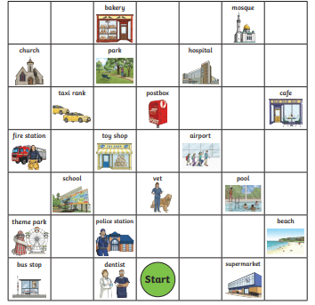
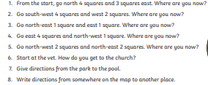
Spicy

Slide 22
Talk 4 Writing
Tuesday 2nd March 2021
LI: to use descriptive techniques to create setting.
Task Board
Live Lesson Read the passage on the following slide or listen here https://soundcloud.com/talkforwriting/keep-off-the-tracks/s-7QnBMQuWOlb Create your own setting for your warning story. Use the techniques in the task slide. CHALLENGE –

Slide 23
Literacy – T4W
Tuesday 2nd March 2021
Keep off the tracks!
“Don’t go playing near that railway track!” Jake’s dad warned, “You know it’s dangerous. That’s why it’s illegal!”
Jake and Nazeem nodded in agreement but then grinned secretly at each other as they turned to go. Whilst they raced through the park on their bikes, Nazeem shot off shouting, “Last one to the tracks buys the ice creams!”
Jake set off in pursuit, puffing and panting. They both zipped under the barrier onto the railway track just before it came down. Nazeem punched the air triumphantly like Usain Bolt. Victory! Up ahead, brambles choked the stony tracks, an old shopping trolley lay discarded and empty crisp packets were pinned to the thorny hedge. The tracks gleamed, reflecting the harsh, midday sun.

Slide 24
Literacy – T4W
Tuesday 2nd March 2021
There was nobody to be seen so Jake dropped his bike and went to explore, ignoring the bright red warning signs. Without a care in the world, he balanced like a tightrope-walker along the cold, rusty rail. He felt vibrations shudder through his body. The train was coming! At that moment, his foot slipped and jammed in the sleepers*. “Ow!” he howled, desperately tugging at his foot. It was stuck fast. There was no escape.
Nazeem span around and, with his heart pounding, ran to rescue his friend. He pulled with all his might but to no avail. The colour drained from Nazeem’s face; this was serious! Panicking, he scrambled down the track and screamed for help. As he heard the train rumbling closer, he spotted Jake’s dad screeching to a halt in his red car. Desperately, Nazeem blurted out the problem. “Where is he?” Mr Newton shouted frantically. With fear in his eyes, he ran as fast as he could to his son’s rescue.

Slide 25
Literacy – T4W
Tuesday 2nd March 2021
With all his might, he tugged on Jake’s leg, dislodging his trainer. Jake was free! A second later, an Intercity 125 sped past in a blur with its horn blaring. After their narrow escape, Jake’s dad ranted at the shaken boys. They bowed their heads in shame. That day, they learned a valuable lesson: playing on railway lines is insane. And, of course, there were no ice creams … (*A sleeper is the name of the strong planks of timber that support railway lines.)

Slide 26
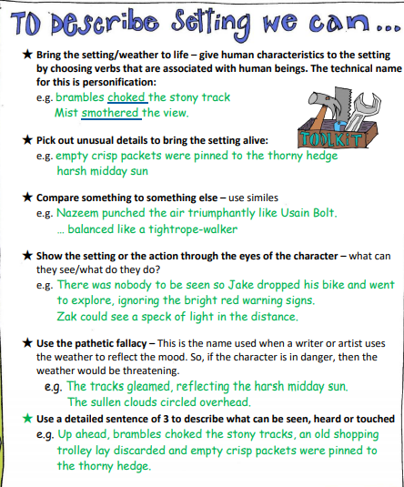
Task
Using these techniques – write your own setting.

Slide 27
RME – Lent
LI: to discuss opinions on the teachings in religious stories.
Task Board
Live Lesson Read & watch the text and video to learn about the story of Rama and Sita in Hinduism. https://www.bbc.co.uk/bitesize/clips/zsk8mp3 Re-write the story or create a comic strip showing the story of Rama and Sita. Answer the following question: What do you think the message behind this story is?

Slide 28
MATHS – Directions
LI: to use co-ordinates and compass points.
Task Board
Live lesson – co-ordinates and compass points to provide directions. Create a co-ordinates grid (as big as you like). Plot important places around Maybole (use google maps to help you imagine where they are) eg – Gardenrose, Carrick, the park, chip shop, Co-Op, Carrick Centre, your house etc. Using knowledge of compass points and co-ordinates, give directions from your house to one area of Maybole. Create co-ordinates/compass point questions for a friend or family member on how to get from one place to another. Share with me / a friend / a family member ☺

Slide 29
Talk 4 Writing
Wednesday 3rd March 2021
LI: to create a setting description.
Task Board
Live Lesson Read the passage on the following slide or listen here https://soundcloud.com/talkforwriting/keep-off-the-tracks/s-7QnBMQuWOlb Create a setting description for the picture on the task slide. Include as many techniques as you can.

Slide 30
Literacy – T4W
Wednesday 3rd March 2021.
Keep off the tracks!
“Don’t go playing near that railway track!” Jake’s dad warned, “You know it’s dangerous. That’s why it’s illegal!”
Jake and Nazeem nodded in agreement but then grinned secretly at each other as they turned to go. Whilst they raced through the park on their bikes, Nazeem shot off shouting, “Last one to the tracks buys the ice creams!”
Jake set off in pursuit, puffing and panting. They both zipped under the barrier onto the railway track just before it came down. Nazeem punched the air triumphantly like Usain Bolt. Victory! Up ahead, brambles choked the stony tracks, an old shopping trolley lay discarded and empty crisp packets were pinned to the thorny hedge. The tracks gleamed, reflecting the harsh, midday sun.

Slide 31
Literacy – T4W
Wednesday 3rd March 2021
There was nobody to be seen so Jake dropped his bike and went to explore, ignoring the bright red warning signs. Without a care in the world, he balanced like a tightrope-walker along the cold, rusty rail. He felt vibrations shudder through his body. The train was coming! At that moment, his foot slipped and jammed in the sleepers*. “Ow!” he howled, desperately tugging at his foot. It was stuck fast. There was no escape.
Nazeem span around and, with his heart pounding, ran to rescue his friend. He pulled with all his might but to no avail. The colour drained from Nazeem’s face; this was serious! Panicking, he scrambled down the track and screamed for help. As he heard the train rumbling closer, he spotted Jake’s dad screeching to a halt in his red car. Desperately, Nazeem blurted out the problem. “Where is he?” Mr Newton shouted frantically. With fear in his eyes, he ran as fast as he could to his son’s rescue.

Slide 32
Literacy – T4W
Wednesday 3rd March 2021.
With all his might, he tugged on Jake’s leg, dislodging his trainer. Jake was free! A second later, an Intercity 125 sped past in a blur with its horn blaring. After their narrow escape, Jake’s dad ranted at the shaken boys. They bowed their heads in shame. That day, they learned a valuable lesson: playing on railway lines is insane. And, of course, there were no ice creams … (*A sleeper is the name of the strong planks of timber that support railway lines.)

Slide 33
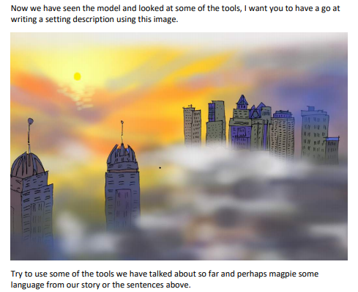
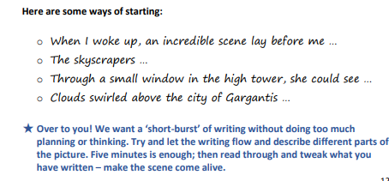
Literacy – T4W
Wednesday 3rd March 2021
LI: to write a setting description.

Slide 34
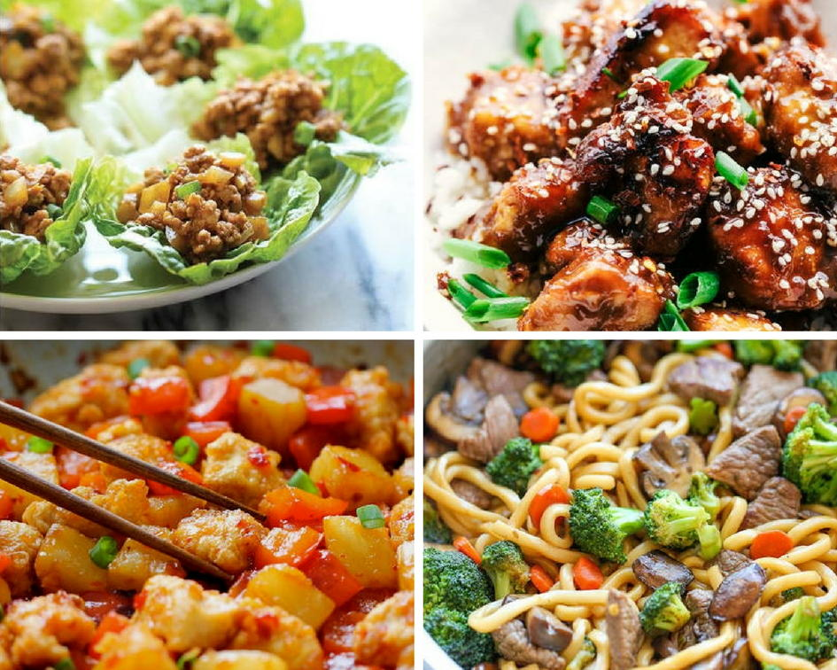
China Topic – Food & Diet
Wednesday 3rd March 2021
LI: to research traditional Chinese food.
Task Board
Research traditional Chinese food and find out the following: Are there specific foods associated with specific regions? A recipe for a traditional Chinese meal. Write a traditional Chinese food meal plan – breakfast, lunch, dinner. (Compare this with a typical day of eating for yourself. Any similarities? Any differences?)

Slide 35
World Book Day
Thursday 4th March 2021
Task Board
TBC – world book day activity.

Slide 36
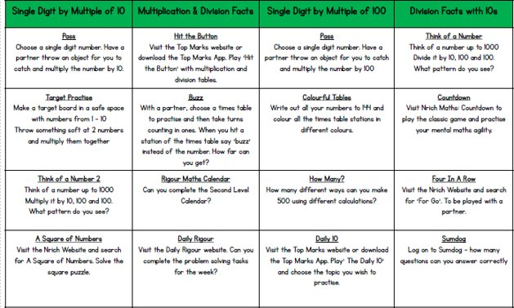
Mental Maths
Friday 5th March 2021
LI: to improve speed and accuracy in basic numeracy skills.

Slide 37
HWB
LI: to discuss strategies for mental, emotional and physical health.
Task Board
Create a leaflet/poster/powerpoint etc on tips for staying healthy during lockdown. You may want to think about the following and how they can impact mental and physical health – Food/nutrition, exercise, sleep, relaxation, muscle recovery, mindfulness, mental health. & Anything else you can think of!

Slide 38
Art/World Book Day
Task Board
Get creative! I’d love for you to design a new front cover for a book of your choice. This may be a book you have already read, a book you would like to read, or even a book that you are going to make up! Your front cover should include – A title An author (this could be yourself) Picture relating to the book (if you’ve made up your own idea for a book the front cover should be related to your idea)

Slide 39
Fun 31!
Task Board
You have worked SO hard so enjoy your fun 31 time! Try to get away from the laptop/tablet for a wee while and enjoy your time off. See you Monday ☺

