Slide 1
Health and Wellbeing Week
WB 8th February 2021

Slide 2
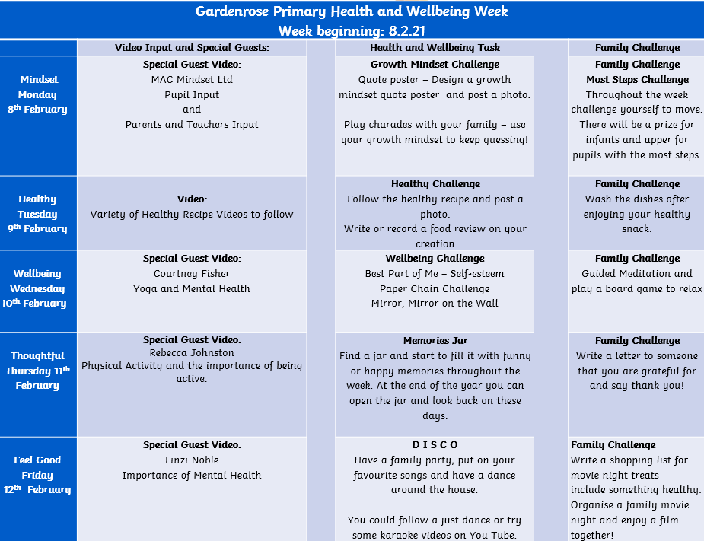
The Timetable
Each day has a specific theme relating to your Health and Wellbeing. We have daily recorded inputs from a specialist and activities around these themes.
CLICK HERE

Slide 3
Message from Mrs Morrison
CLICK HERE

Slide 4
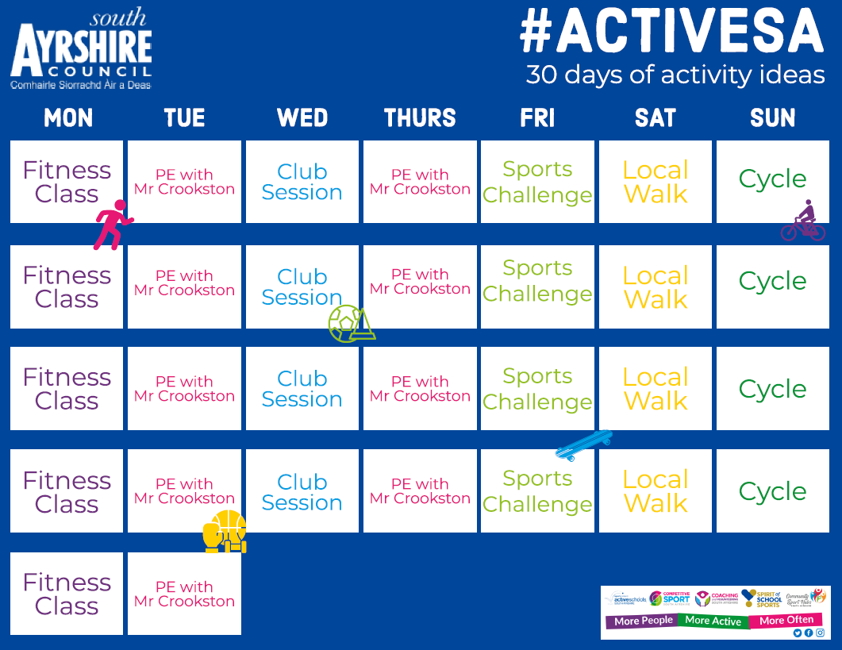
Remember to check out and get involved in South Ayrshire Council’s 30 Days of Activity!

Slide 5
CONTENTS FOR THE WELLBEING PDF
A little contents page too help you navigate through our wellbeing PDF:
Pages 1-3 – Introduction, Timetable & Message from Mrs Morrison
Page 5 – South Ayrshire’s 30 days of Activity
Pages 6-13 – Mindful Monday, Activities & Family Challenge
Pages 14-18 – Healthy Tuesday, Activities & Family Challenge
Pages 19-23 – Wellbeing Wednesday, Activities & Family Challenge
Pages 24-26 – Thoughtful Thursday, Activities & Family Challenge
Pages 27-29 – Feel Good Friday, Activities & Family Challenge
Pages 30-32 – Extra Wellbeing Activities

Slide 6
Mindful Monday
Pupil Input
We are very lucky to have John from Mac Mindset Ltd talking us through the importance of having a growth mindset and developing resilience in our everyday lives.
https://www.macmindset.co.uk/

Slide 7
Mindful Monday
Parent/Teacher Input
We are very lucky to have John from Mac Mindset Ltd. The children have been amazing adapting to the changes we have faced this past year. It is a very stressful time. Please remember to look after yourselves too!
https://www.macmindset.co.uk/

Slide 8
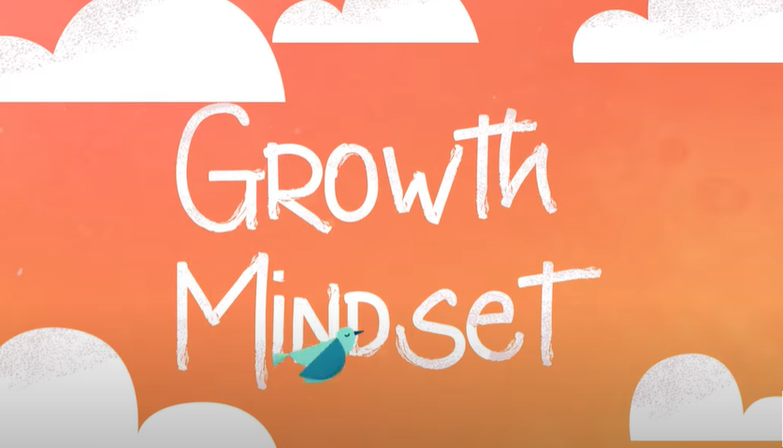
GROWTH MINDSET
A growth mindset is the belief that intelligence improves through study and practice. Children with a growth mindset tend to see challenges as opportunities to grow because they understand that they can improve their abilities by pushing themselves. If something is hard, they understand it will push them to get better.

Slide 9
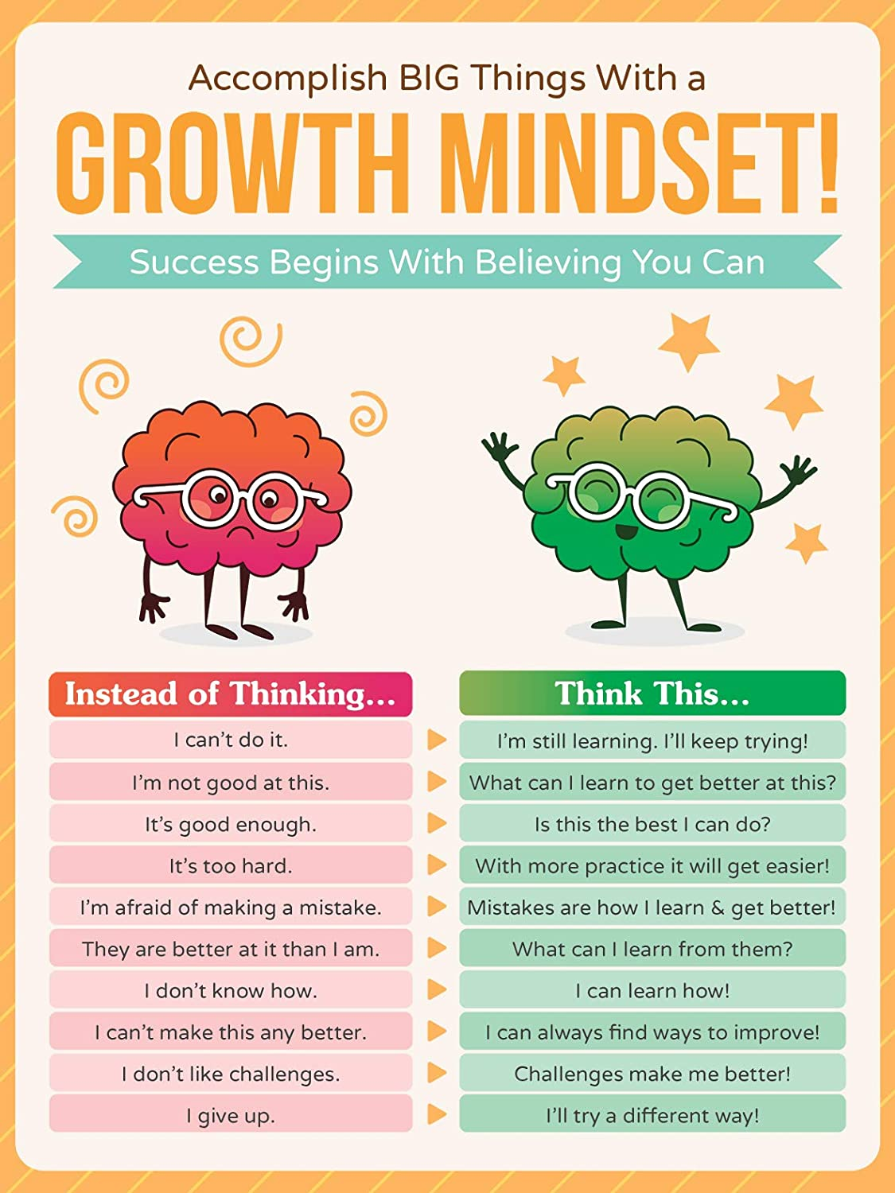
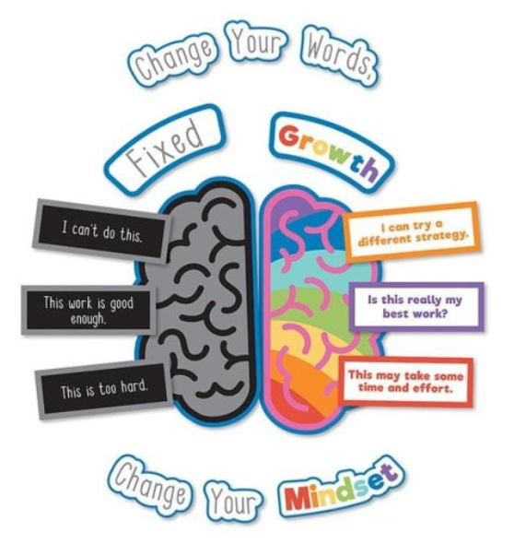
GROWTH MINDSET CHALLENGE
Get super creative and design your very own Growth Mindset Poster!
Feel free to use colouring pencils, pens, crayons, paint (ask first!), technologies to create your poster.
Here are some posters to give you some ideas:

Slide 10
GROWTH MINDSET CHALLENGE
Time to get your acting skills at the ready!
With your family or friends, play a game of:
charades
Remember, do not give up if you do not guess correctly!
Use your growth mindset to keep guessing!

Slide 11
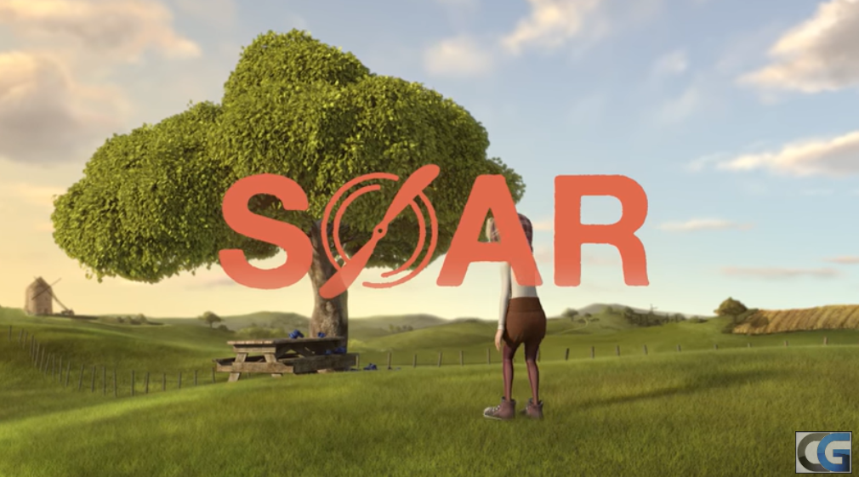
GROWTH MINDSET OPTIONAL ACTIVITIES
The title of this film is 'Soar'. Can you think of synonyms for this word? Would any of them make a better film title in your opinion?
Look at the first frame of the animation. Predict what you think may happen in the rest of the film.
Retell the story from the point of view of Mara (the girl) or Lucas (the pilot).
Draw a picture of your favourite part of the film. Describe why this is your favourite part (verbally or write it down).
Watch the lovely, Award Winning 3D Short Film ‘Soar’ and choose an activity to complete!
Activities can be adapted for all ages and stages!

Slide 12
MOST STEPS CHALLENGE!
How many steps can you get in this week (Monday-Friday)?
Using a Fitbit, Apple watch or smart phone App tracker to track your steps each day. We’d love to see pictures of the evidence of your walks! Be sure to fill in your step tracker to keep yourselves accountable too!
Get the whole family involved too!
Please ensure you are always safe on your walks and being sensible when crossing roads.

Slide 13
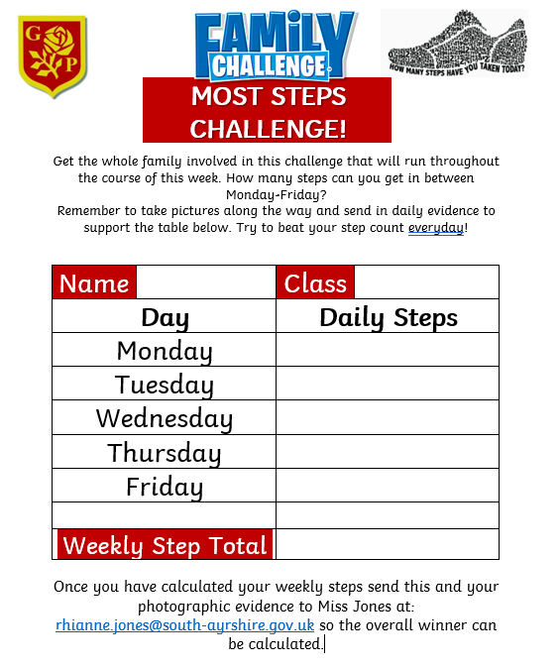
Click to be taken to the PDF to download/print.
This will allow you to fill it in daily.
You can edit this digitally or print it off to edit.
Feel free to create your own tracker if you’re unable to use this.

Slide 14
Healthy Tuesday
Recipes
Cooking is a fantastic way to look after your wellbeing. Of course the healthier the meal the better it is for your body. But it’s not always about just being super healthy. Knowing what’s in your food is important and what better way to know this, than cooking fresh!
Cooking is also a fun way of getting the whole family involved.

Slide 15
Healthy Tuesday
Mrs Briggs’
Easy Peasy Muffins
250g plain flour
100g castor sugar
3 tsp baking powder
1/2 tsp salt
175ml milk
75ml vegetable oil
1 egg
125g choc chips or blueberries
3tbsp sugar for sprinkling

Slide 16
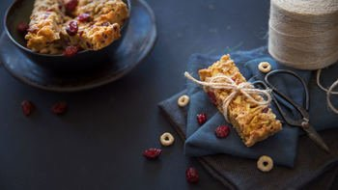
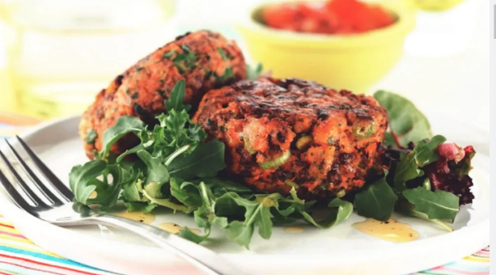
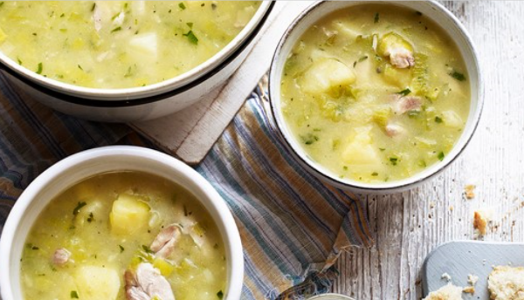
MORE DELICIOUS RECIPES
Click the worksheets, to take you the PDF recipes to download. Youtube link available below.
Fruitylicious Apple & Berry Bars
Video available:
https://youtu.be/HlkrSMV13do
Veggie Fruity Burgers
Video available:
https://youtu.be/1SG6w3RVg1U
Chunky Chicken and Potato Soup
Video available:
https://youtu.be/cZIS1_RgGZ0
For more recipes and ideas visit: https://www.nutrition.org.uk/healthyliving/hew/cookingsessions.html

Slide 17
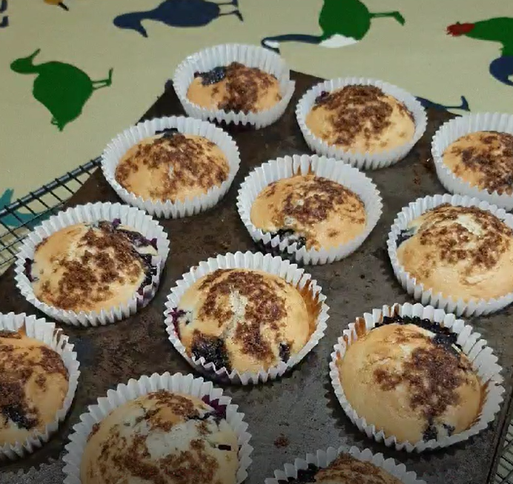
REVIEW TIME
Write or voice record a food review on the food you have created. Or a review on another meal you have recently tried.

Slide 18
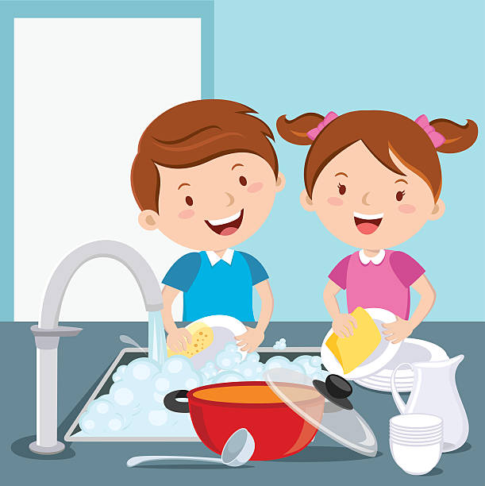
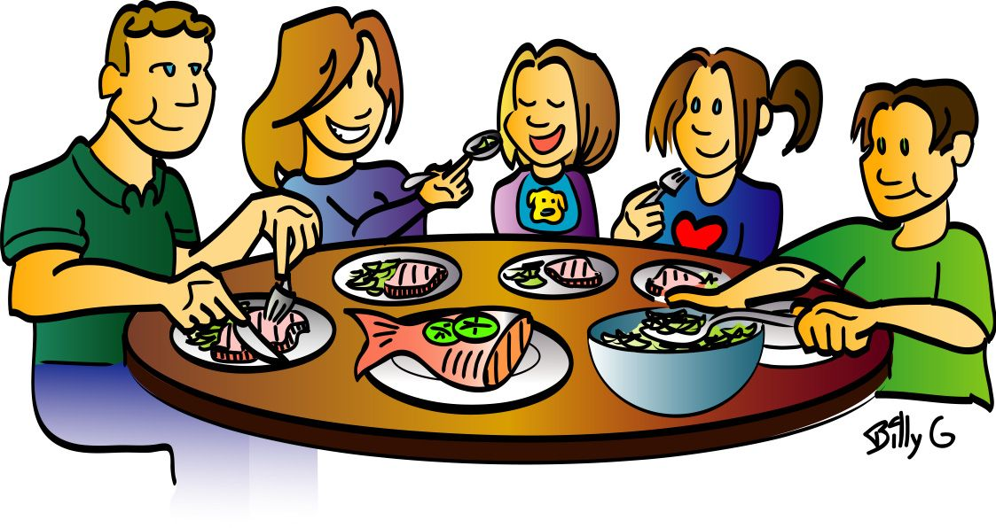
Have dinner altogether as a family. Put the phones and devices away.
Wash up after cooking today! OR Wash up after your dinner!

Slide 19
Wellbeing Wednesday
Yoga and Mental Health
We are very lucky to have Courtney from Wisdom Within You taking us through a yoga routine and discussing the importance of looking after our Mental Health.
Regular yoga practice creates mental clarity and calmness; increases body awareness; relieves stress; relaxes the mind; centres attention; and sharpens concentration.

Slide 20
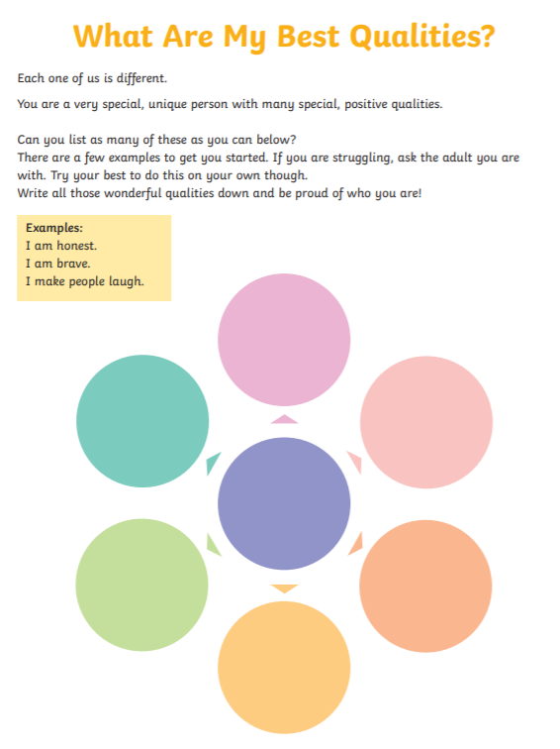
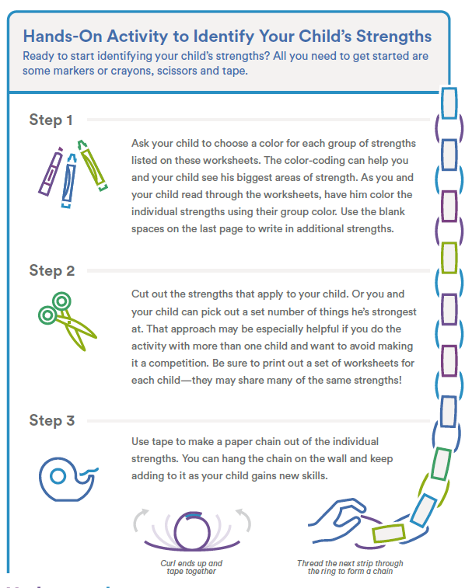
BEST PART OF ME
Click the worksheets, to take you the PDF file to download/print.

Slide 21
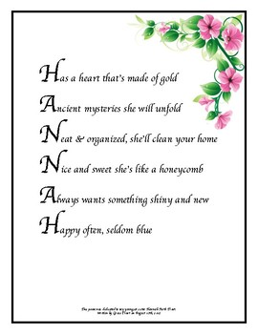
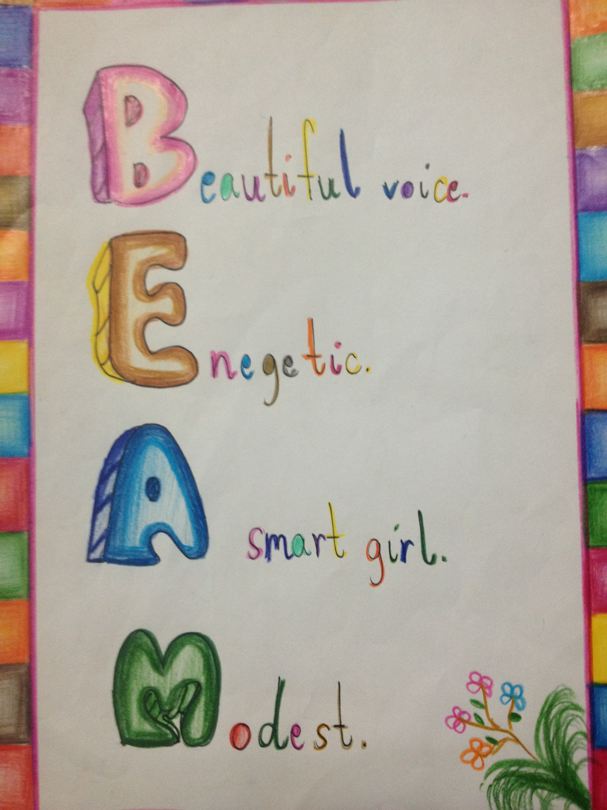
Personal Acrostic Poem
Create an acrostic poem about YOU!
Think about all the things you are good at, like about yourself and enjoy.
Here are some examples…

Slide 22
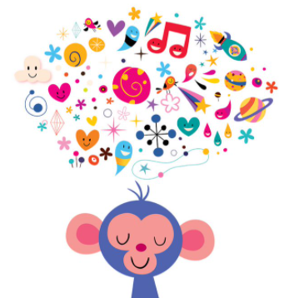
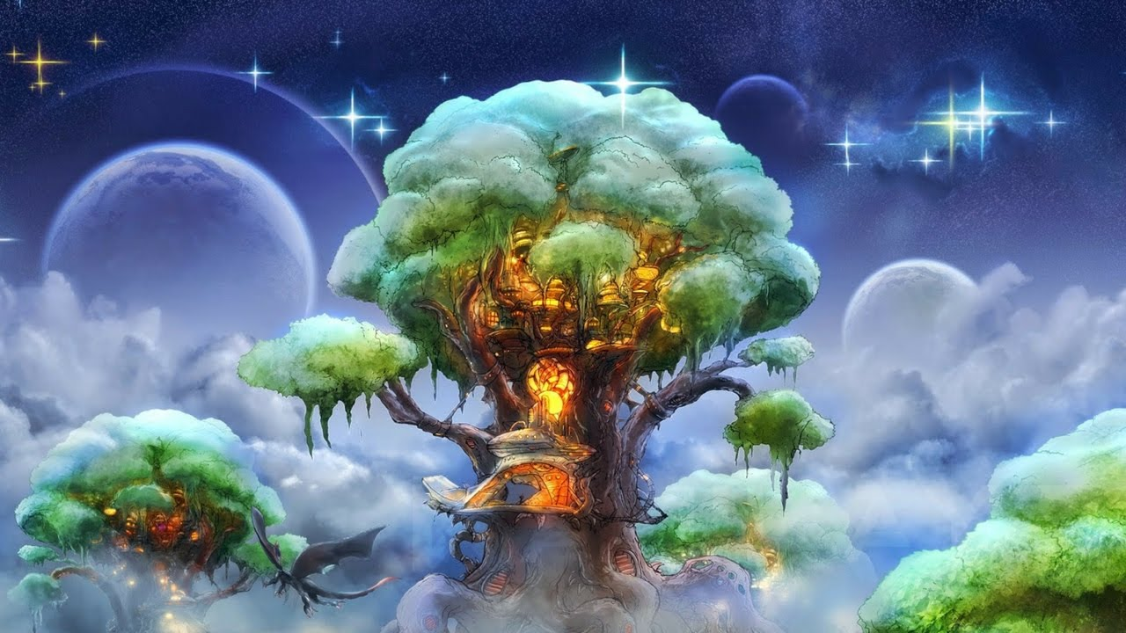
Guided Meditation
Meditation in adults and children before bedtime has proven to improve sleep quality.
There are many New Horizon - Meditation & Sleep stories videos, browse away.
All ages and stages.
There are many Peace Out: Guided Meditations videos for Kids, browse away.
More suitable for EYC-P3

Slide 23
Play a relaxing Board Game
Choose a favourite board or card game to play with someone.
If you don’t have a board game or cards, why not create one?
Who am I? is a great guessing game where players use yes or no questions to guess the identity of a famous person. Questions are based upon the traits and characteristics of a person everyone will be able to identify.

Slide 24
Thoughtful Thursday
Physical Wellbeing
We are lucky enough to have Rebecca from RJ Fitness taking us through a workout today. It’s vitally important we are keeping our bodies active! Get moving as much as you can, walk, dance, jog, have fun!
BUT MOVE!

Slide 25
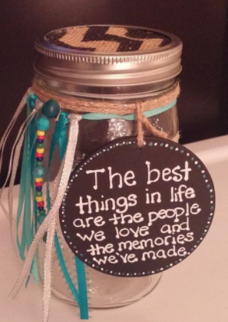
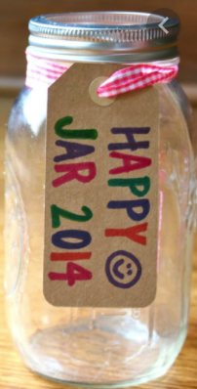
Memories Jar!
2021
More help to create your jar: https://www.messylittlemonster.com/2014/12/new-years-eve-memory-jar-time-capsule.html

Slide 26
Want some ideas? https://www.muminthemadhouse.com/kid-made-thank-you-cards/
Who are you grateful for?
Today’s thoughtful task is to think about someone that you would like to say thank you to. This could be a friend, a family member, a teacher, a neighbour or someone else.
Make their day and create a thank you card for them. Tell them why you are thankful.

Slide 27
Feel Good Friday
Physical & Mental Health
We are very lucky to have Linzi from LivFit Ayrshire showing us just how fun working out can be. Exercising releases positive endorphins and makes us feel much better in general.
Exercise also helps our concentration levels which benefits us in school and everyday life!
https://livfitayrshire.com/

Slide 28
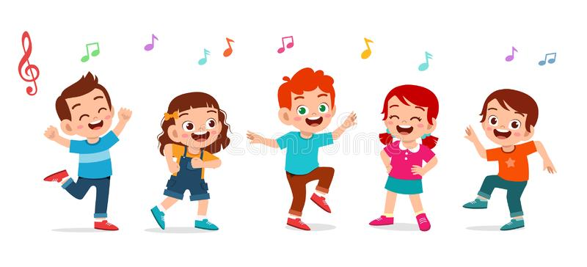
Have a family disco/party! Put on your favourite songs and dance around the house! Why not follow a Just Dance or sing your hearts out to some Karaoke songs on YouTube.

Slide 29
Write a shopping list for a few movie night treats, and try to include something healthy. Organise a family movie night and enjoy a film together!

Slide 30
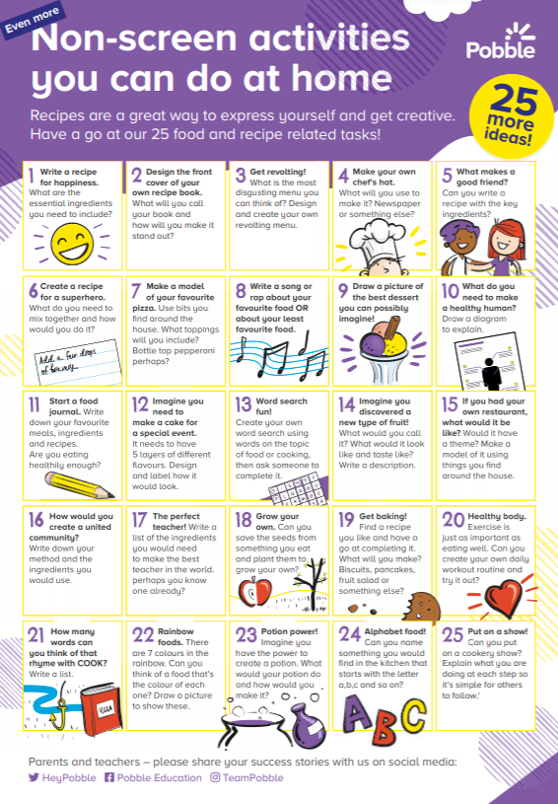
EXTRA ACTIVITIES
We have spent so much time on the laptops or our devices due to home learning so here are some non-screen activities you can do! ☺
Get away from the screens!

Slide 31
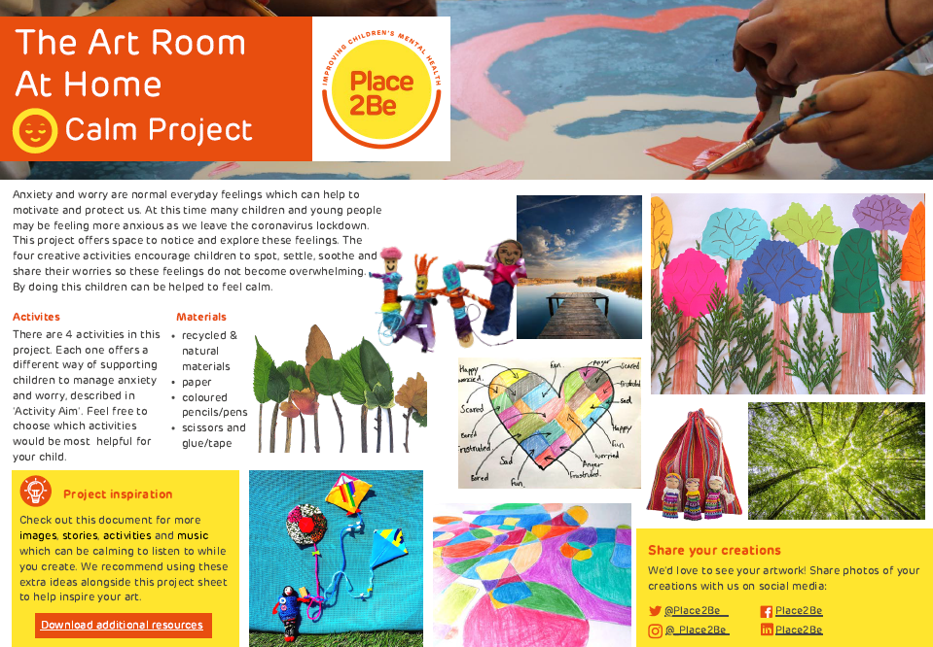
EXTRA ACTIVITIES
Amazing bank of resources that you can choose from! Have a browse and see what ones you want to complete.
Lots of fun arts and crafts!

Slide 32
EXTRA ACTIVITIES
Lots of amazing videos suitable for children from EYC-P7 level!
Videos from footballers, to boy bands, to natural historians, to health care workers, to fun presenters.
Check them out at:
https://www.bbc.co.uk/teach/supermovers/just-for-fun-collection/z7tymfr

Slide 33
Thank you all!
Thank you to all our amazing guests for taking their time to record the videos for us all!
Thank you to all the boys and girls for getting involved and as always doing an amazing job!
Thank you to all parents, grandparents and carers for getting involved!
Thank you to all school staff for also getting involved throughout the week.

Slide 34
Thank You!
Gardenrose Primary School

