Slide 1
Primary 7
Week beginning
2nd November 2020
Miss Caldwell

Slide 2
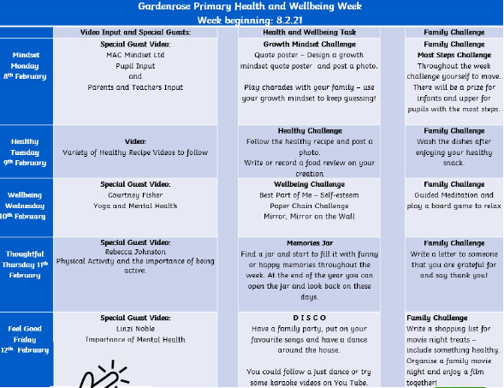
Weekly Timetable

Slide 3
Weekly Timetable
Daily Maths Tasks (MORNING between 9:00-11:00am)
Monday – Number talk & daily 10
Tuesday – Number talk & sumdog
Wednesday – Number talk & hit the button (tables practice)
Thursday – Number talk & daily 10
Friday – Number talk & My Maths
Daily Literacy Tasks (MORNING between 11:00am-1:00pm)
Monday – Spelling practice (GL words age 11)
Tuesday – Write a recipe for a healthy meal
Wednesday – Read a book of your choice for enjoyment
Thursday – Write a positive note to a friend or family member
Friday – Pick 10 words from the GL spelling list and find synonyms using a thesaurus.

Slide 4
Weekly Timetable
Live Check Ins/Instructions – Miss Caldwell
Monday – 9am
Tuesday – 9am
Wednesday – NONE (in school today)
Thursday – 1pm
Friday – 11am
Live Support – Ms Ryding & Mrs Briggs (ONLY CHILDREN WHO HAVE BEEN NOTIFIED)
Monday – 2pm Mrs Briggs
Tuesday – 2pm Mrs Briggs
Wednesday – 9:15 Ms Ryding, 2pm Mrs Briggs
Thursday – NONE
Friday – 9:15 – Ms Ryding

Slide 5
Weekly Maths
Wednesday
Number talk: 570 divided by 10 -------------------------------- Hit the Button: https://www.topmarks.co.uk/maths-games/hit-the-button#:~:text=Hit%20the%20Button%20is%20an%20interactive%20maths%20game,challenge%20and%20develop%20a%20child%27s%20mental%20maths%20skills.
Monday
Number talk: 2562 - 1645 -------------------------------- Daily 10: https://www.topmarks.co.uk/maths-games/daily10
Tuesday
Number talk: 583.2 x 100 -------------------------------- Sumdog: https://www.sumdog.com
Thursday
Number talk: 58238 + 5828 -------------------------------- Daily 10: https://www.topmarks.co.uk/maths-games/daily10
Monday
Number talk: 43 x 18 -------------------------------- Daily 10: https://www.mymaths.co.uk/

Slide 6
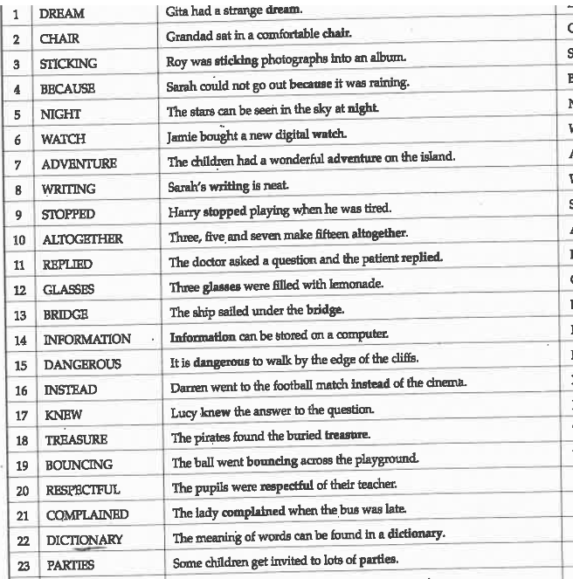
GL spelling words

Slide 7
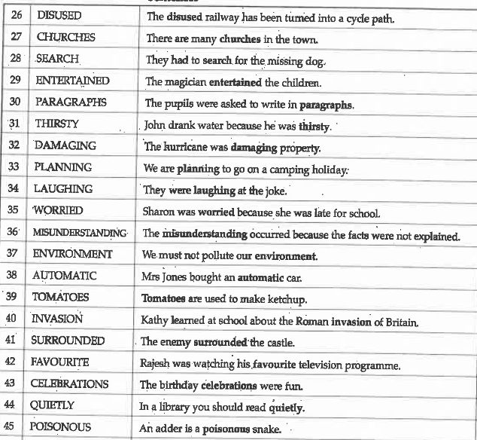
GL spelling words

Slide 8
GL spelling words

