Slide 1
Before you go to the next slide…Draw a mega quick sketch of what you think the lungs look like!
Thursday 4th February 2021
LI. I can describe how living things breathe

Slide 2
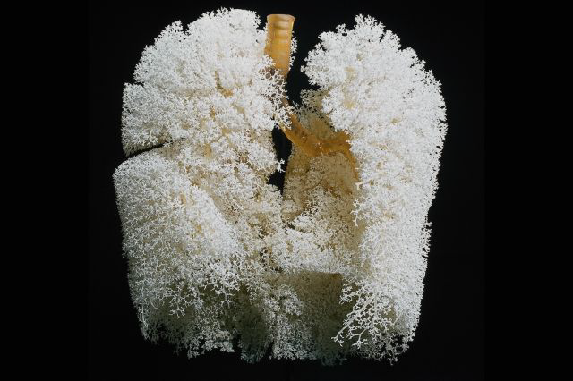
Did any of you draw them looking like this?

Slide 3
LO: Describe how the lungs help us to breathe
BASIC:
Recall the different structures in the lungs
BETTER:
Describe the pathway that oxygen takes through our body
BEST:
Explain how the lungs are suited to their function by describing the role of alveoli

Slide 4
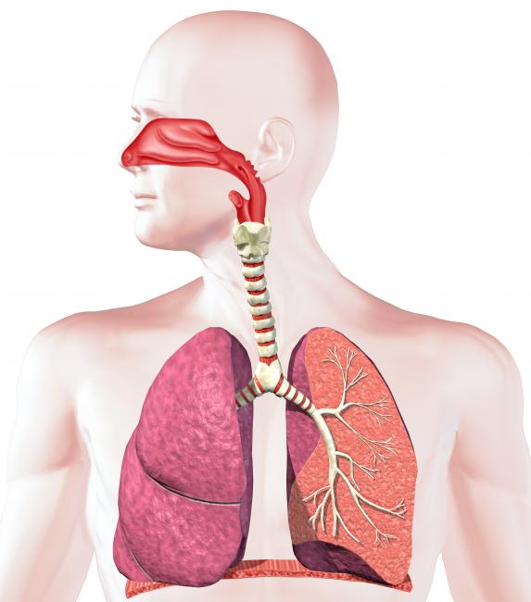
LO: Describe how the lungs help us to breathe
The respiratory system
Trachea
Bronchioles
Bronchus
Lung
Alveoli (“air sacs”)
Diaphragm

Slide 5
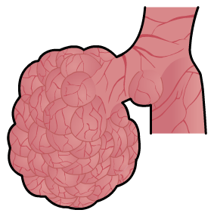
Gas exchange at the alveoli
LO: Describe how the lungs help us to breathe
The alveoli are bunches of tiny air sacks inside the lungs.
When you breathe in, they fill with air.

Slide 6
TASK : Make a model lung
LO: Describe how the lungs help us to breathe
Using the following items:
Large straw- Trachea
Smaller straws- Bronchus
Raisins- Alveoli
Cocktail sticks- Bronchioles
If you don’t have these materials at home have a hunt to see what can be used instead!

Slide 7
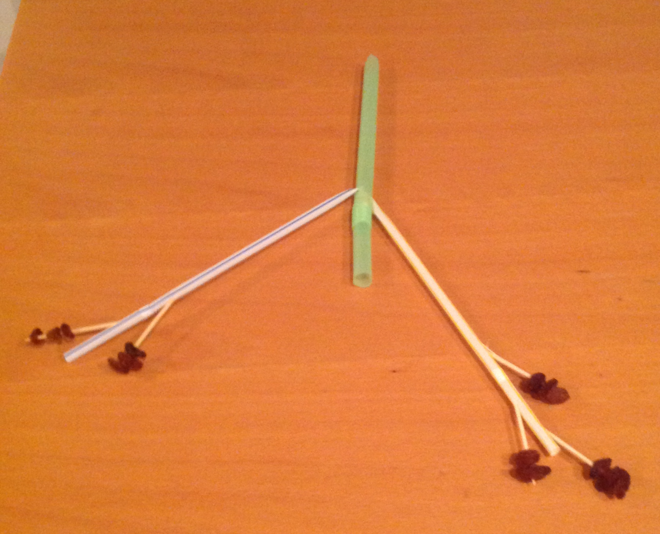
It could look like this.....?

Slide 8
PROGRESS CHECK
LO: Describe how the lungs help us to breathe
Put these in the correct order...
Mouth Alveoli Bronchus Trachea Bronchioles
Record the correct order in Teams Chat

Slide 9
PROGRESS CHECK
LO: Describe how the lungs help us to breathe
In the correct order:
Mouth Trachea Bronchus Bronchioles Alveoli

Slide 10
TASK
Complete 2 (or more) tasks from the following slide…

Slide 11
LO: Describe how the lungs help us to breathe
Draw and label a picture of the lungs (use slide 4 to help you)
BASIC:
Recall the different structures in the lungs
BETTER:
Describe the pathway that oxygen takes through our body
BEST:
Explain how the lungs are suited to their function by describing the role of alveoli
Make a flow diagram to show the path oxygen takes through our body! Start: Oxygen is breathed in through our mouth Keywords: carbon dioxide, oxygen and oxygenated, deoxygenated, diffuse, carry, tissues, lungs, red blood cells.
Using your Lung model, RECORD a video of yourself describing the function of the Lungs using the keywords above as well as describing the role of the alveoli.

Slide 12
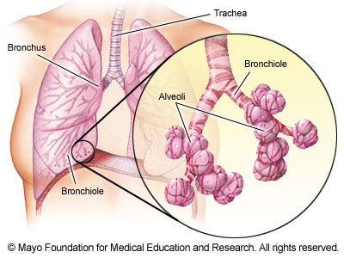
LO: Describe how the lungs help us to breathe
Extension: The alveoli are adapted to make gas exchange in lungs happen easily and efficiently.
Features of the alveoli that allow gas exchange
They have moist, thin walls (just one cell thick)
They give the lungs a really big surface area
They have a lot of tiny blood vessels called capillaries.
Alveoli

Slide 13
LO: Describe how the lungs help us to breathe
WHAT HAVE YOU LEARNT TODAY?
Choose one of the following...
TEAMS CHAT - What was the most important thing you learnt today?
Post a statement and Tag me in Teams
Art Smart Draw me the most important thing you’ve learnt today
Call my bluff! Write TWO true statements and one false. Post to Teams Chat so we can all guess the false statement and explain why?

