Slide 1
3 for Thursday!!
Thursday 4th February 2021
Mrs briggs
Julie.briggs2@south-Ayrshire.gov.uk

Slide 2
Hello p7 ☺
We’re over halfway though the week….. The end is in sight.
Woo hoo!!!
Time for some fun tasks to get you active and creative.
Best of all…….there’s prizes!!!!!!!!!!!!!!!!!!!!!!!!!!!!!!!!!!!!!!!!!
All completed tasks should be posted into the Thursday folder on Teams or e-mailed by 3pm

Slide 3
Task 1…… STEM
Today is all about LUNGS and how they help us to breathe.
Work your way through the Lungs PPT that includes some activities.
Air contains oxygen
Oxygen is needed to release the energy in food
Air (oxygen) travels around in the blood to reach the food in every part of the body.

Slide 4
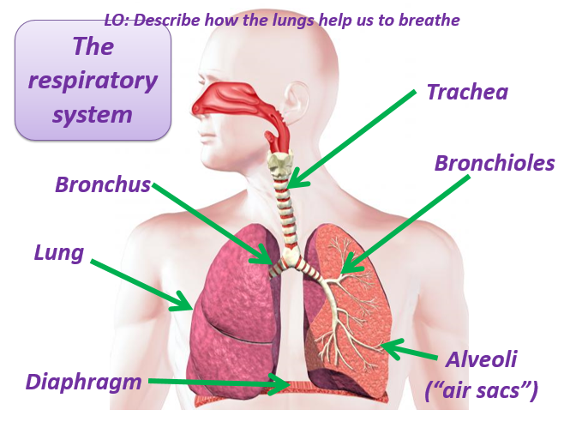
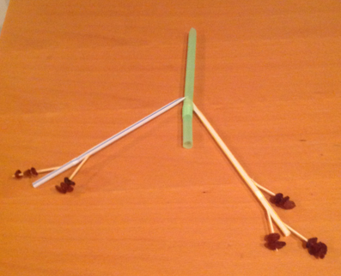
Task 1 MIGHT look something like this…

Slide 5
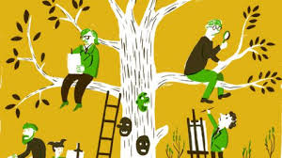
Task 2…… outdoor learning
Its time to get some fresh air, if you can. It’s a great way to de-stress and refresh your mind and body after so much online learning. However, if its not possible today I have included an indoor option.
TASKS :
Outdoor: Write a letter for one of your friends who lives nearby. Post it through the letterbox when you walk past their house. If you write several in your family you could plan your route first.
Indoor: Draw a poster to display in your window to send a message of encouragement and cheer to the people who live near you. The bigger the better so that people can see it as they walk past!

Slide 6
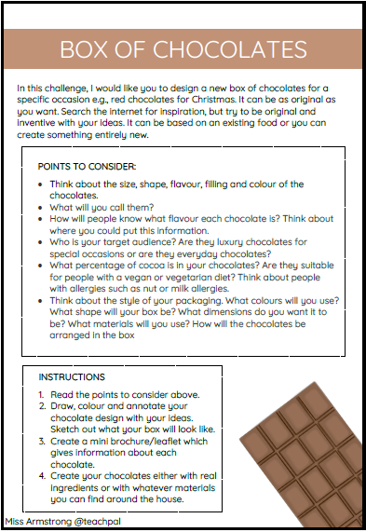
Task 2…… creative challenge
Get your creative brains in gear after all that fresh air to tackle this mini competition for a chance to have a Treat Bag delivered to your doorstep!!!!
TASK : Design a box of chocolates for VALENTINES !!!
THE MORE CREATIVE THE BETTER!!!!!!!
Remember to complete ALL instructions
Entries for this challenge can be submitted (Teams/E-mail) no later than 3pm on FRIDAY
Treats will be delivered by 6pm that evening.

Slide 7
You’re smashing it p7…. Keep it up!!

