Slide 1
3 for Thursday!!
Thursday 28th January 2021
Mrs briggs
Julie.briggs2@south-Ayrshire.gov.uk

Slide 2
Hello p7 ☺
We’re over halfway though the week….. The end is in sight.
Woo hoo!!!
Time for some fun tasks to get you active and creative.
Best of all…….there’s prizes!!!!!!!!!!!!!!!!!!!!!!!!!!!!!!!!!!!!!!!!!
All completed tasks should be posted into the Thursday folder on Teams or e-mailed by 3pm

Slide 3
Task 1…… STEM
Digestion is the process that breaks down large pieces of food into tiny parts that are then used by the body for energy and growth.
The body has to break down large bits of food like bread, into tiny bits of food like glucose powder, so that it can fit into the blood stream, where it is carried to all parts of the body providing energy. The breaking down system in the body is called the digestive system.
TASKS :
1. Research the different types of teeth we have in our mouths (canines, molars, premolars, incisors) and what their role is in breaking down food. Present your findings as a labelled diagram.
2. Complete the cloze passage ‘Digestion Summary 28th Jan 21’ with the wordbank at the bottom of the document.

Slide 4
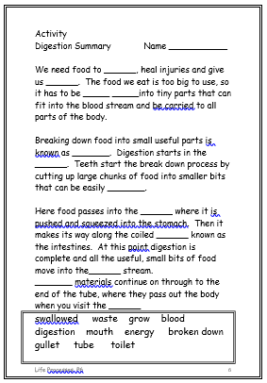
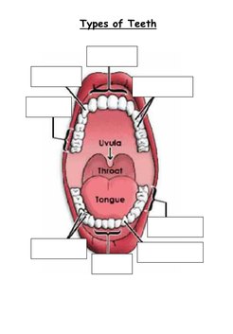
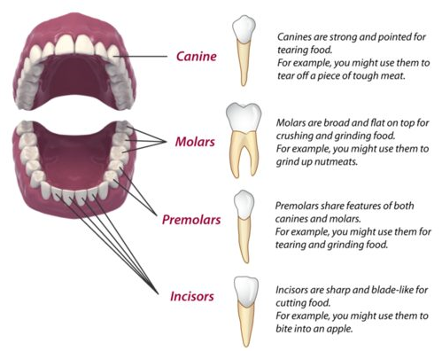
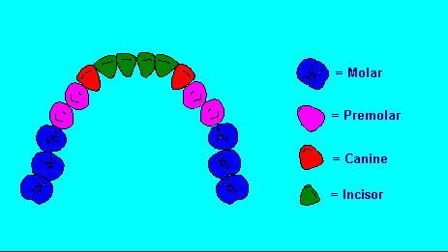
Task 2
Task 1 MIGHT look something like this…

Slide 5
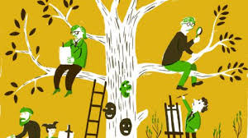
Task 2…… outdoor learning
Its time to get some fresh air, if you can. It’s a great way to de-stress and refresh your mind and body after so much online learning. However, if its not possible today I have included an indoor option.
TASKS :
Outdoor: Go outside and do some observational drawing. What will you draw – something man-made or something natural? Will you choose to zoom in and focus on the details or will you zoom out and draw everything you can see?
Indoor: Design and make an obstacle course at home. Where will the course take you? How will you make it easier or more difficult? Take a video of yourself completing the course and post it on Teams!

Slide 6
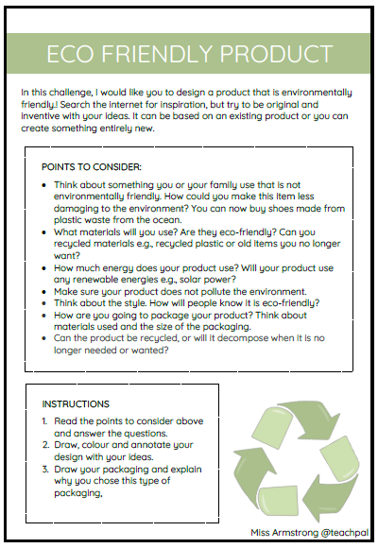
Task 2…… creative challenge
Get your creative brains in gear after all that fresh air to tackle this mini competition for a chance to have a Treat Bag delivered to your doorstep!!!!
TASK : Design an environmentally friendly product
THE MORE CREATIVE THE BETTER!!!!!!!
Remember to complete ALL instructions
Entries for this challenge can be submitted (Teams/E-mail) no later than 3pm on FRIDAY
Treats will be delivered by 6pm that evening.

Slide 7
You’re smashing it p7…. Keep it up!!

